Slide 1
Westminster Abbey
Learning
Which signs and symbols will you find in a church?
©2020 Dean and Chapter of Westminster
1
Notes:
Image:
©2021 Dean & Chapter of Westminster
Please be aware that these images are for educational use only in the classroom and should not be reproduced online.

Slide 2
Westminster Abbey
Learning
Information for teachers
Thank you for downloading this resource. We hope that it will be a useful teaching tool in your classroom.
As we continue to grow our free catalogue of teaching resources, we’d really appreciate a few minutes of your time to let us know what you liked and what could be improved. Please complete this five-question survey.
2
Notes:
Image:
©2021 Dean & Chapter of Westminster

Slide 3
Learning
Today, we’re thinking about signs and symbols. These can be pictures or objects that represent an idea. These symbols make you think about something else. Can you think of any signs and symbols at your school? Perhaps you’ve seen this sign telling others that children will be crossing the road? Perhaps you’ve seen these signs on toilet doors? Or these symbols reminding you to wash your hands?
In churches, there are lots of signs and symbols that teach us about Christianity. Crosses can be found in lots of different forms, some are large and some are small. In fact, many churches are built in the shape of the cross. All of this is to remind Christians that Jesus Christ died on the cross. You’ll also find lots of candles, which are lit when Christians pray and reminds them of the light of God.
Look out for natural symbols in churches too. For example, at Westminster Abbey you can see doves which represent the Holy Spirit, water which represents baptism and rainbows which are a symbol of God’s promises. For Christians, bread and wine are also special symbols. The bread represents Jesus’ body and the red wine represents His blood. What other symbols have you seen in a church?

Slide 4
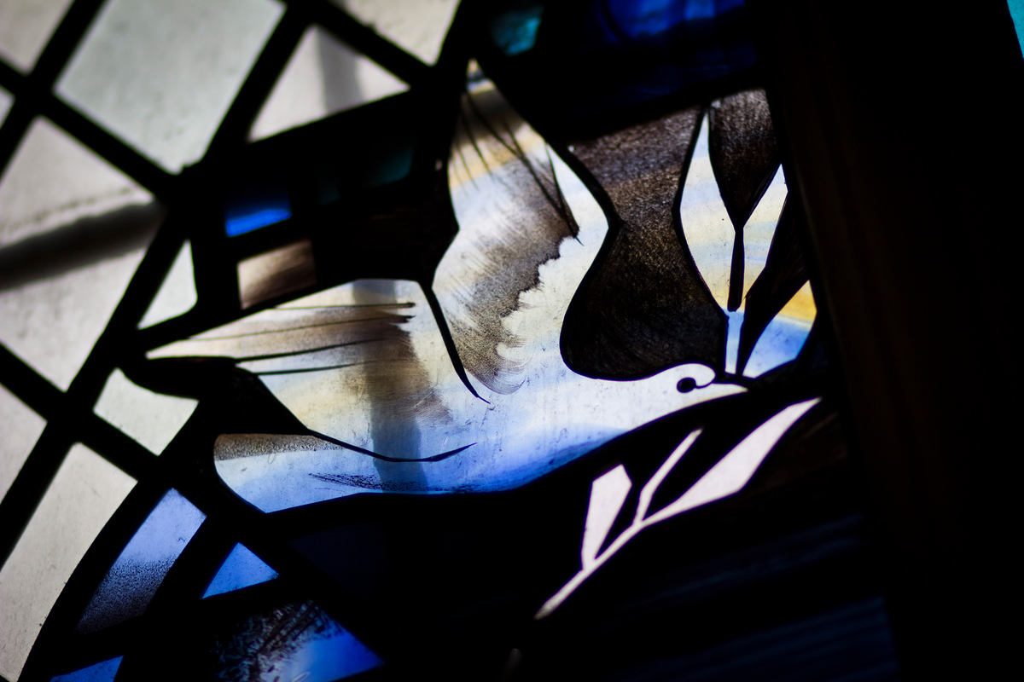
Learning
Notes:
Dove in stained-glass window
Image:
©2021 Dean & Chapter of Westminster
Please be aware that these images are for educational use only in the classroom and should not be reproduced online.

Slide 5
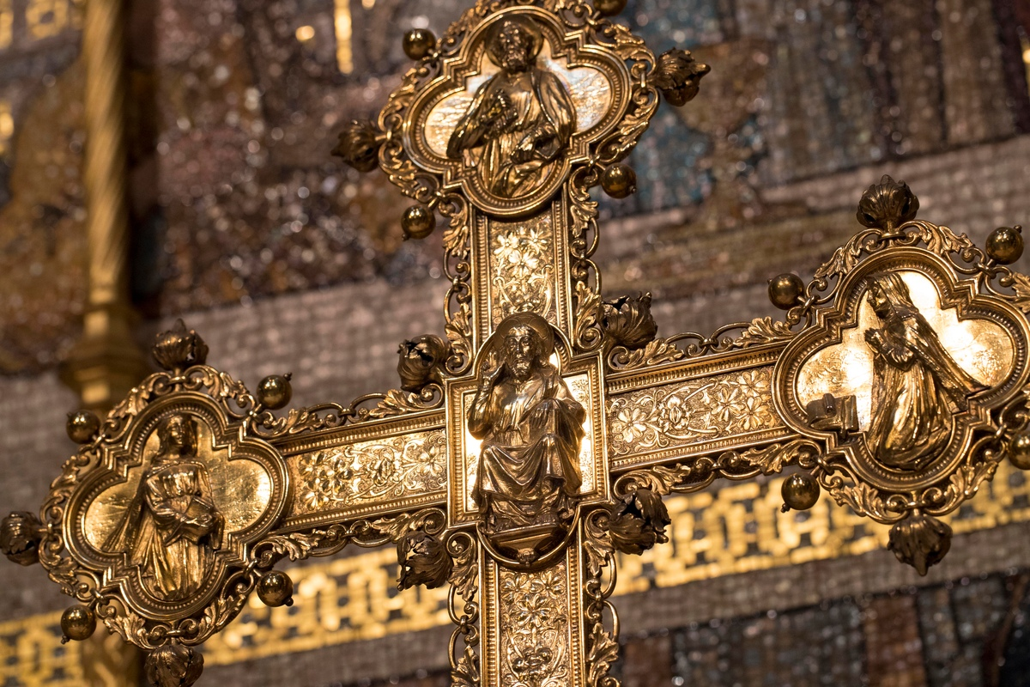
Learning
Notes:
Cross on the High Altar
Image:
©2021 Dean & Chapter of Westminster
Please be aware that these images are for educational use only in the classroom and should not be reproduced online.

Slide 6
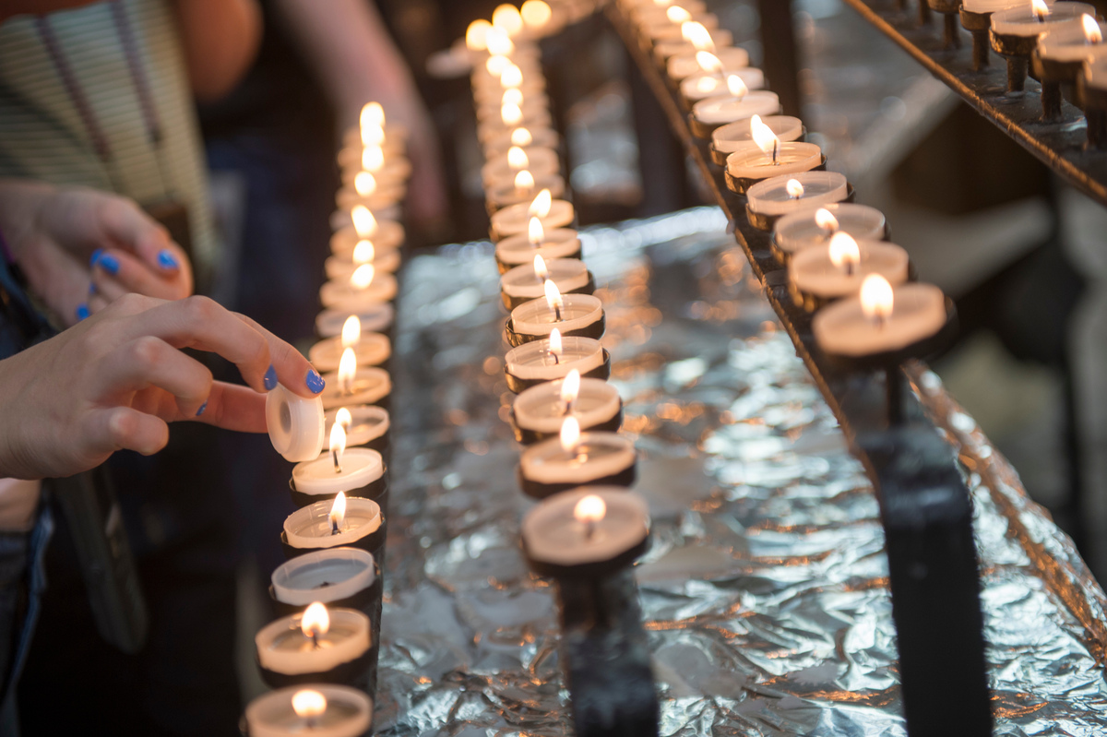
Learning
Notes:
Candles being lit
Image:
©2021 Dean & Chapter of Westminster
Please be aware that these images are for educational use only in the classroom and should not be reproduced online.

Slide 7
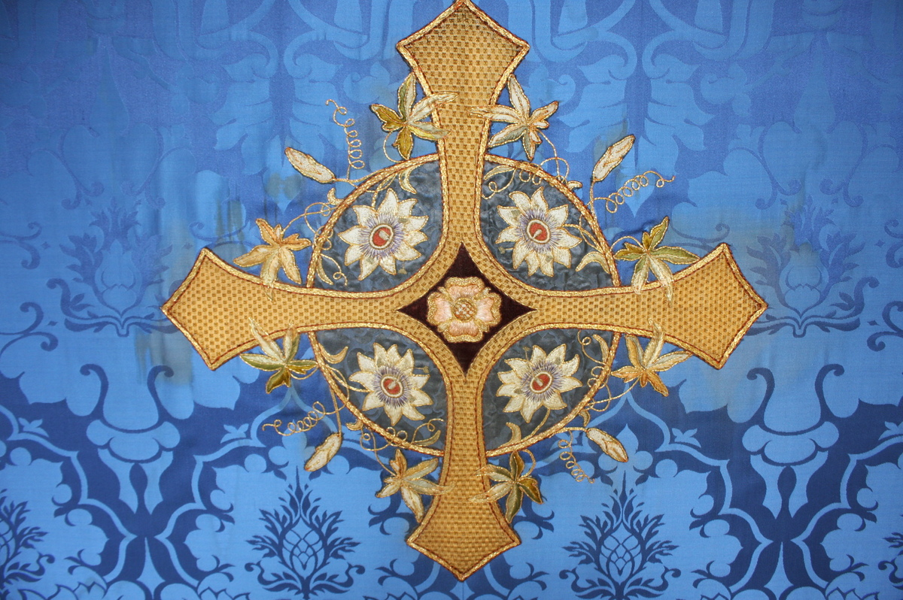
Learning
Notes:
Cross on a frontal, hung on the altar
Image:
©2021 Dean & Chapter of Westminster
Please be aware that these images are for educational use only in the classroom and should not be reproduced online.

Slide 8
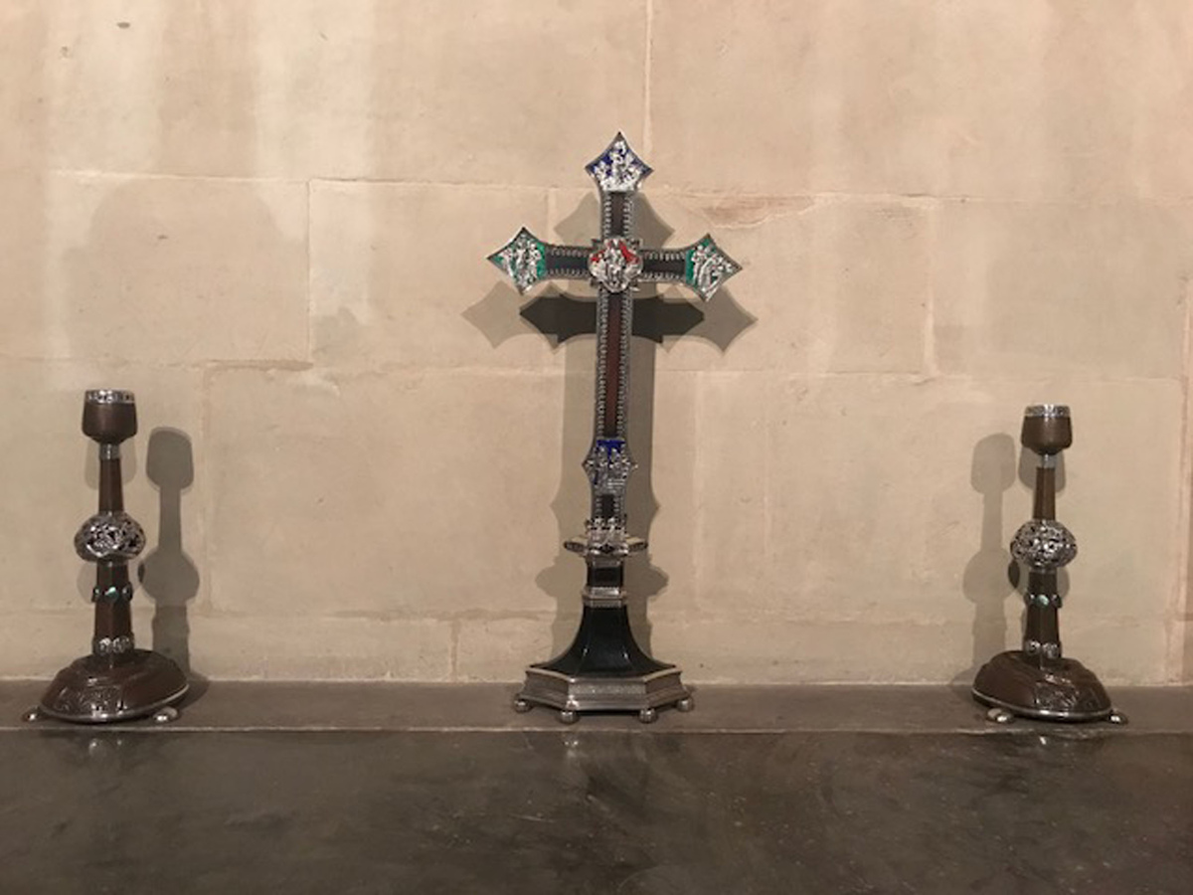
Learning
Notes:
Cross on an altar
Image:
©2021 Dean & Chapter of Westminster
Please be aware that these images are for educational use only in the classroom and should not be reproduced online.

Slide 9
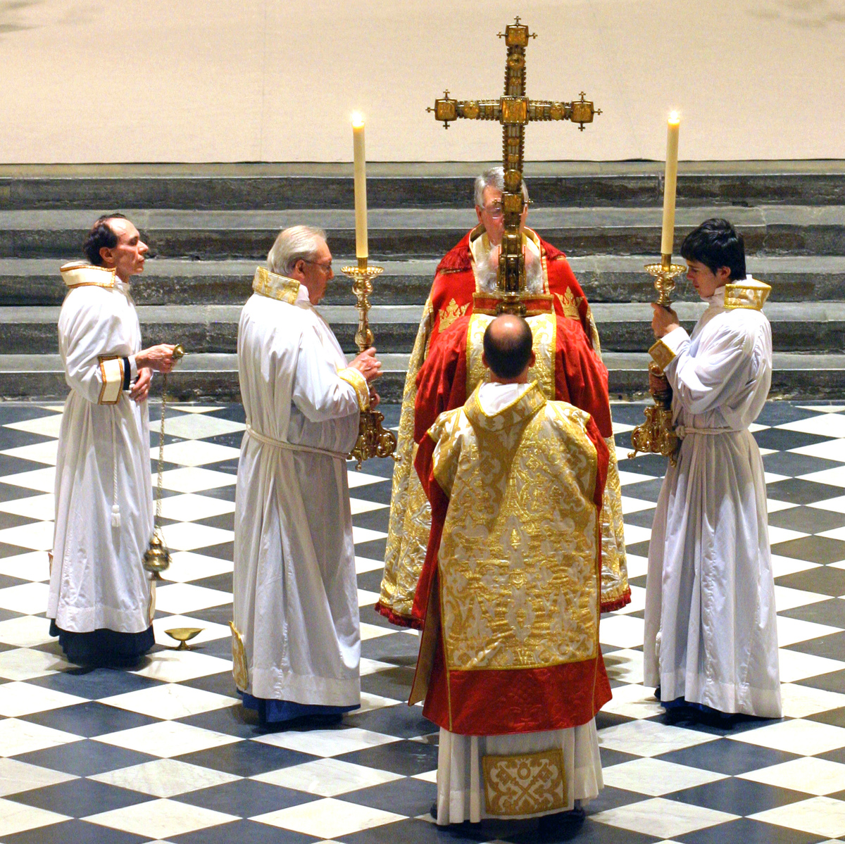
Learning
Notes:
Large cross used during a service
Image:
©2021 Dean & Chapter of Westminster
Please be aware that these images are for educational use only in the classroom and should not be reproduced online.

Slide 10
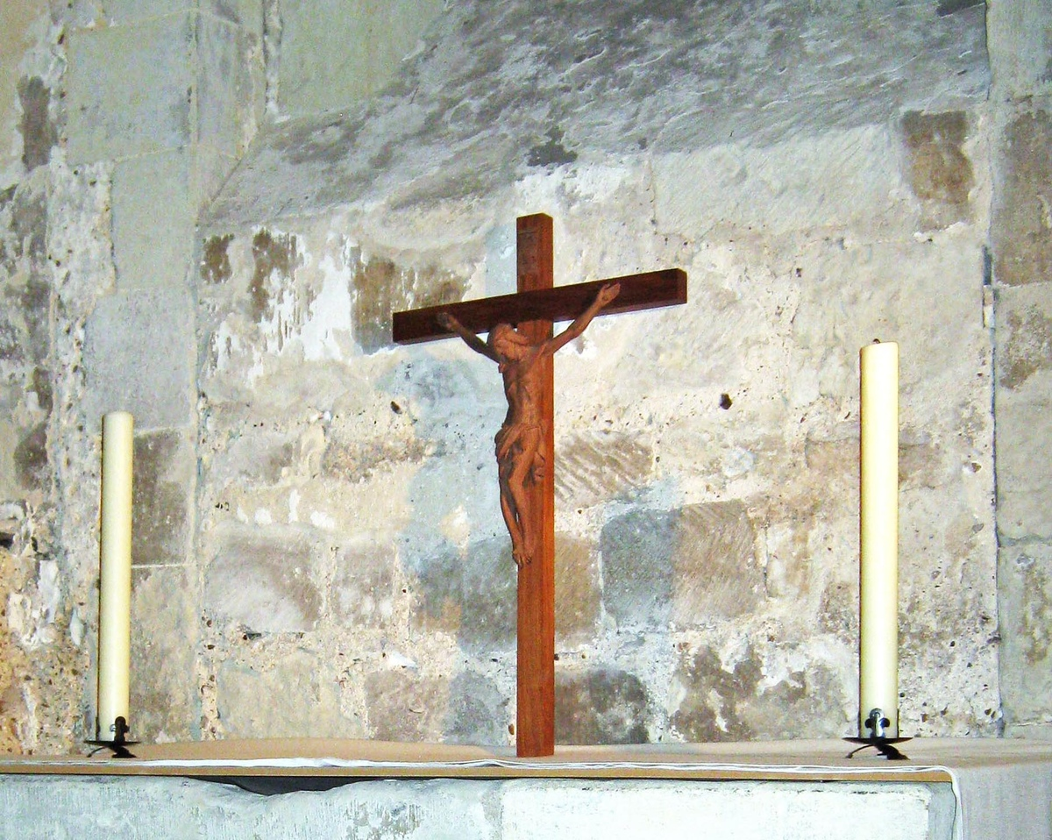
Learning
Notes:
Cross in the Pyx Chamber
Image:
©2021 Dean & Chapter of Westminster
Please be aware that these images are for educational use only in the classroom and should not be reproduced online.

Slide 11
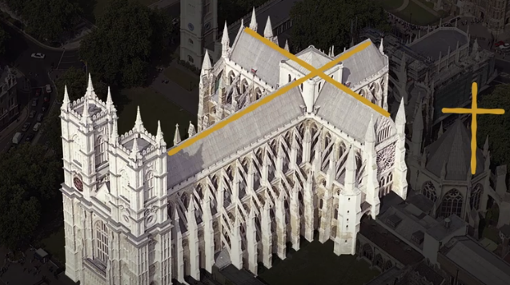
Learning
Notes:
Bird’s-eye view showing Westminster Abbey built in the shape of the cross
Image:
©2021 Dean & Chapter of Westminster
Please be aware that these images are for educational use only in the classroom and should not be reproduced online.

Slide 12
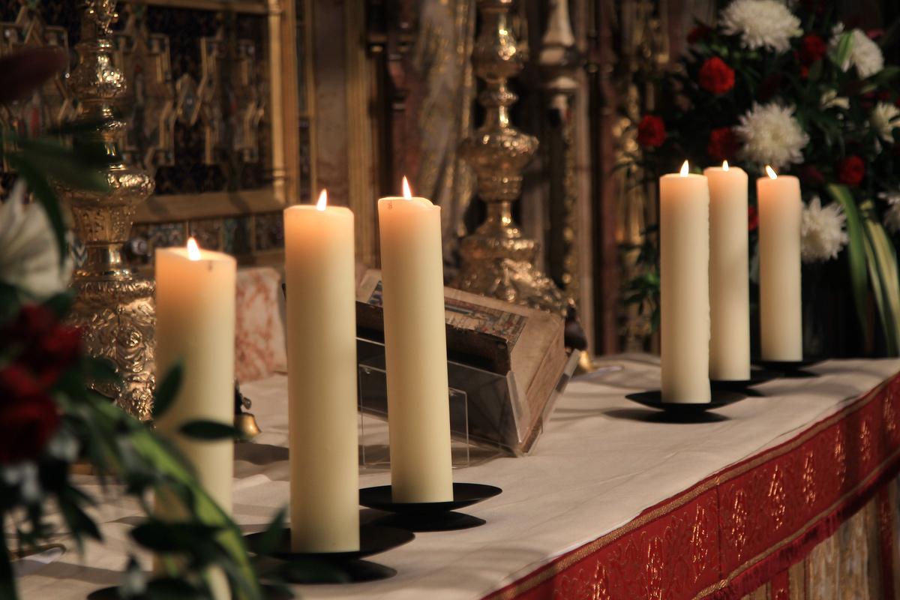
Learning
Notes:
Candles
Image:
©2021 Dean & Chapter of Westminster
Please be aware that these images are for educational use only in the classroom and should not be reproduced online.

Slide 13
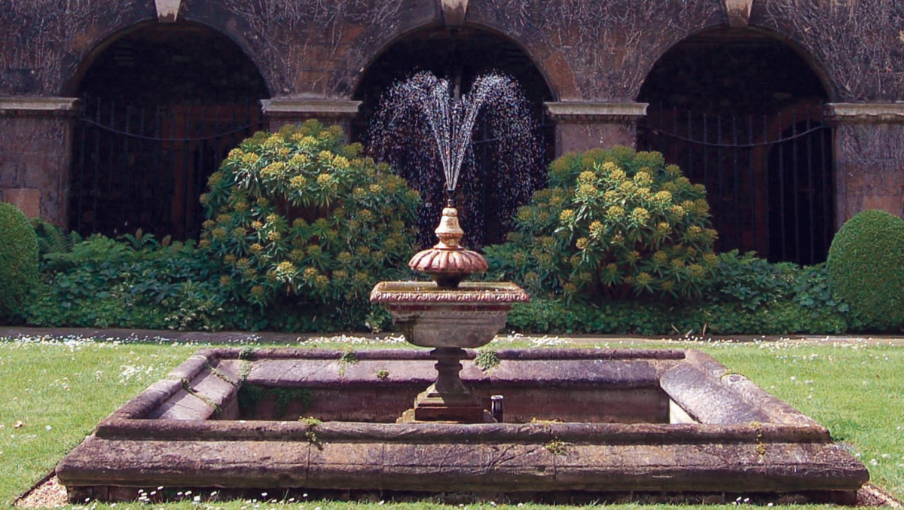
Learning
Notes:
Little Cloister fountain
Image:
©2021 Dean & Chapter of Westminster
Please be aware that these images are for educational use only in the classroom and should not be reproduced online.

Slide 14
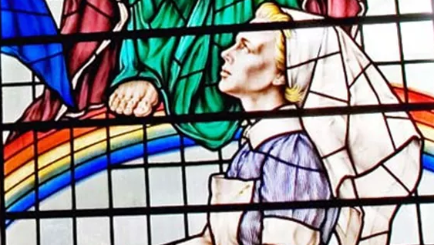
Learning
Notes:
Rainbow within stained-glass window
Image:
©2021 Dean & Chapter of Westminster
Please be aware that these images are for educational use only in the classroom and should not be reproduced online.

Slide 15
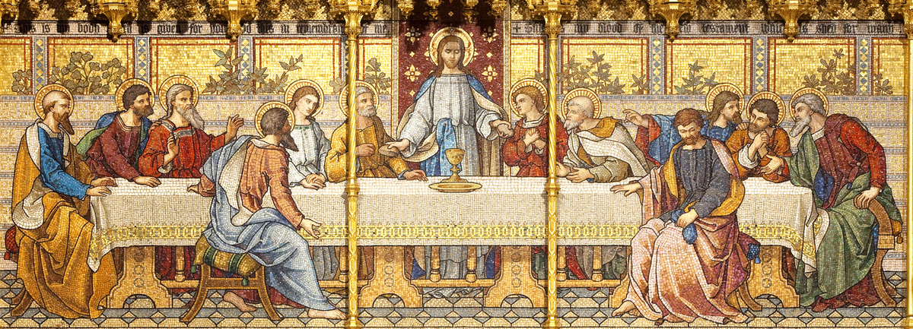
Learning
Notes:
High Altar mosaic of the Last Supper
Image:
©2021 Dean & Chapter of Westminster
Please be aware that these images are for educational use only in the classroom and should not be reproduced online.

