Slide 1
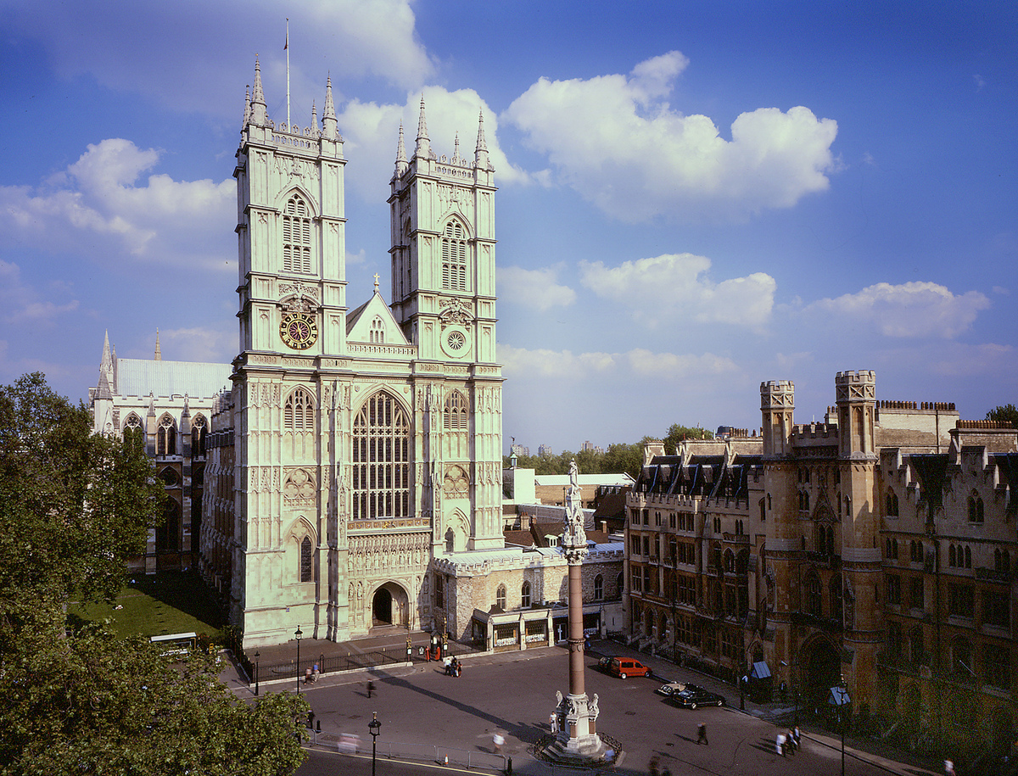

Westminster Abbey
Learning
Which objects will you find in a church?
©2020 Dean and Chapter of Westminster
1
Notes:
Image:
©2021 Dean & Chapter of Westminster
Please be aware that these images are for educational use only in the classroom and should not be reproduced online.

Slide 2
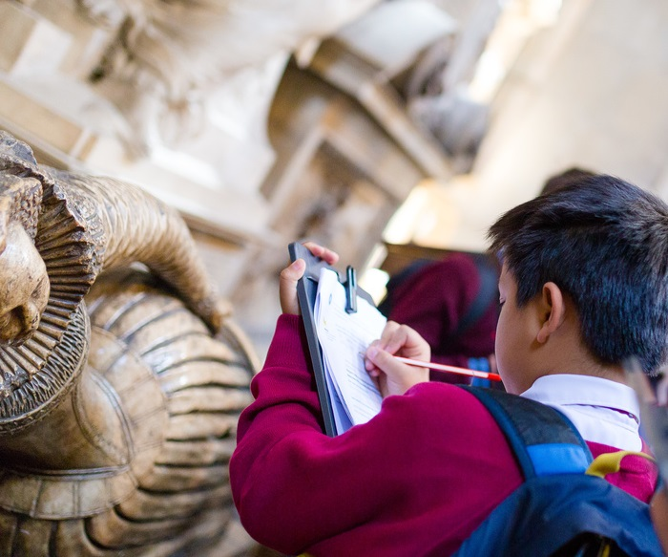
Westminster Abbey
Learning
Information for teachers
Thank you for downloading this resource. We hope that it will be a useful teaching tool in your classroom.
As we continue to grow our free catalogue of teaching resources, we’d really appreciate a few minutes of your time to let us know what you liked and what could be improved. Please complete this five-question survey.
2
Notes:
Image:
©2021 Dean & Chapter of Westminster

Slide 3
Learning
Today we’re thinking about objects and where you would find them. Have a think about your classroom. All over the country, classrooms look different but, in every classroom, there are some objects you will always find. All classrooms have desks and chairs and books. Can you think of any other examples?
It’s the same for churches. All over the country, churches look different but, in every church, you will find the same objects. Priests use many of the objects in church. Every priest needs somewhere to rest the Bible so they use this stand called a lectern, and many priests will talk to the congregation from a pulpit like this. When Holy Communion takes place, priests bless the bread and wine on a special table called an altar and during a christening, a font like this is used to hold the water.
Of course, every church needs somewhere for the congregation to sit. Some churches have pews but at Westminster Abbey, we have chairs. From your seat, you’d be able to see lots of crosses, lots of candles and lots of stained-glass windows. Every object in a church helps Christians pray and worship God. What else might you find in a church?

Slide 4
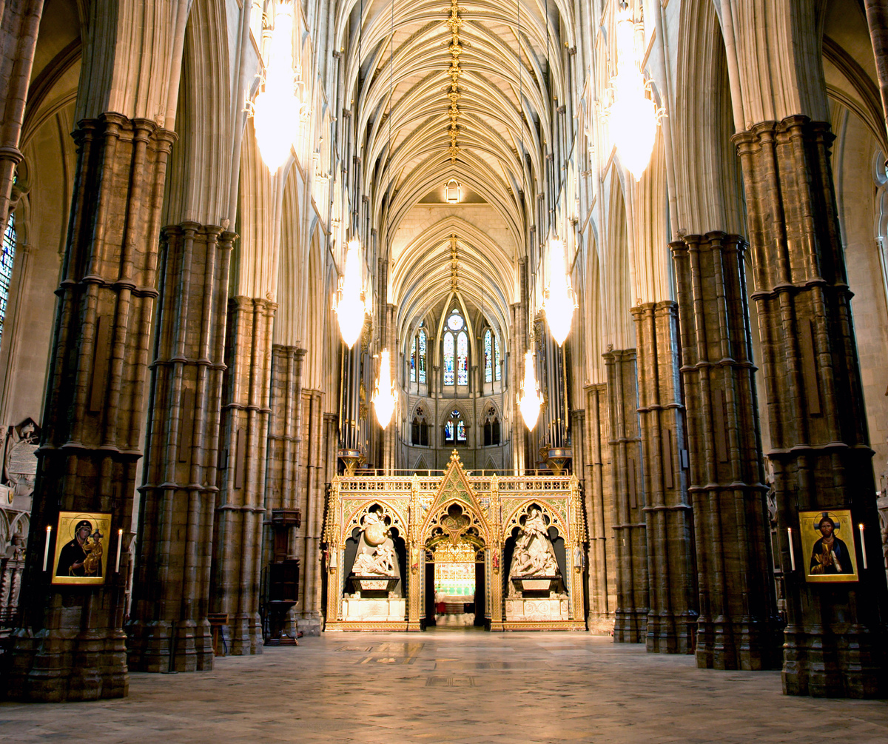
Learning
Notes:
Nave of Westminster Abbey, looking East
Image:
©2021 Dean & Chapter of Westminster
Please be aware that these images are for educational use only in the classroom and should not be reproduced online.

Slide 5
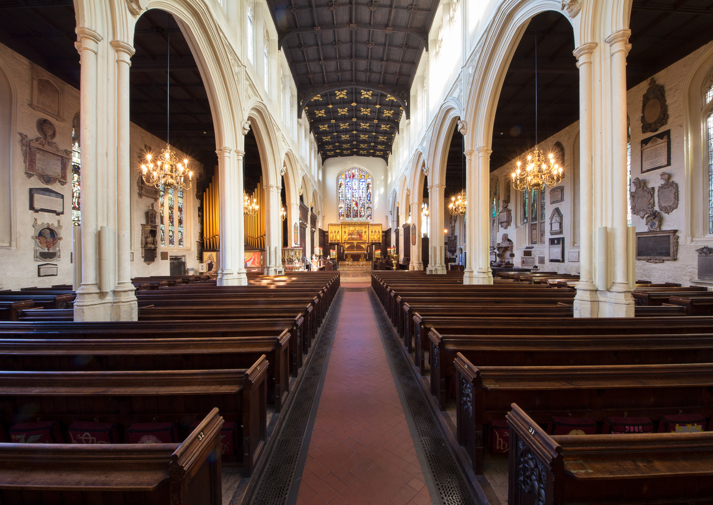
Learning
Notes:
St Margaret’s Church, next to Westminster Abbey
Image:
©2021 Dean & Chapter of Westminster
Please be aware that these images are for educational use only in the classroom and should not be reproduced online.

Slide 6
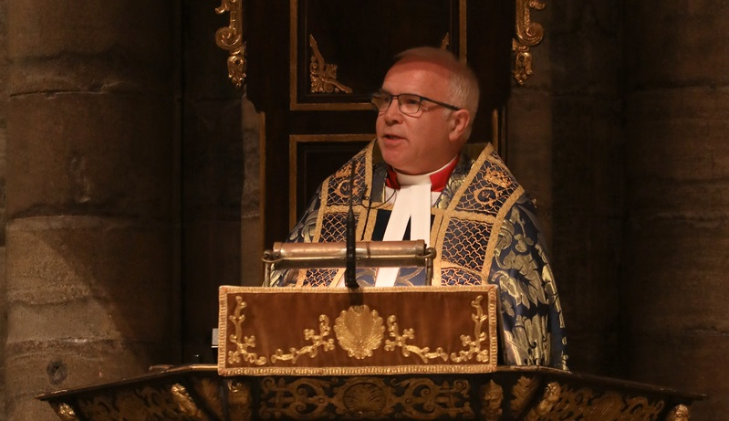
Learning
Notes:
The Very Reverend Dr David Hoyle
Image:
©2021 Dean & Chapter of Westminster
Please be aware that these images are for educational use only in the classroom and should not be reproduced online.

Slide 7
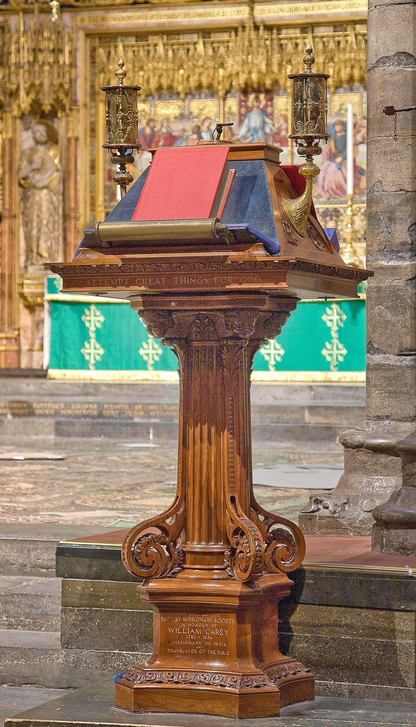
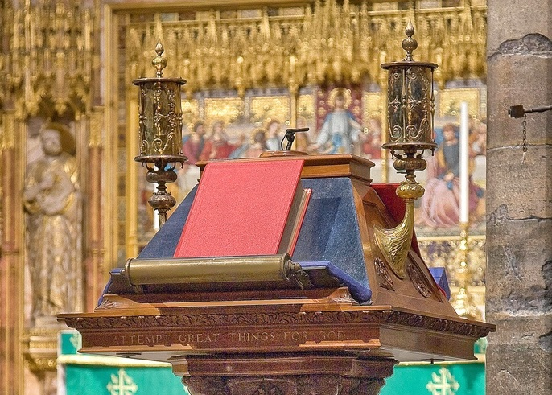
Learning
Notes:
Lectern
Image:
©2021 Dean & Chapter of Westminster
Please be aware that these images are for educational use only in the classroom and should not be reproduced online.

Slide 8
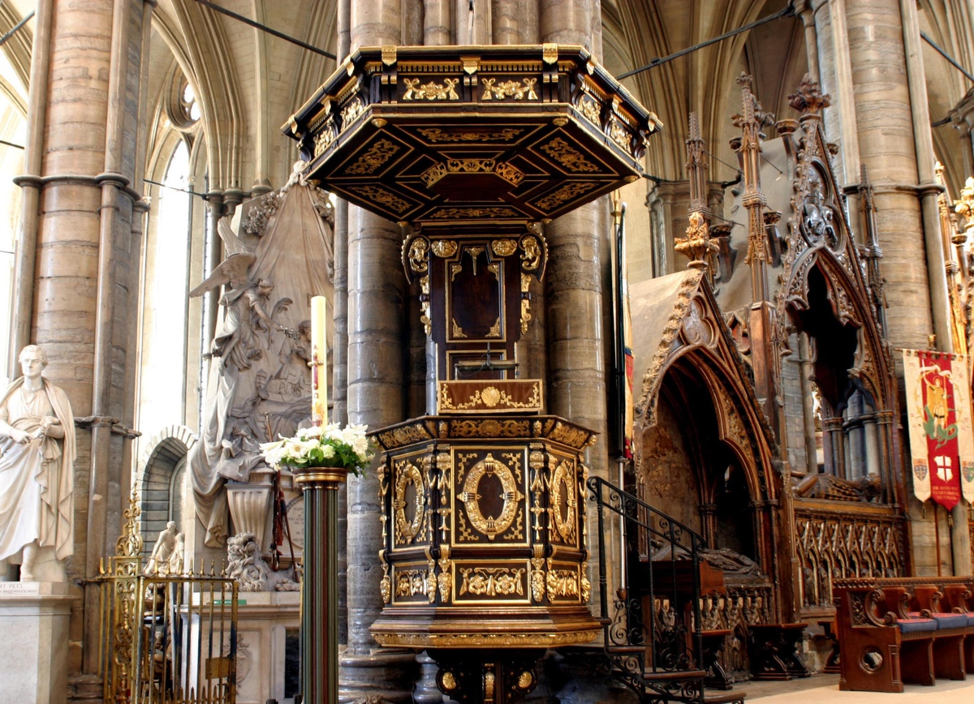
Learning
Notes:
Pulpit in Lantern
Image:
©2021 Dean & Chapter of Westminster
Please be aware that these images are for educational use only in the classroom and should not be reproduced online.

Slide 9
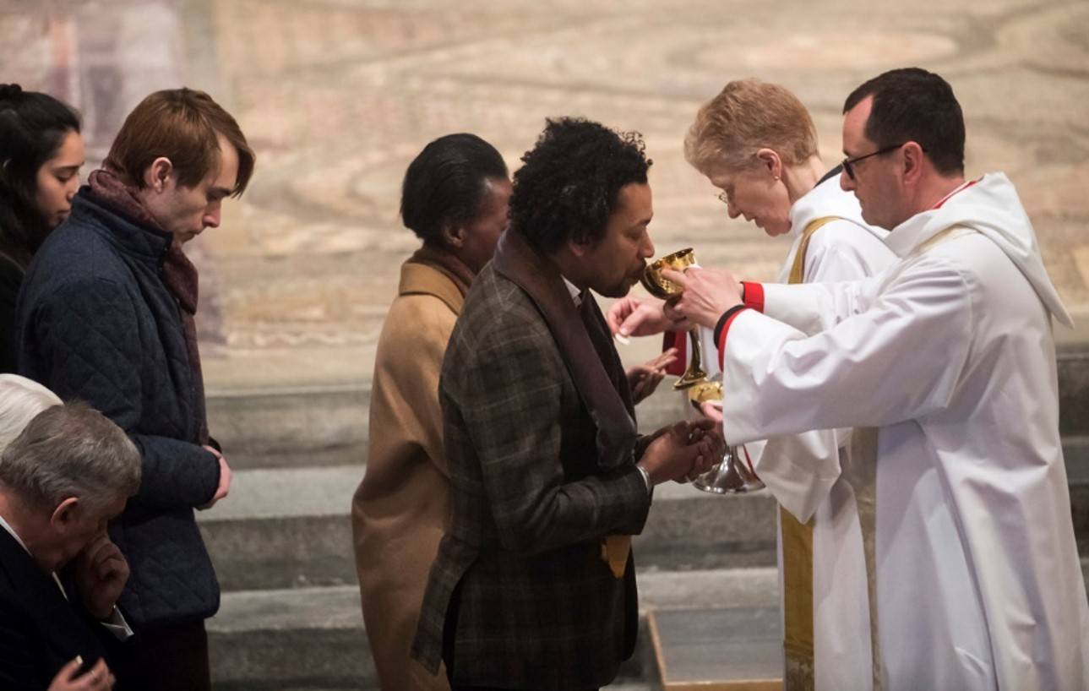
Learning
Notes:
People receiving Communion
Image:
©2021 Dean & Chapter of Westminster
Please be aware that these images are for educational use only in the classroom and should not be reproduced online.

Slide 10
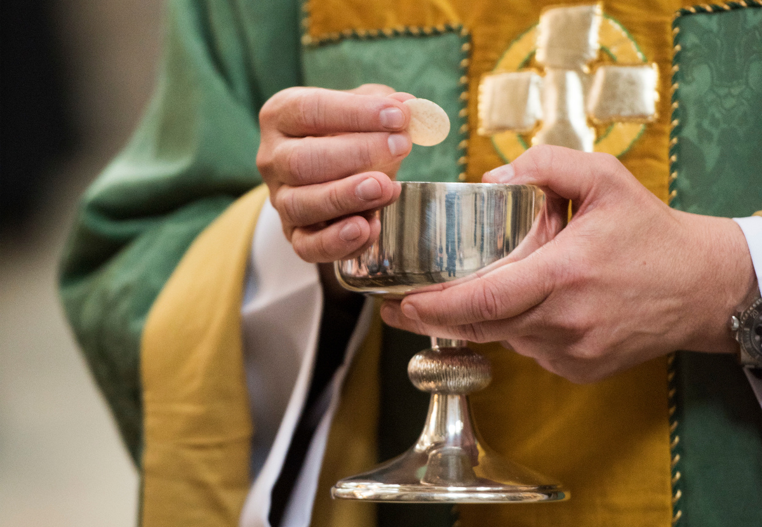
Learning
Notes:
Communion cup
Image:
©2021 Dean & Chapter of Westminster
Please be aware that these images are for educational use only in the classroom and should not be reproduced online.

Slide 11
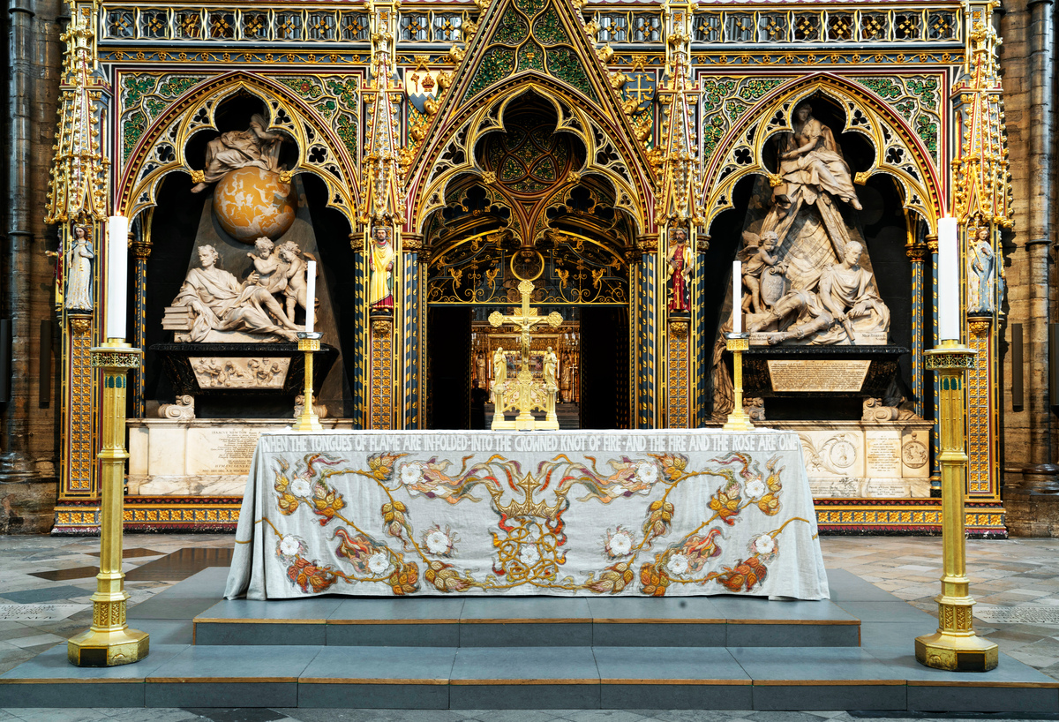
Learning
Notes:
Altar in the Nave
Image:
©2021 Dean & Chapter of Westminster
Please be aware that these images are for educational use only in the classroom and should not be reproduced online.

Slide 12
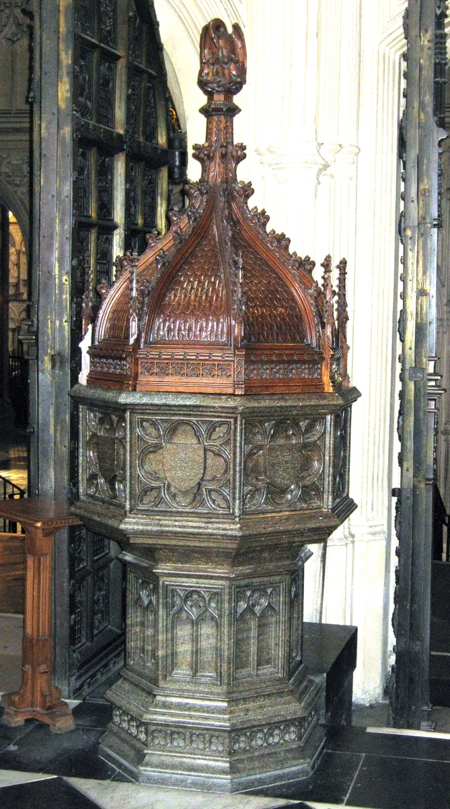
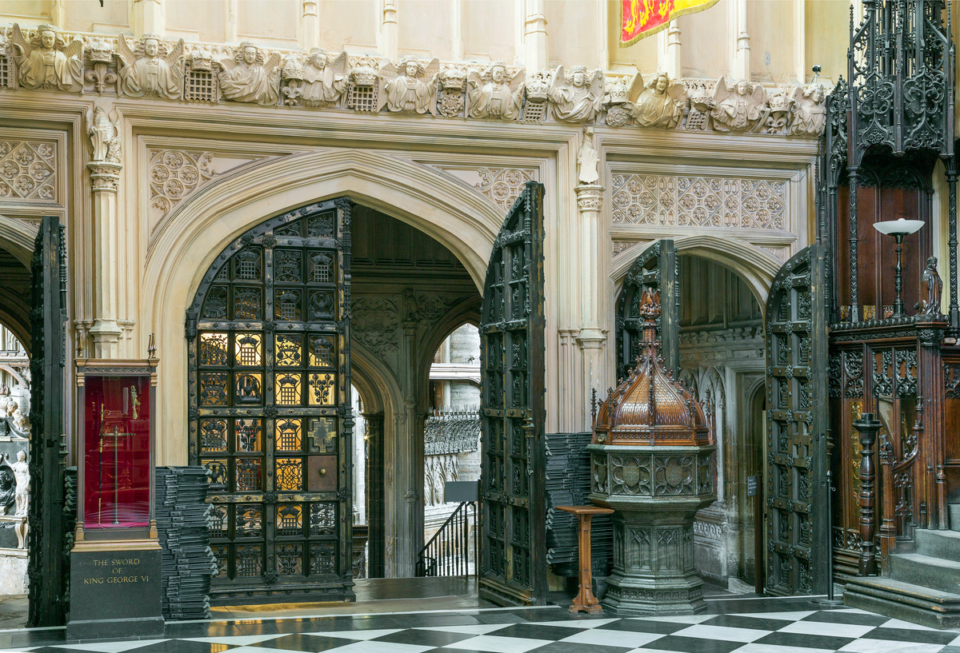
Learning
Notes:
Font in the Lady Chapel
Image:
©2021 Dean & Chapter of Westminster
Please be aware that these images are for educational use only in the classroom and should not be reproduced online.

Slide 13
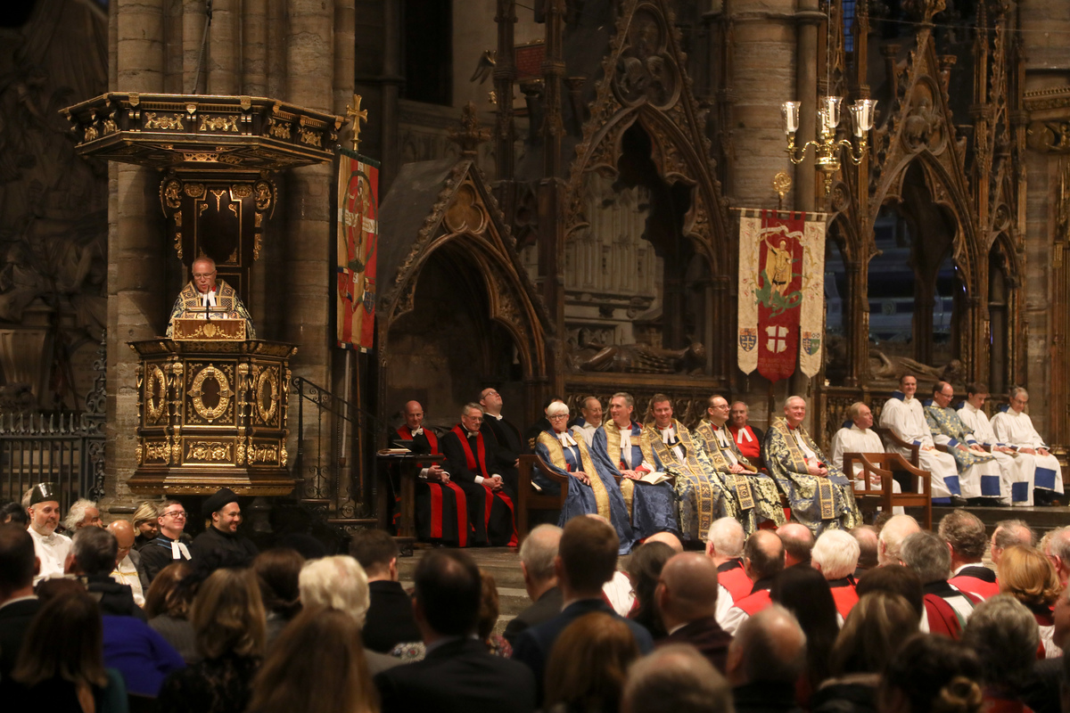
Learning
Notes:
Congregation during a service
Image:
©2021 Dean & Chapter of Westminster
Please be aware that these images are for educational use only in the classroom and should not be reproduced online.

Slide 14
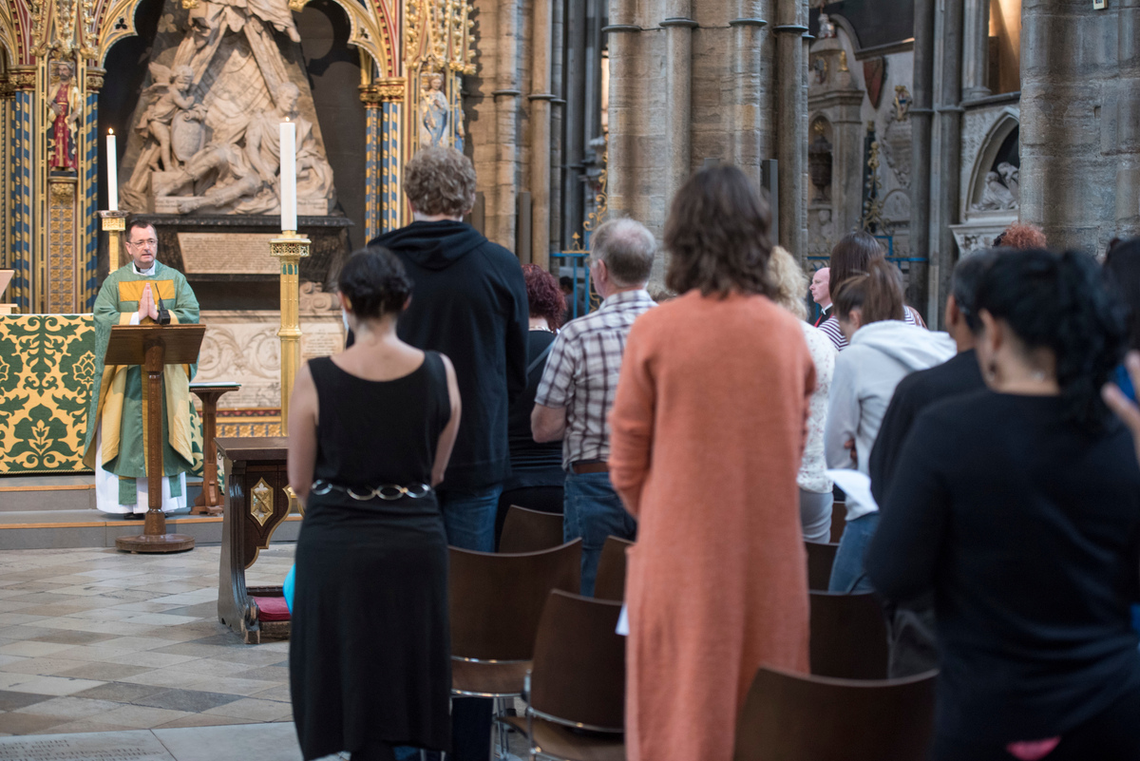
Learning
Notes:
Congregation during a service
Image:
©2021 Dean & Chapter of Westminster
Please be aware that these images are for educational use only in the classroom and should not be reproduced online.

Slide 15
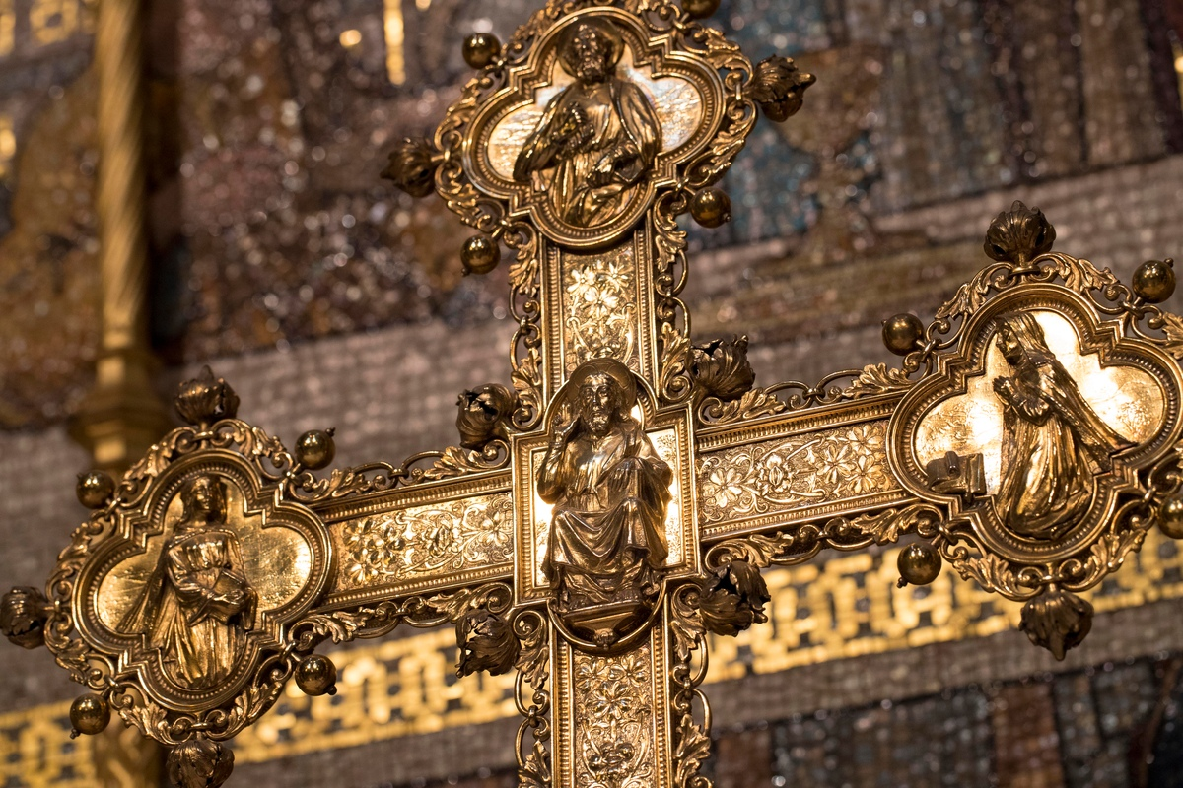
Learning
Notes:
Cross on the High Altar
Image:
©2021 Dean & Chapter of Westminster
Please be aware that these images are for educational use only in the classroom and should not be reproduced online.

Slide 16
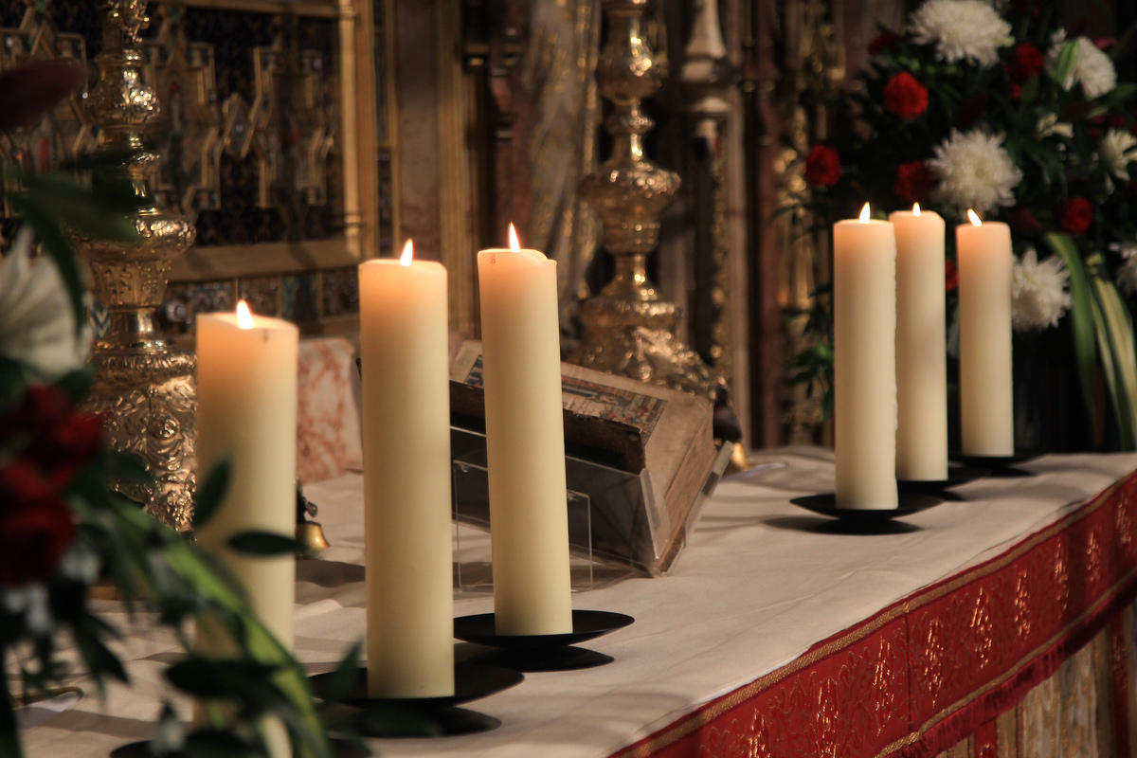
Learning
Notes:
Candles
Image:
©2021 Dean & Chapter of Westminster
Please be aware that these images are for educational use only in the classroom and should not be reproduced online.

Slide 17
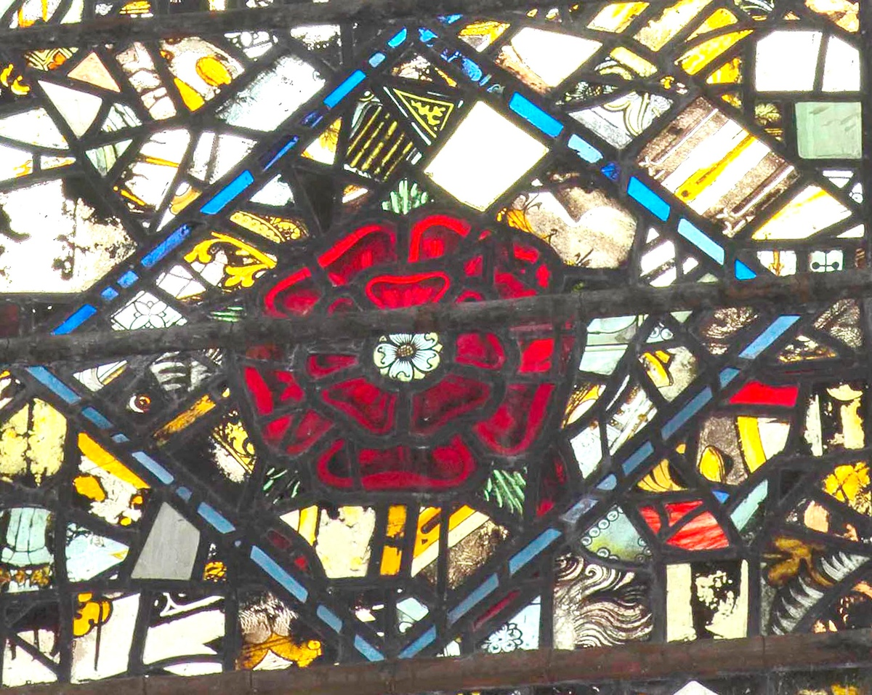
Learning
Notes:
Stained-glass window
Image:
©2021 Dean & Chapter of Westminster
Please be aware that these images are for educational use only in the classroom and should not be reproduced online.

Slide 18
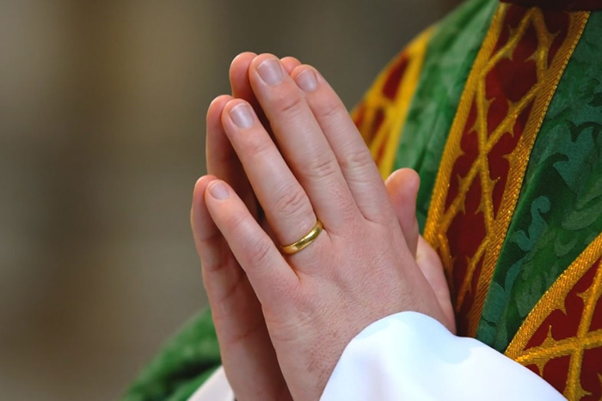
Learning
Notes:
Hands praying
Image:
©2021 Dean & Chapter of Westminster
Please be aware that these images are for educational use only in the classroom and should not be reproduced online.

