Slide 1
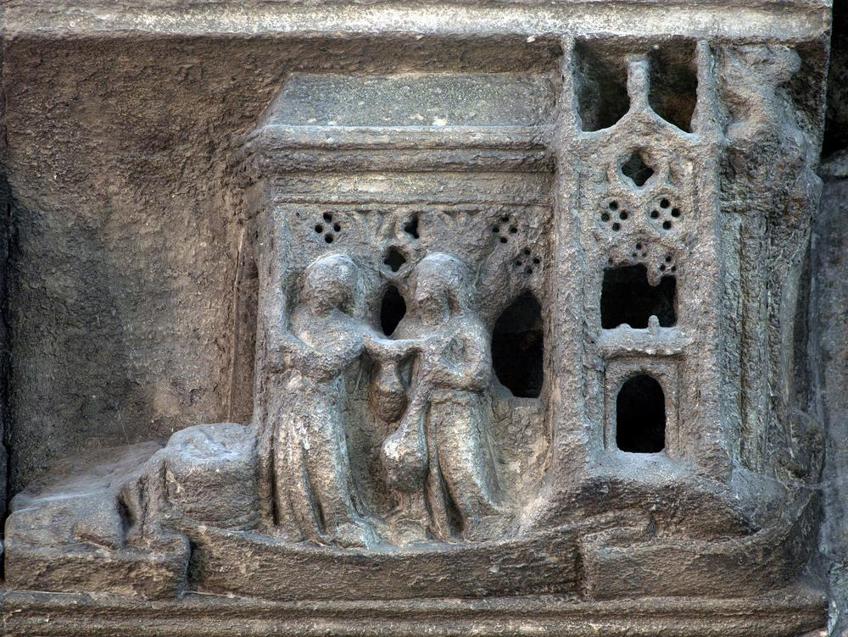

Westminster Abbey
Learning
St Edward the Confessor image bank
©2025 Dean and Chapter of Westminster
1
Notes:
Image:
©2025 Dean & Chapter of Westminster
Please be aware that these images are for educational use only in the classroom and should not be reproduced online.

Slide 2
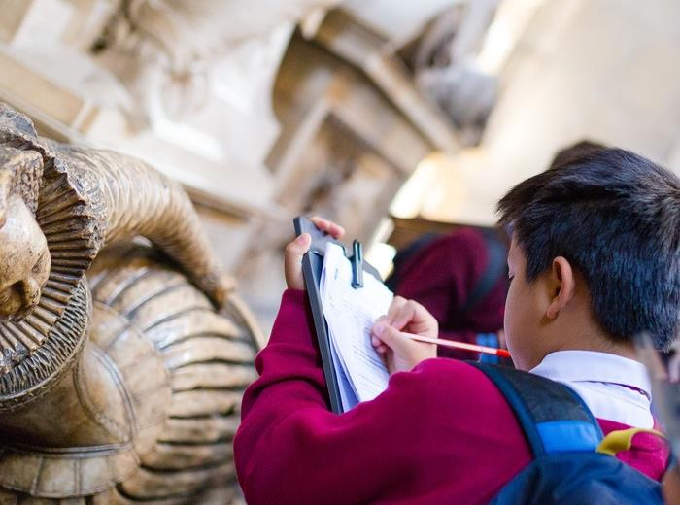
Westminster Abbey
Learning
Information for teachers
Thank you for downloading this resource. We hope that it will be a useful teaching tool in your classroom.
As we continue to grow our free catalogue of teaching resources, we’d really appreciate a few minutes of your time to let us know what you liked and what could be improved. Please complete this five-question survey.
2
Notes:
Image:
©2025 Dean & Chapter of Westminster

Slide 3
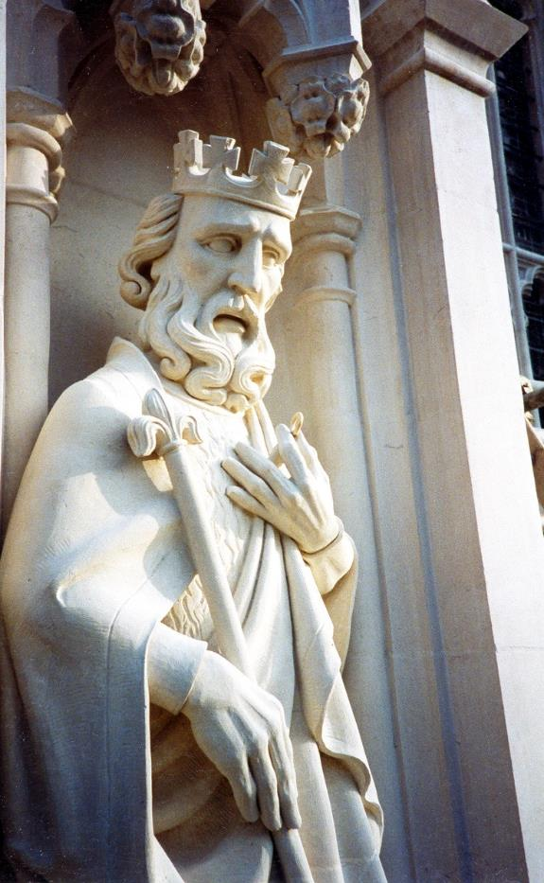
Learning
Notes:
Statue of St Edward the Confessor on the West Front
Image:
©2025 Dean & Chapter of Westminster
Please be aware that these images are for educational use only in the classroom and should not be reproduced online.

Slide 4
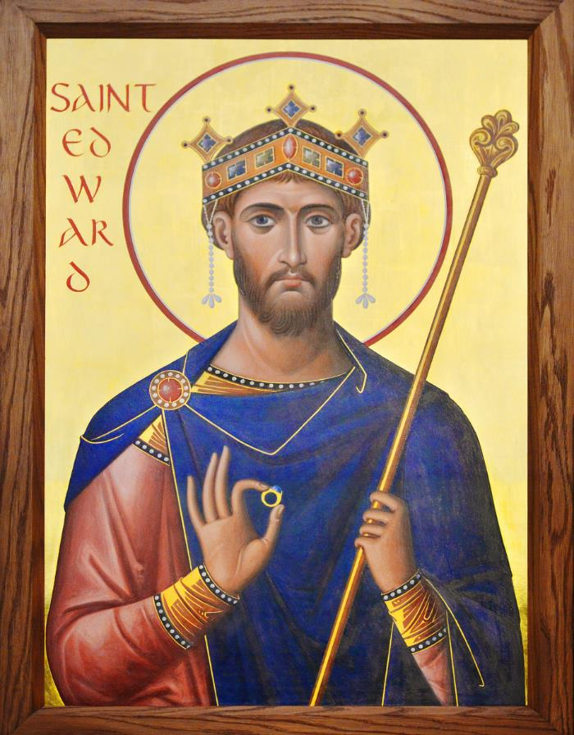
Learning
Notes:
St Edward the Confessor icon
Image:
©2025 Dean & Chapter of Westminster
Please be aware that these images are for educational use only in the classroom and should not be reproduced online.

Slide 5
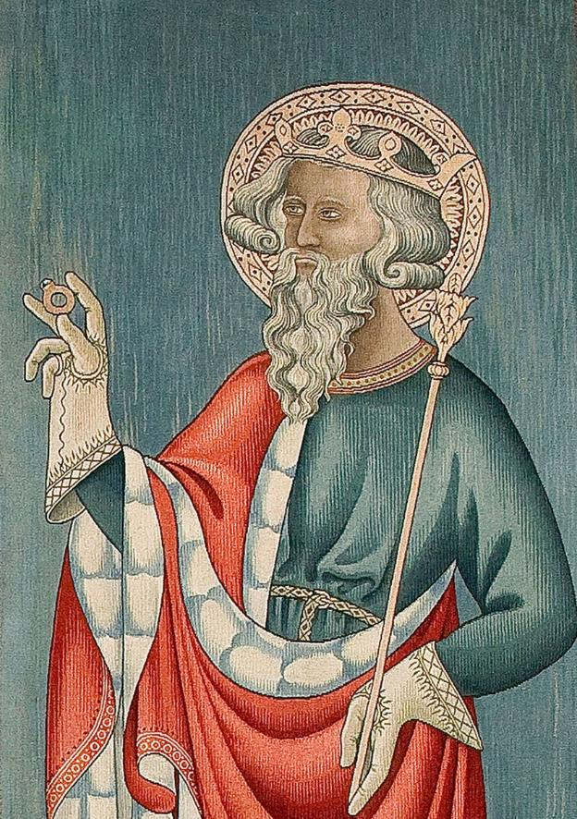
Learning
Notes:
St Edward the Confessor tapestry
Image:
©2025 Dean & Chapter of Westminster
Please be aware that these images are for educational use only in the classroom and should not be reproduced online.

Slide 6
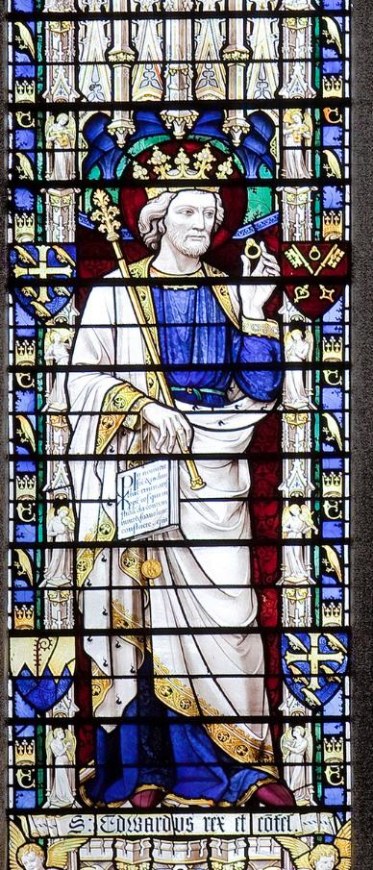
Learning
Notes:
St Edward the Confessor stained-glass window
Image:
©2025 Dean & Chapter of Westminster
Please be aware that these images are for educational use only in the classroom and should not be reproduced online.

Slide 7
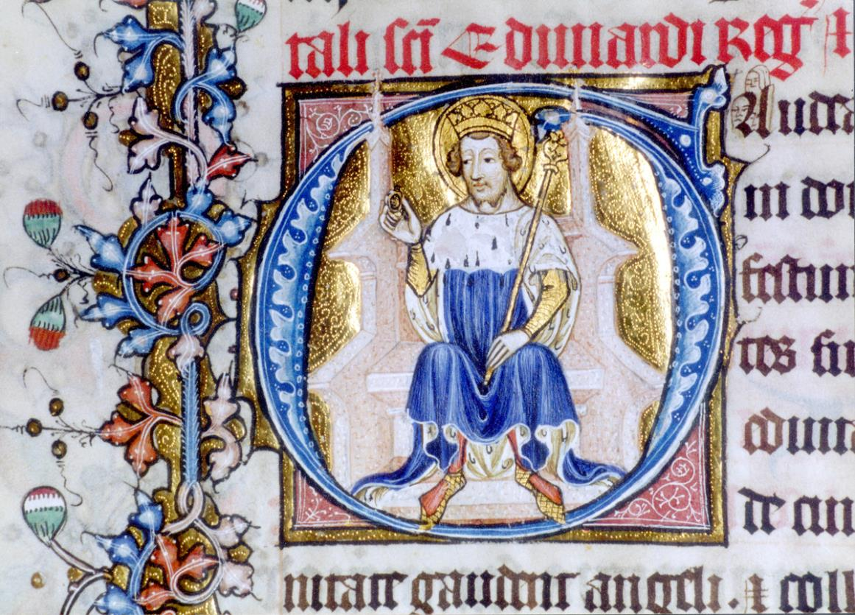
Learning
Notes:
St Edward the Confessor initial in Litlyngton Missal
Image:
©2025 Dean & Chapter of Westminster
Please be aware that these images are for educational use only in the classroom and should not be reproduced online.

Slide 8
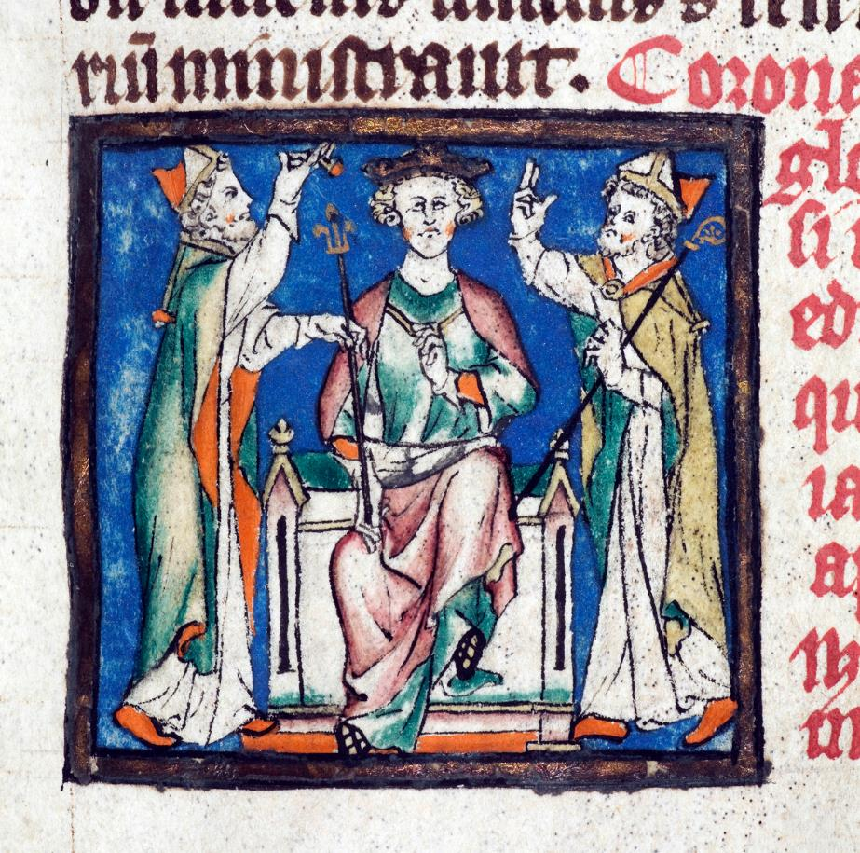
Learning
Notes:
St Edward the Confessor manuscript illustration
Image:
©2025 Dean & Chapter of Westminster
Please be aware that these images are for educational use only in the classroom and should not be reproduced online.

Slide 9
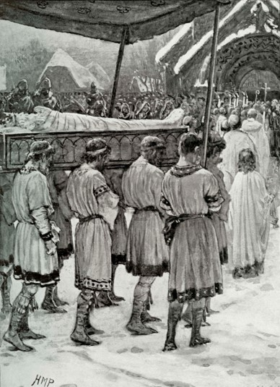
Learning
Notes:
Reconstruction drawing of St Edward the Confessor’s funeral procession
Image:
©2025 Dean & Chapter of Westminster
Please be aware that these images are for educational use only in the classroom and should not be reproduced online.

Slide 10
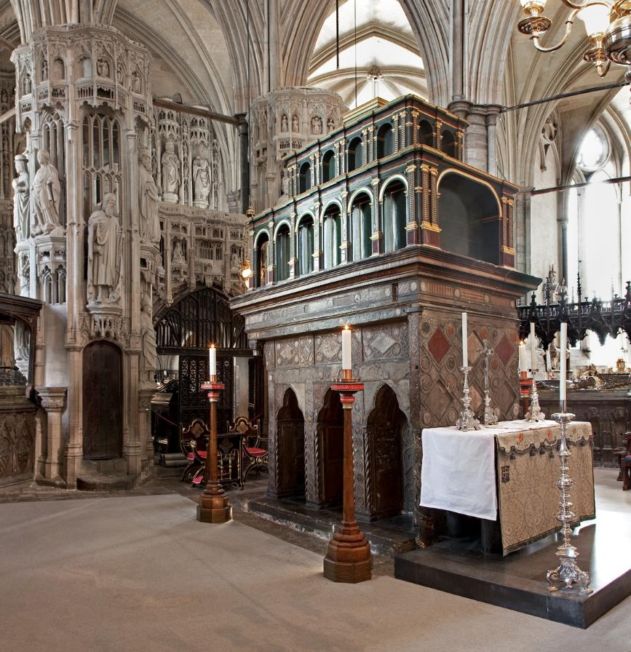
Learning
Notes:
Shrine of St Edward the Confessor
Image:
©2025 Dean & Chapter of Westminster
Please be aware that these images are for educational use only in the classroom and should not be reproduced online.

Slide 11
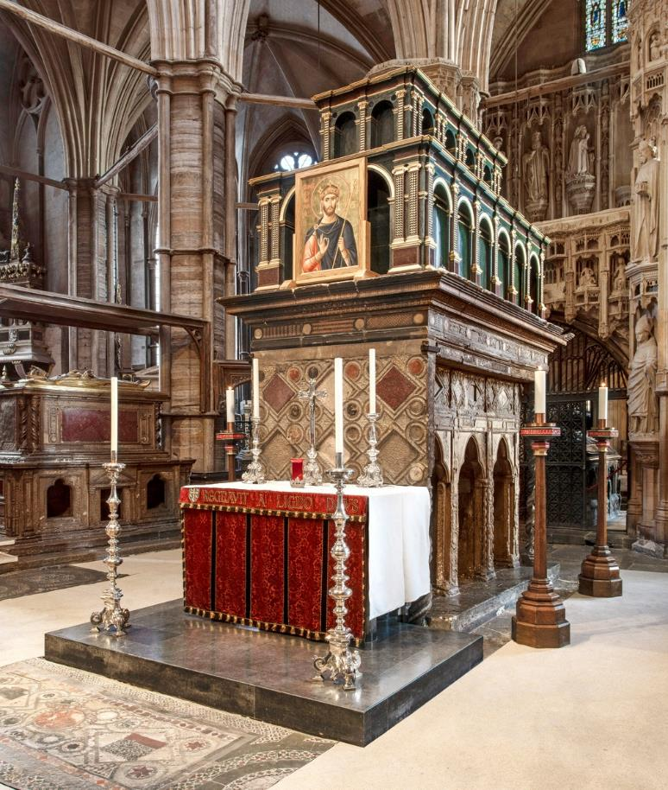
Learning
Notes:
Shrine of St Edward the Confessor with icon
Image:
©2025 Dean & Chapter of Westminster
Please be aware that these images are for educational use only in the classroom and should not be reproduced online.

Slide 12
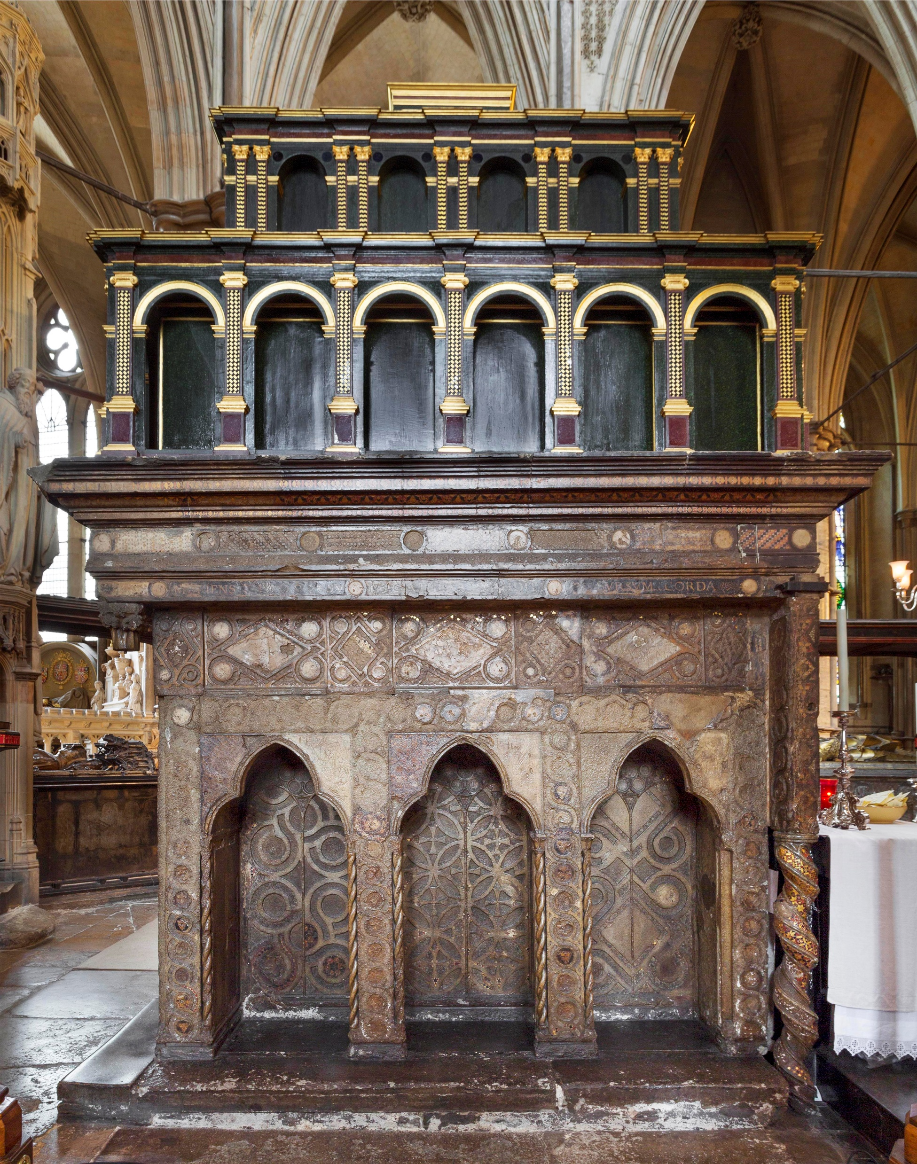
Learning
Notes:
Side view of the Shrine of St Edward the Confessor
Image:
©2025 Dean & Chapter of Westminster
Please be aware that these images are for educational use only in the classroom and should not be reproduced online.

Slide 13
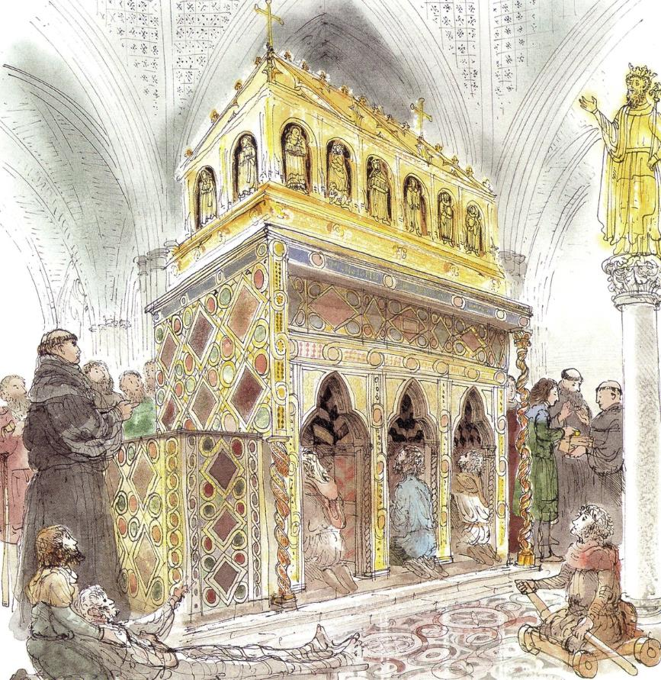
Learning
Notes:
Illustration of St Edward the Confessor’s shrine
Image:
©2025 Dean & Chapter of Westminster
Please be aware that these images are for educational use only in the classroom and should not be reproduced online.

Slide 14
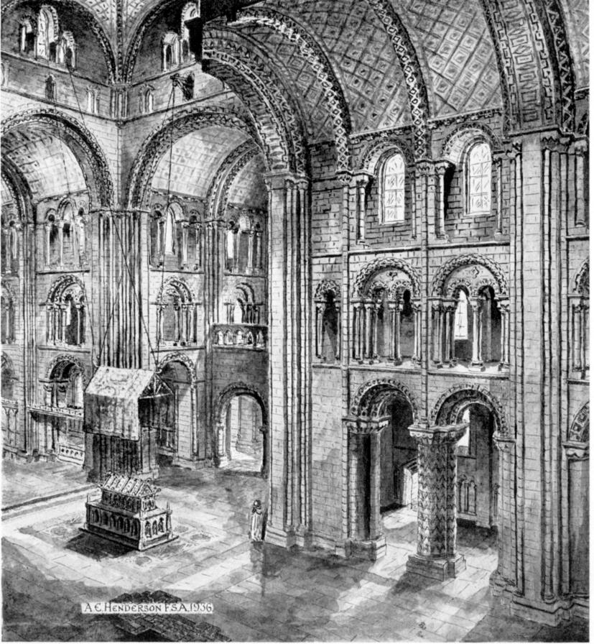
Learning
Notes:
Historic view of St Edward the Confessor’s shrine
Image:
©2025 Dean & Chapter of Westminster
Please be aware that these images are for educational use only in the classroom and should not be reproduced online.

Slide 15
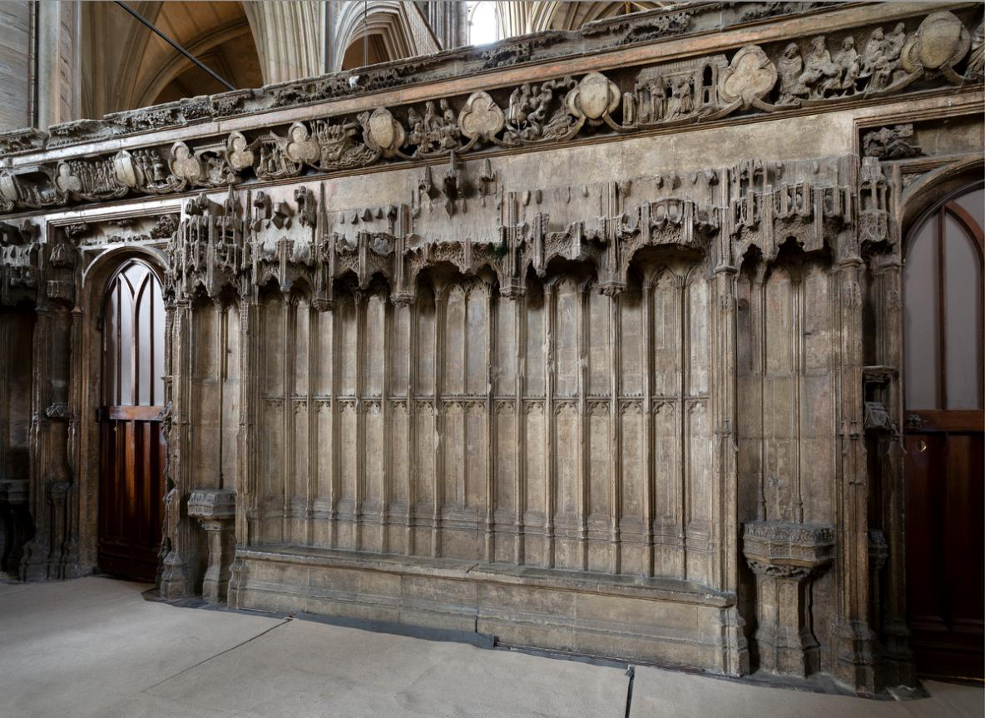
Learning
Notes:
St Edward the Confessor Chapel Screen
Image:
©2025 Dean & Chapter of Westminster
Please be aware that these images are for educational use only in the classroom and should not be reproduced online.

Slide 16
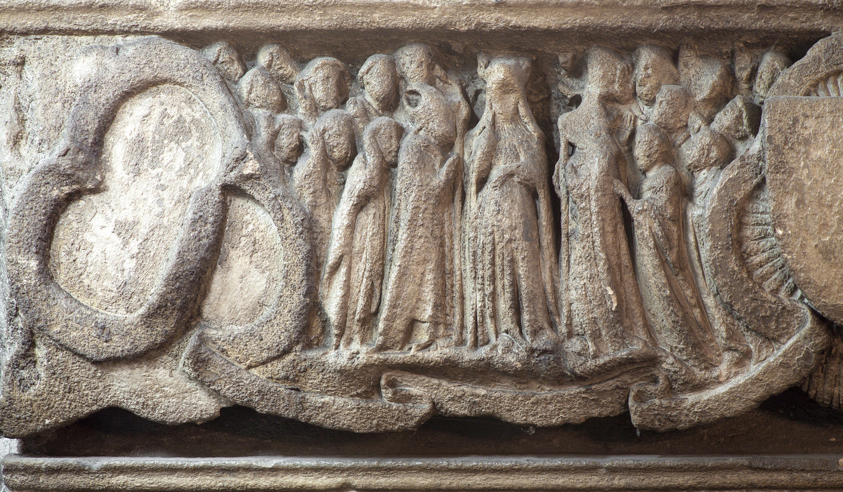
Learning
Notes:
St Edward the Confessor Chapel Screen - oath of fealty to Queen Emma by nobles in the name of her unborn son
Image:
©2025 Dean & Chapter of Westminster
Please be aware that these images are for educational use only in the classroom and should not be reproduced online.

Slide 17
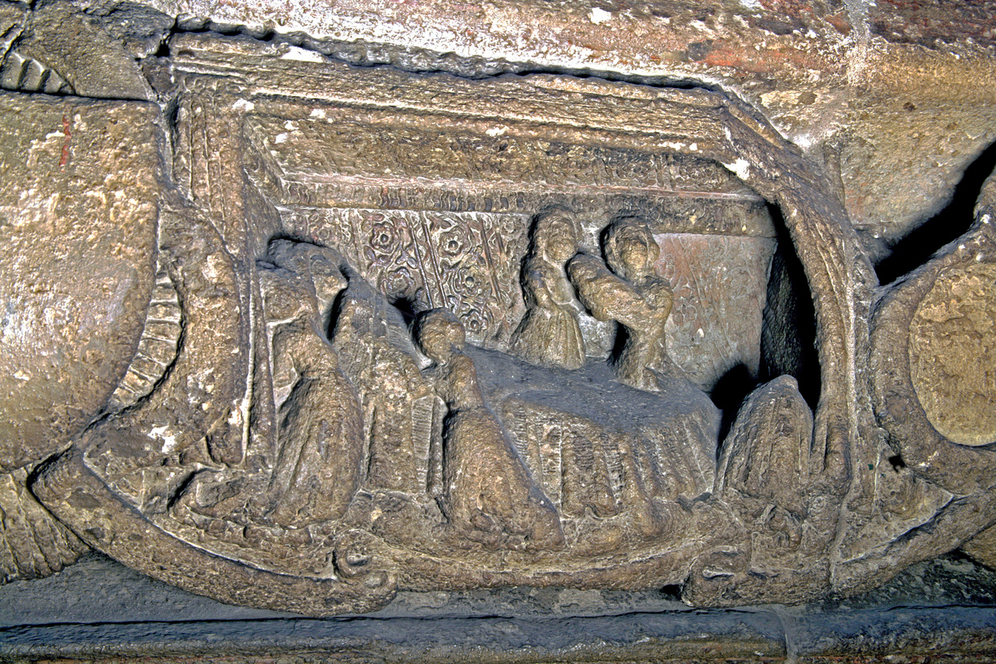
Learning
Notes:
St Edward the Confessor Chapel Screen – Edward's birth
Image:
©2025 Dean & Chapter of Westminster
Please be aware that these images are for educational use only in the classroom and should not be reproduced online.

Slide 18
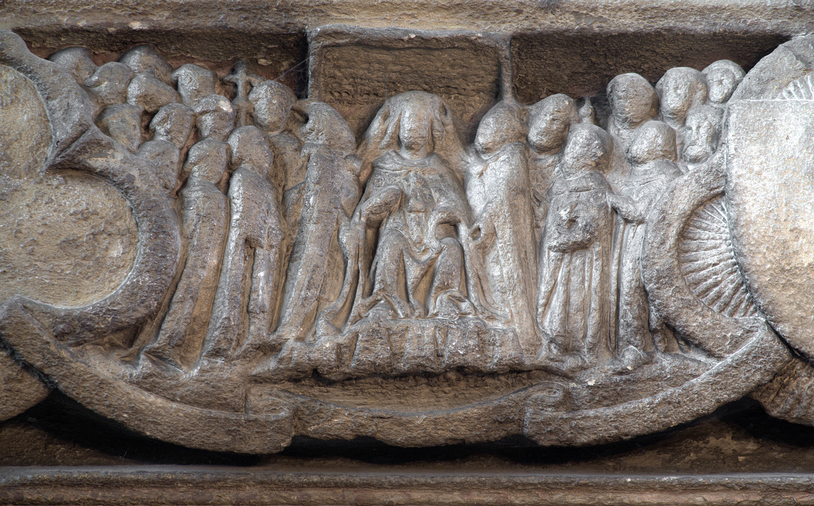
Learning
Notes:
St Edward the Confessor Chapel Screen – Edward’s coronation
Image:
©2025 Dean & Chapter of Westminster
Please be aware that these images are for educational use only in the classroom and should not be reproduced online.

Slide 19
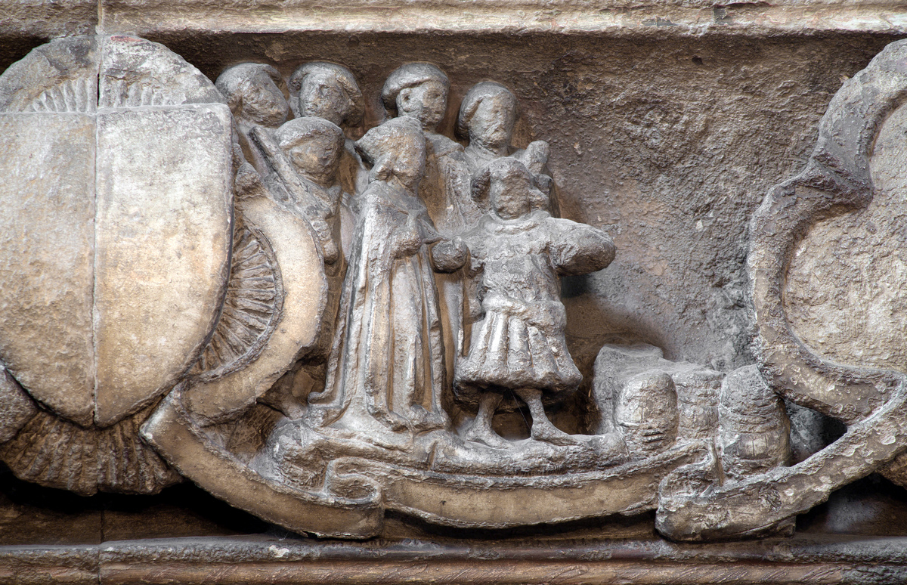
Learning
Notes:
St Edward the Confessor Chapel Screen – the devil dancing on the Danegeld
Image:
©2025 Dean & Chapter of Westminster
Please be aware that these images are for educational use only in the classroom and should not be reproduced online.

Slide 20
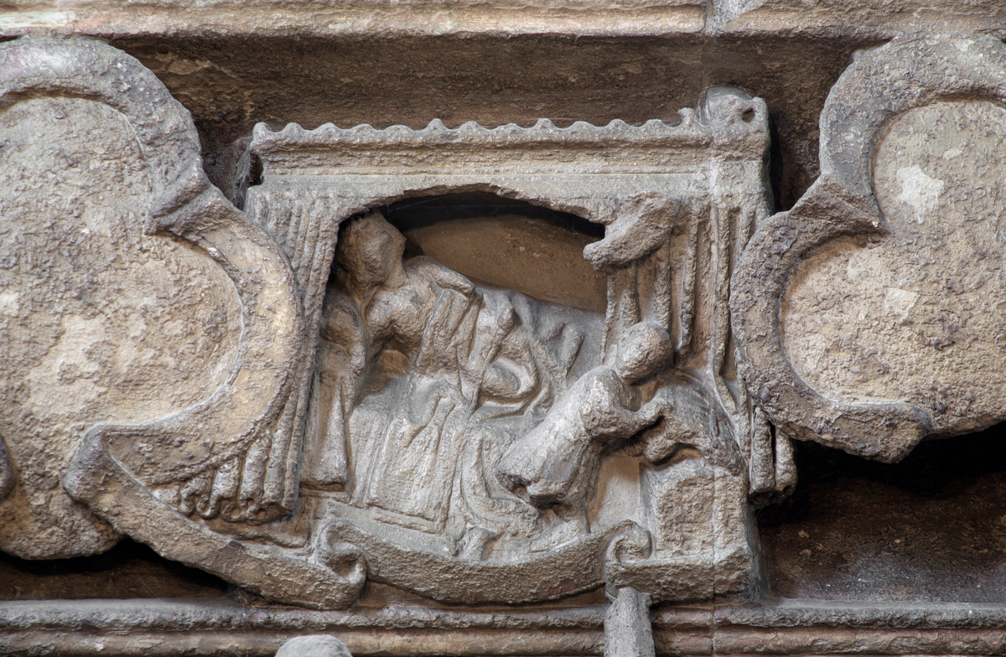
Learning
Notes:
St Edward the Confessor Chapel Screen – a thief trying to steal treasure from the king’s bedchamber
Image:
©2025 Dean & Chapter of Westminster
Please be aware that these images are for educational use only in the classroom and should not be reproduced online.

Slide 21
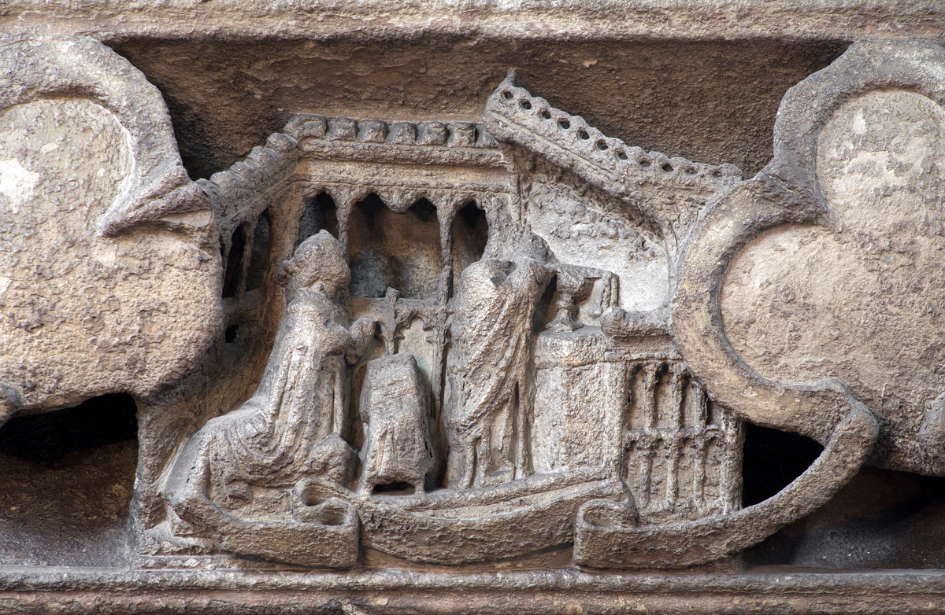
Learning
Notes:
St Edward the Confessor Chapel Screen – Christ appearing to Edward at Mass
Image:
©2025 Dean & Chapter of Westminster
Please be aware that these images are for educational use only in the classroom and should not be reproduced online.

Slide 22
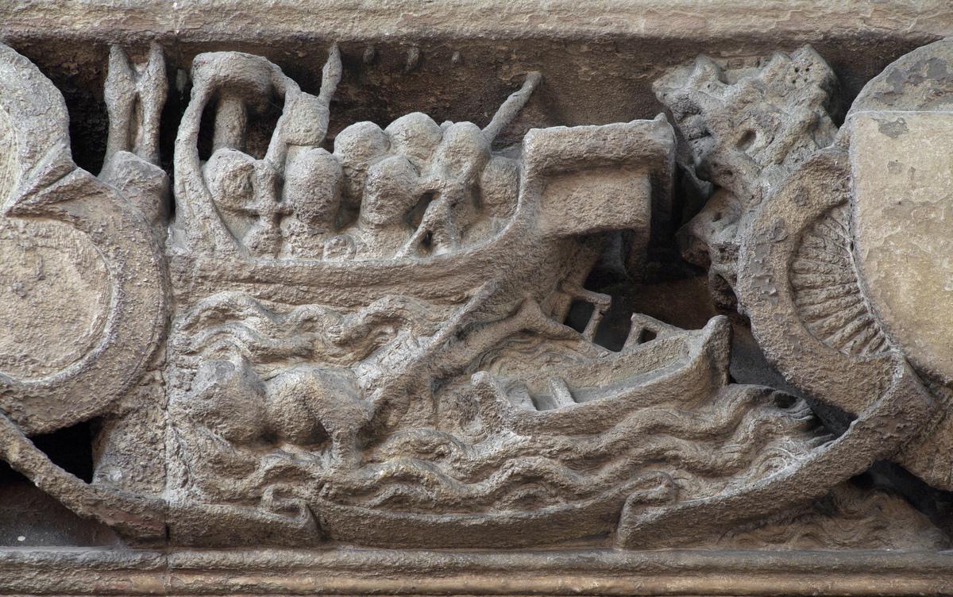
Learning
Notes:
St Edward the Confessor Chapel Screen – vision of the shipwreck of the King of Denmark
Image:
©2025 Dean & Chapter of Westminster
Please be aware that these images are for educational use only in the classroom and should not be reproduced online.

Slide 23
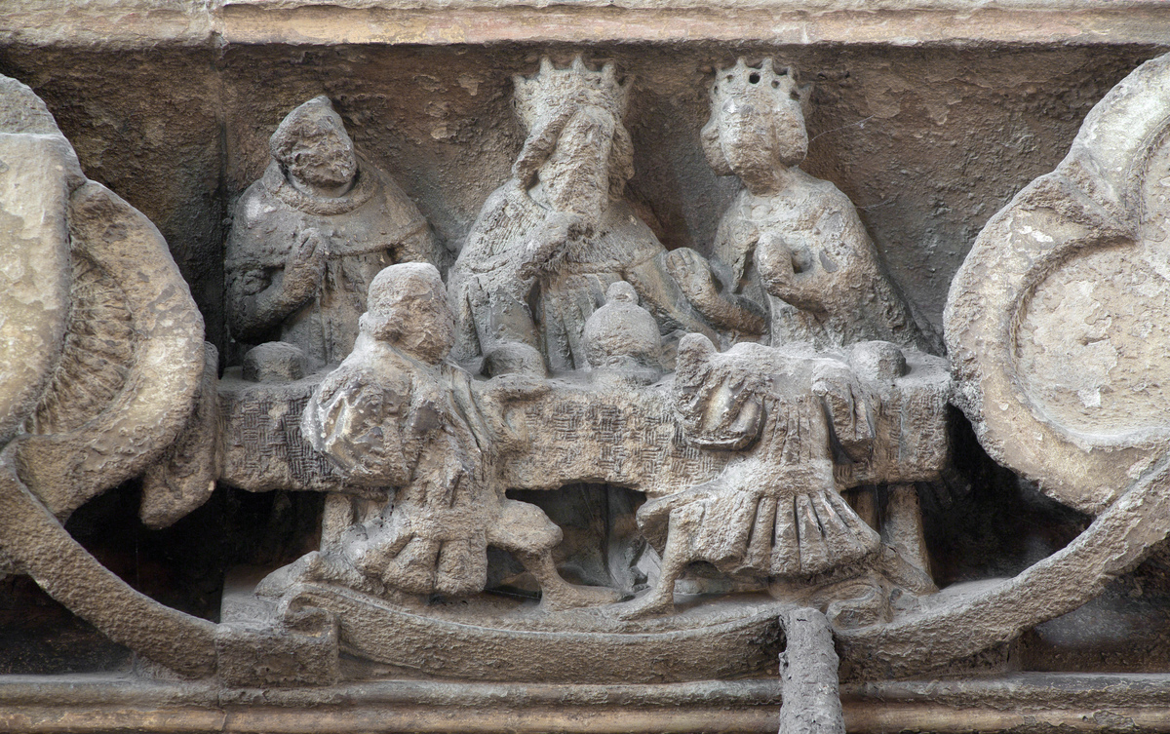
Learning
Notes:
St Edward the Confessor Chapel Screen – Edward at a table with Earl Godwin and his sons when he prophesied the future feud between the sons
Image:
©2025 Dean & Chapter of Westminster
Please be aware that these images are for educational use only in the classroom and should not be reproduced online.

Slide 24
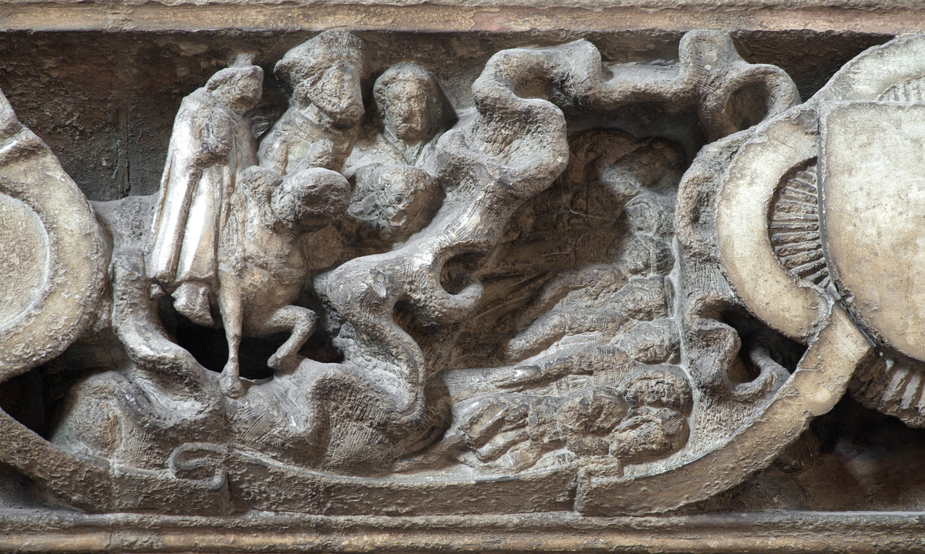
Learning
Notes:
St Edward the Confessor Chapel Screen – vision of the Seven Sleepers
Image:
©2025 Dean & Chapter of Westminster
Please be aware that these images are for educational use only in the classroom and should not be reproduced online.

Slide 25
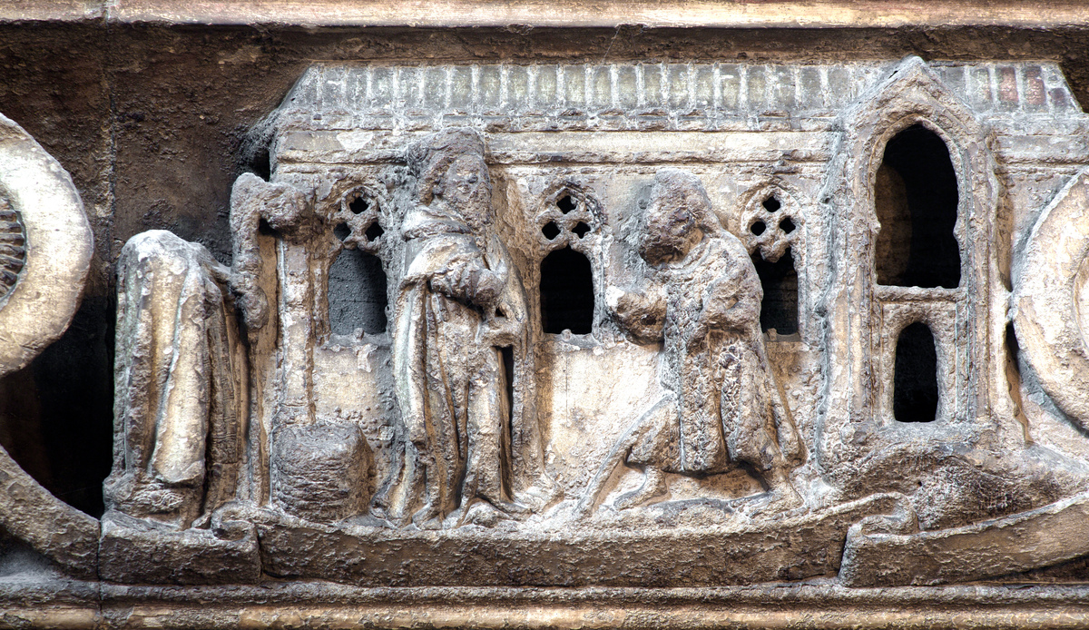
Learning
Notes:
St Edward the Confessor Chapel Screen – St John the Evangelist disguised as a pilgrim asking alms of the king and receiving a ring
Image:
©2025 Dean & Chapter of Westminster
Please be aware that these images are for educational use only in the classroom and should not be reproduced online.

Slide 26
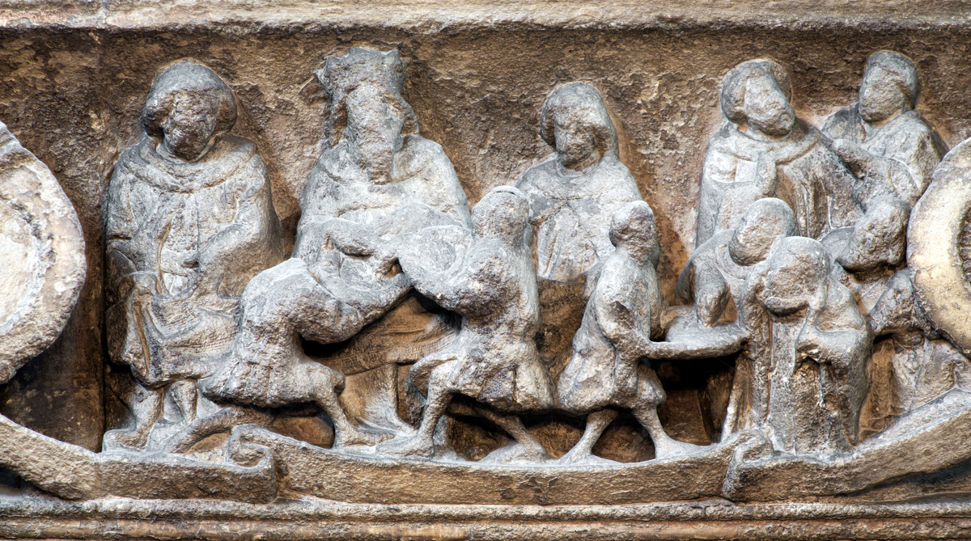
Learning
Notes:
St Edward the Confessor Chapel Screen – blind men cured by washing in the king’s water
Image:
©2025 Dean & Chapter of Westminster
Please be aware that these images are for educational use only in the classroom and should not be reproduced online.

Slide 27
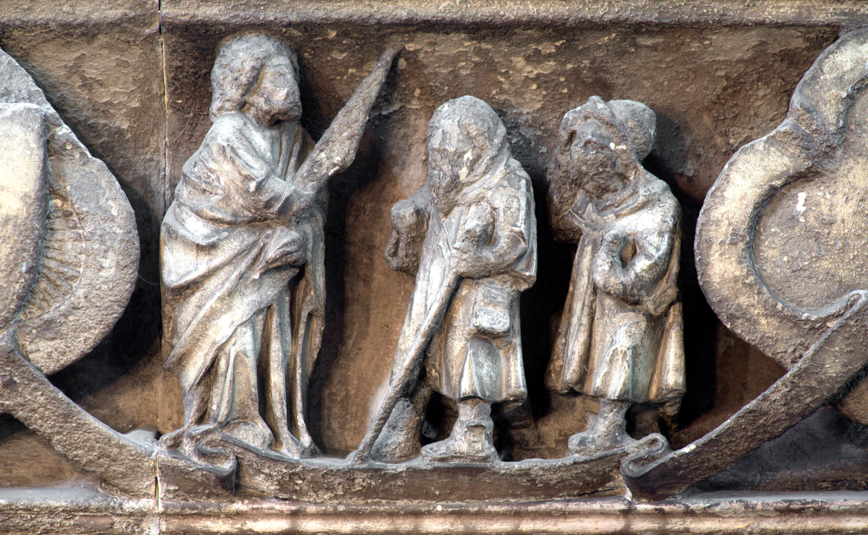
Learning
Notes:
St Edward the Confessor Chapel Screen – St John the Evangelist giving ring to pilgrims in the Holy Land to return to Edward and foretelling the king’s death
Image:
©2025 Dean & Chapter of Westminster
Please be aware that these images are for educational use only in the classroom and should not be reproduced online.

Slide 28
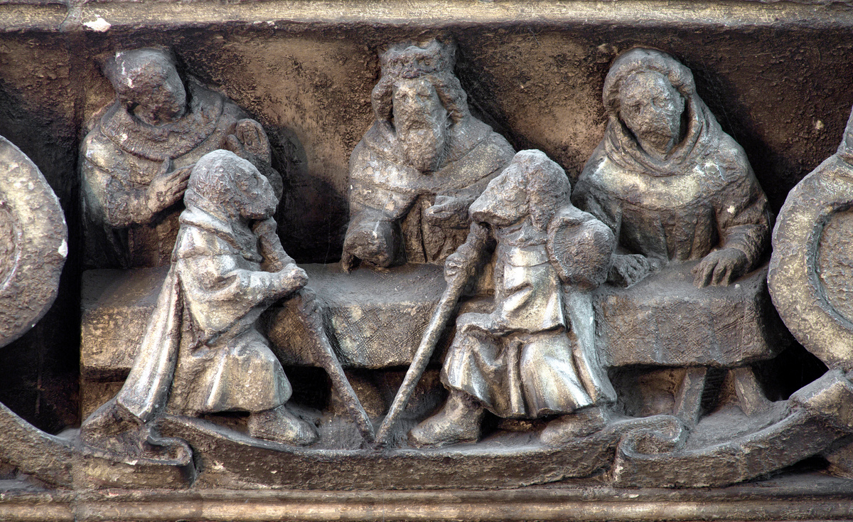
Learning
Notes:
St Edward the Confessor Chapel Screen – pilgrims giving the ring to Edward
Image:
©2025 Dean & Chapter of Westminster
Please be aware that these images are for educational use only in the classroom and should not be reproduced online.

Slide 29
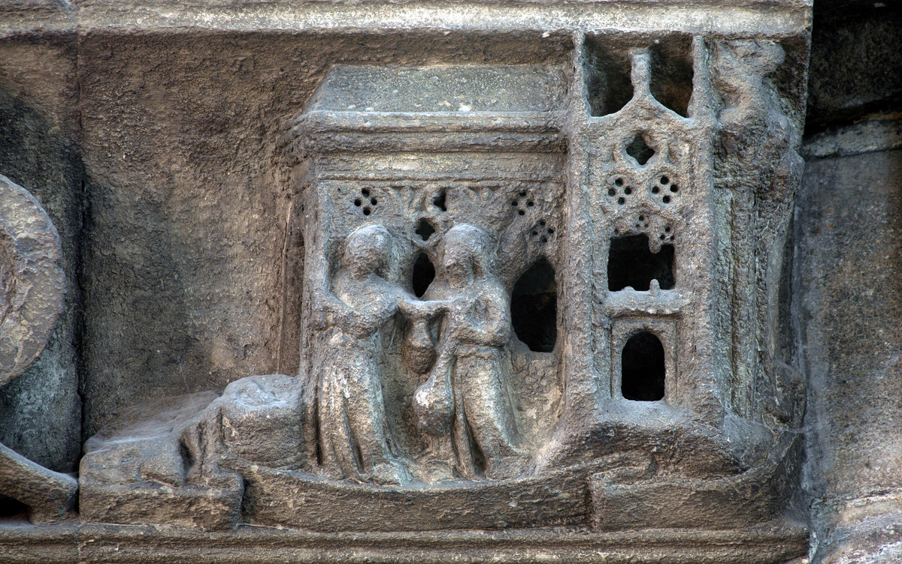
Learning
Notes:
St Edward the Confessor Chapel Screen – the dedication of a church (assumed to be Westminster Abbey)
Image:
©2025 Dean & Chapter of Westminster
Please be aware that these images are for educational use only in the classroom and should not be reproduced online.

Slide 30
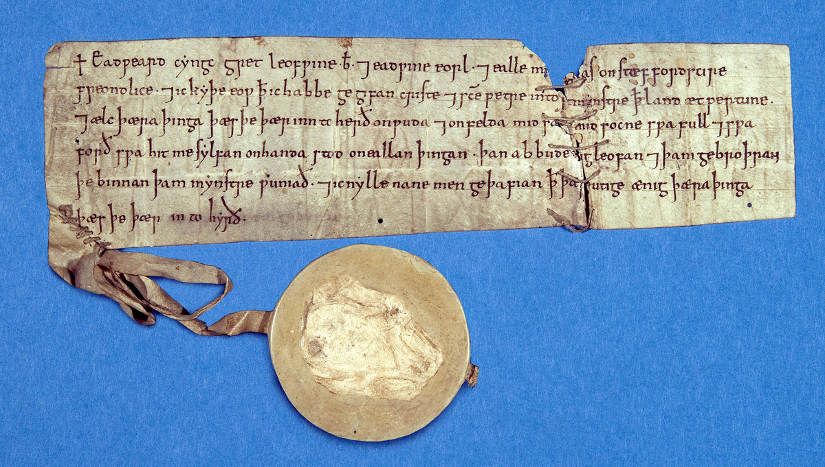
Learning
Notes:
St Edward the Confessor writ and seal
Image:
©2025 Dean & Chapter of Westminster
Please be aware that these images are for educational use only in the classroom and should not be reproduced online.

Slide 31
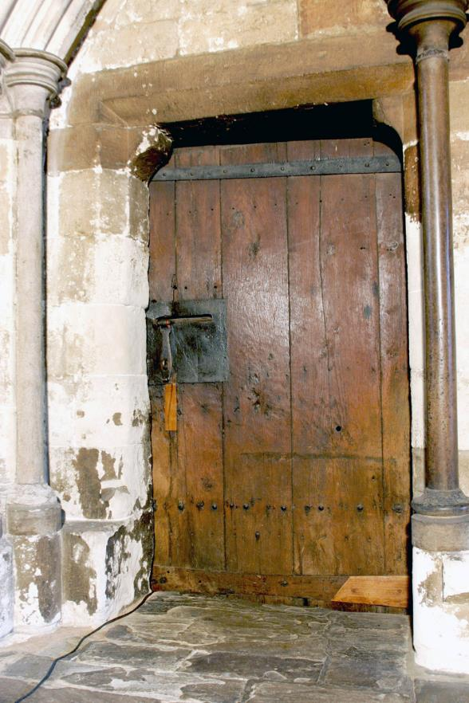
Learning
Notes:
Anglo-Saxon door
Image:
©2025 Dean & Chapter of Westminster
Please be aware that these images are for educational use only in the classroom and should not be reproduced online.

Slide 32
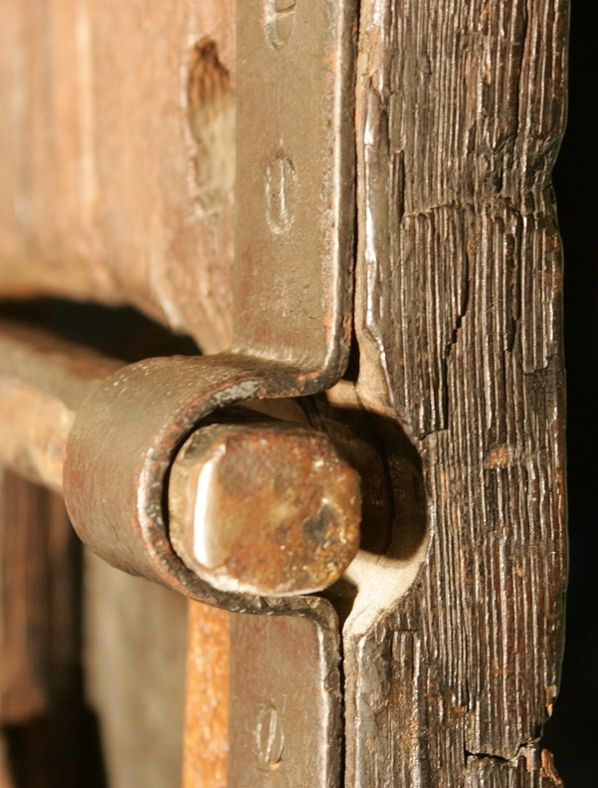
Learning
Notes:
Close-up of Anglo-Saxon door
Image:
©2025 Dean & Chapter of Westminster
Please be aware that these images are for educational use only in the classroom and should not be reproduced online.

Slide 33
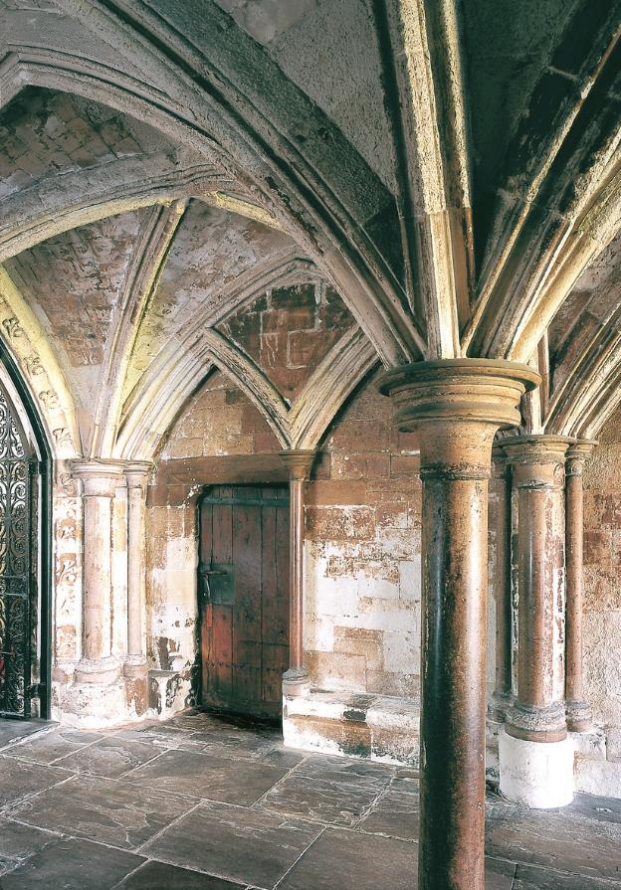
Learning
Notes:
Anglo-Saxon door in Chapter House vestibule
Image:
©2025 Dean & Chapter of Westminster
Please be aware that these images are for educational use only in the classroom and should not be reproduced online.

Slide 34
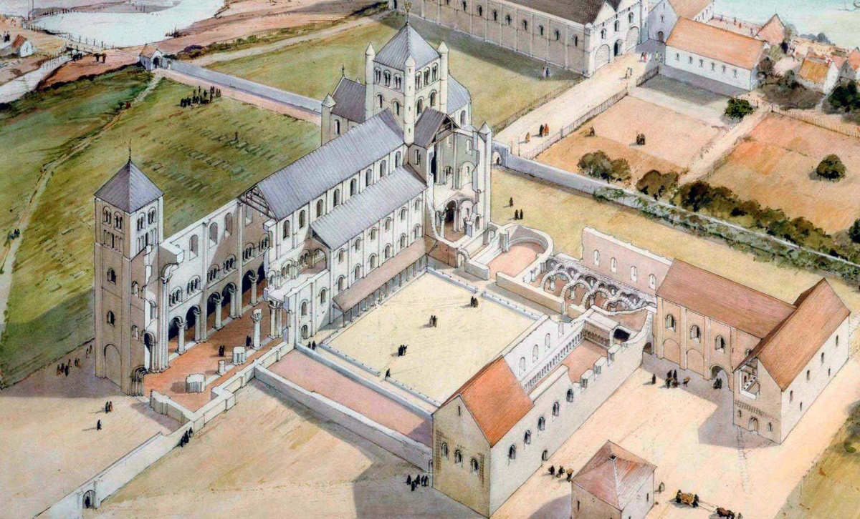
Learning
Notes:
Reconstruction drawing of the Norman Abbey
Image:
©2025 Dean & Chapter of Westminster
Please be aware that these images are for educational use only in the classroom and should not be reproduced online.

Slide 35
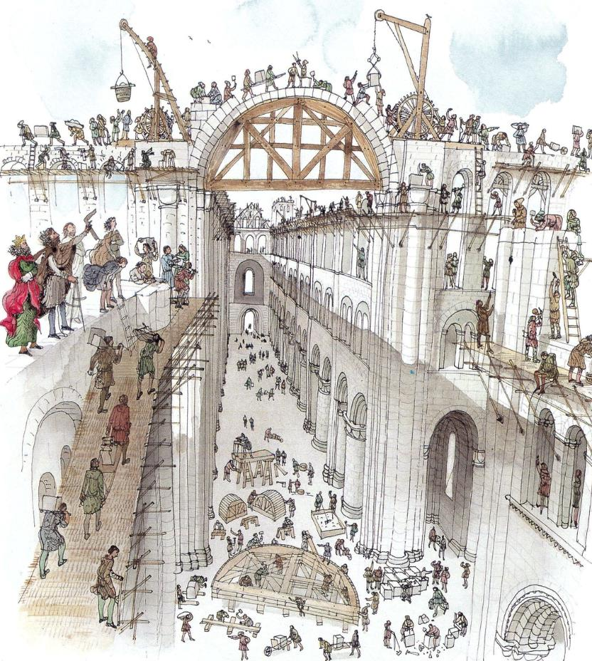
Learning
Notes:
Illustration of building the Norman Abbey
Image:
©2025 Dean & Chapter of Westminster
Please be aware that these images are for educational use only in the classroom and should not be reproduced online.

