Slide 1
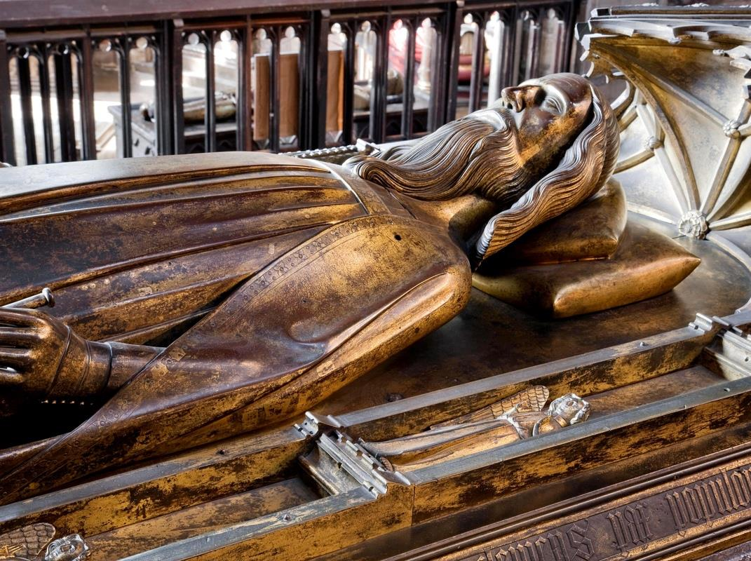

Westminster Abbey
Learning
Royal Funerals
Assembly for primary
©Dean and Chapter of Westminster
1
Notes:
Set up: Play excerpt from Handel’s Dead March as students are coming into assembly. Recommended start 00:00, finish 01:54. Saul: Act III, Scene IV, Dead March (Symphony)
Image:
©Dean & Chapter of Westminster

Slide 2
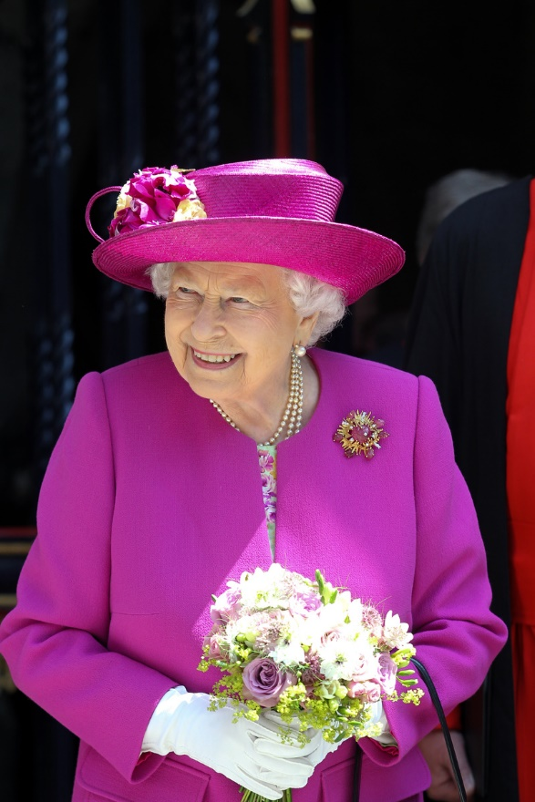
Learning
Notes:
Teacher: The news of Queen Elizabeth II’s death has left many of us feeling really sad and upset. Perhaps you yourself feel sad and it may be that you’re not sure why. Few, if any of us have ever met Queen Elizabeth II, yet no one in this room remembers a time when she was not the Queen. Today we’re going to think about Queen Elizabeth II and talk about what will happen at her funeral. If you want to spend more time talking about this after the assembly, do talk to your class teacher. It’s a difficult time for us all and we can find comfort from talking to each other.
Image:
©Dean & Chapter of Westminster

Slide 3
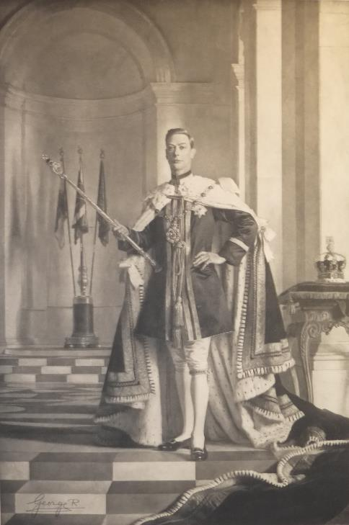
Learning
King George VI
Queen Elizabeth, the Queen Mother
Queen Elizabeth II
King Charles III
Notes:
Teacher: The piece of music we just listened to (Saul: Act III, Scene IV, Dead March (Symphony)) was played at the funeral of King George VI. King George VI was the father of Queen Elizabeth II. He had led Britain through the difficult years of the Second World War and a lot of people in this country felt very sad when he died. They might never have even met him but they felt sad to have lost him as king.
Image:
Royal Collection Trust / © Her Majesty Queen Elizabeth II 2022 www.rct.uk/collection/630805-c

Slide 4
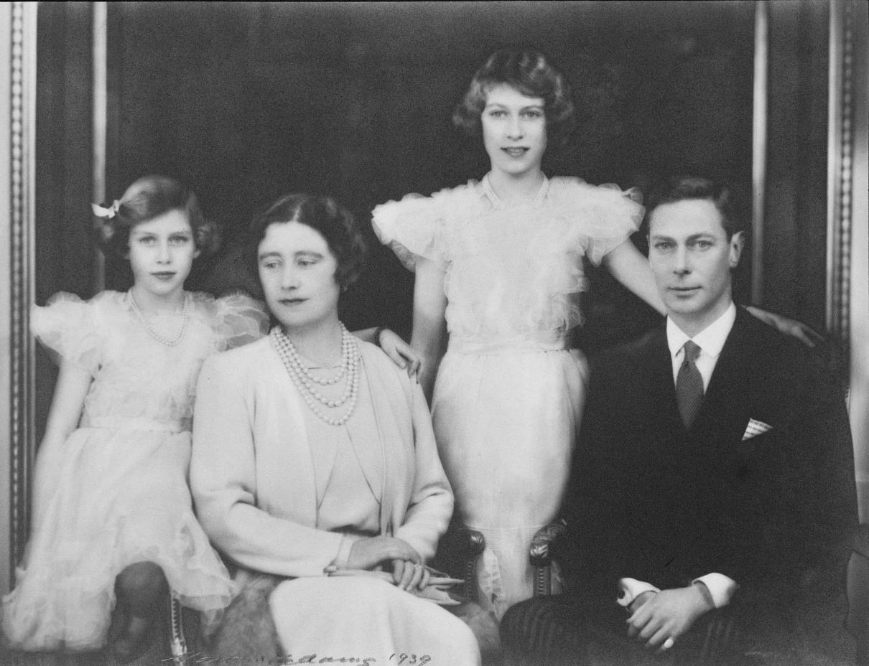
Learning
Notes:
Teacher: King George VI was not just a king. He was also a devoted family man. He had a wife and two daughters and the four were very close to each other. When he died, his eldest daughter, Elizabeth, became Queen Elizabeth II. She not only had her own sadness, she also had a new job to manage; the job of being queen. Her mother (known as Queen Elizabeth The Queen Mother, when Elizabeth became Queen) helped her through this difficult time. Family and friends can help us through difficult times, particularly when someone we love has died.
Image:
Royal Collection Trust / © Her Majesty Queen Elizabeth II 2022 www.rct.uk/collection/2108301

Slide 5
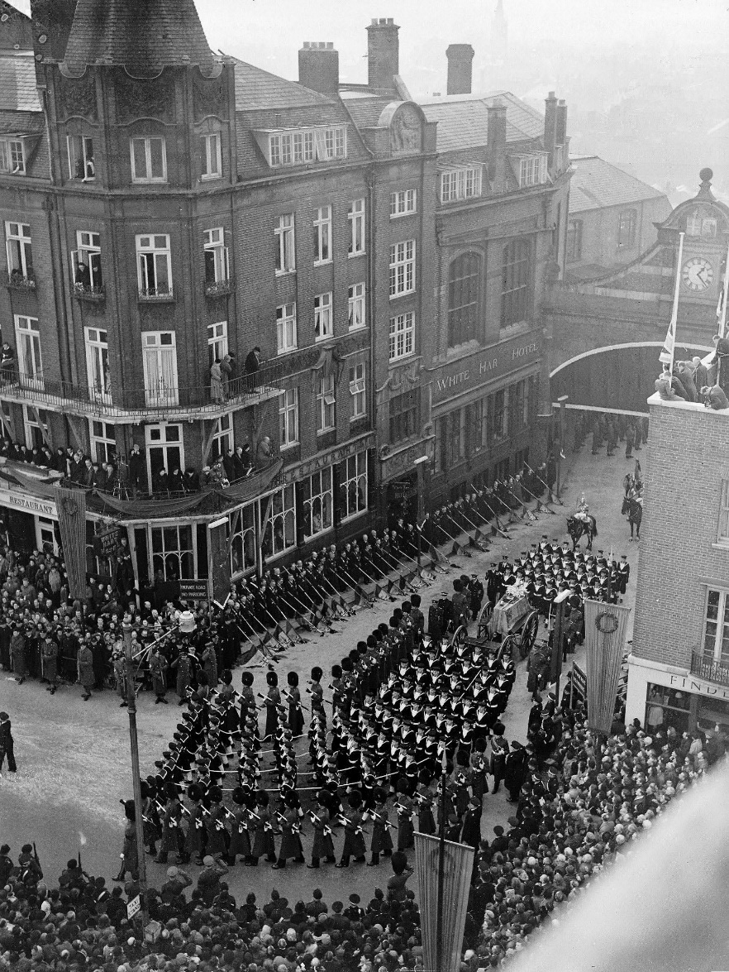
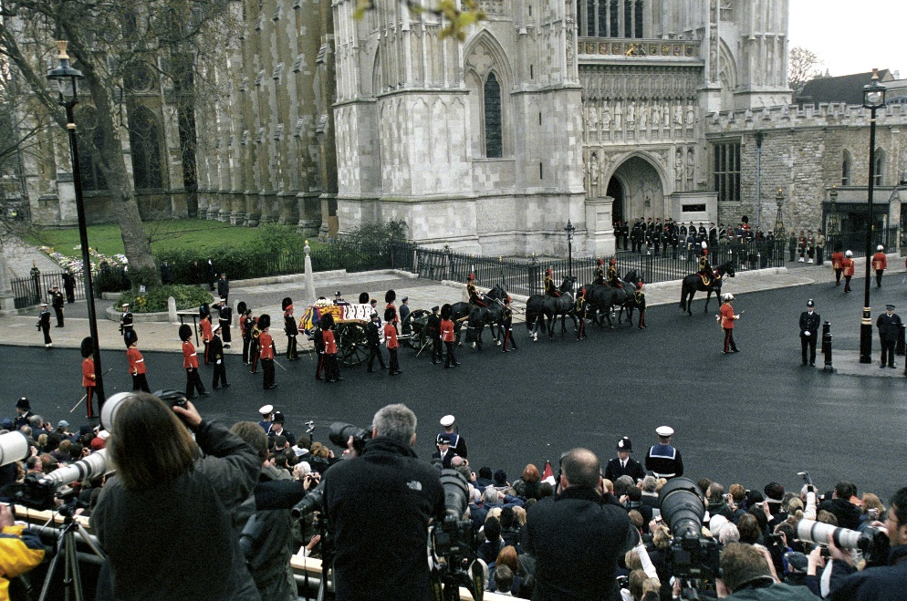
Learning
Ceremonial funeral
State funeral
Notes:
Teacher: The Sovereign (the ruling king or queen) is always given a State Funeral. King George VI was the Sovereign and after his death he was given a State Funeral. His daughter Elizabeth II became the next Sovereign and she will be given a State Funeral too.
Other members of the royal family such as Queen Elizabeth The Queen Mother are given a Royal Ceremonial Funeral.
A State Funeral must be agreed by Parliament.
A Royal Ceremonial Funeral only needs the agreement of the Sovereign.
State Funerals and Ceremonial Funerals can look almost identical.
In the past there has been one visual difference between the two, can you spot it?
(In State Funerals, sailors pull the gun carriage. In Royal Ceremonial Funerals, horses usually pull the gun carriage, however this may not always be the case)
Images:
George VI’s state funeral – ©Alamy Stock Photo
Queen Elizabeth The Queen Mother ceremonial funeral – ©Alamy Stock Photo

Slide 6
Main parts of a State Funeral
Learning
The lying in state
The funeral procession through the streets of London
The funeral in church
The burial
Notes:
Teacher:
State Funerals have developed certain traditions. Many of these traditions are hundreds of years old, some are more recent. Let’s look in more detail at what happens during a State Funeral.

Slide 7
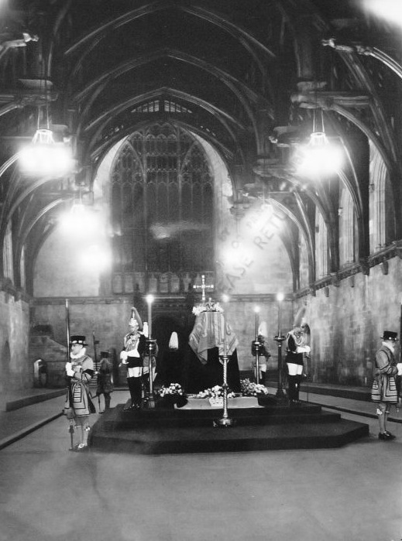
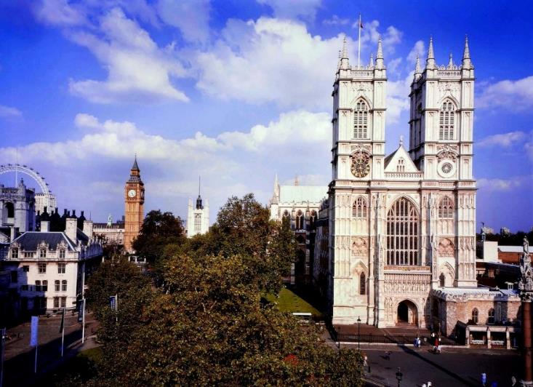
The lying in state
Learning
Notes:
Teacher: Westminster Hall is one of the oldest parts of the Palace of Westminster (where Parliament meets). It has become the usual place for the lying in state of kings and queens. The coffin containing the body is placed in Westminster Hall for a number of days to give people the chance to say goodbye to the king or queen. In 1952, 300,000 people queued up to say goodbye to King George VI. People sometimes sign their name in a special book.
Images:
George VI lying in state - Royal Collection Trust / © Her Majesty Queen Elizabeth II 2022 www.rct.uk/collection/2000811
Westminster Abbey and surrounding area – ©Dean & Chapter of Westminster

Slide 8
The funeral procession
Learning
Watch this clip of the funeral procession of King George VI.
Notes:
Set up: Film clip- Start 0:00 Finish 2:10
Teacher:
This is the most public part of a royal funeral. King George VI’s coffin was taken from Westminster Hall though the streets of London to Paddington Station and onto a waiting train. Thousands of people lined the route to watch King George VI’s coffin on top of a gun carriage being pulled by sailors from the Royal Navy. The Armed Forces play a large part in the procession because the Sovereign is the head of the army, navy and air force. Can you hear the music? It is the same music that we heard at the start of this assembly.
Image:
George VI’s state funeral – ©Alamy Stock Photo

Slide 9
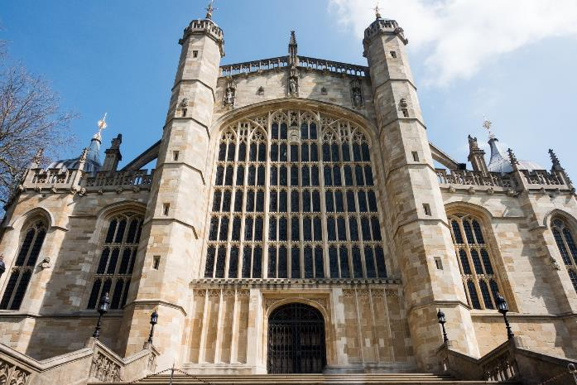
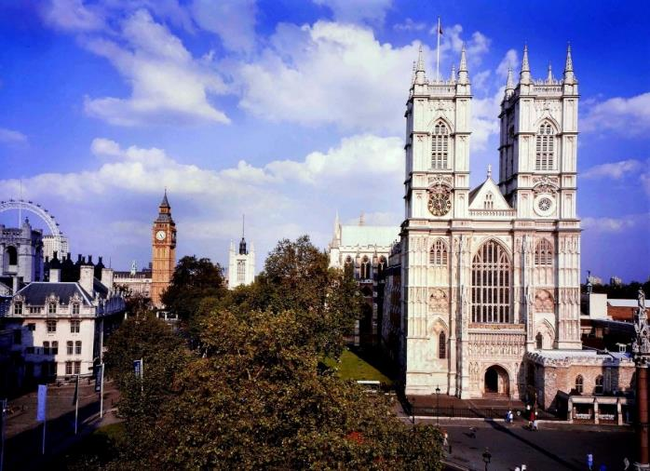
The funeral service
Learning
Notes:
Teacher: Kings and queens are always given a Christian funeral in a church because the Sovereign is the Supreme Governor of the Church of England. King George VI’s funeral took place at St George’s Chapel, Windsor Castle but his wife – Queen Elizabeth The Queen Mother - had her funeral service at Westminster Abbey. Kings and queens can choose and usually their funeral service is planned many years before they die. Queen Elizabeth II’s funeral will take place at Westminster Abbey.
Images:
St George’s Chapel, Windsor – Image by astize from Pixabay
Westminster Abbey and the surrounding area – ©Dean & Chapter of Westminster

Slide 10
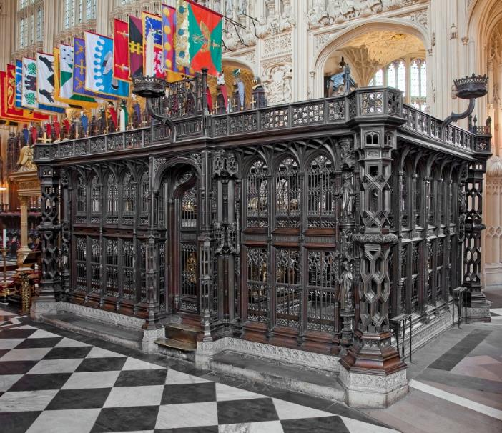
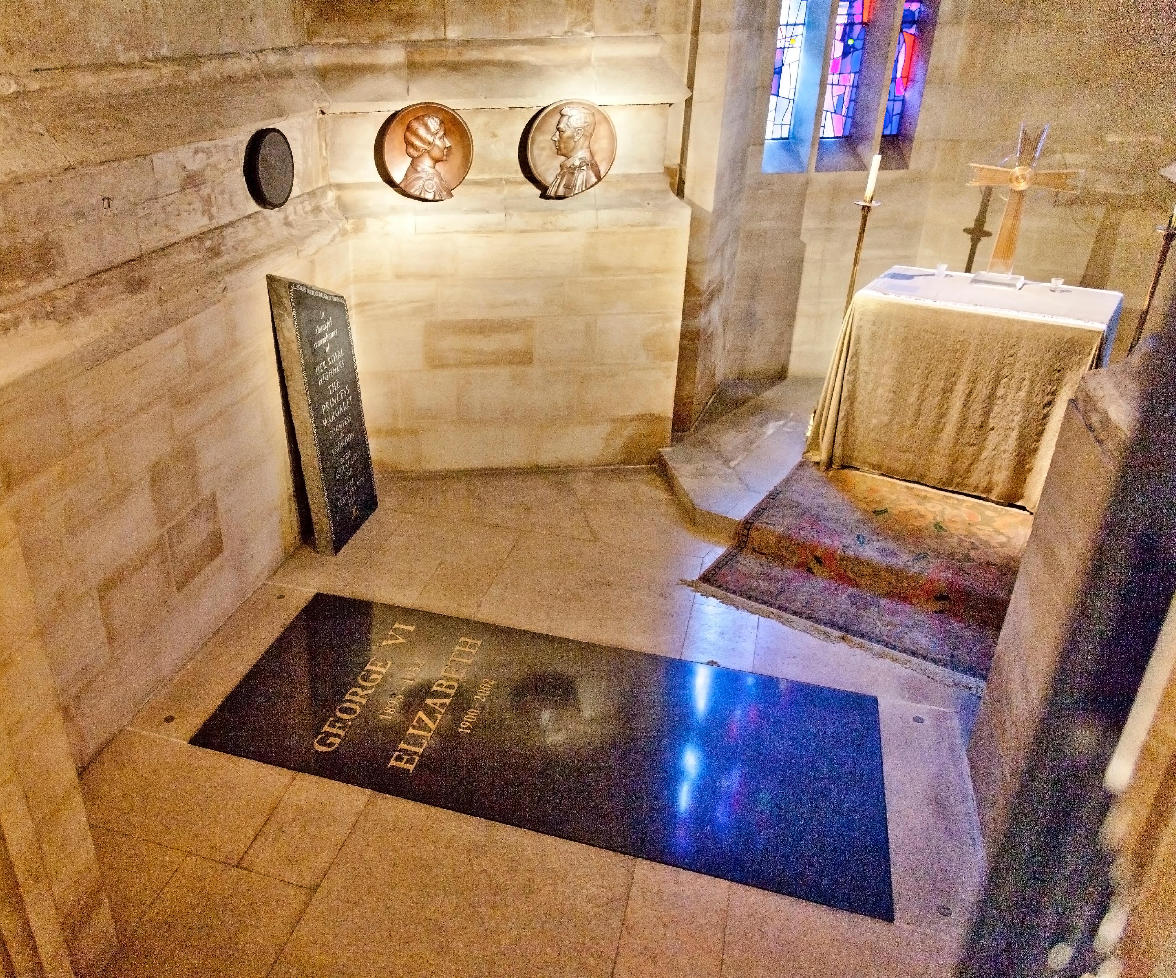
Burial
Learning
Notes:
Teacher: Until 1760, kings and queens were often buried at Westminster Abbey. This photograph shows the tomb of Henry VII, the first of the Tudor kings, at Westminster Abbey. In more recent times, kings and queens tend to be buried at St George’s Chapel, Windsor Castle. King George VI and Queen Elizabeth The Queen Mother are buried side by side at St George’s Chapel, Windsor Castle. A stone marking the spot is more common now than a big stone tomb. Their daughter, Queen Elizabeth II, will be buried near her parents and near her husband Prince Phillip.
Images:
Henry VII tomb – ©Dean & Chapter of Westminster
George VI and Queen Elizabeth The Queen Mother’s memorial chapel at Windsor – ©Alamy Stock Photo

Slide 11
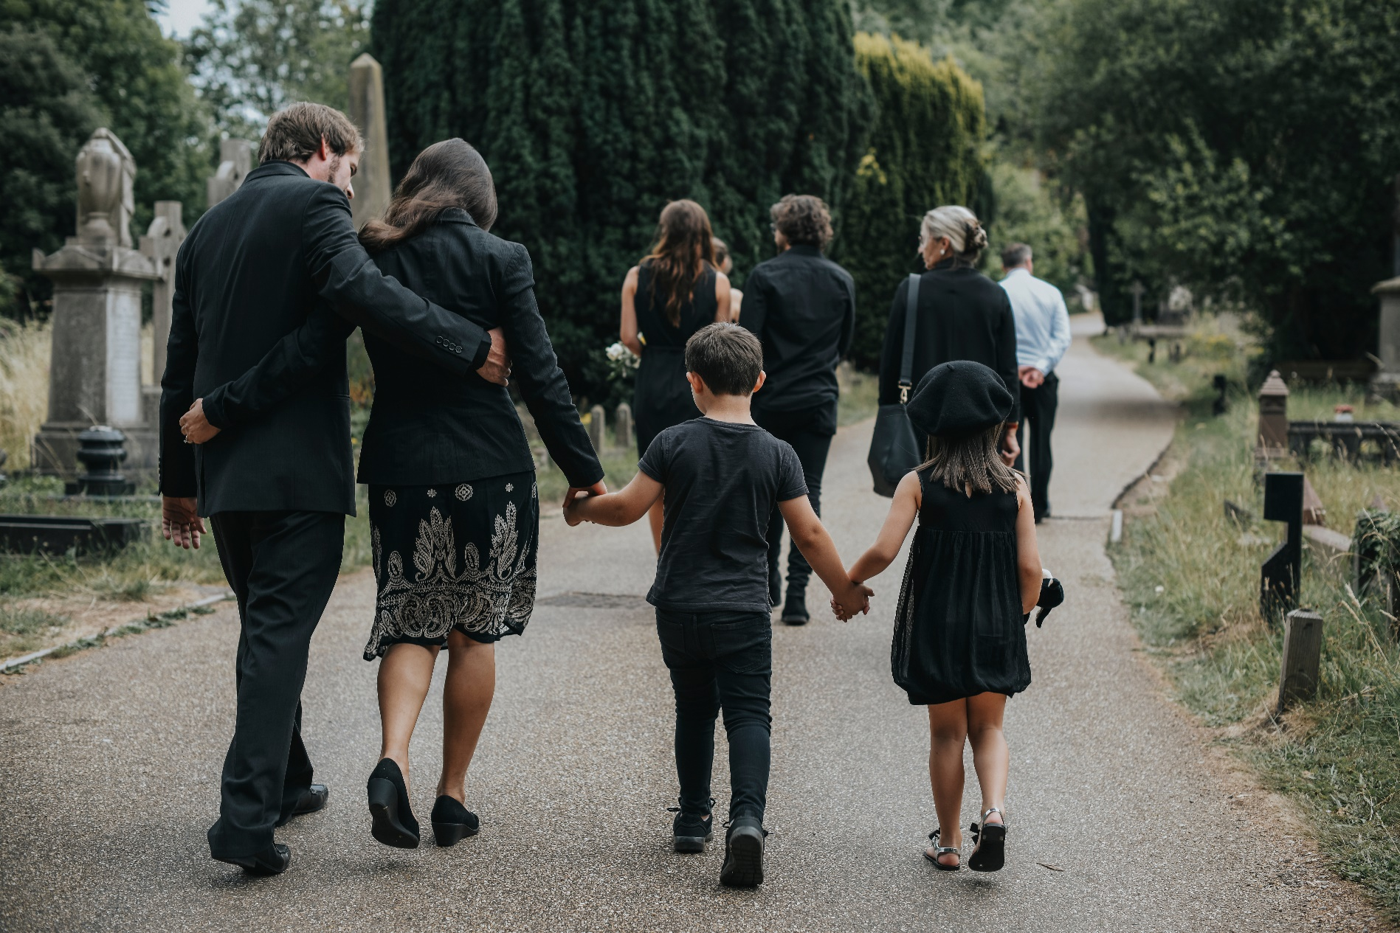
Learning
Notes:
Teacher: Funerals are sad events because a person has died and will be missed by family and friends. This sadness and grief is reflected in the way that people move, speak and even dress. On hearing the news of King George VI’s death, shops, theatres and cinemas across the country closed down, dances were cancelled, major sporting events were postponed. People wore black clothes. We call this ‘mourning’. People were mourning for the king. They wanted to show their sadness and they wanted to show respect, just as we do at funerals for our family and friends.
Image: Shutterstock

Slide 12
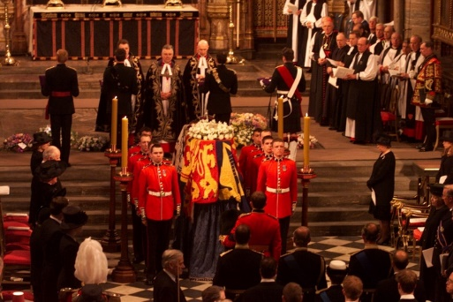
Learning
Listen to one of the hymns sung at Queen Elizabeth The Queen Mother’s funeral at Westminster Abbey in 2002.
Notes:
Set up: Clip- Start at 45:38. Hymn ends at 48:12.
Teacher: Funerals are also full of hope. Christians believe that Jesus died on the cross so that people could have eternal life. This means life in heaven even after they have died on earth. The Christian funeral service for the monarch is almost the same as that for any other Christian person. The same words from the Bible are spoken, the Lord’s prayer is said and hymns are sung. When Queen Elizabeth The Queen Mother died at the age of 101, the funeral service was full of hope and grateful thanks for her long life of public service and duty. Listen to the hymn that was sung at her funeral service. Think about how it makes you feel.
Image:
Photo: Andrew Dunsmore – ©Dean & Chapter of Westminster

Slide 13
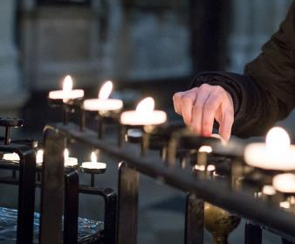

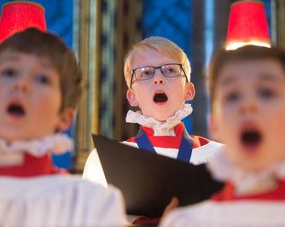
What happens at a Christian funeral?
Learning
Candles are lit
The Paschal (Easter) candle is lit to remind people that when Jesus died, he rose again and promised everlasting life to those who believe in him. The light of the candle represents Jesus and so brings hope to a dark world.
Prayers are said
Many Christians pray for the soul of the person who has died. These include prayers thanking God for the life of the person who has died, prayers asking for God’s comfort on those who mourn and the Lord’s Prayer. This is the prayer that Jesus said after his friends asked him how to pray.
Music is heard
Music is often a very important part of a funeral service. Hymns are songs that praise God and often contain words from the Bible. Music can help people to release feelings and can be very healing.
Notes:
Teacher: These are some of the things you might see or hear at a Christian funeral.
Candles
You could also discuss with your students that the Paschal Candle is first lit every year during the night before Easter and that it symbolises new, resurrection life which is indestructible.
Prayer
The Lord’s Prayer is always said at a Christian funeral.
Our Father in heaven,
hallowed be your name,
your kingdom come,
your will be done,
on earth as in heaven.
Give us today our daily bread.
Forgive us our sins
as we forgive those who sin against us.
Lead us not into temptation
but deliver us from evil.
For the kingdom, the power,
and the glory are yours
now and for ever. Amen.
Music
If time, play the hymn ‘The Lord bless you and keep you’, which is often played at funerals. https://www.youtube.com/watch?v=lZN1mryHEnQ&t=43s Ask your students how this type of music makes them feel.
Images:
Candles – ©Dean & Chapter of Westminster
Praying - Photo by Naassom Azevedo on Unsplash
Choir singing – ©Dean & Chapter of Westminster

Slide 14
What happens at a Christian funeral?
Learning
A funeral takes place in the presence of the coffin, which is then taken for burial or cremation.
Bible readings are selected to remind mourners of Jesus’s promise about life after death as a way to offer support as they grieve.
The priest, a friend or a relative will talk about the life of the person who has died and give thanks for it. This is called a eulogy.
Prayers are offered for the person who has died, for their family and friends, and for the gift of hope and faith in Jesus Christ.
“I am the resurrection and the life. Those who believe in me, even though they die, will live, and everyone who lives and believes in me will never die”
John 11:25-26
At the end of the funeral, the priest asks God to look after the person who has died using the words: ’We commit this body to the ground, earth to earth, ashes to ashes, dust to dust; in sure and certain hope of the Resurrection to eternal life through our Lord Jesus Christ’.
Notes:
Teacher: Along with a eulogy, Bible readings are an essential part of Christian funerals. These words, from John 11:25-26 are used at the start of every Christian funeral service. How do they make you feel?
“Blessed are those who mourn, for they will be comforted” (Matthew 5:4) is often read at funerals also.
Although a funeral happens after a person has died, Christian funerals place a lot of emphasis on life.
Christians believe that death is not the end, and that through Jesus everyone can have eternal life. In other words, life goes on even though it is a different life from the life on earth. There is a strong message of hope at every Christian funeral service.

Slide 15
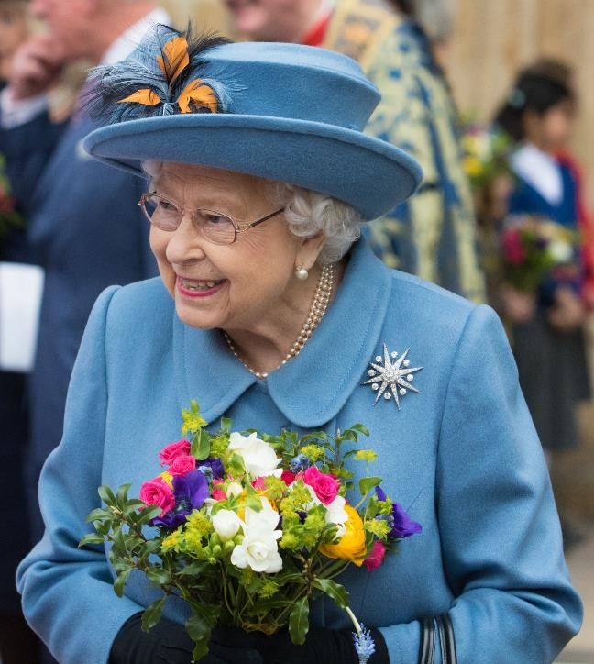
Learning
‘I declare before you all that my whole life whether it be long or short shall be devoted to your service’
Queen Elizabeth II, radio broadcast 1947
Notes:
Teacher: Queen Elizabeth II was our Queen for 70 years. She tried her best every day to keep the promise she made on her 21st birthday. Her life was a long one, her reign was the longest in British history. Queen Elizabeth II was known for her strong sense of duty and hard work. Throughout her life she visited charities and other organisations, checked government papers daily, hosted visits from Heads of State and led the nation in celebrations and commemorations. She made a commitment to devote herself to the service of her people and she maintained that commitment to the end of her life.
Let’s now sit quietly for a few minutes together and reflect on the life of Queen Elizabeth II and on the things we have talked about today. If anyone wishes to pray, this is a good time. If you prefer to just sit quietly that is fine too. Do stay behind at the end of the assembly if you want to talk further.
Image:
©Dean & Chapter of Westminster

