Slide 1
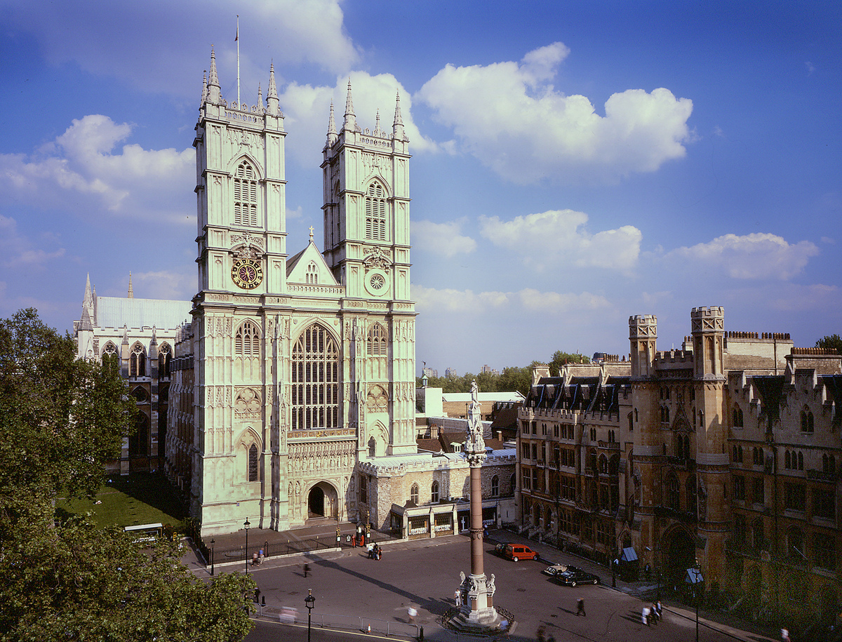

Westminster Abbey
Learning
Why are there lots of candles in church?
©2020 Dean and Chapter of Westminster
1
Notes:
Image:
©2021 Dean & Chapter of Westminster
Please be aware that these images are for educational use only in the classroom and should not be reproduced online.

Slide 2
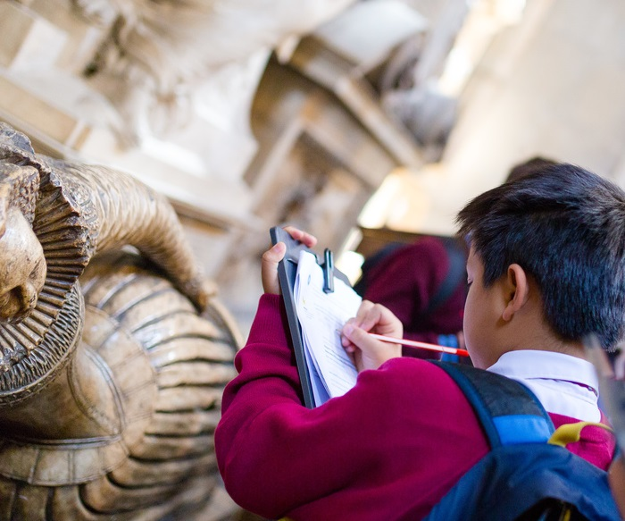
Westminster Abbey
Learning
Information for teachers
Thank you for downloading this resource. We hope that it will be a useful teaching tool in your classroom.
As we continue to grow our free catalogue of teaching resources, we’d really appreciate a few minutes of your time to let us know what you liked and what could be improved. Please complete this five-question survey.
2
Notes:
Image:
©2021 Dean & Chapter of Westminster

Slide 3
Learning
Today, we’re thinking about light. Light is part of our lives as it helps us to see. This can be natural light from the sun, the stars or fire. It can also be man-made light, such as lightbulbs and torches. Look around where you are. What light can you see?
When we think about light in church we often think of candles. Churches like Westminster Abbey have large stained-glass windows and electric lighting, so candles aren’t really about providing light anymore. Instead, they have a symbolic meaning. Sometimes candles are used during worship, where large candles are lit during a service. Or sometimes candles can be lit privately by one person, as they take a moment to think and reflect.
Whether the candle is large or small, Christians believe that the light is very important. In the Bible, we learn that on the first day of Creation, God said “Let there be light” and Christians believe that the light from the candle represents the light of God. For Christians, lighting a candle helps them with their faith and seeing the power of God. How does light make you feel?

Slide 4
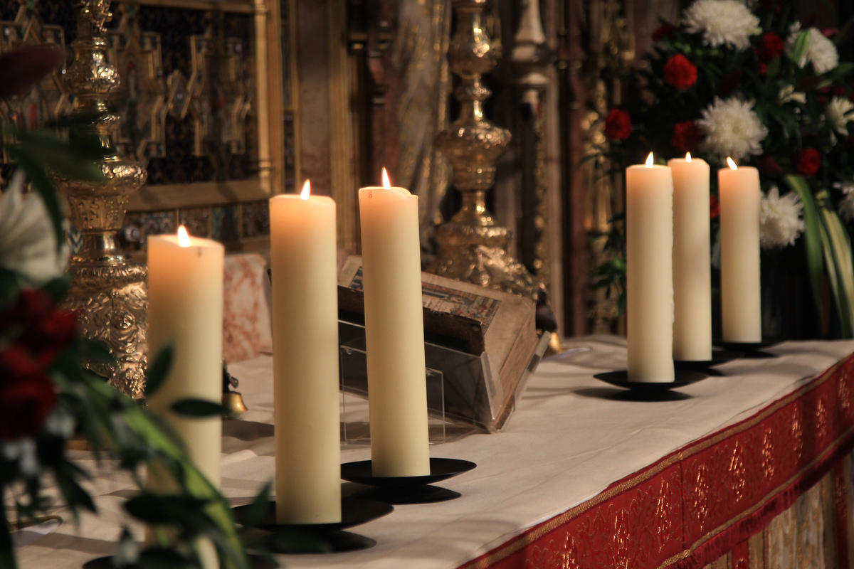
Learning
Notes:
Candles
Image:
©2021 Dean & Chapter of Westminster
Please be aware that these images are for educational use only in the classroom and should not be reproduced online.

Slide 5
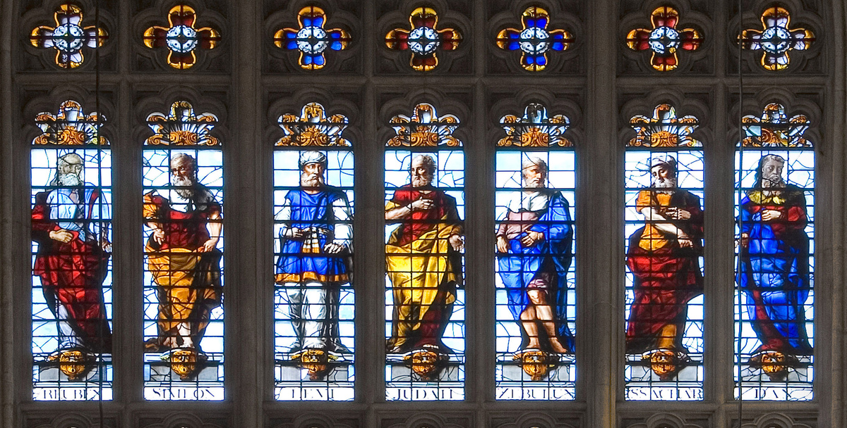
Learning
Notes:
Stained-glass windows
Image:
©2021 Dean & Chapter of Westminster
Please be aware that these images are for educational use only in the classroom and should not be reproduced online.

Slide 6
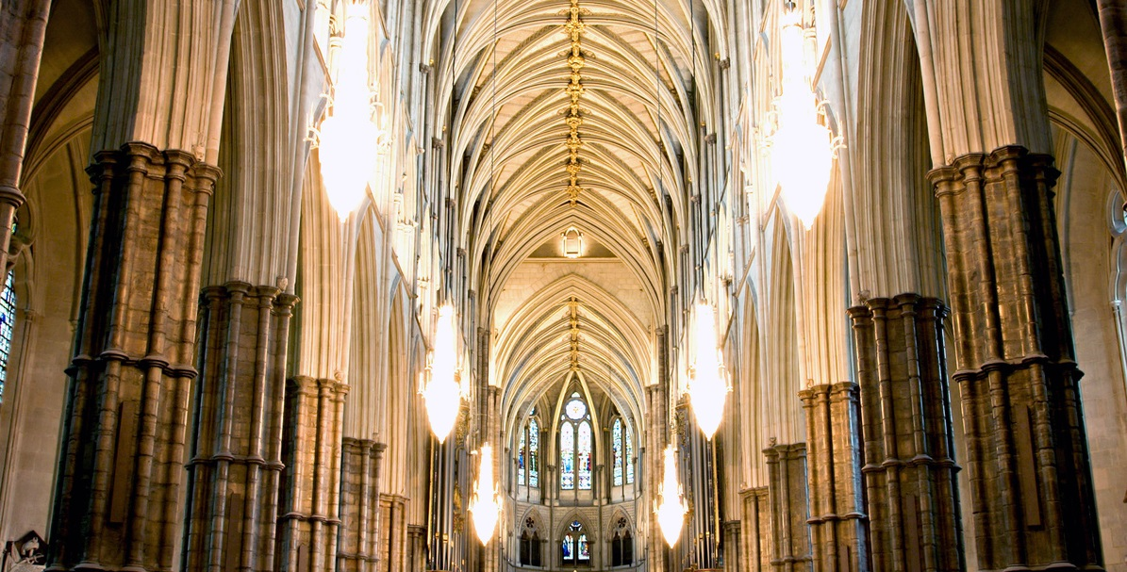
Learning
Notes:
Electric lights in the Nave
Image:
©2021 Dean & Chapter of Westminster
Please be aware that these images are for educational use only in the classroom and should not be reproduced online.

Slide 7
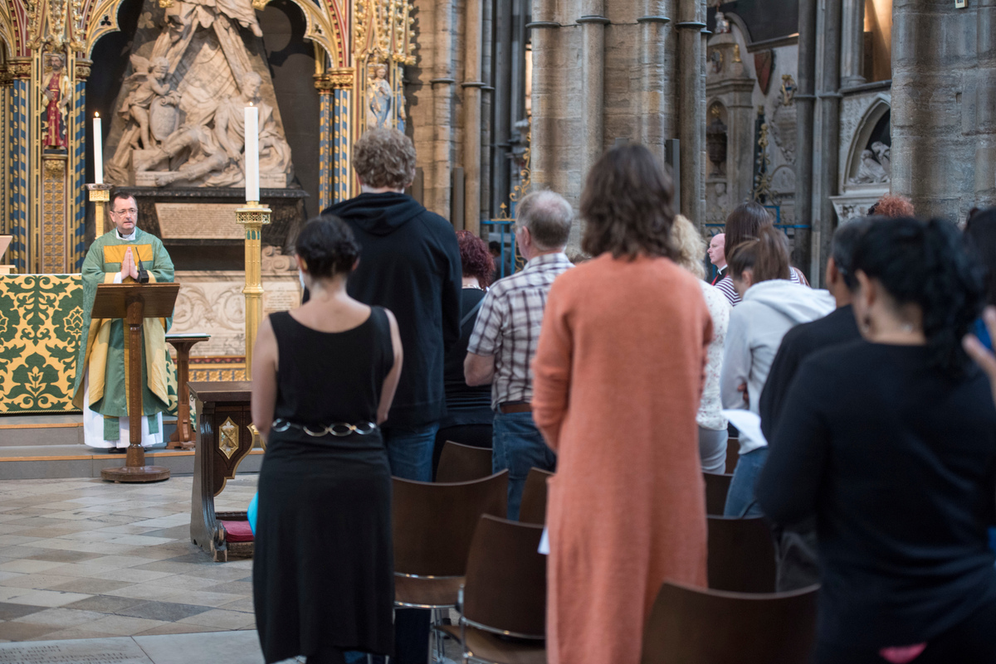
Learning
Notes:
Congregation during a service
Image:
©2021 Dean & Chapter of Westminster
Please be aware that these images are for educational use only in the classroom and should not be reproduced online.

Slide 8
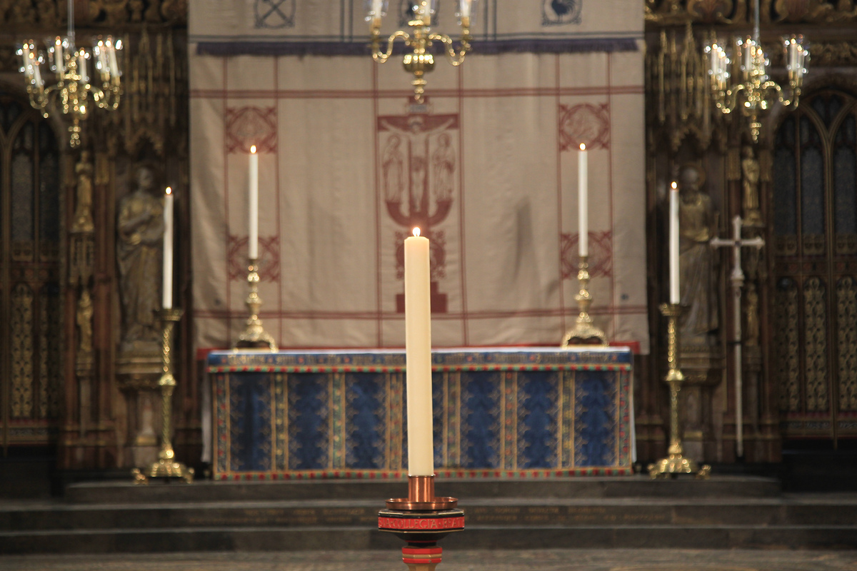
Learning
Notes:
The Candle of Hope
Image:
©2021 Dean & Chapter of Westminster
Please be aware that these images are for educational use only in the classroom and should not be reproduced online.

Slide 9
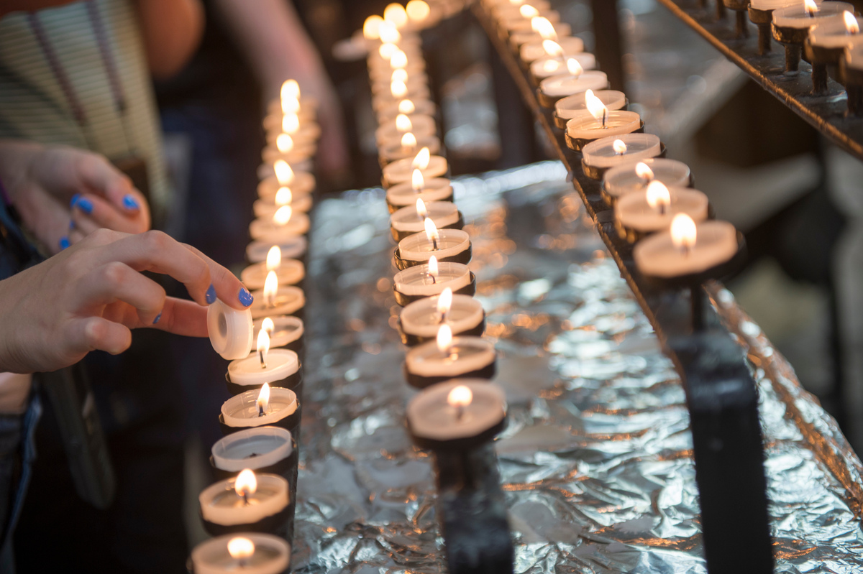
Learning
Notes:
Candles being lit
Image:
©2021 Dean & Chapter of Westminster
Please be aware that these images are for educational use only in the classroom and should not be reproduced online.

Slide 10
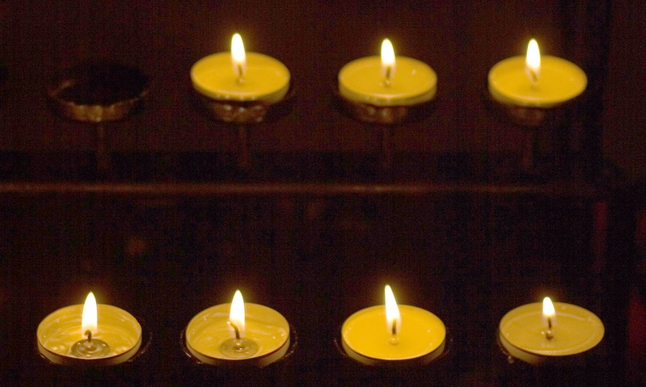
Learning
Notes:
Candles
Image:
©2021 Dean & Chapter of Westminster
Please be aware that these images are for educational use only in the classroom and should not be reproduced online.

Slide 11
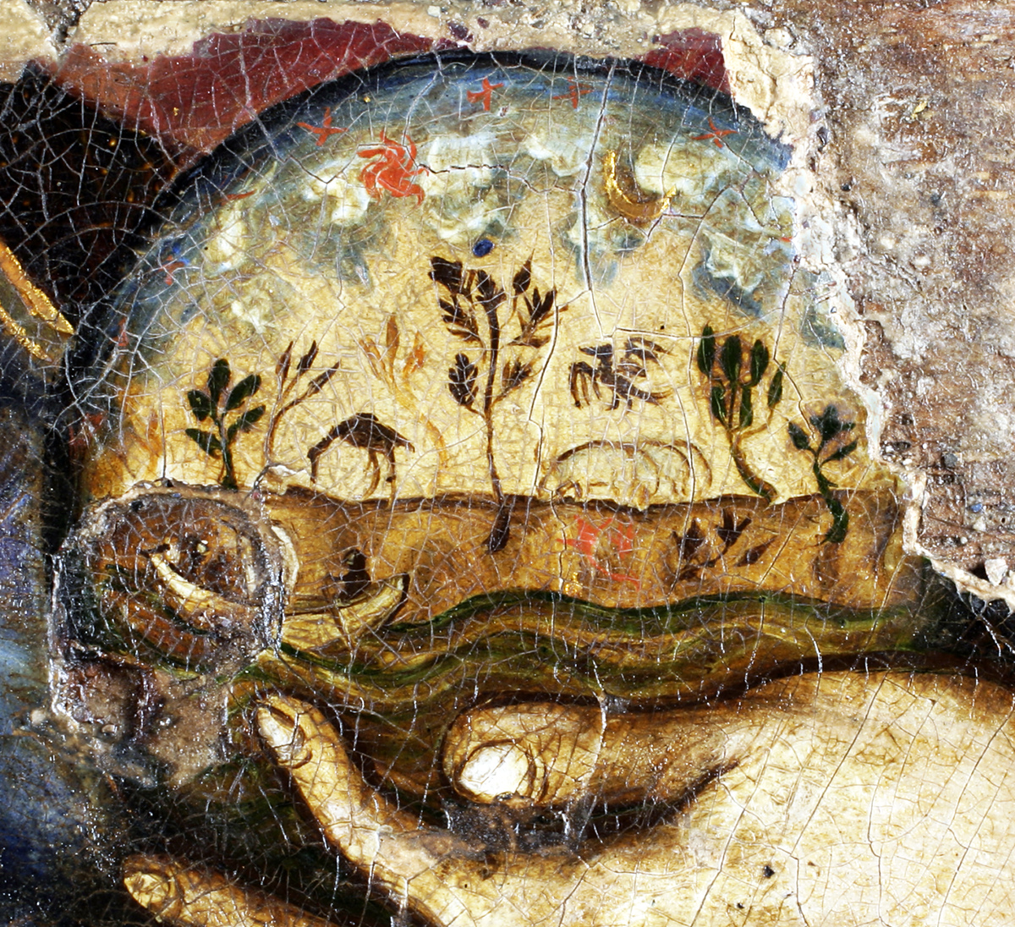
Learning
Notes:
Globe in Christ’s hand on Westminster Retable
Image:
©2021 Dean & Chapter of Westminster
Please be aware that these images are for educational use only in the classroom and should not be reproduced online.

Slide 12
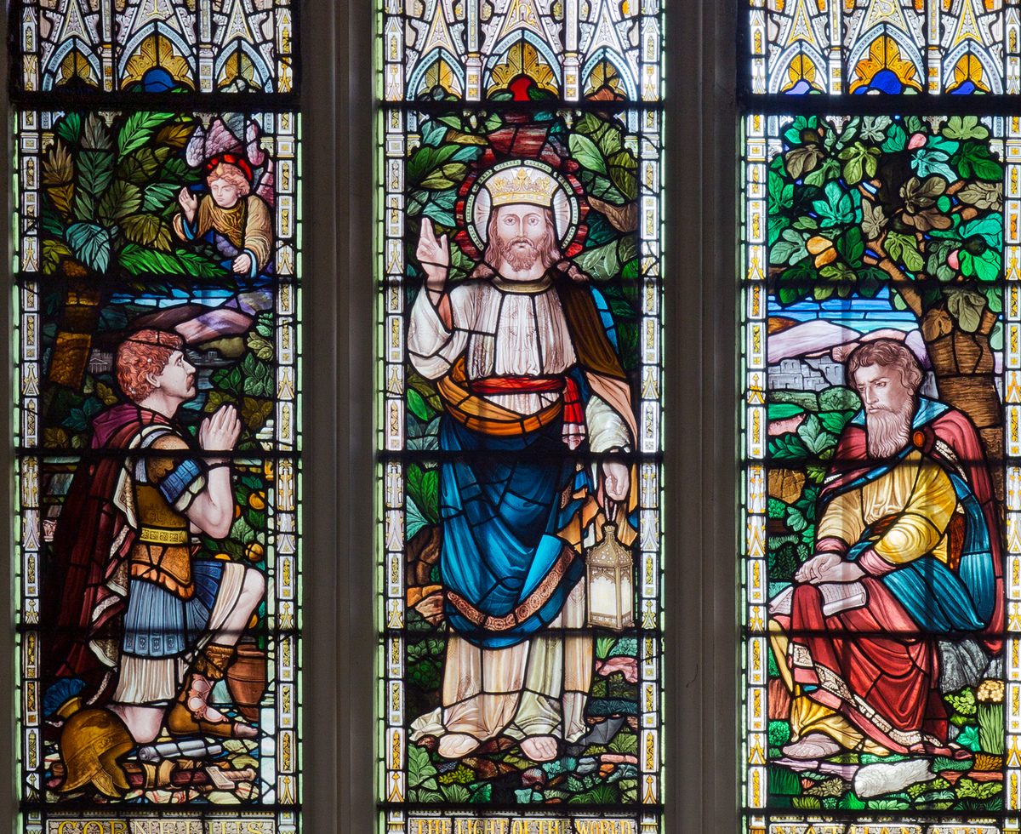
Learning
Notes:
Light of the World stained-glass window in St Margaret’s Church, next to Westminster Abbey
Image:
©2021 Dean & Chapter of Westminster
Please be aware that these images are for educational use only in the classroom and should not be reproduced online.

Slide 13
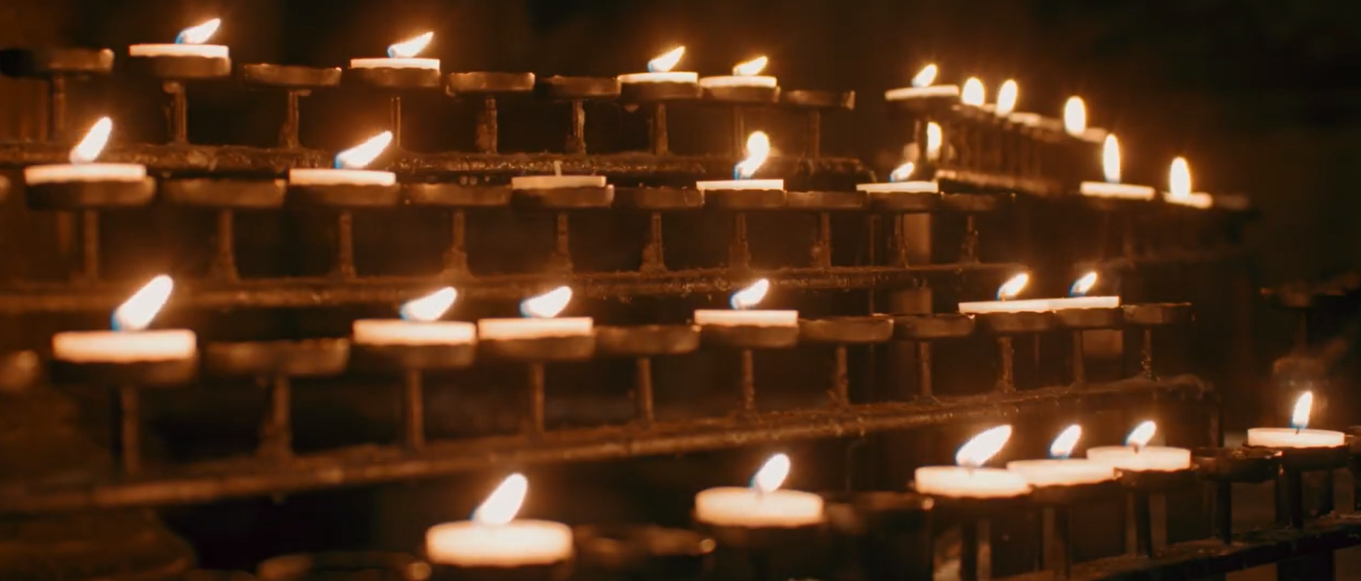
Learning
Notes:
Candles
Image:
©2021 Dean & Chapter of Westminster
Please be aware that these images are for educational use only in the classroom and should not be reproduced online.

