Slide 1
Westminster Abbey
Learning
Examining Royal Funerals
KS3 lesson
©Dean and Chapter of Westminster
1
Notes:
Image:
©Dean & Chapter of Westminster

Slide 2
Learning
Learning objectives:
To find out about modern Royal Funerals (state and ceremonial)
To learn how Royal Funerals have evolved over time
To use historical sources to understand change in Royal Funerals

Slide 3
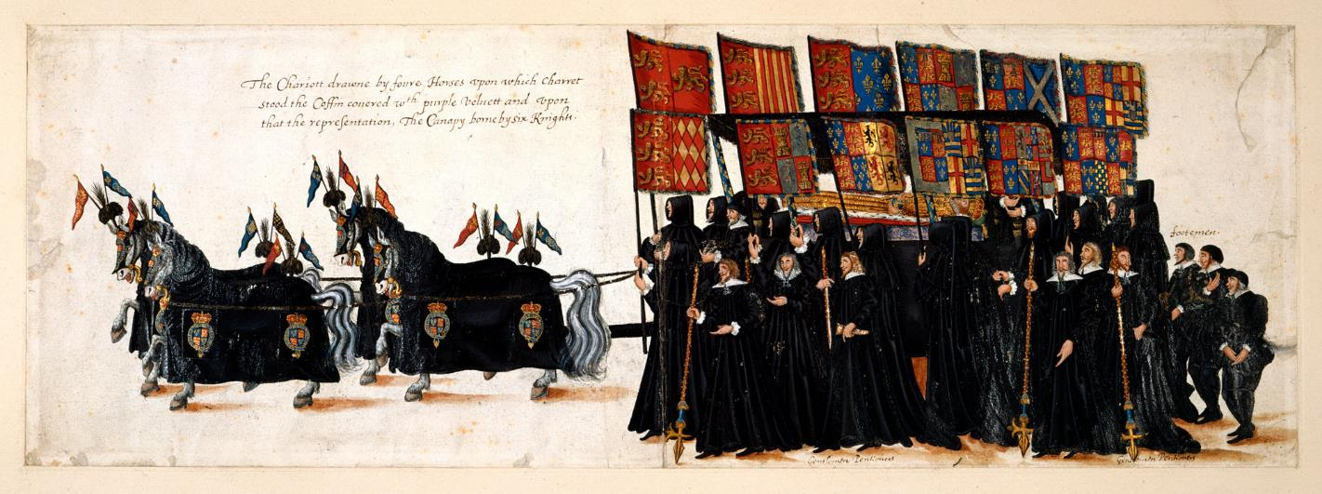
How do we know about Royal Funerals in the past?
Learning
Think:
What can you learn about the funeral of Queen Elizabeth I from this image?
Notes:
Teachers notes:
The image depicts the funeral procession of Queen Elizabeth I to Westminster Abbey in 1603, over four hundred years ago.
The funeral was lavish, thousands turned out to pay their respects, to see Queen Elizabeth I’s lifelike effigy and to watch her coffin enter Westminster Abbey for the funeral and burial.
The drawing may be the work of William Camden. He wrote a book about the life of Queen Elizabeth I. He started working on the book in 1608. This is one image from a collection of images showing Queen Elizabeth I’s funeral procession. The sequence of images works like a storyboard- it tells the story of the funeral with pictures.
We can see the effigy of Queen Elizabeth I resting on top of the coffin. The effigy was made to look extremely lifelike. Effigies of kings and queens were made throughout the Medieval and Tudor period. They were a focal point of the Royal Funeral and were exhibited inside Westminster Abbey for weeks after the funeral.
Students could discuss what the image doesn’t tell us- for example how people were feeling. The Tudor chronicler John Stow described people as ‘sighing, groaning and weeping as the like hath not been seen or known in the memory of man’.
Image:
The British Library, [Add MS 35324, f. 37v] - https://www.bl.uk/collection-items/drawings-of-the-funeral-procession-of-elizabeth-I

Slide 4
Learning
Activity:
What types of historical sources could we use to find out about the funeral of Queen Elizabeth I?
Think about the kind of information each source would give you.
Type of source | Type of information
Drawing of the funeral procession | What people wore, how the funeral procession was organised, what the coffin looked like (Effigy on top of the coffin)
? | ?
? | ?
? | ?
Notes:
Teachers notes: This is a quick activity to get students thinking about historical sources and what was and wasn’t available in the 16th century. Answers may include: diaries; drawings; eye-witness accounts; church records from the funeral service

Slide 5
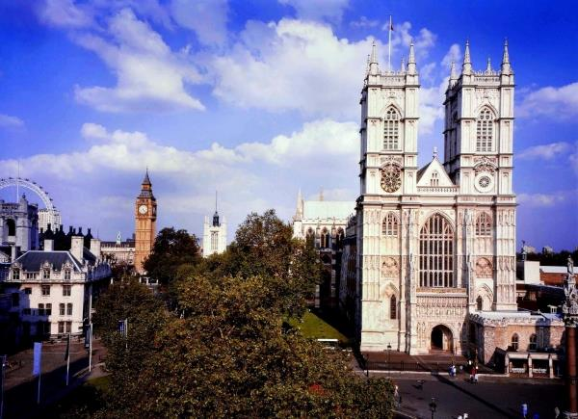
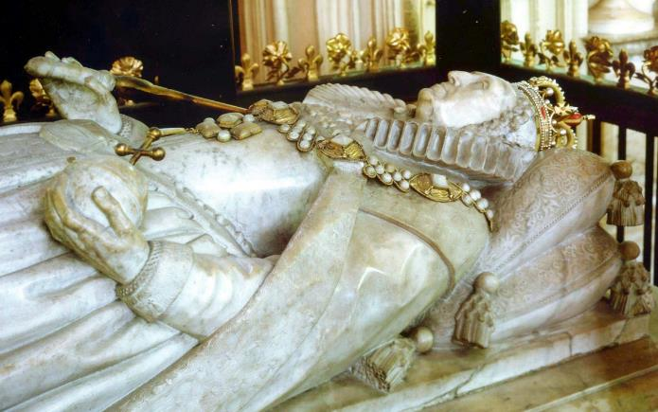
Learning
In the past kings and queens were often buried at Westminster Abbey.
Thirty kings and queens are buried there, including Queen Elizabeth I.
Royal Funerals have evolved since the time of Queen Elizabeth I. Some older traditions continue and others are new.
Notes:
Images:
Westminster Abbey – ©Dean & Chapter of Westminster
Elizabeth I tomb – ©Dean & Chapter of Westminster

Slide 6
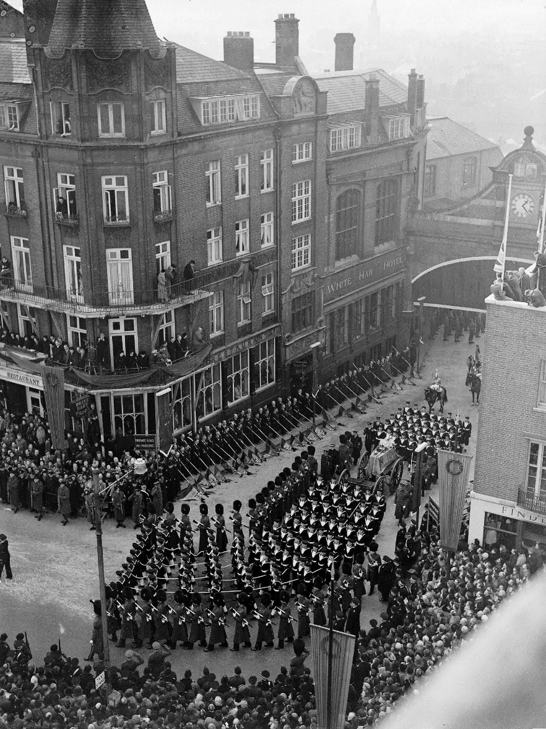
Learning
How do we know about Royal Funerals in modern times?
Think:
What can you learn about the funeral of King George VI from this image?
Notes:
Teachers notes:
King George VI died in 1952. Parts of his funeral were televised. Many people rushed out to buy televisions so that they could watch the event at home.
On hearing the news of King George VI’s death, shops, theatres and cinemas across the country closed down. On the day of the funeral, thousands of people lined the streets to pay their respects to the king who had led the country through the Second World War.
This photograph shows the royal funeral procession.
King George VI’s coffin was placed on a gun carriage and the carriage was pulled by sailors from the Royal Navy.
This tradition dates back to Queen Victoria’s funeral when some fittings connecting the horses to the gun carriage broke. Men from the Royal Navy stepped in to haul the carriage to its destination. From then on, State Funerals have followed this tradition.
King George VI’s funeral and burial both took place at St George’s Chapel, Windsor Castle. From the 18th century onwards, the funeral and burial of a monarch has nearly always taken place at St George’s Chapel, Windsor Castle as opposed to Westminster Abbey where many medieval, Tudor and Stuart monarchs are buried.
Image:
George VI’s state funeral – ©Alamy Stock Photo

Slide 7
Learning
Activity:
What types of historical sources could we use to find out about Royal Funerals in modern times?
Think about the kind of information each source would give you.
Type of source | Type of information
Photograph of funeral procession | What people wore, how the funeral procession was organised- sailors pulled the gun carriage, what the coffin looked like (a crown rested on the coffin)
? | ?
? | ?
? | ?
Notes:
Teachers notes: This is a quick activity to get students thinking about historical sources which are available today.
Answers may include all the same sources as were available in the time of Queen Elizabeth I plus: television footage; photographs; newspaper reports; recorded interviews; worldwide perspective, including the reaction of Commonwealth countries.

Slide 8
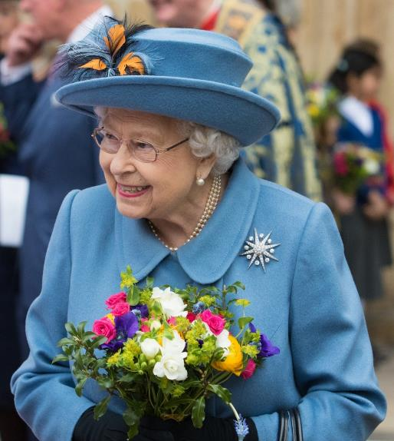
Learning
Types of Royal Funeral
There are two types of royal funerals.
A State Funeral is given to the Sovereign (the ruling king or queen).
A Ceremonial Funeral is given to other senior members of the royal family.
A State Funeral must be agreed by Parliament.
A Ceremonial Funeral only needs the agreement of the Sovereign.
Queen Elizabeth II’s funeral was planned many years ago.
Plans were drawn up and known as ‘London Bridge’.
Queen Elizabeth II was the Sovereign and so she will be given a State Funeral.
Notes:
Image:
©Dean & Chapter of Westminster

Slide 9
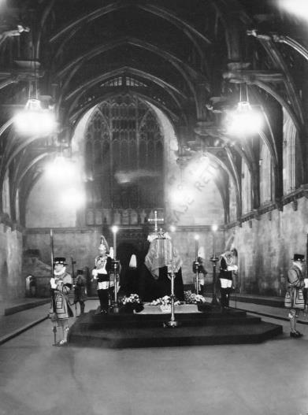
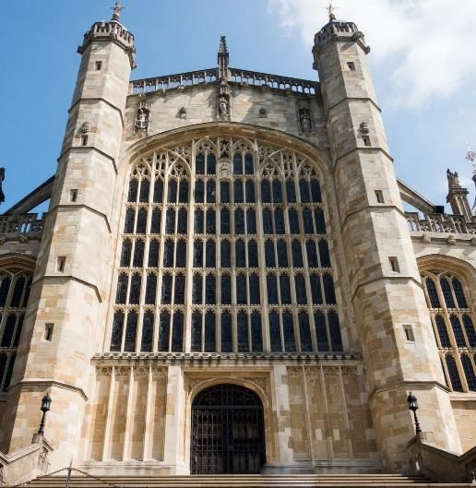
Learning
What happens at modern State Funerals?
State Funerals have followed a similar pattern over the last one hundred years.
The last State Funeral of a Sovereign took place in 1952 when Queen Elizabeth II’s father, King George VI died. Queen Elizabeth II’s funeral will follow a similar pattern to that of her father’s.
The photographs help to explain the different stages of a modern State Funeral.
Notes:
Teacher:
Understanding what happened at King George VI’s funeral will help us to understand what will happen at the funeral of Queen Elizabeth II.
First King George VI’s coffin was placed inside Westminster Hall for the ‘lying in state’. For three days, members of the public came to pay their respects and sign their name in a special book.
Next, the coffin was placed on a gun carriage and taken from Westminster Hall to Paddington Station, London before being transported to Windsor by train. This royal funeral procession took several hours and thousands of people stood still to watch sailors pulling the gun carriage along the roads, as King George VI’s coffin made its last journey through the streets of London.
Finally, King George VI was given a Christian funeral service and burial at St George’s Chapel, Windsor Castle.
The funeral of the Sovereign is always a Christian funeral service because the Sovereign is the Supreme Governor of the Church of England.
Images:
George VI lying in state - Royal Collection Trust / © Her Majesty Queen Elizabeth II 2022 www.rct.uk/collection/2000811
George VI’s state funeral – ©Alamy Stock Photo
St George’s Chapel, Windsor – Image by astize from Pixabay

Slide 10
Learning
How will people today record the funeral of Queen Elizabeth II?
The funeral of Queen Elizabeth II will have worldwide significance. Queen Elizabeth II was the longest reigning monarch this country has ever had.
She was Queen of the UK and 14 Commonwealth Realms.
You are living through this historic event.
Social media didn’t exist at the time of King George VI's death in 1952.
Many people will use social media to discuss the funeral of Queen Elizabeth II and the impact it had on them.
Think:
What impact has the death of Queen Elizabeth II and her funeral had on you, your friends and family?
What are the most important things about the funeral for the historians of the future to understand?

Slide 11
Learning
Activity:
Write an eye witness account of the funeral of Queen Elizabeth II and the impact it had on you.
If the funeral is yet to happen, focus on how you are feeling and what is going on in the run up to the event.
You could include the following:
Lying in state at Westminster Hall (Parliament)
Funeral at Westminster Abbey
Funeral procession through streets of London
Burial at St George’s Chapel, Windsor
Notes:
Teachers Notes: Students could choose the type of social media they like best and think about how best to convey their thoughts, feelings and observations through this medium.

