Slide 1
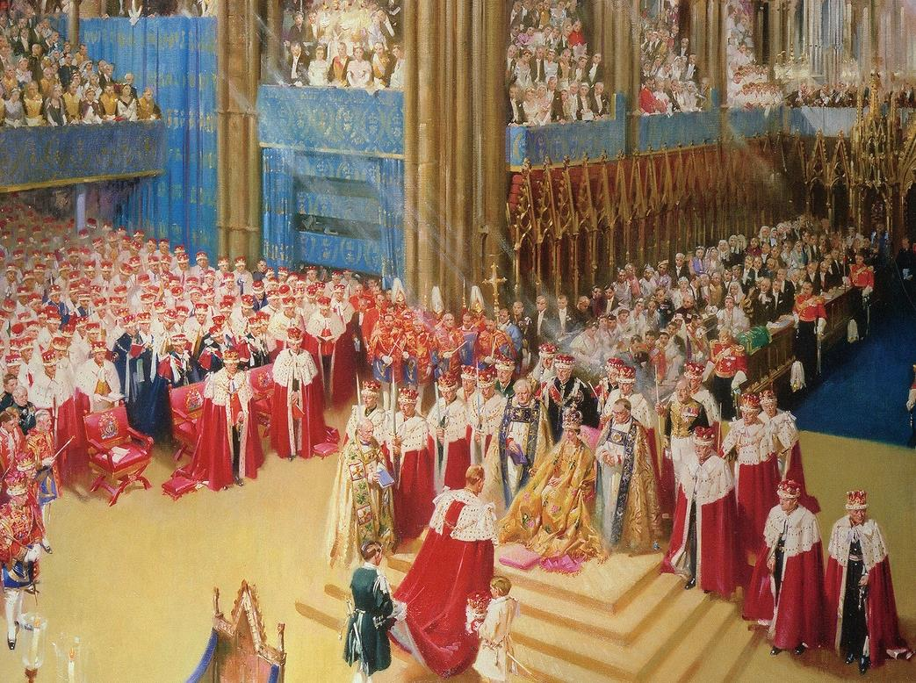

Westminster Abbey
Learning
Coronations image bank
©2023 Dean and Chapter of Westminster
1
Notes:
Image:
©2023 Dean & Chapter of Westminster
Please be aware that these images are for educational use only in the classroom and should not be reproduced online.

Slide 2
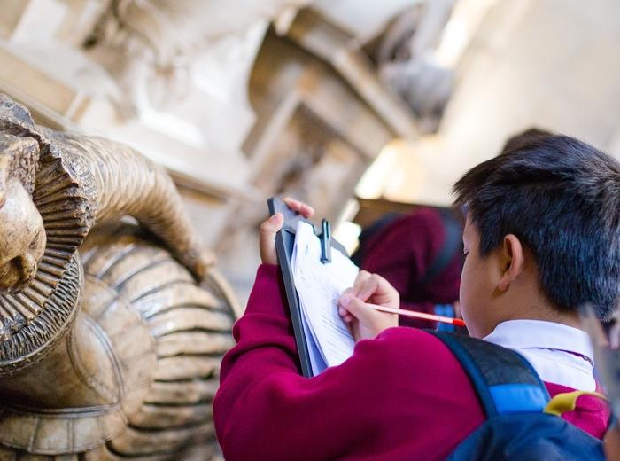
Westminster Abbey
Learning
Information for teachers
Thank you for downloading this resource. We hope that it will be a useful teaching tool in your classroom.
As we continue to grow our free catalogue of teaching resources, we’d really appreciate a few minutes of your time to let us know what you liked and what could be improved. Please complete this five-question survey.
2
Notes:
Image:
©2023 Dean & Chapter of Westminster
Please be aware that these images are for educational use only in the classroom and should not be reproduced online.

Slide 3
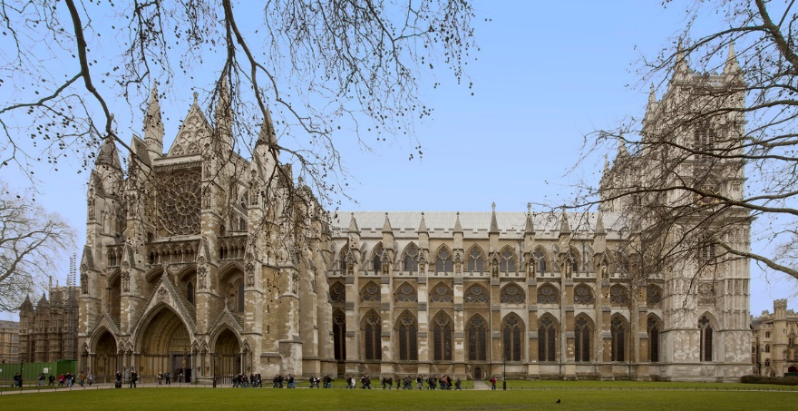
Learning
Notes:
North side of Westminster Abbey
Image:
©2023 Dean & Chapter of Westminster
Please be aware that these images are for educational use only in the classroom and should not be reproduced online.

Slide 4
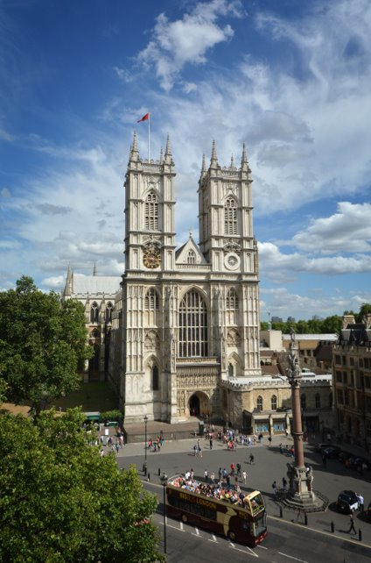
Learning
Notes:
West Front
Image:
©2023 Dean & Chapter of Westminster
Please be aware that these images are for educational use only in the classroom and should not be reproduced online.

Slide 5
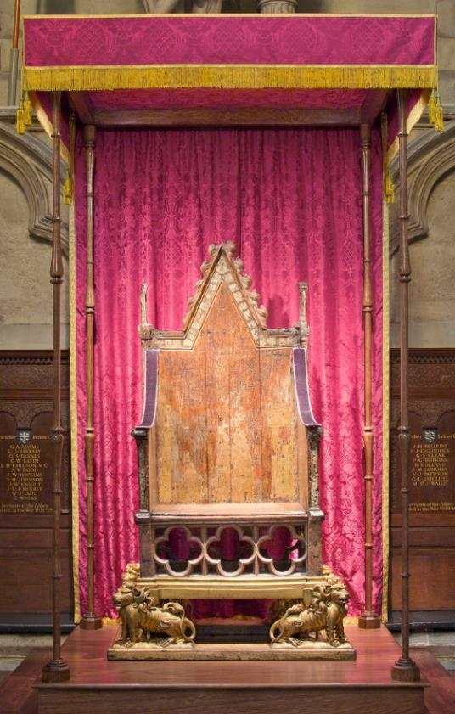
Learning
Notes:
Coronation chair
Image:
©2023 Dean & Chapter of Westminster
Please be aware that these images are for educational use only in the classroom and should not be reproduced online.

Slide 6
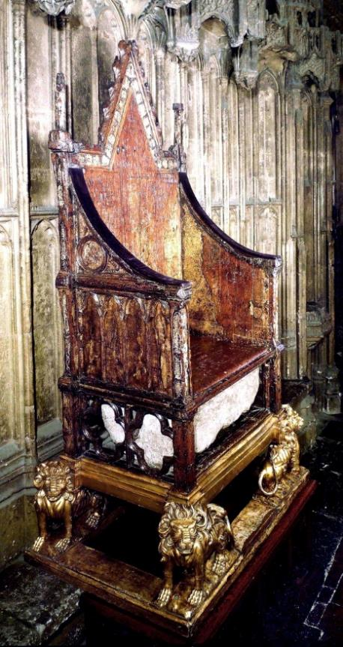
Learning
Notes:
Coronation chair, side on
Image:
©2023 Dean & Chapter of Westminster
Please be aware that these images are for educational use only in the classroom and should not be reproduced online.

Slide 7
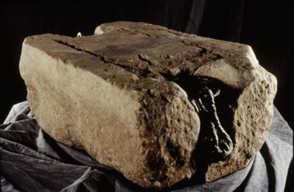
Learning
Notes:
Stone of Scone
Image:
©2023 Dean & Chapter of Westminster
Please be aware that these images are for educational use only in the classroom and should not be reproduced online.

Slide 8
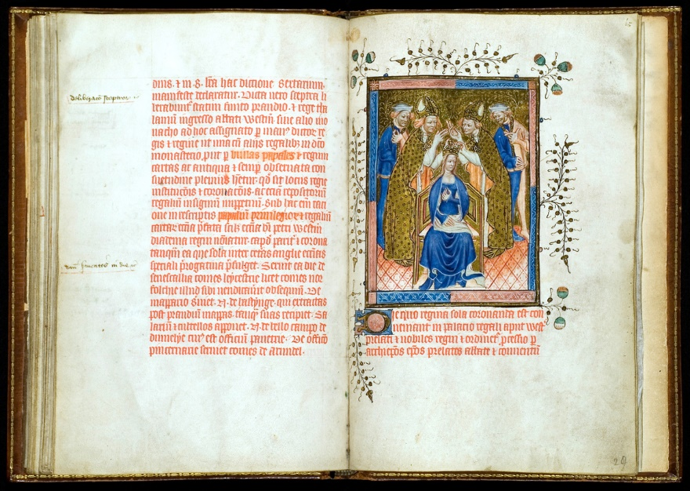
Learning
Notes:
Liber Regalis f.28v_29r
Image:
©2023 Dean & Chapter of Westminster
Please be aware that these images are for educational use only in the classroom and should not be reproduced online.

Slide 9
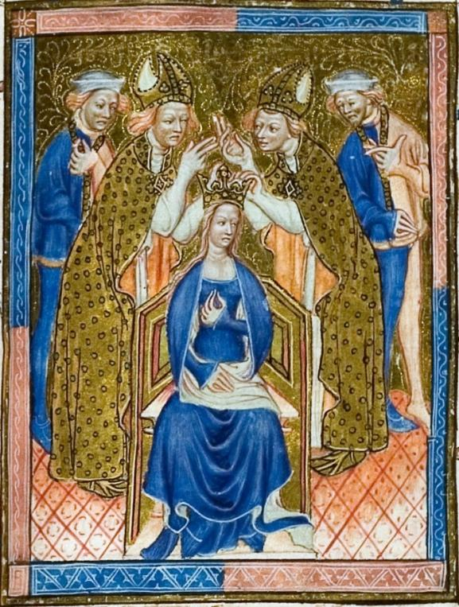
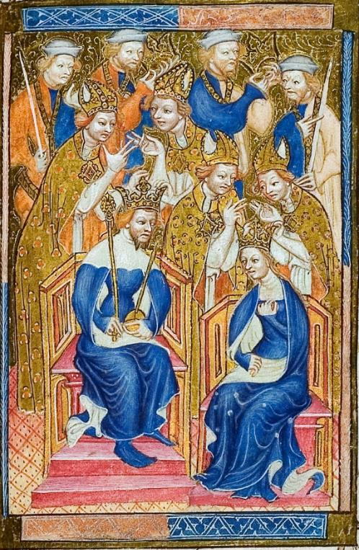
Learning
Notes:
Liber Regalis, close up
Image:
©2023 Dean & Chapter of Westminster
Please be aware that these images are for educational use only in the classroom and should not be reproduced online.

Slide 10
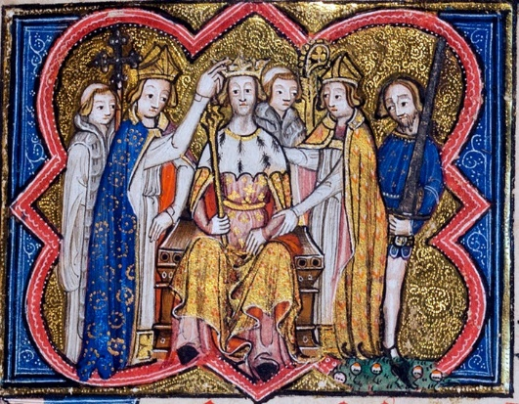
Learning
Notes:
Missal coronation initial
Image:
©2023 Dean & Chapter of Westminster
Please be aware that these images are for educational use only in the classroom and should not be reproduced online.

Slide 11
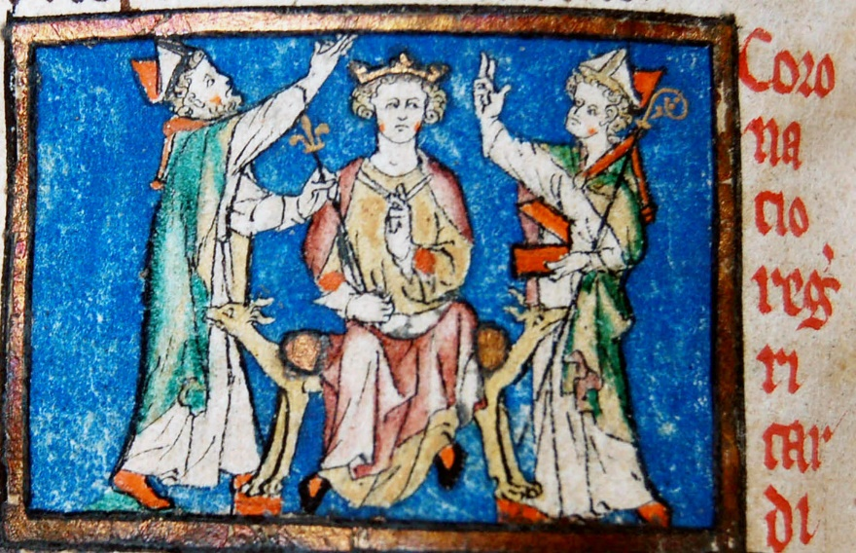
Learning
Notes:
Richard I coronation
Image:
©2023 Dean & Chapter of Westminster
Please be aware that these images are for educational use only in the classroom and should not be reproduced online.

Slide 12
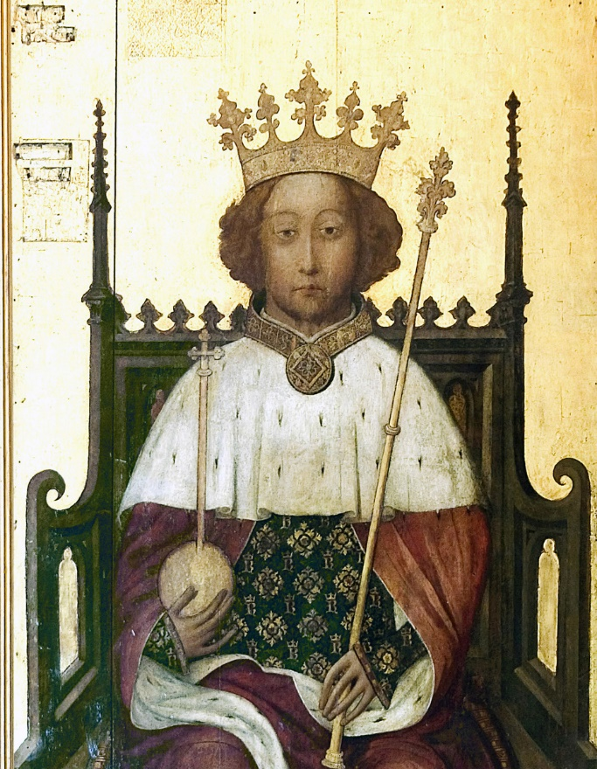
Learning
Notes:
Richard II portrait
Image:
©2023 Dean & Chapter of Westminster
Please be aware that these images are for educational use only in the classroom and should not be reproduced online.

Slide 13
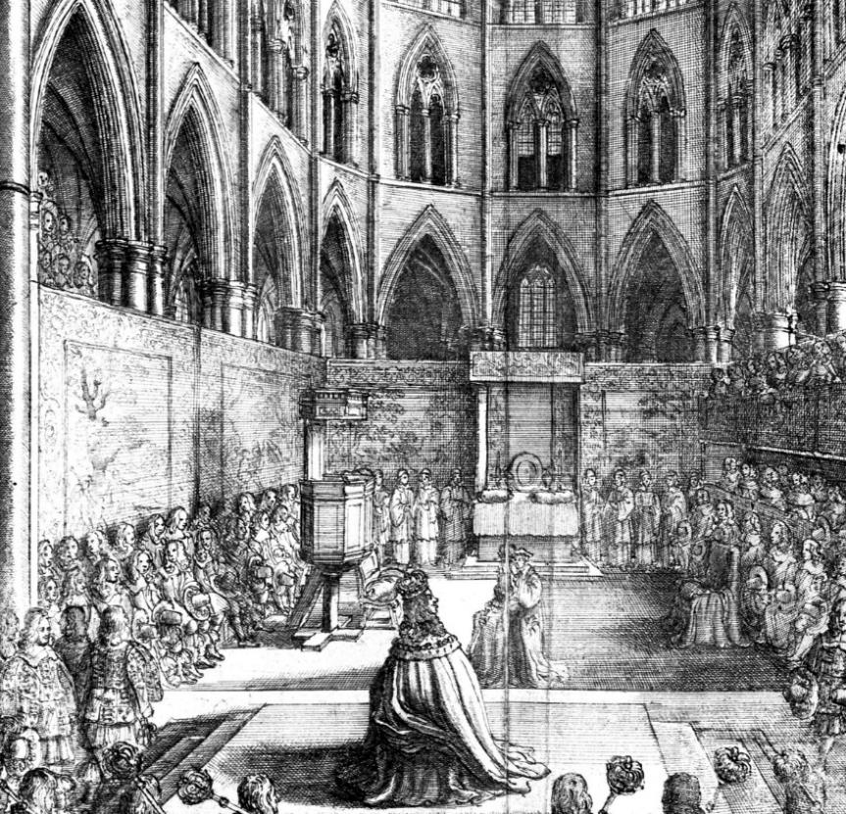
Learning
Notes:
Charles II coronation
Image:
©2023 Dean & Chapter of Westminster
Please be aware that these images are for educational use only in the classroom and should not be reproduced online.

Slide 14
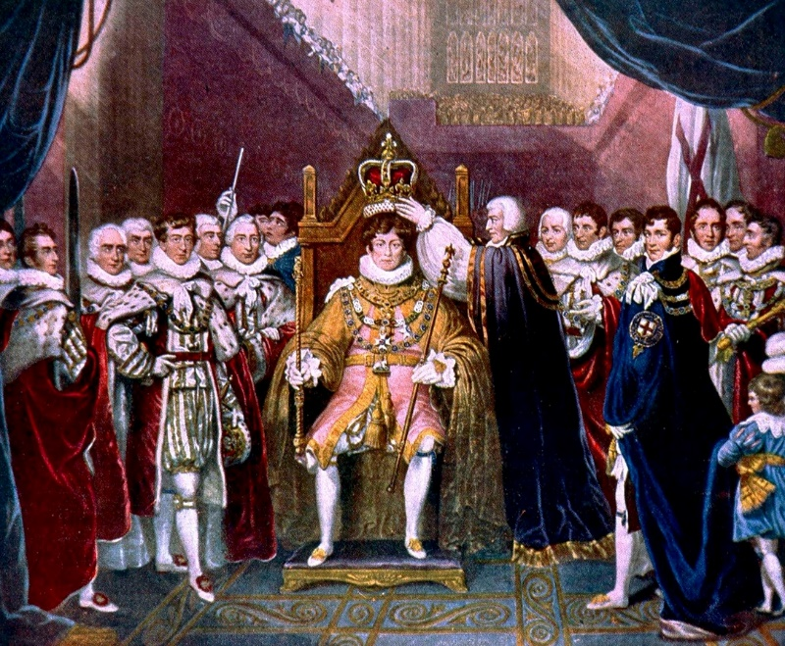
Learning
Notes:
George IV coronation
Image:
©2023 Dean & Chapter of Westminster
Please be aware that these images are for educational use only in the classroom and should not be reproduced online.

Slide 15
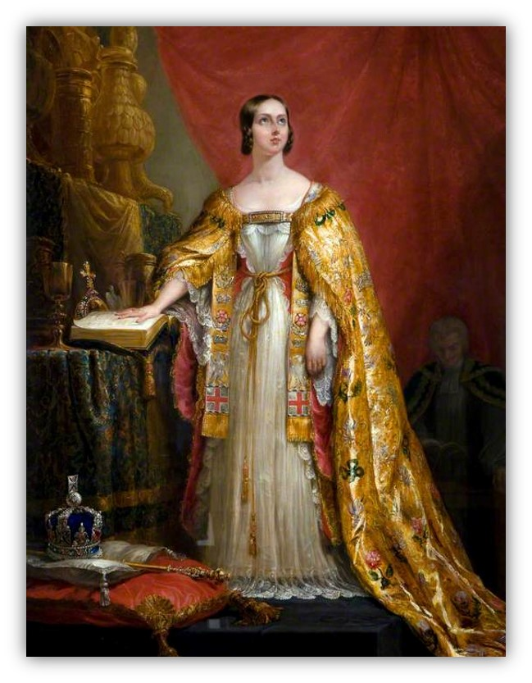
Learning
Notes:
Queen Victoria’s coronation
Image:
©2023 Dean & Chapter of Westminster
Please be aware that these images are for educational use only in the classroom and should not be reproduced online.

Slide 16
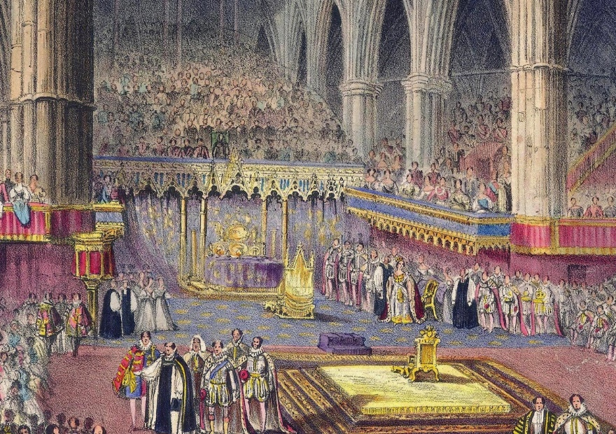
Learning
Notes:
Queen Victoria’s coronation
Image:
©2023 Dean & Chapter of Westminster
Please be aware that these images are for educational use only in the classroom and should not be reproduced online.

Slide 17
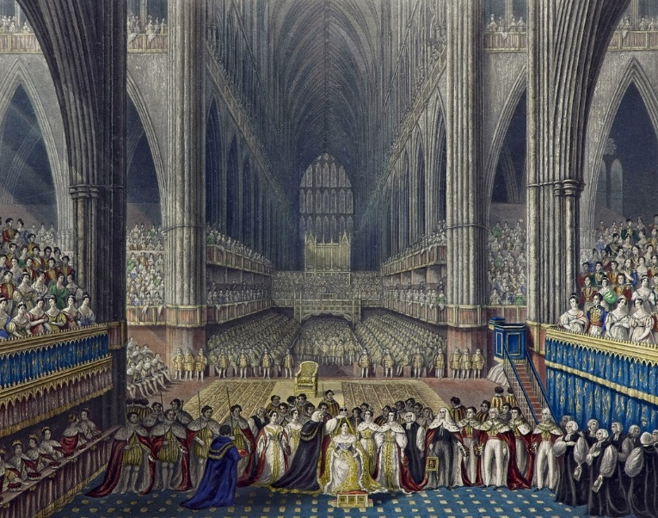
Learning
Notes:
Queen Victoria’s coronation
Image:
©2023 Dean & Chapter of Westminster
Please be aware that these images are for educational use only in the classroom and should not be reproduced online.

Slide 18
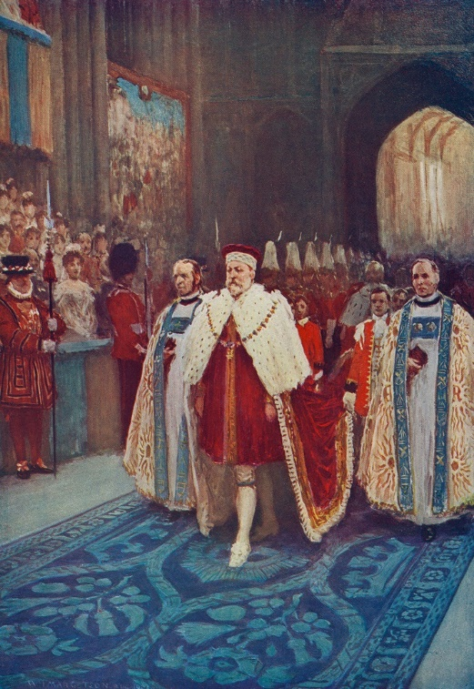
Learning
Notes:
Edward VII’s coronation
Image:
©2023 Dean & Chapter of Westminster
Please be aware that these images are for educational use only in the classroom and should not be reproduced online.

Slide 19
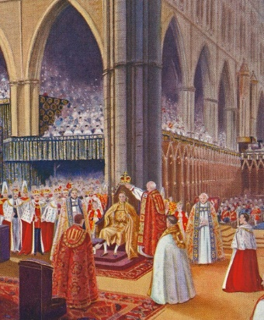
Learning
Notes:
George VI’s coronation
Image:
©2023 Dean & Chapter of Westminster
Please be aware that these images are for educational use only in the classroom and should not be reproduced online.

Slide 20
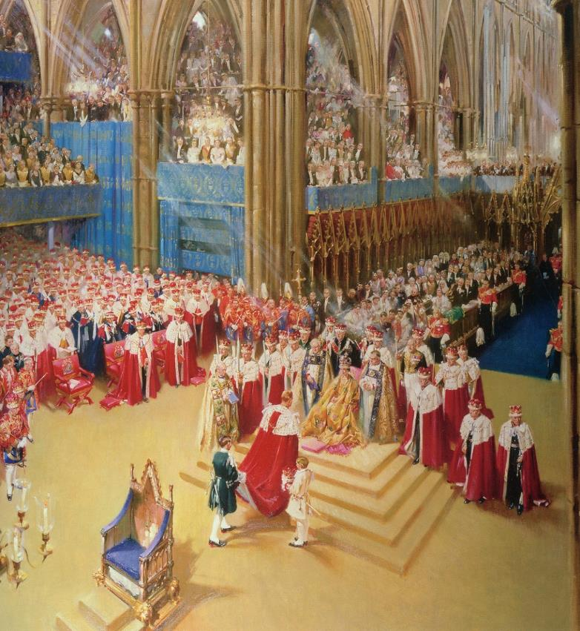
Learning
Notes:
Elizabeth II’s coronation
Image:
©2023 Dean & Chapter of Westminster
Please be aware that these images are for educational use only in the classroom and should not be reproduced online.

Slide 21
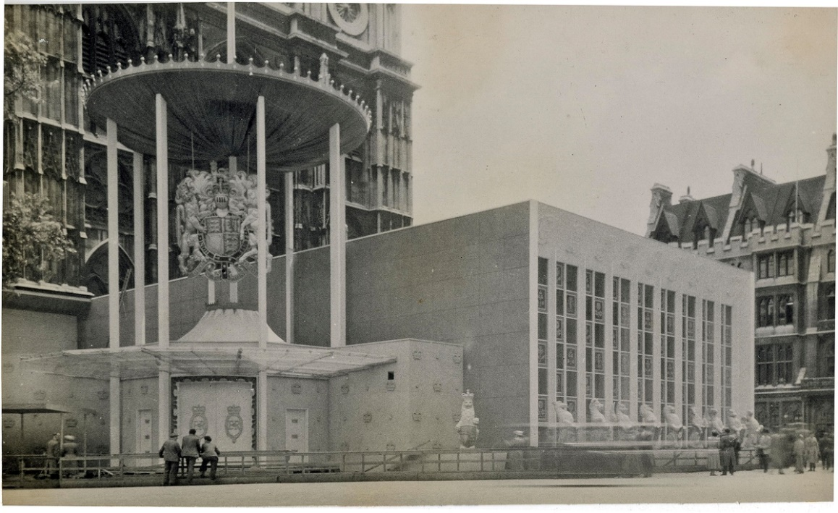
Learning
Notes:
Elizabeth II’s coronation, exterior annexe
Image:
©2023 Dean & Chapter of Westminster
Please be aware that these images are for educational use only in the classroom and should not be reproduced online.

Slide 22
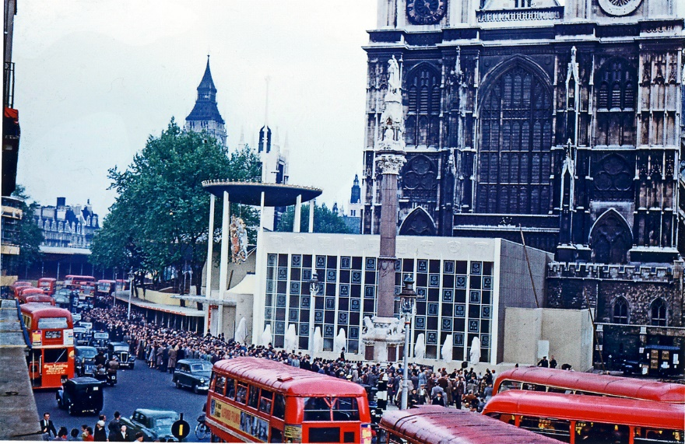
Learning
Notes:
Elizabeth II’s coronation, exterior of Abbey
Image:
©2023 Dean & Chapter of Westminster
Please be aware that these images are for educational use only in the classroom and should not be reproduced online.

Slide 23
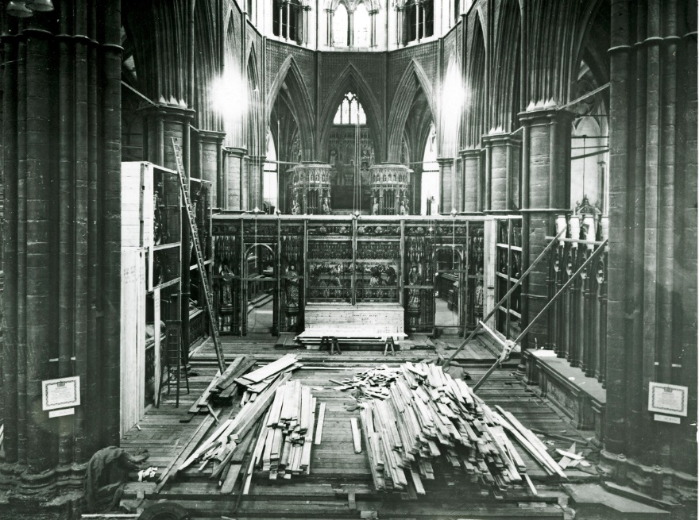
Learning
Notes:
Elizabeth II’s coronation, construction at altar
Image:
©2023 Dean & Chapter of Westminster
Please be aware that these images are for educational use only in the classroom and should not be reproduced online.

Slide 24
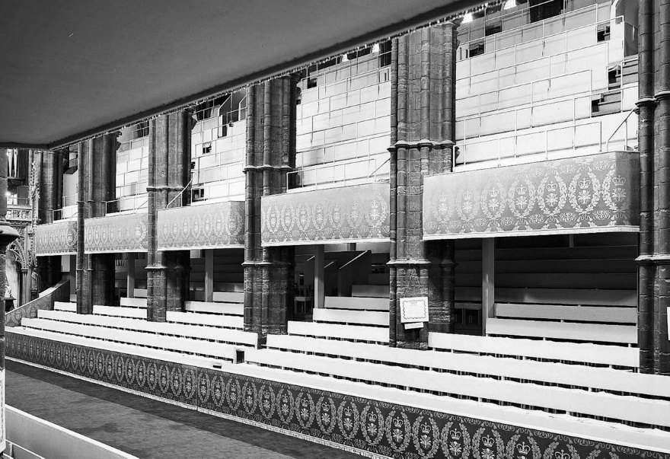
Learning
Notes:
Elizabeth II’s coronation, nave tiers
Image:
©2023 Dean & Chapter of Westminster
Please be aware that these images are for educational use only in the classroom and should not be reproduced online.

Slide 25
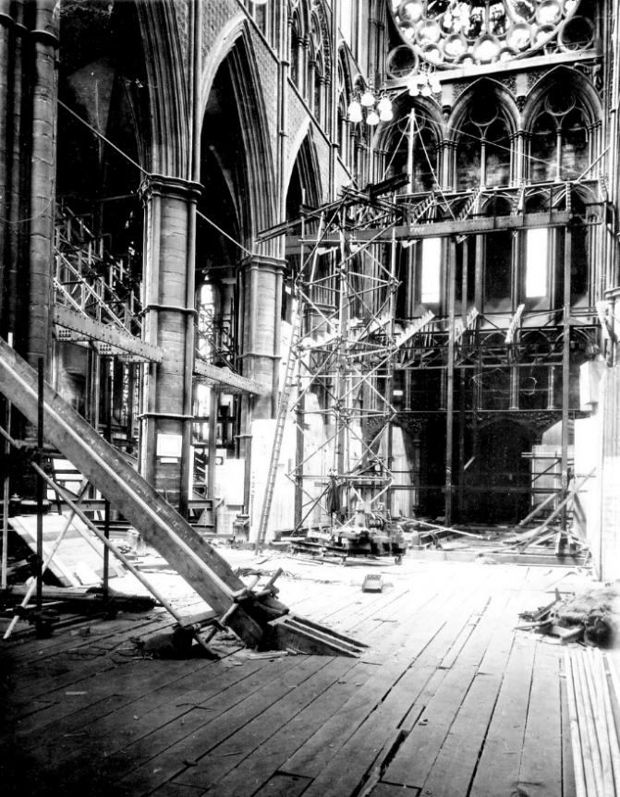
Learning
Notes:
Elizabeth II’s coronation, north transept building work
Image:
©2023 Dean & Chapter of Westminster
Please be aware that these images are for educational use only in the classroom and should not be reproduced online.

Slide 26
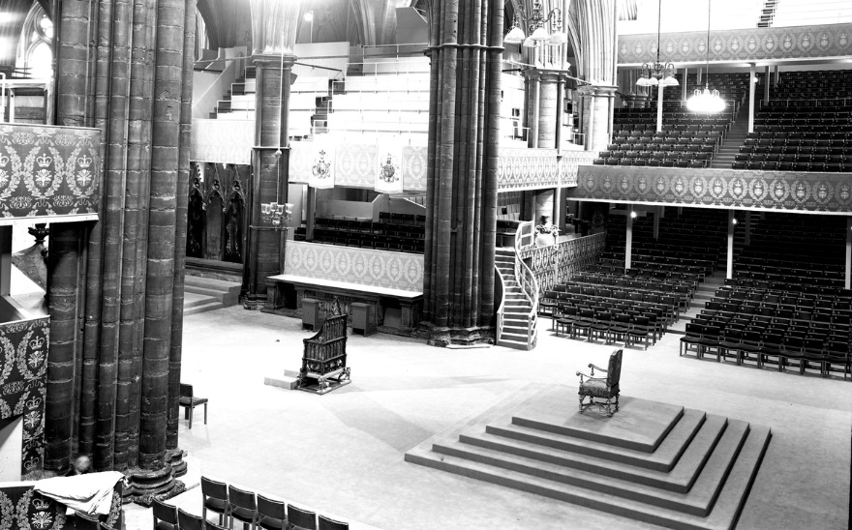
Learning
Notes:
Elizabeth II’s coronation, setting in lantern
Image:
©2023 Dean & Chapter of Westminster
Please be aware that these images are for educational use only in the classroom and should not be reproduced online.

Slide 27
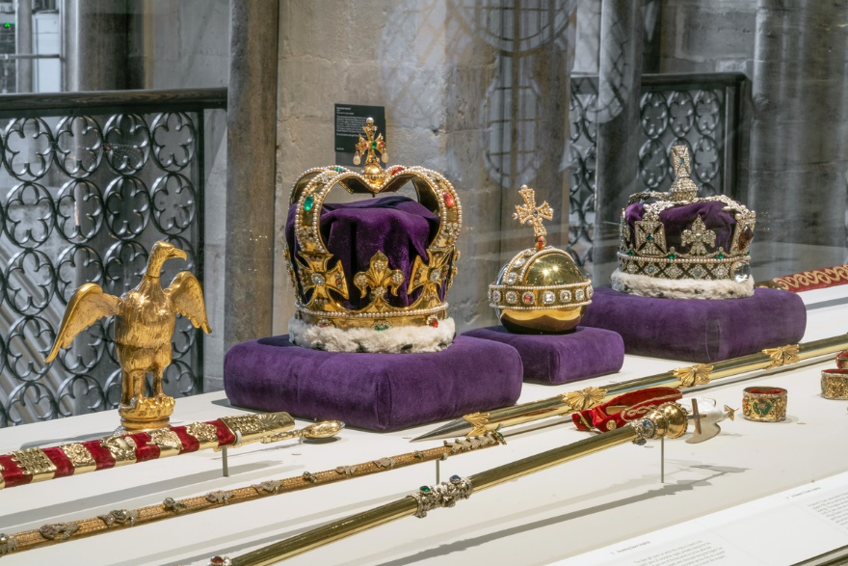
Learning
Notes:
Regalia replica
Image:
©2023 Dean & Chapter of Westminster
Please be aware that these images are for educational use only in the classroom and should not be reproduced online.

Slide 28
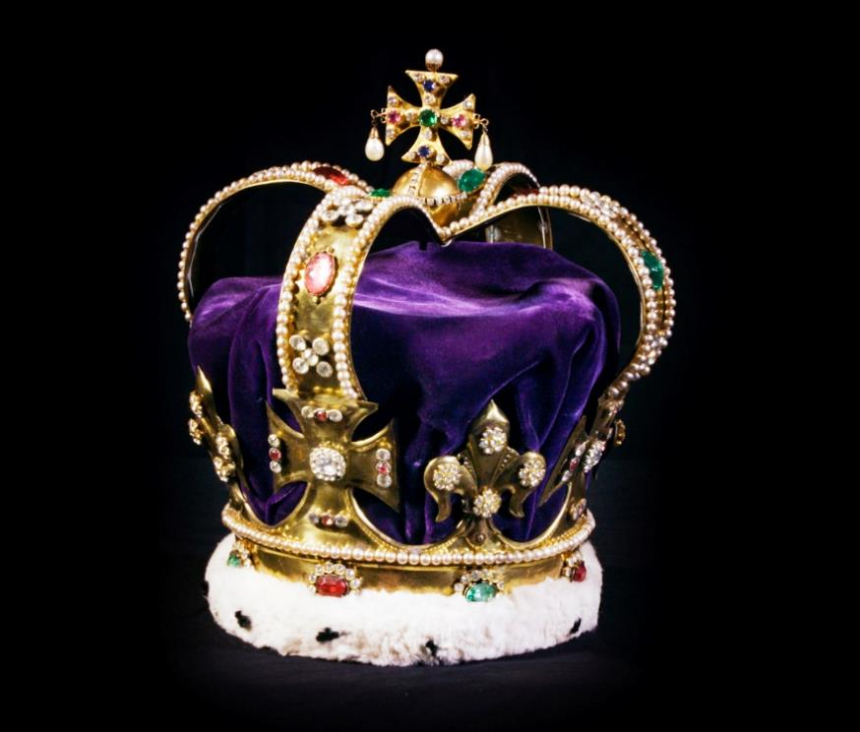
Learning
Notes:
St Edward’s Crown replica
Image:
©2023 Dean & Chapter of Westminster
Please be aware that these images are for educational use only in the classroom and should not be reproduced online.

Slide 29
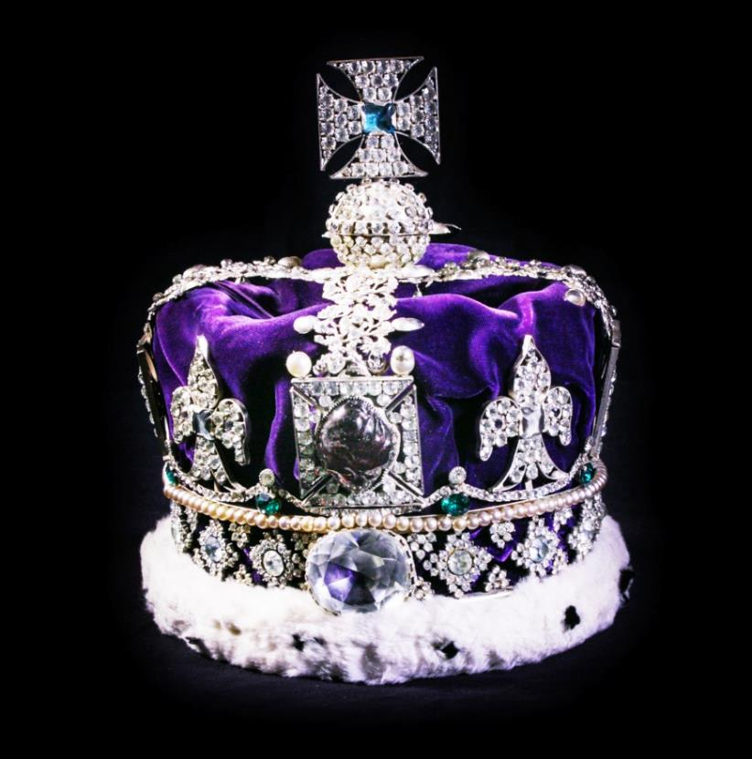
Learning
Notes:
Imperial State Crown replica
Image:
©2023 Dean & Chapter of Westminster
Please be aware that these images are for educational use only in the classroom and should not be reproduced online.

Slide 30
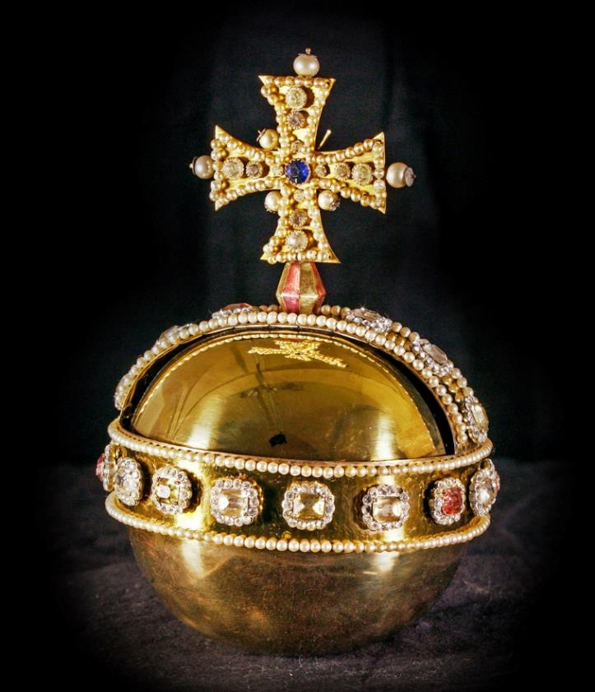
Learning
Notes:
Orb replica
Image:
©2023 Dean & Chapter of Westminster
Please be aware that these images are for educational use only in the classroom and should not be reproduced online.

Slide 31
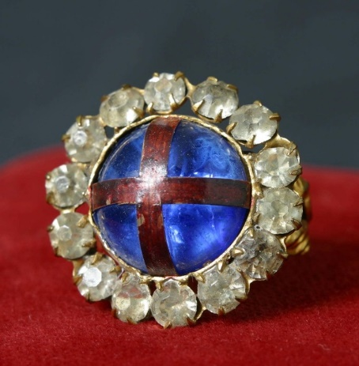
Learning
Notes:
Ring replica
Image:
©2023 Dean & Chapter of Westminster
Please be aware that these images are for educational use only in the classroom and should not be reproduced online.

Slide 32
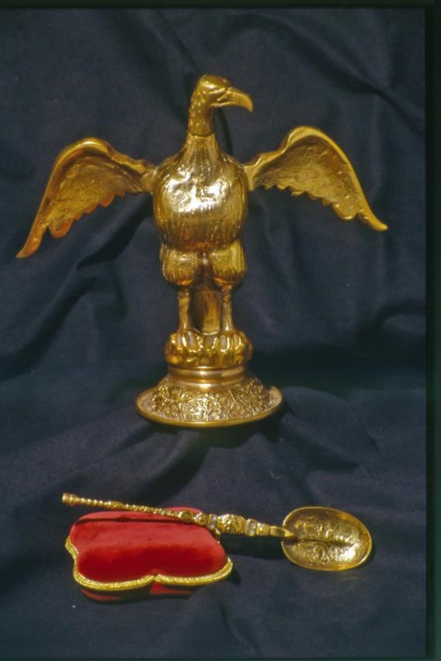
Learning
Notes:
Ampulla and spoon replica
Image:
©2023 Dean & Chapter of Westminster
Please be aware that these images are for educational use only in the classroom and should not be reproduced online.

Slide 33
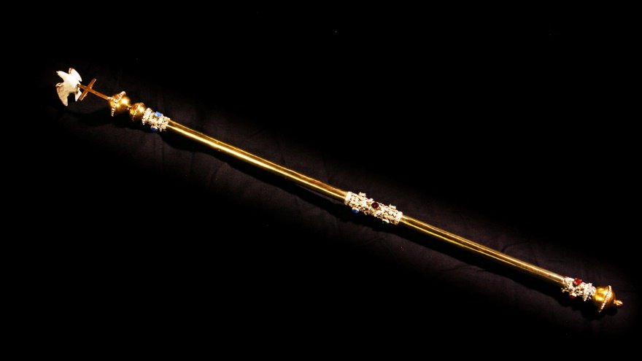
Learning
Notes:
Sceptre with dove replica
Image:
©2023 Dean & Chapter of Westminster
Please be aware that these images are for educational use only in the classroom and should not be reproduced online.

Slide 34
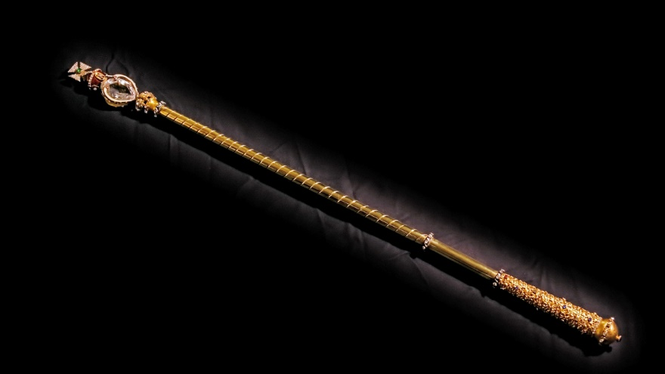
Learning
Notes:
Sceptre with cross replica
Image:
©2023 Dean & Chapter of Westminster
Please be aware that these images are for educational use only in the classroom and should not be reproduced online.

