Slide 1
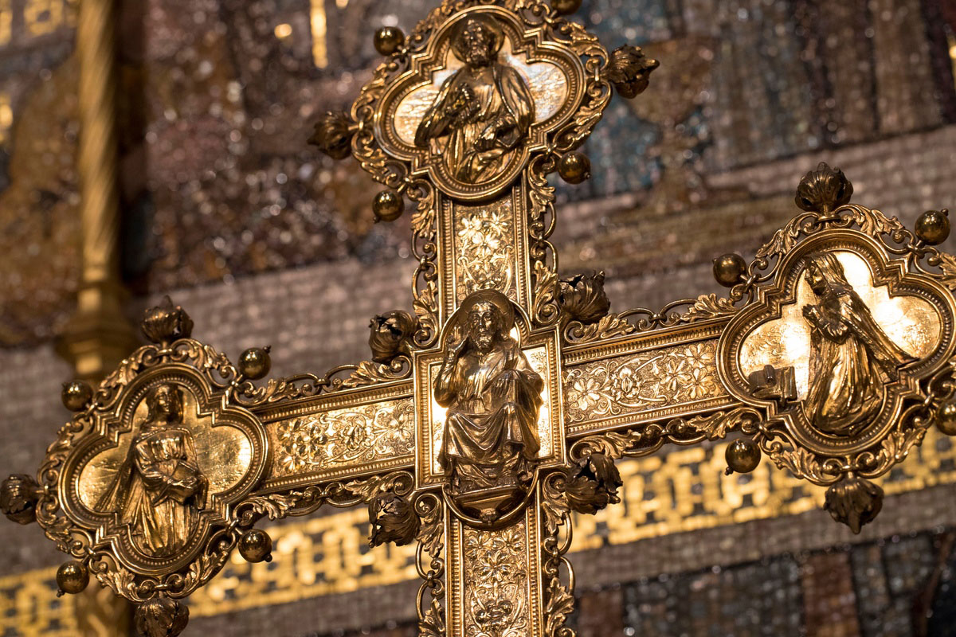

Westminster Abbey
Learning
Christian festivals
image bank
©2020 Dean and Chapter of Westminster
1
Notes:
Image:
©2020 Dean & Chapter of Westminster
Please be aware that these images are for educational use only in the classroom and should not be reproduced online.

Slide 2
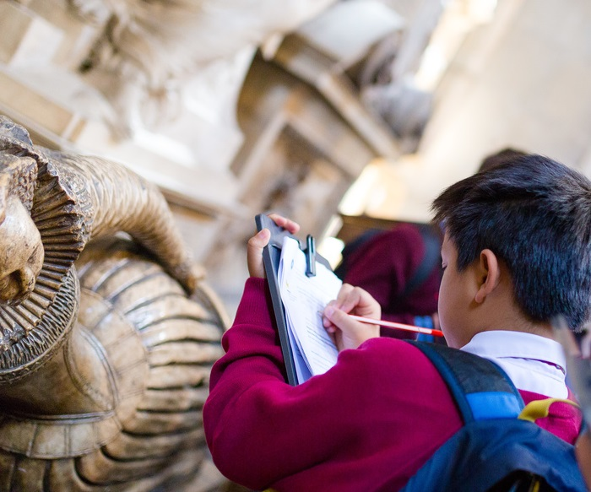
Westminster Abbey
Learning
Information for teachers
Thank you for downloading this resource. We hope that it has been a useful teaching tool in your classroom.
As we continue to grow our free catalogue of teaching resources, we’d really appreciate a few minutes of your time to let us know what you liked and what could be improved. Please complete this five-question survey.
2
Notes:
Image:
©2019 Dean & Chapter of Westminster
Please be aware that these images are for educational use only in the classroom and should not be reproduced online.

Slide 3
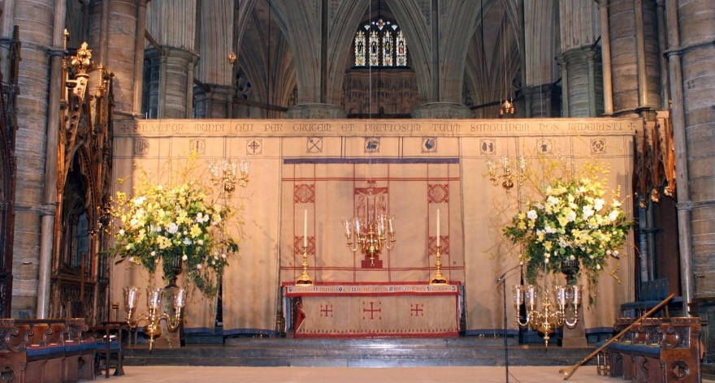
Learning
Notes:
High Altar during Lent
Image:
©2020 Dean & Chapter of Westminster
Please be aware that these images are for educational use only in the classroom and should not be reproduced online.

Slide 4
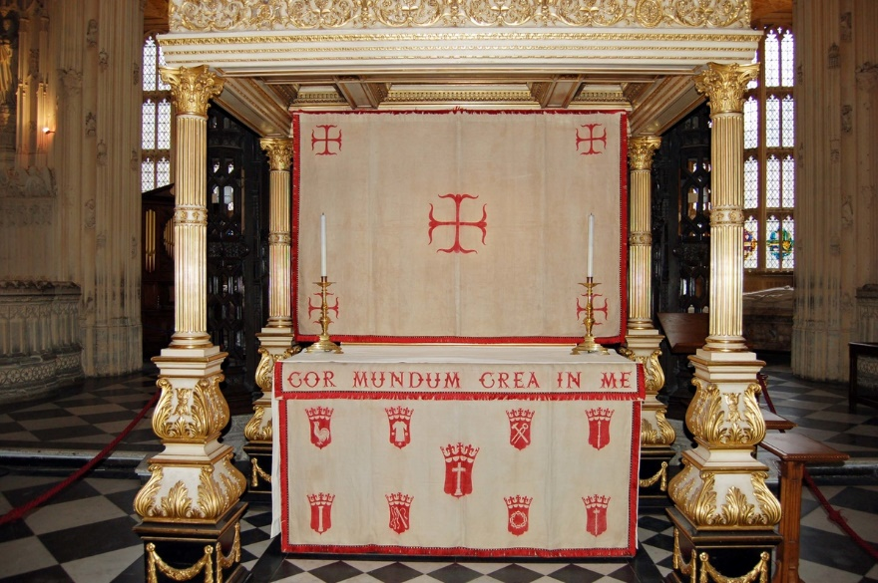
Learning
Notes:
Lent frontal in Henry VII chapel
Image:
©2020 Dean & Chapter of Westminster
Please be aware that these images are for educational use only in the classroom and should not be reproduced online.

Slide 5
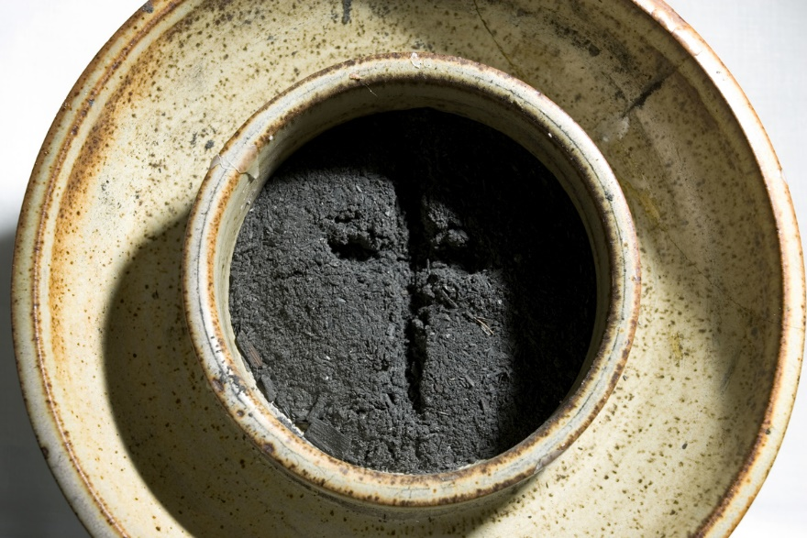
Learning
Notes:
Ashes with cross for Ash Wednesday
Image:
©2020 Dean & Chapter of Westminster
Please be aware that these images are for educational use only in the classroom and should not be reproduced online.

Slide 6
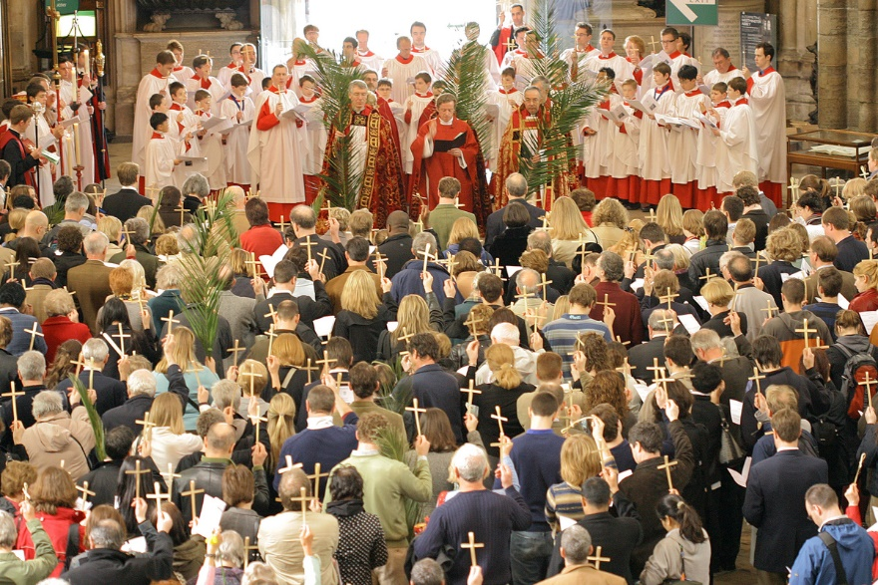
Learning
Notes:
Palm Sunday service
Image:
©2020 Dean & Chapter of Westminster
Please be aware that these images are for educational use only in the classroom and should not be reproduced online.

Slide 7
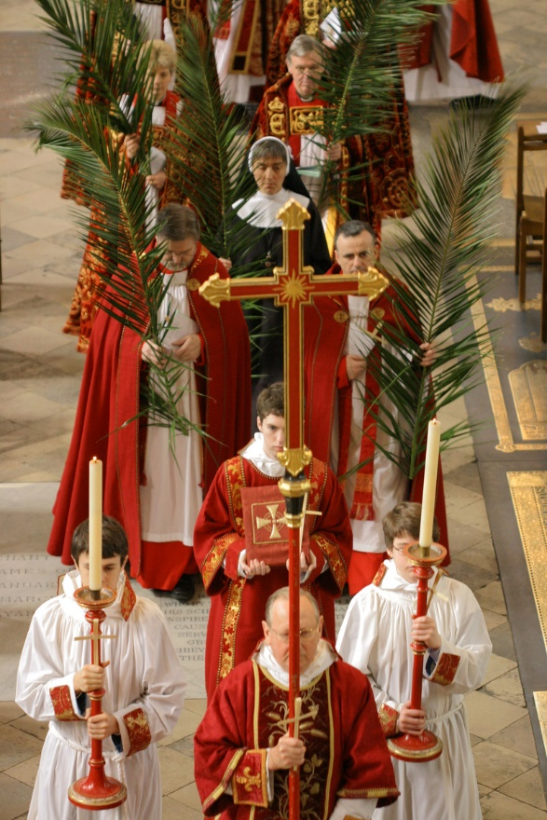
Learning
Notes:
Palm Service procession
Image:
©2020 Dean & Chapter of Westminster
Please be aware that these images are for educational use only in the classroom and should not be reproduced online.

Slide 8
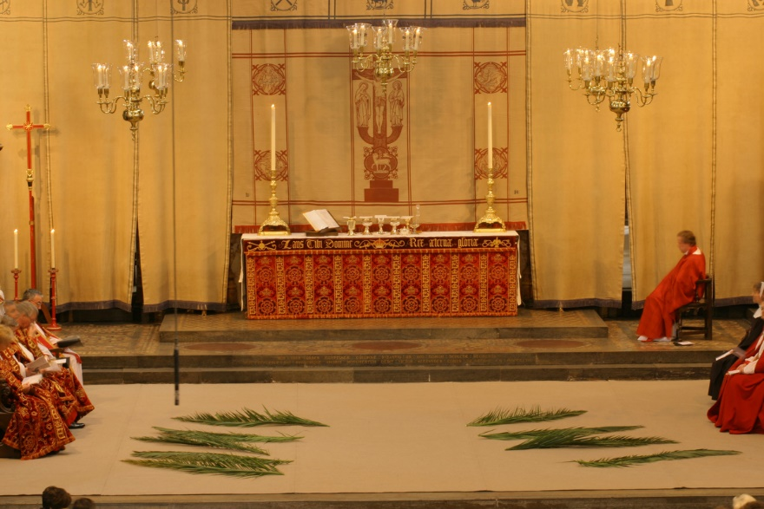
Learning
Notes:
High Altar during Palm Sunday service
Image:
©2020 Dean & Chapter of Westminster
Please be aware that these images are for educational use only in the classroom and should not be reproduced online.

Slide 9
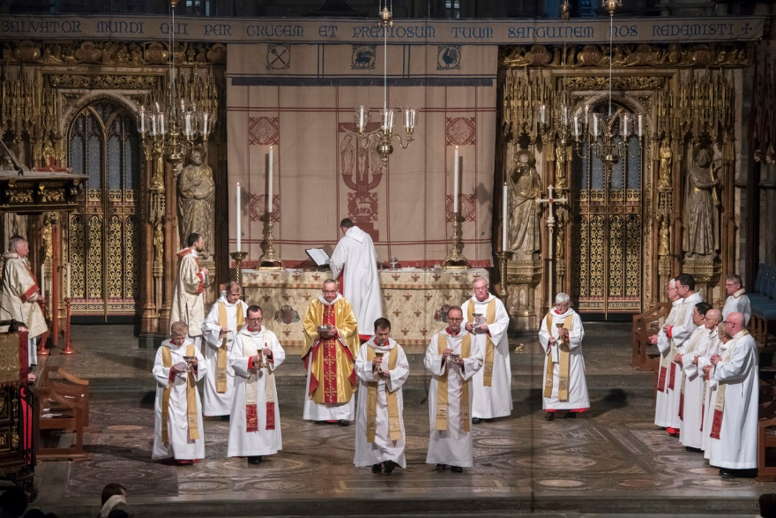
Learning
Notes:
Maundy Thursday service
Image:
©2020 Dean & Chapter of Westminster
Please be aware that these images are for educational use only in the classroom and should not be reproduced online.

Slide 10
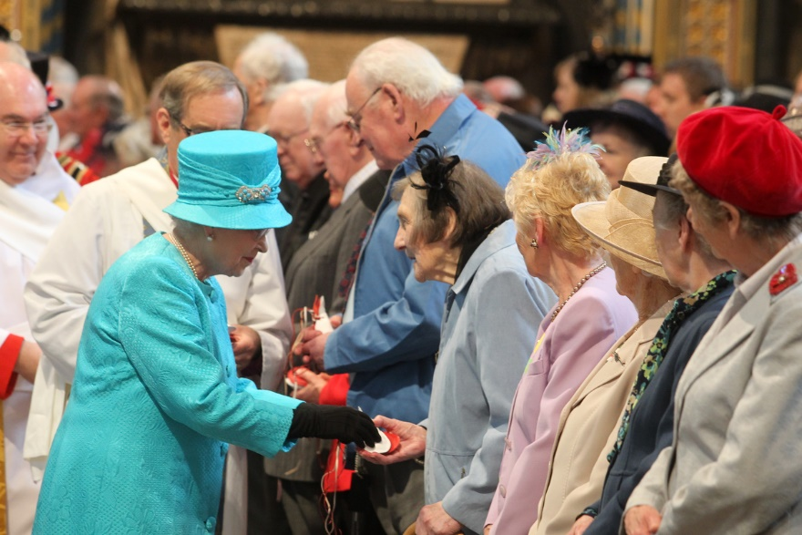
Learning
Notes:
Monarch giving our Maundy money
Image:
©2020 Dean & Chapter of Westminster
Please be aware that these images are for educational use only in the classroom and should not be reproduced online.

Slide 11
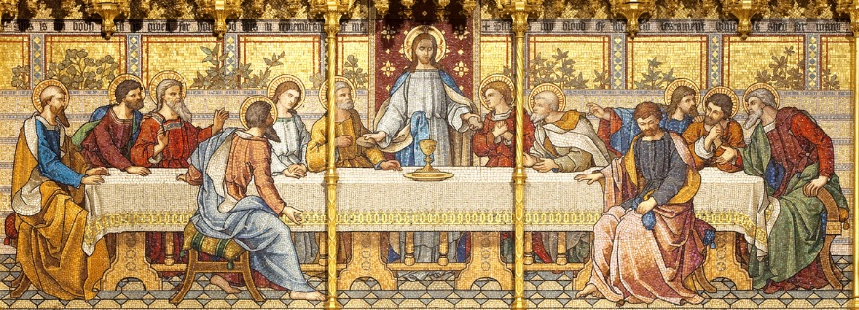
Learning
Notes:
Close up of High Altar mosaic of Last Supper
Image:
©2020 Dean & Chapter of Westminster
Please be aware that these images are for educational use only in the classroom and should not be reproduced online.

Slide 12
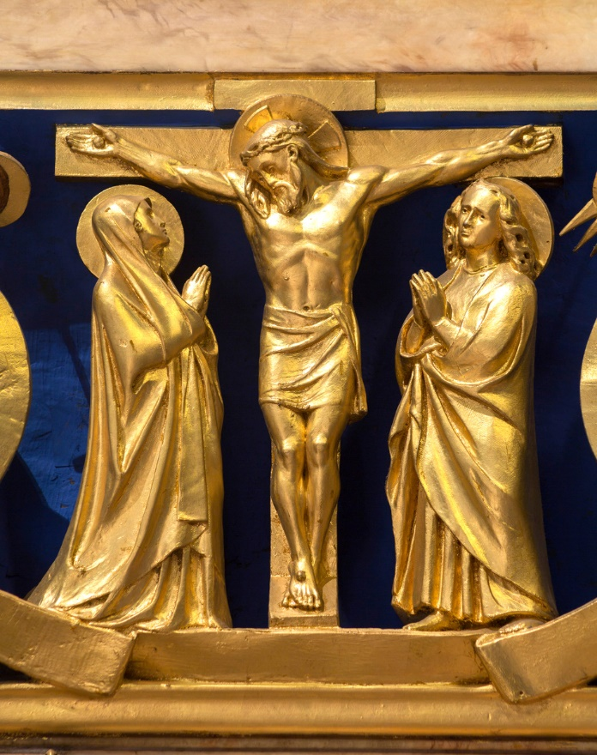
Learning
Notes:
Crucifixion on the High Altar
Image:
©2020 Dean & Chapter of Westminster
Please be aware that these images are for educational use only in the classroom and should not be reproduced online.

Slide 13
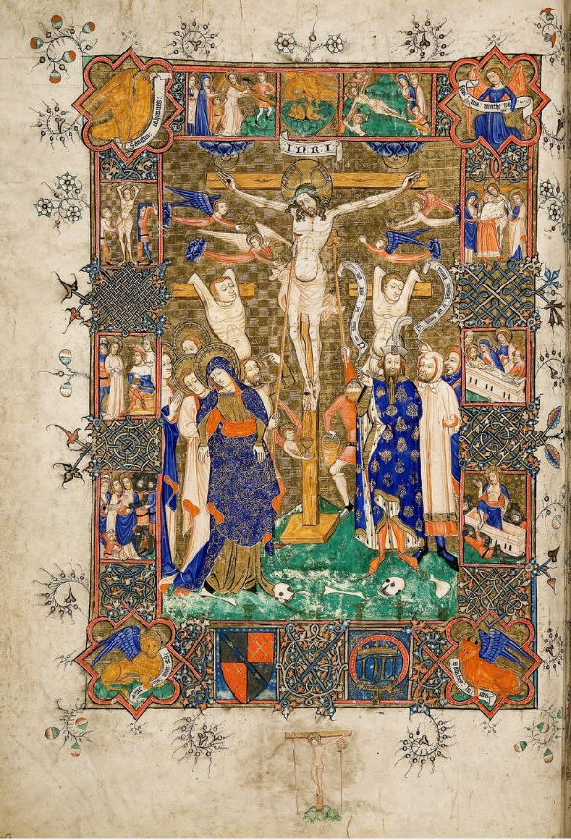
Learning
Notes:
Depiction of the Crucifixion in the Litlyngton Missal
Image:
©2020 Dean & Chapter of Westminster
Please be aware that these images are for educational use only in the classroom and should not be reproduced online.

Slide 14
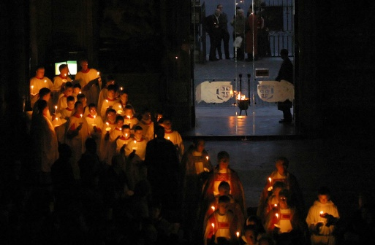
Learning
Notes:
Holy Saturday service
Image:
©2020 Dean & Chapter of Westminster
Please be aware that these images are for educational use only in the classroom and should not be reproduced online.

Slide 15
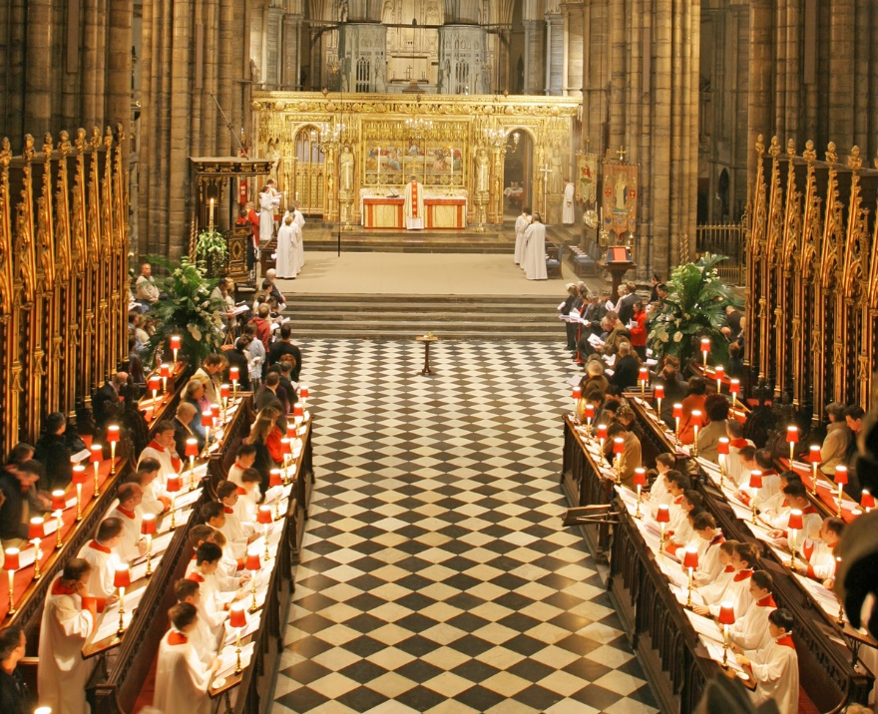
Learning
Notes:
Easter service
Image:
©2020 Dean & Chapter of Westminster
Please be aware that these images are for educational use only in the classroom and should not be reproduced online.

Slide 16
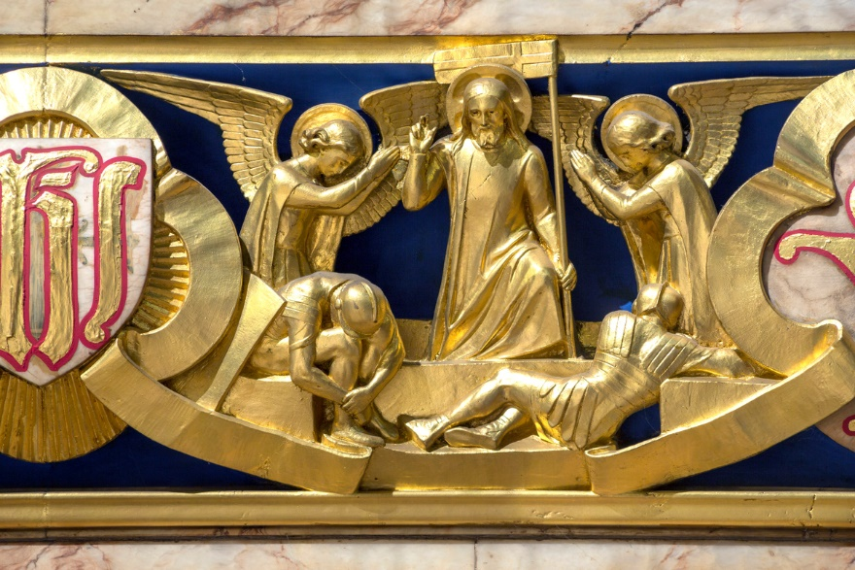
Learning
Notes:
Resurrection on the High Altar
Image:
©2020 Dean & Chapter of Westminster
Please be aware that these images are for educational use only in the classroom and should not be reproduced online.

Slide 17
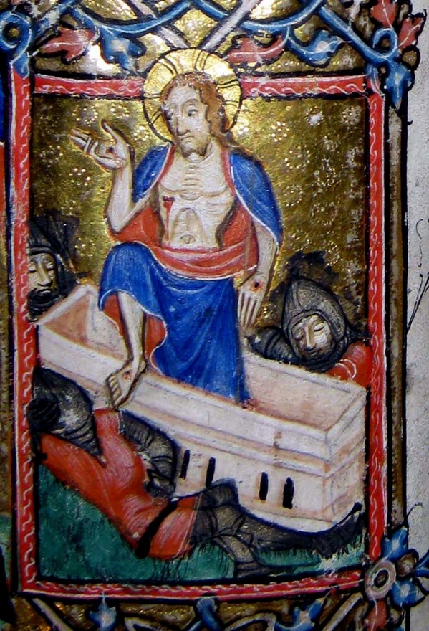
Learning
Notes:
Depiction of the Resurrection in the Litlyngton Missal
Image:
©2020 Dean & Chapter of Westminster
Please be aware that these images are for educational use only in the classroom and should not be reproduced online.

Slide 18
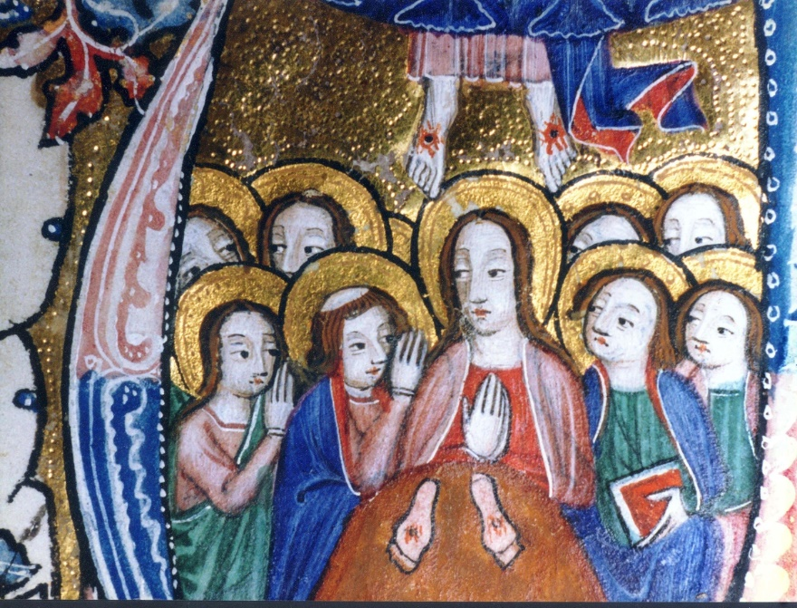
Learning
Notes:
Depiction of the Ascension in the Litlyngton Missal
Image:
©2020 Dean & Chapter of Westminster
Please be aware that these images are for educational use only in the classroom and should not be reproduced online.

Slide 19
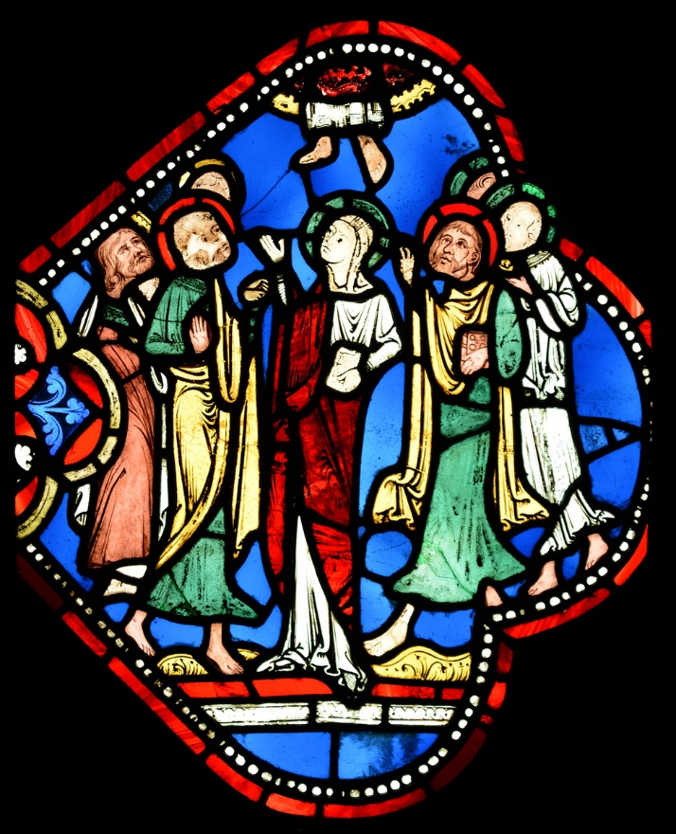
Learning
Notes:
Ascension stained glass window
Image:
©2020 Dean & Chapter of Westminster
Please be aware that these images are for educational use only in the classroom and should not be reproduced online.

Slide 20
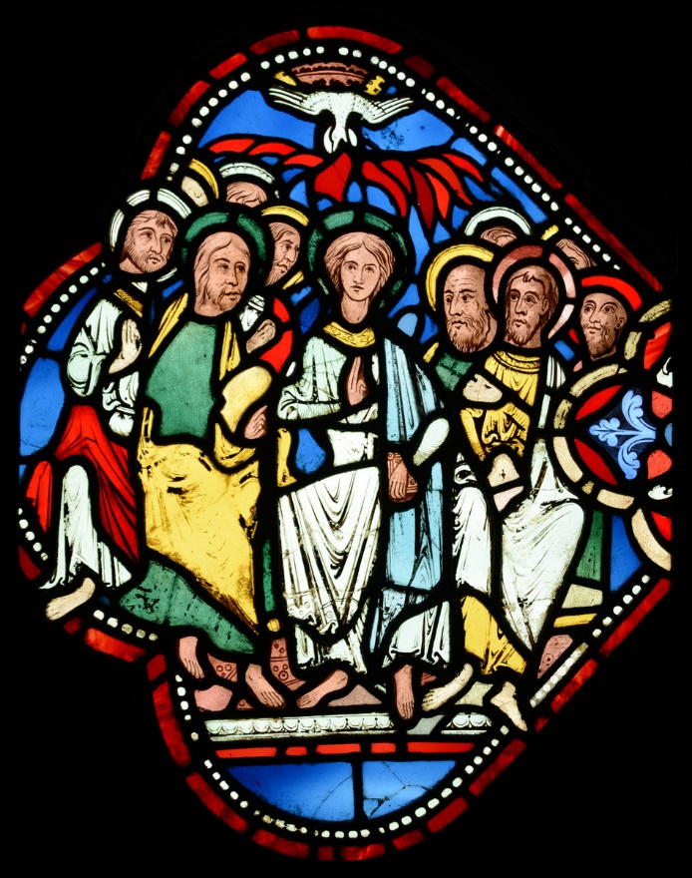
Learning
Notes:
Pentecost stained glass window
Image:
©2020 Dean & Chapter of Westminster
Please be aware that these images are for educational use only in the classroom and should not be reproduced online.

Slide 21
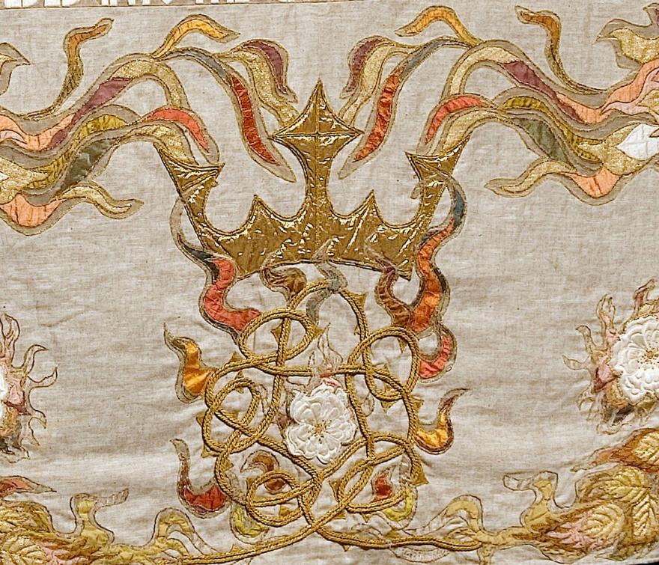
Learning
Notes:
Depiction of the ‘tongues of fire’
Image:
©2020 Dean & Chapter of Westminster
Please be aware that these images are for educational use only in the classroom and should not be reproduced online.

Slide 22
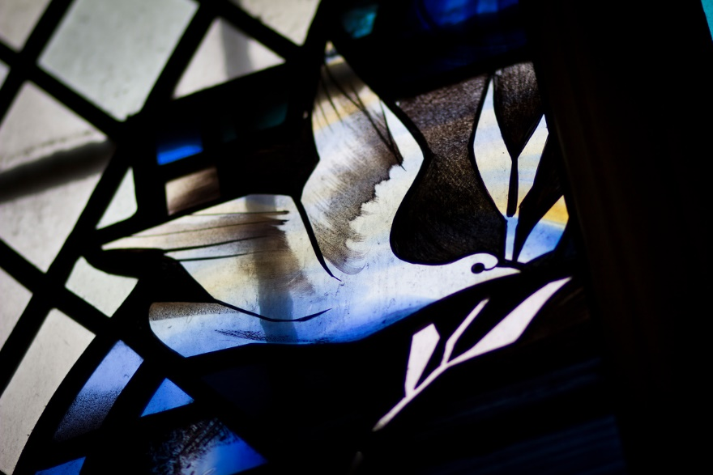
Learning
Notes:
Dove of peace stained glass window
Image:
©2020 Dean & Chapter of Westminster
Please be aware that these images are for educational use only in the classroom and should not be reproduced online.

Slide 23
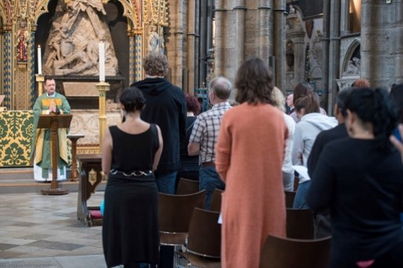
Learning
Notes:
Congregation
Image:
©2020 Dean & Chapter of Westminster
Please be aware that these images are for educational use only in the classroom and should not be reproduced online.

Slide 24
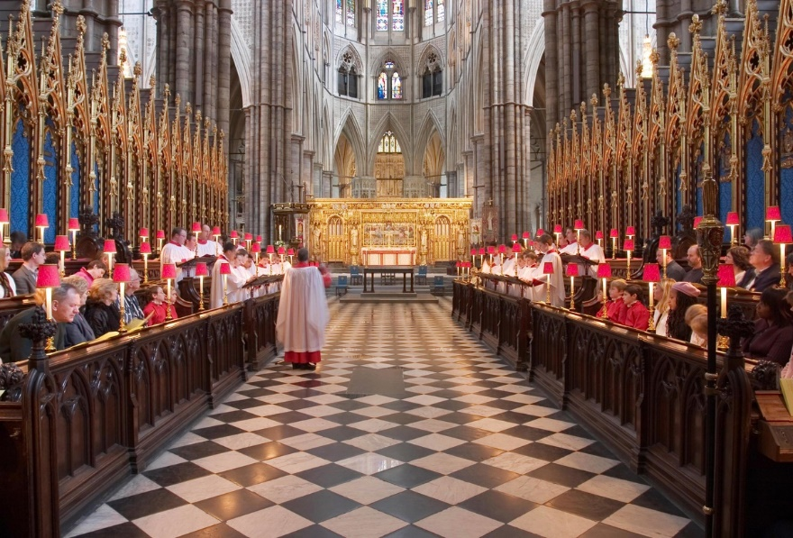
Learning
Notes:
Quire
Image:
©2020 Dean & Chapter of Westminster
Please be aware that these images are for educational use only in the classroom and should not be reproduced online.

Slide 25
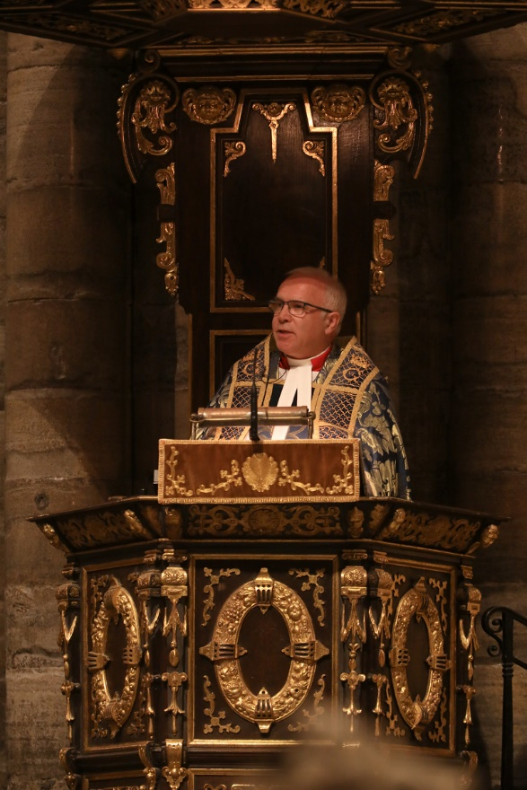
Learning
Notes:
Dean delivering sermon
Image:
©2020 Dean & Chapter of Westminster
Please be aware that these images are for educational use only in the classroom and should not be reproduced online.

Slide 26
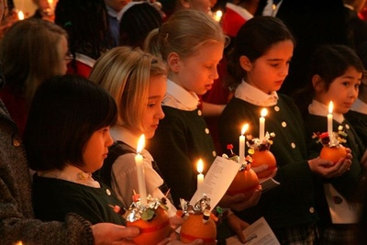
Learning
Notes:
Children attending a Christingle service
Image:
©2020 Dean & Chapter of Westminster
Please be aware that these images are for educational use only in the classroom and should not be reproduced online.

Slide 27
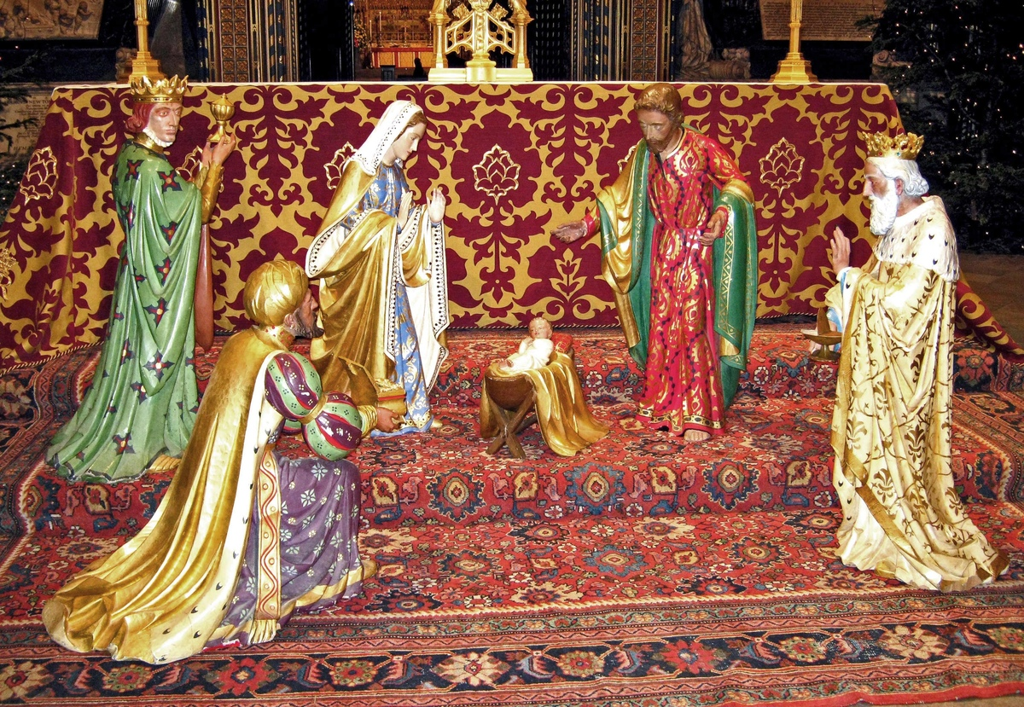
Learning
Notes:
Nativity figures set up in the Nave
Image:
©2020 Dean & Chapter of Westminster
Please be aware that these images are for educational use only in the classroom and should not be reproduced online.

Slide 28
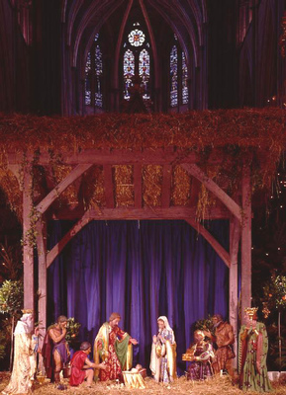
Learning
Notes:
Traditional Christmas Crib in the Nave
Image:
©2020 Dean & Chapter of Westminster
Please be aware that these images are for educational use only in the classroom and should not be reproduced online.

Slide 29
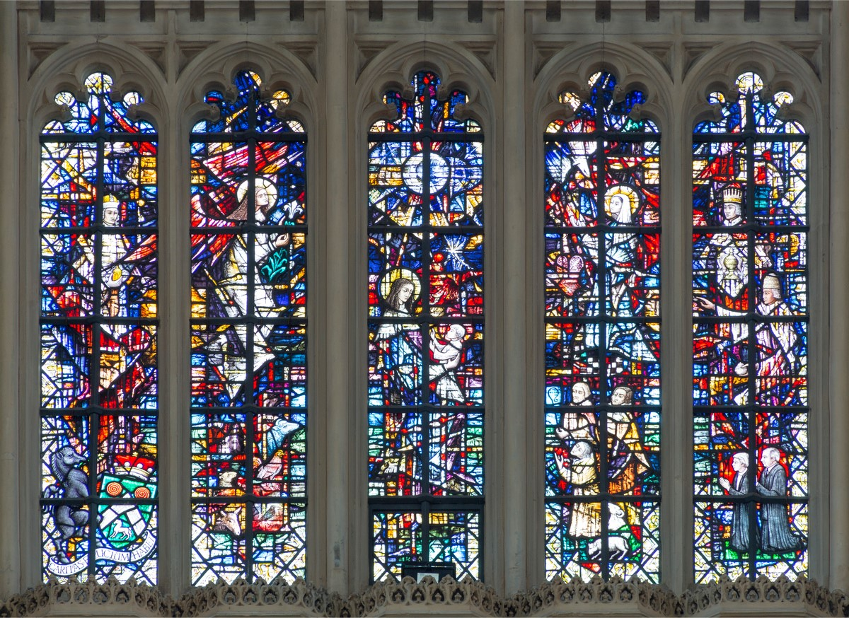
Learning
Notes:
Stained-glass window within the Lady Chapel showing a Nativity scene
Image:
©2020 Dean & Chapter of Westminster
Please be aware that these images are for educational use only in the classroom and should not be reproduced online.

Slide 30
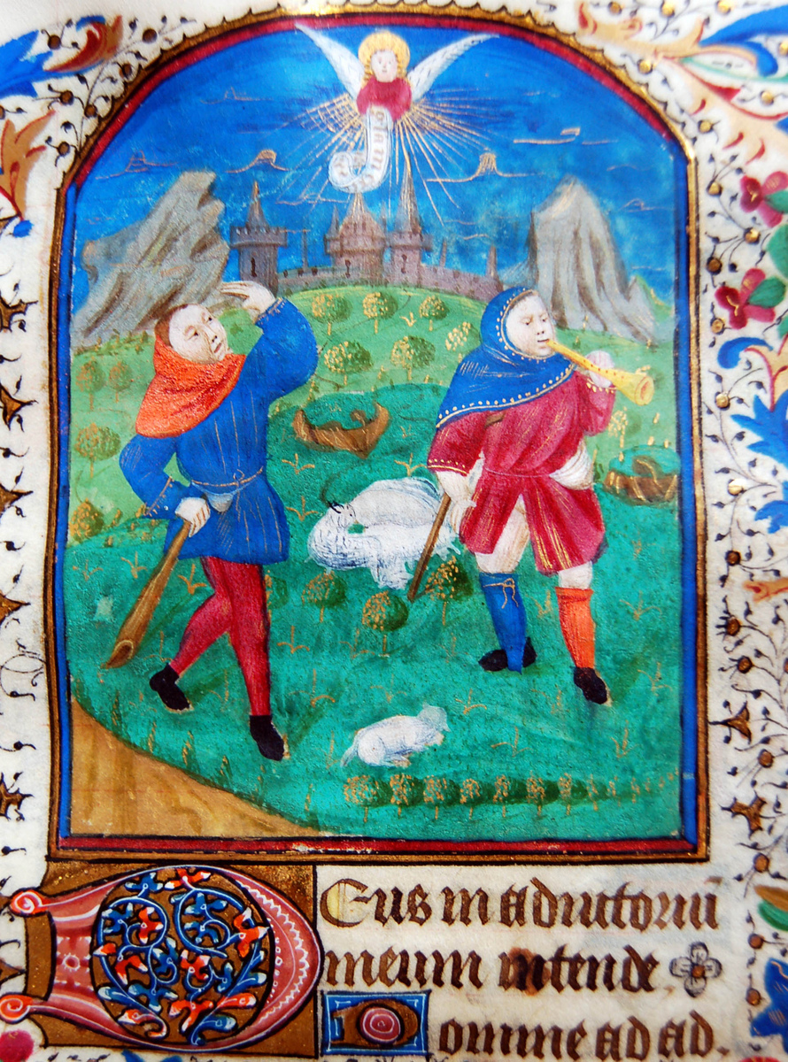
Learning
Notes:
Shepherds and the Angel within a French Book of Hours
Image:
©2020 Dean & Chapter of Westminster
Please be aware that these images are for educational use only in the classroom and should not be reproduced online.

Slide 31
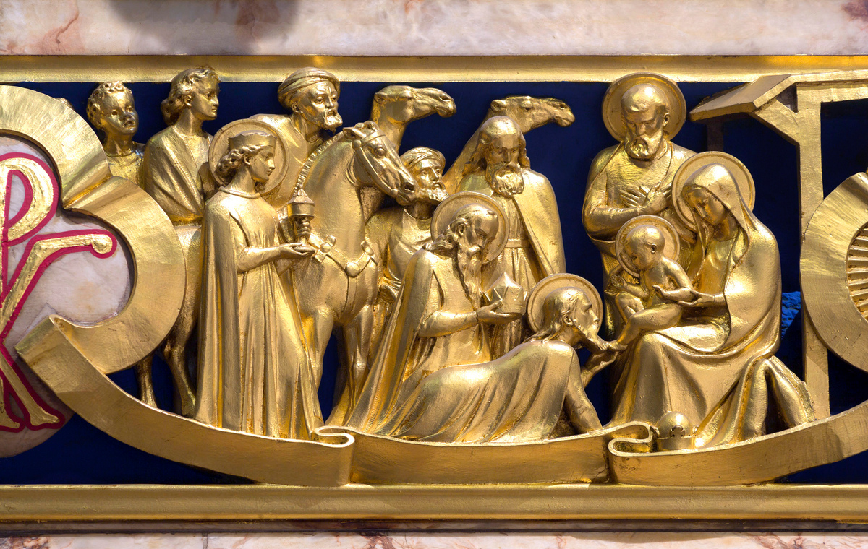
Learning
Notes:
Magi scene on the High Altar
Image:
©2020 Dean & Chapter of Westminster
Please be aware that these images are for educational use only in the classroom and should not be reproduced online.

Slide 32
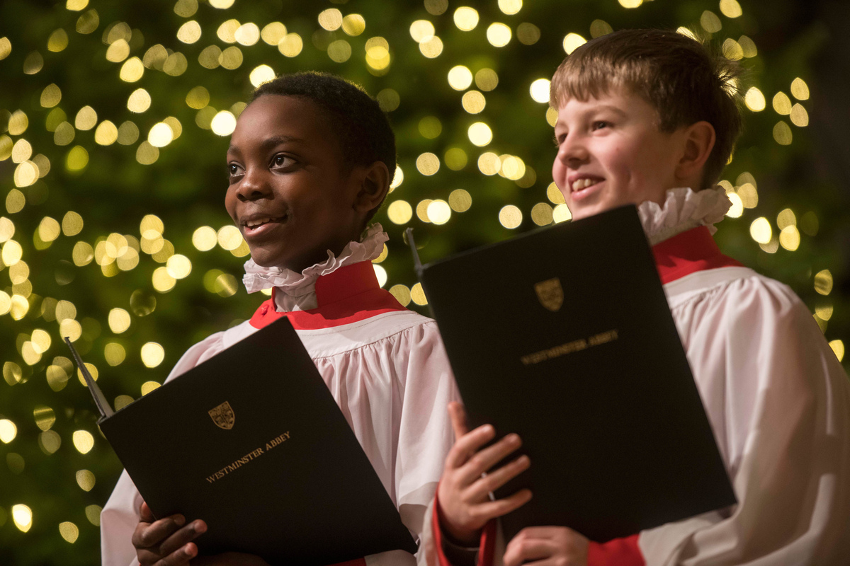
Learning
Notes:
Choirboys at a Christmas service
Image:
©2020 Dean & Chapter of Westminster
Please be aware that these images are for educational use only in the classroom and should not be reproduced online.

Slide 33
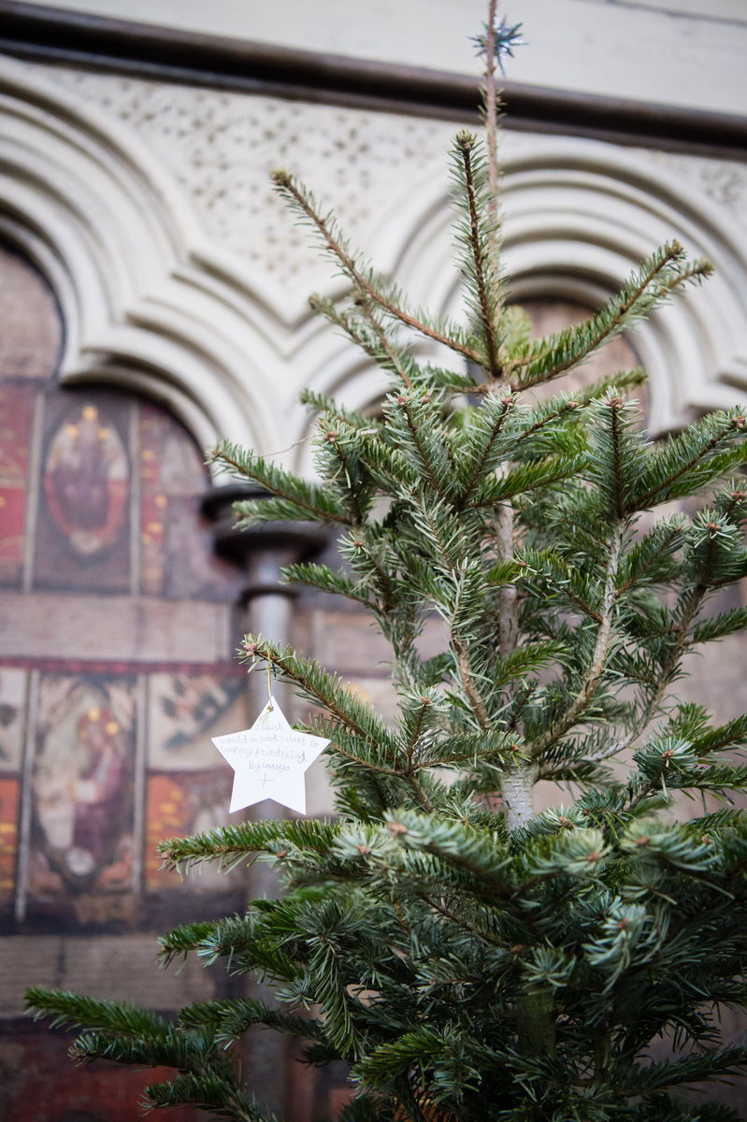
Learning
Notes:
Christmas Tree in the Chapter House
Image:
©2020 Dean & Chapter of Westminster
Please be aware that these images are for educational use only in the classroom and should not be reproduced online.

