Slide 1
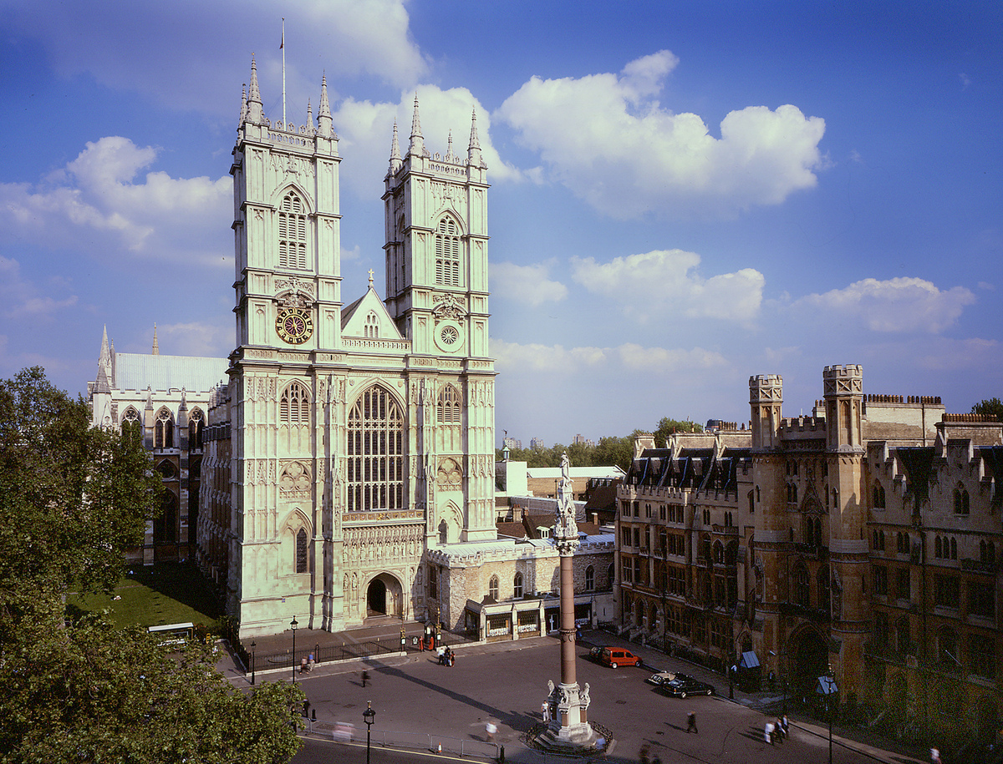

Westminster Abbey
Learning
Why are there lots of crosses in church?
©2020 Dean and Chapter of Westminster
1
Notes:
Image:
©2021 Dean & Chapter of Westminster
Please be aware that these images are for educational use only in the classroom and should not be reproduced online.

Slide 2
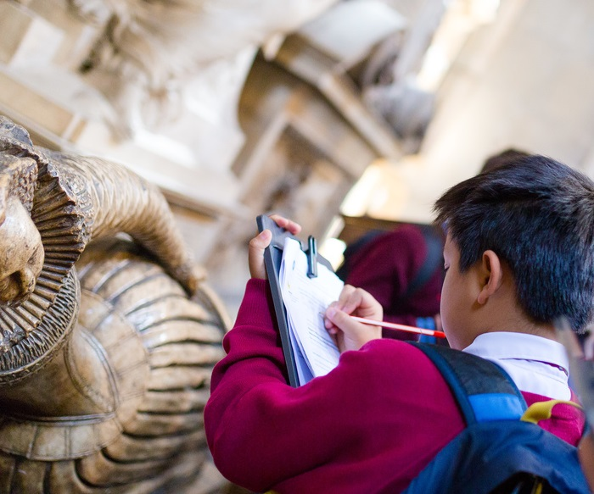
Westminster Abbey
Learning
Information for teachers
Thank you for downloading this resource. We hope that it will be a useful teaching tool in your classroom.
As we continue to grow our free catalogue of teaching resources, we’d really appreciate a few minutes of your time to let us know what you liked and what could be improved. Please complete this five-question survey.
2
Notes:
Image:
©2021 Dean & Chapter of Westminster

Slide 3
Learning
Today, we’re thinking about shapes that have another meaning. Shapes can be a way of sharing an idea without using words. Perhaps you’ve seen shapes when you talk with your teacher or family about the weather? A sunshine means it’s hot while a snowflake means it’s cold. Can you think of any more examples?
Christians have one very special shape – the cross. It is the most important shape in Christianity. Crosses appear everywhere in church. They can be found sitting on the altar, being carried through the church or pictured in stained-glass windows. Crosses are one of the symbols often seen in November along with poppies when remembering people who fought and died in wars.
Crosses can be simple and plain or highly decorated, sometimes with an image of Jesus Christ. The cross might not be an object at all! You might see the priest make the sign of a cross in the air using their finger. All that matters for Christians when they see a cross is that they remember the events of Easter when Jesus dies on the cross and rises again. It is a symbol of one man’s suffering but it is also a symbol of hope.
And did you know that Westminster Abbey, like lots of churches, is even built in the shape of a cross?

Slide 4
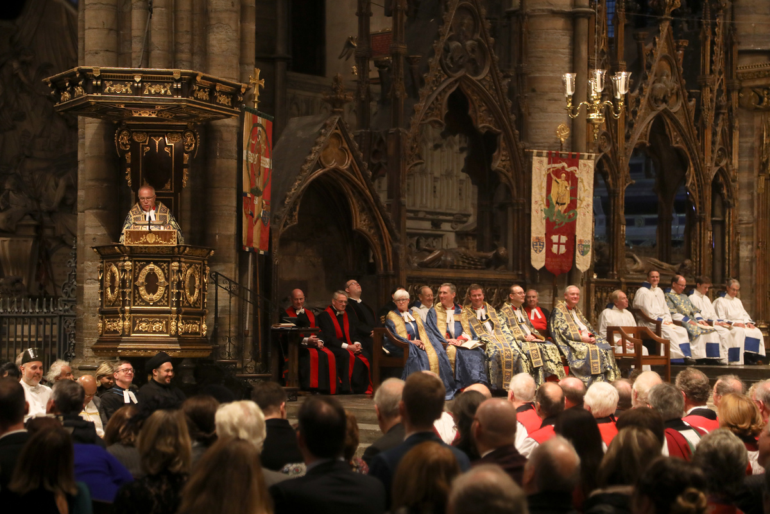
Learning
Notes:
Congregation during a service
Image:
©2021 Dean & Chapter of Westminster
Please be aware that these images are for educational use only in the classroom and should not be reproduced online.

Slide 5
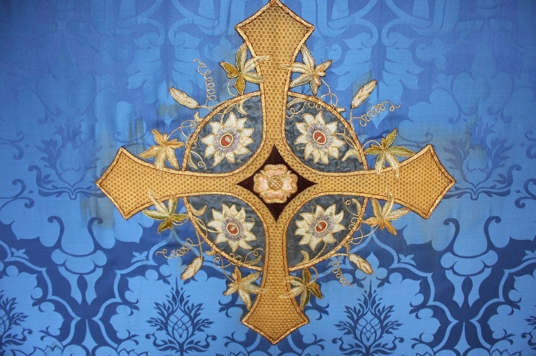
Learning
Notes:
Cross on a frontal, hung on the altar
Image:
©2021 Dean & Chapter of Westminster
Please be aware that these images are for educational use only in the classroom and should not be reproduced online.

Slide 6
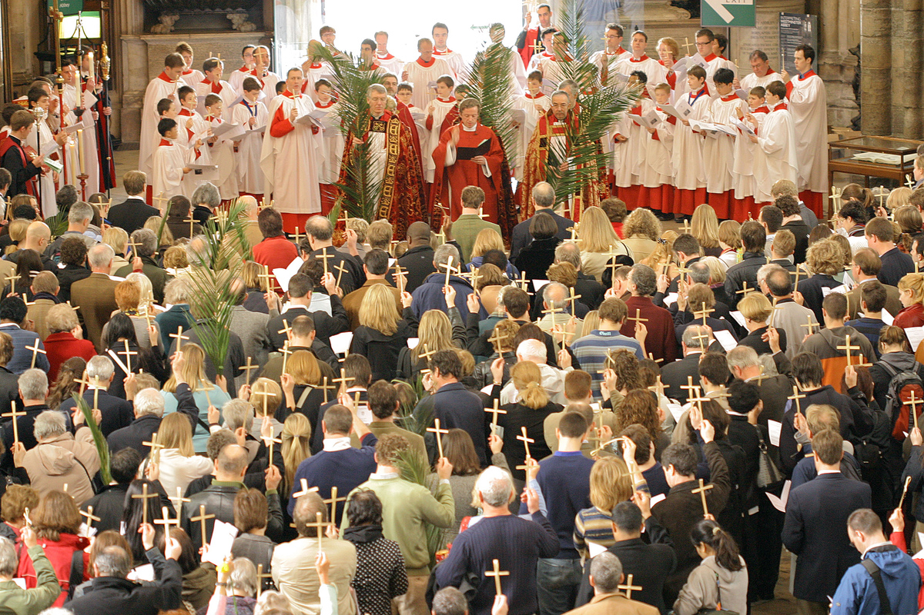
Learning
Notes:
Crosses being held by the congregation at a Palm Sunday service
Image:
©2021 Dean & Chapter of Westminster
Please be aware that these images are for educational use only in the classroom and should not be reproduced online.

Slide 7
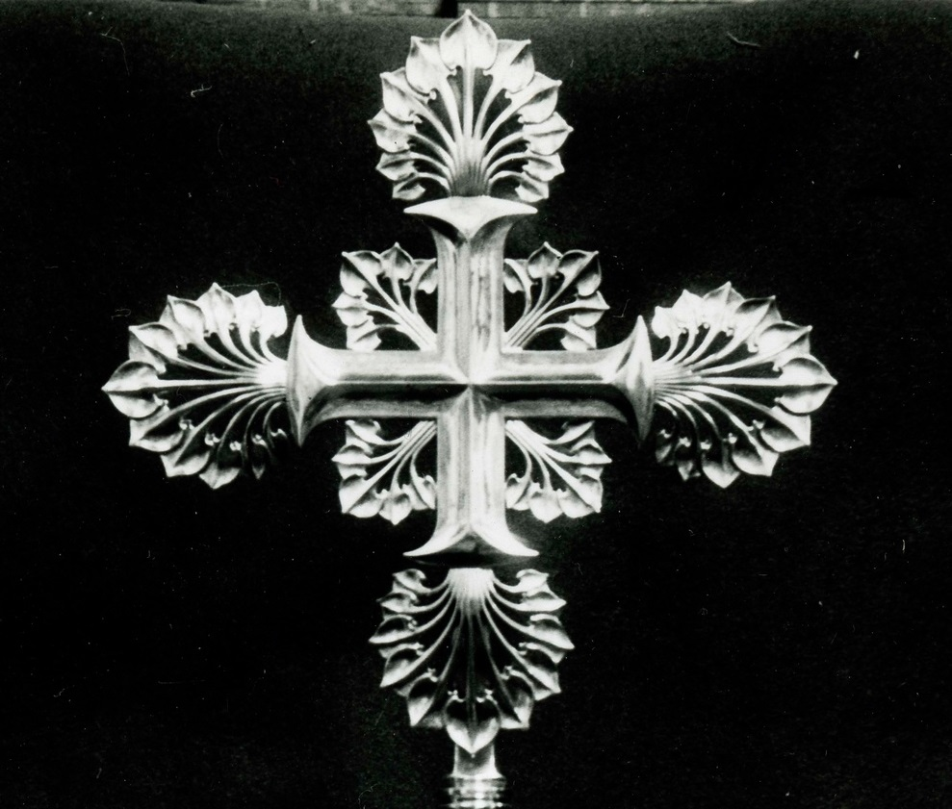
Learning
Notes:
Close-up of a cross
Image:
©2021 Dean & Chapter of Westminster
Please be aware that these images are for educational use only in the classroom and should not be reproduced online.

Slide 8
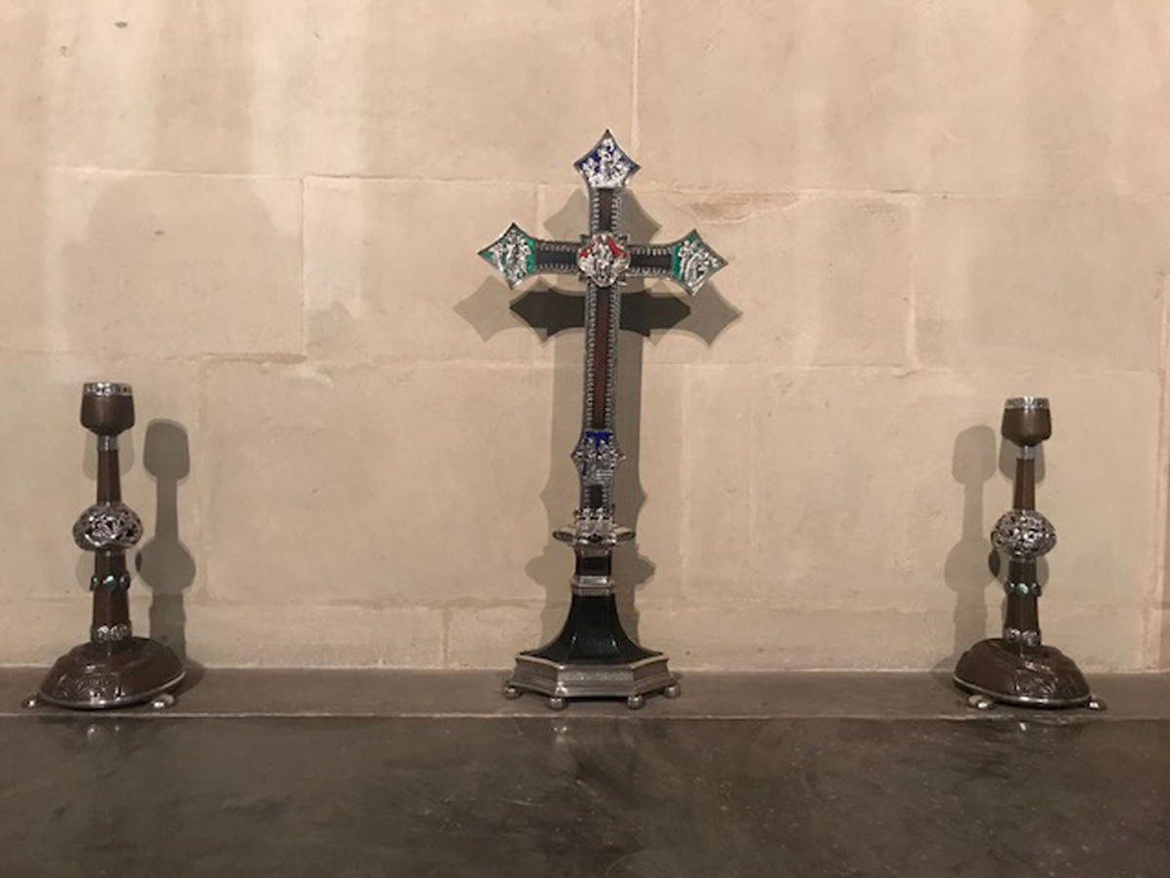
Learning
Notes:
Cross on an altar
Image:
©2021 Dean & Chapter of Westminster
Please be aware that these images are for educational use only in the classroom and should not be reproduced online.

Slide 9
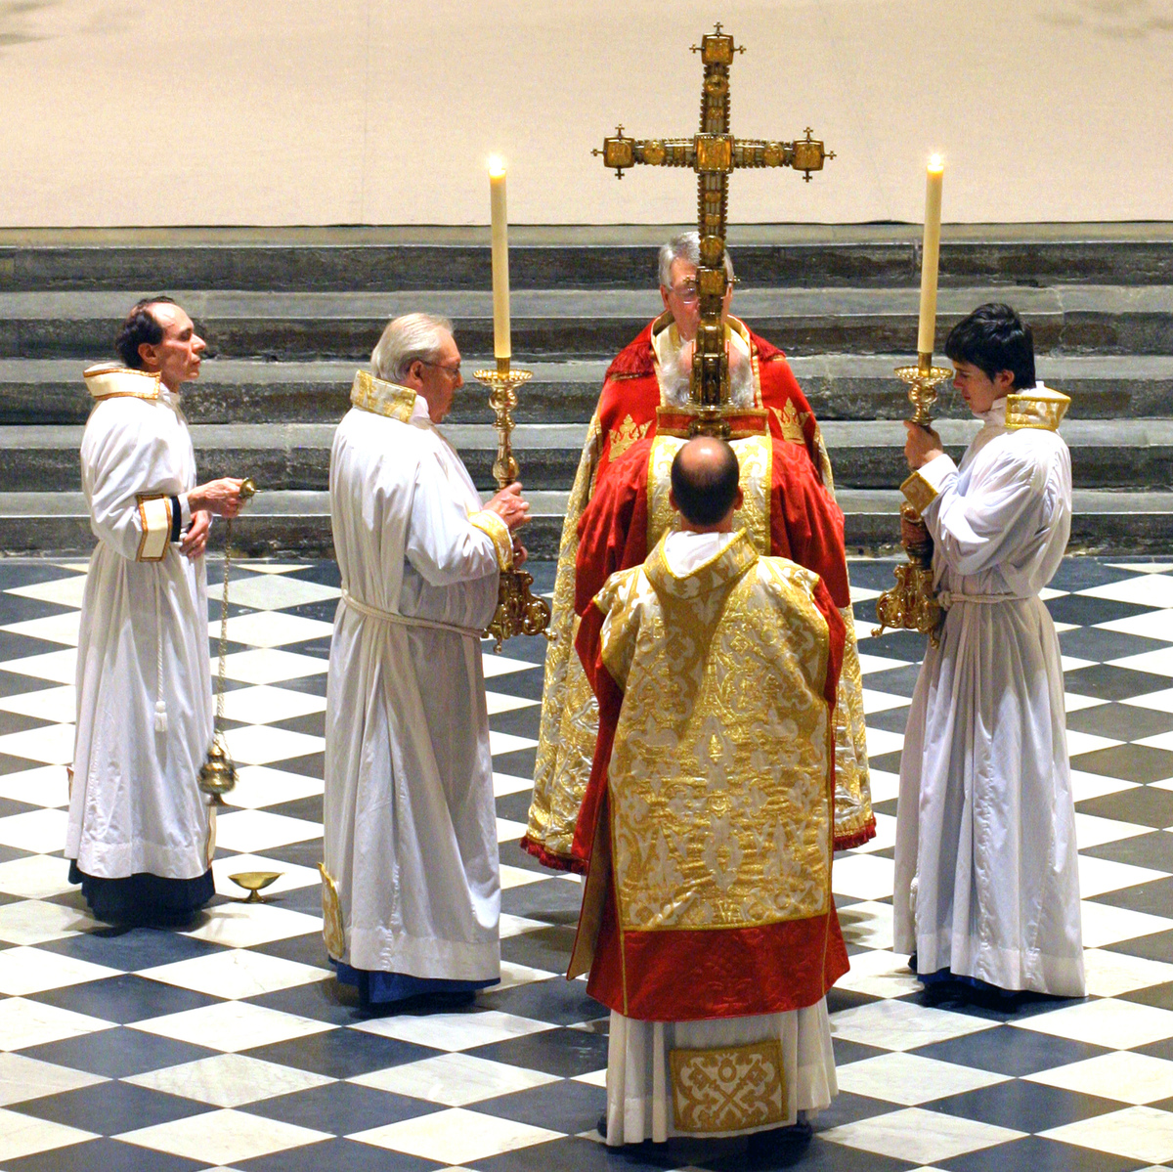
Learning
Notes:
Large cross used during a service
Image:
©2021 Dean & Chapter of Westminster
Please be aware that these images are for educational use only in the classroom and should not be reproduced online.

Slide 10
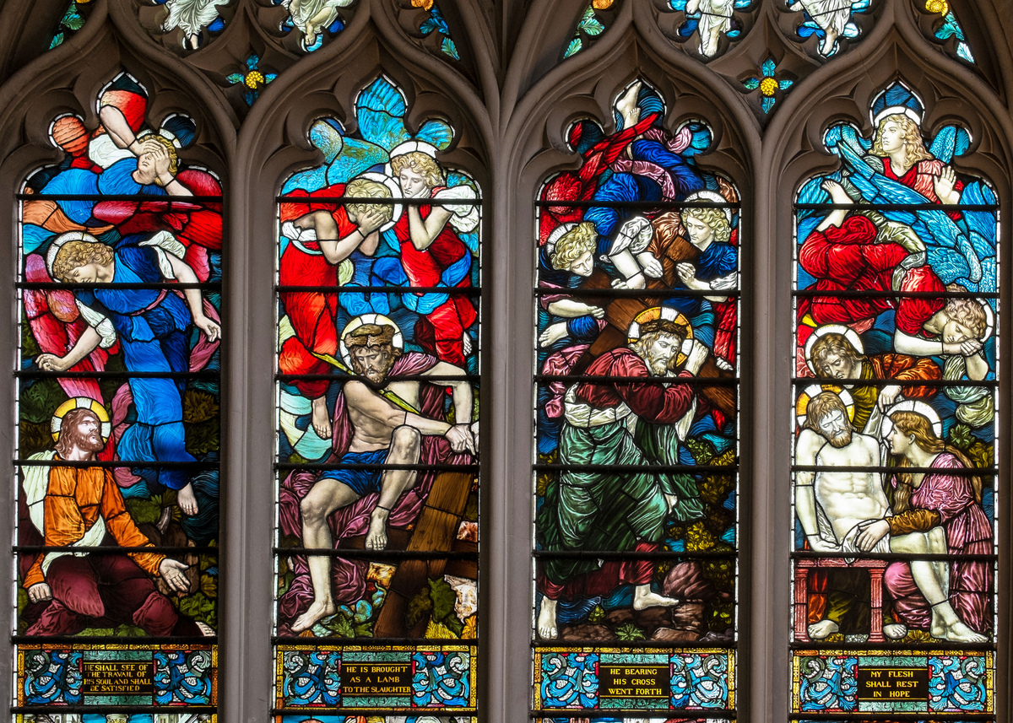
Learning
Notes:
Stained-glass window showing the Passion of Christ
Image:
©2021 Dean & Chapter of Westminster
Please be aware that these images are for educational use only in the classroom and should not be reproduced online.

Slide 11
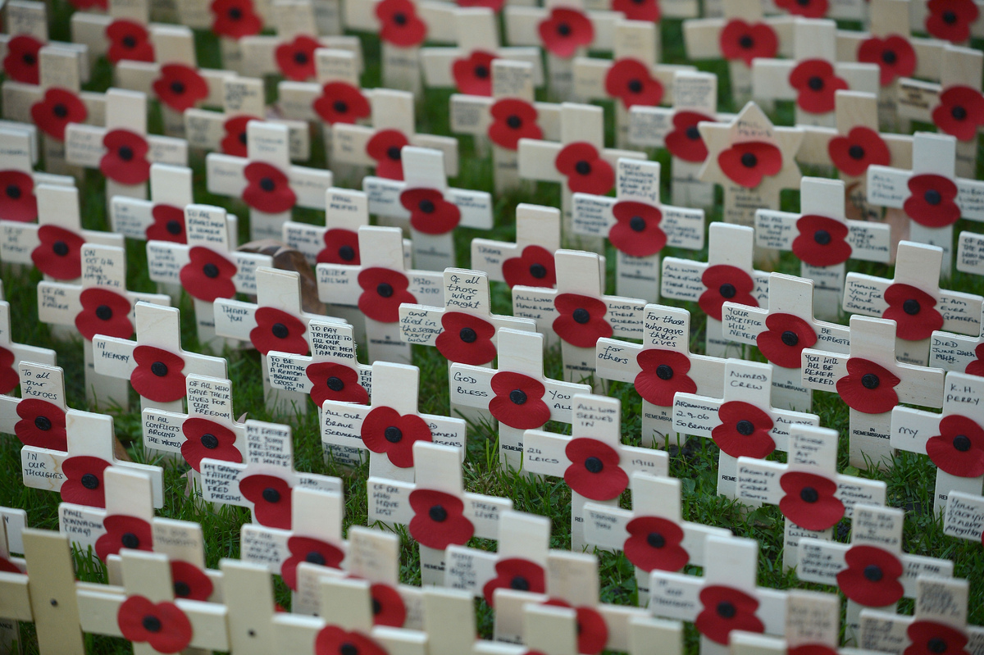
Learning
Notes:
Poppies and crosses within the Field of Remembrance
Image:
©2021 Dean & Chapter of Westminster
Please be aware that these images are for educational use only in the classroom and should not be reproduced online.

Slide 12
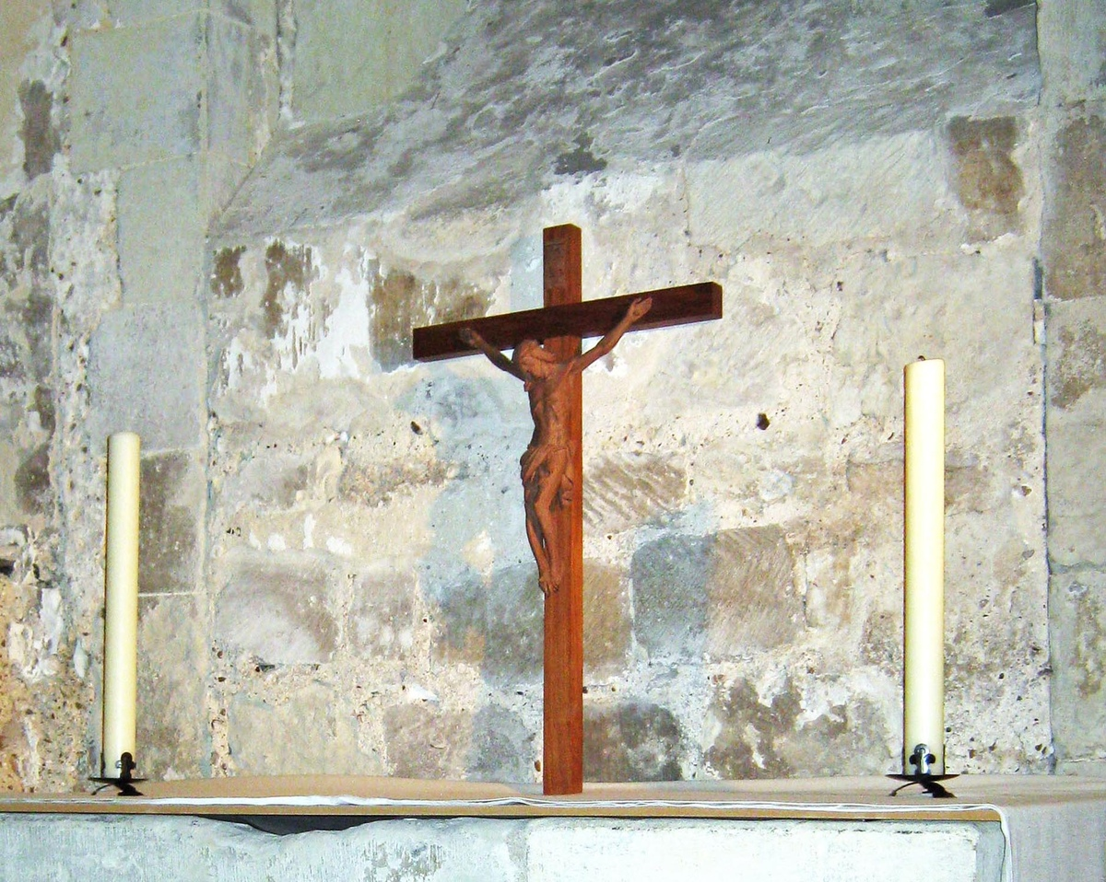
Learning
Notes:
Cross in the Pyx Chamber
Image:
©2021 Dean & Chapter of Westminster
Please be aware that these images are for educational use only in the classroom and should not be reproduced online.

Slide 13
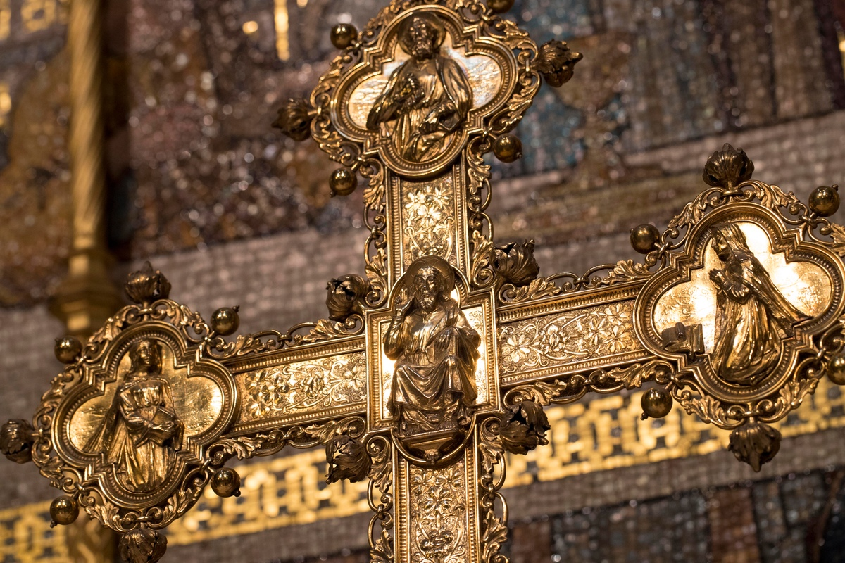
Learning
Notes:
Cross on the High Altar
Image:
©2021 Dean & Chapter of Westminster
Please be aware that these images are for educational use only in the classroom and should not be reproduced online.

Slide 14
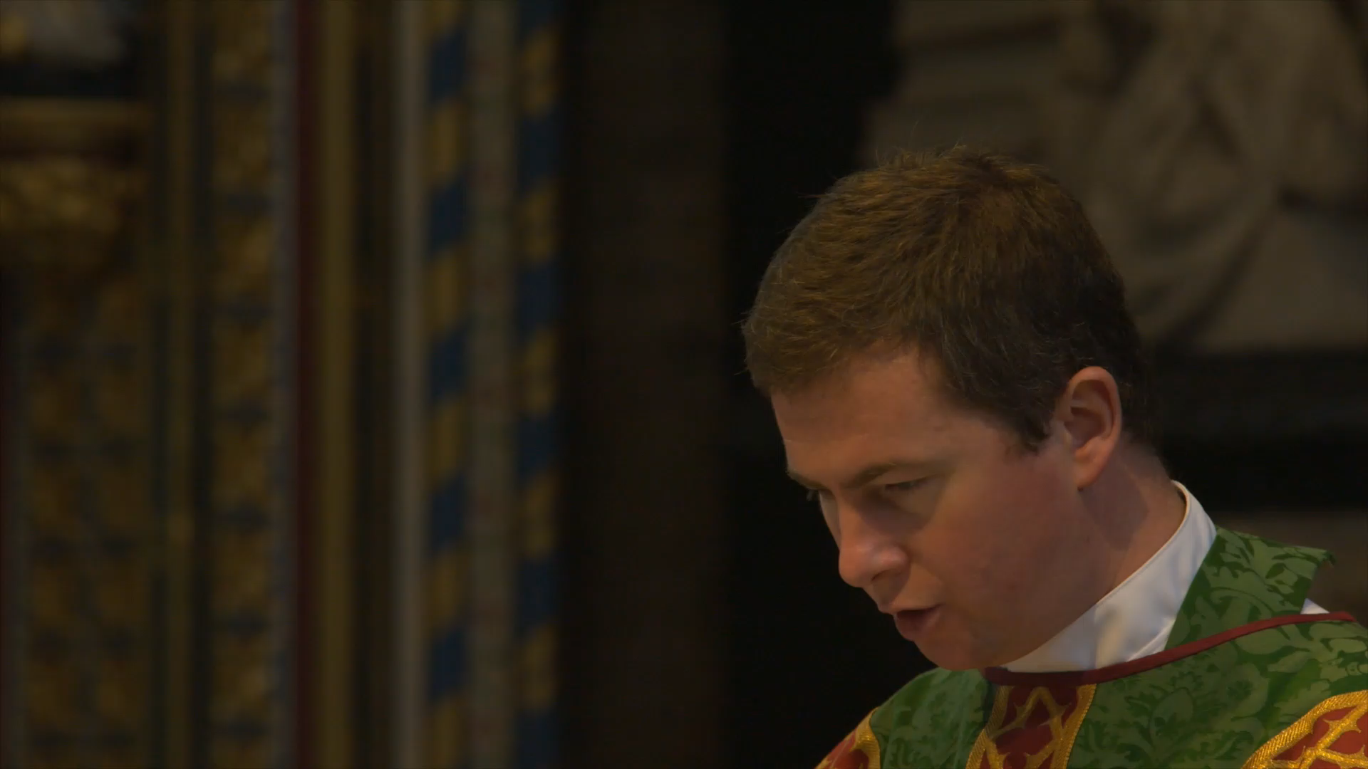
Learning
Notes:
Short clip of priest making the sign of the cross in the air (no audio)
Image:
©2021 Dean & Chapter of Westminster
Please be aware that these images are for educational use only in the classroom and should not be reproduced online.

Slide 15
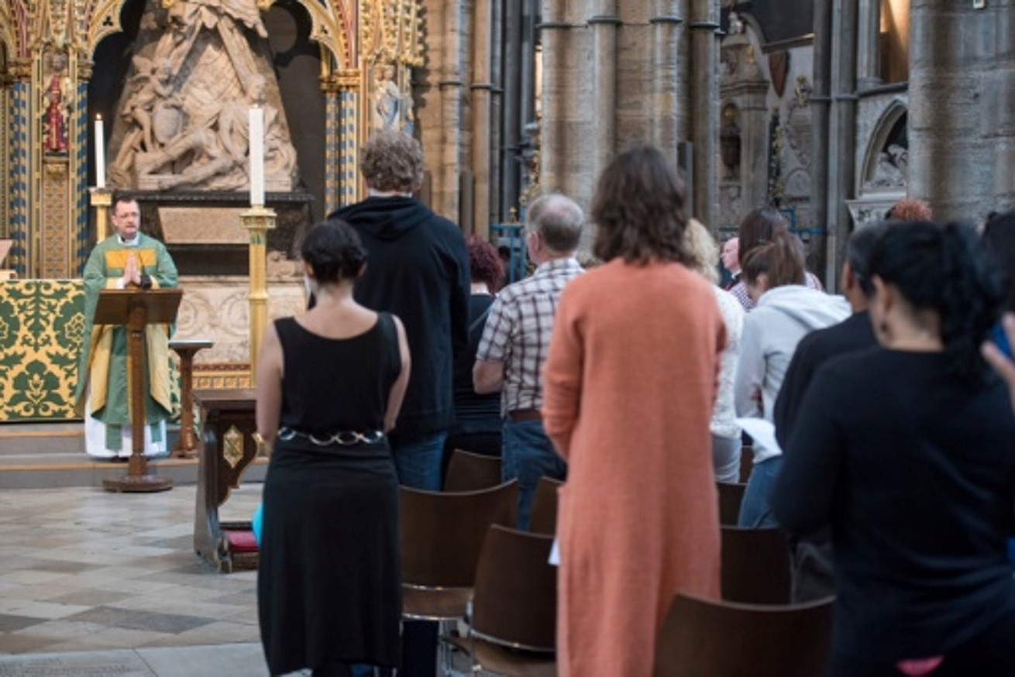
Learning
Notes:
Congregation during a service
Image:
©2021 Dean & Chapter of Westminster
Please be aware that these images are for educational use only in the classroom and should not be reproduced online.

Slide 16
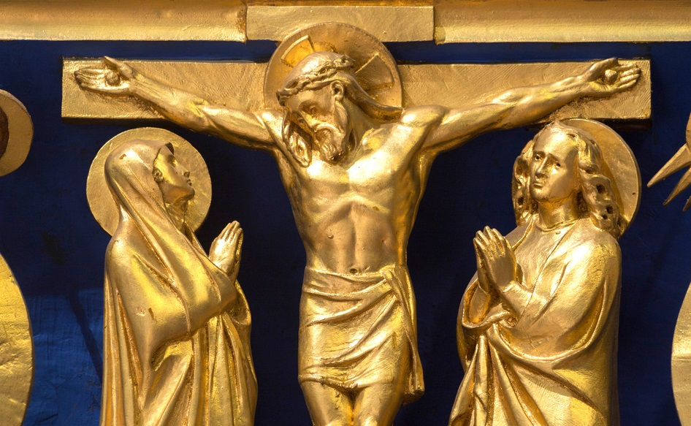
Learning
Notes:
Crucifixion depicted on High Altar screen
Image:
©2021 Dean & Chapter of Westminster
Please be aware that these images are for educational use only in the classroom and should not be reproduced online.

Slide 17
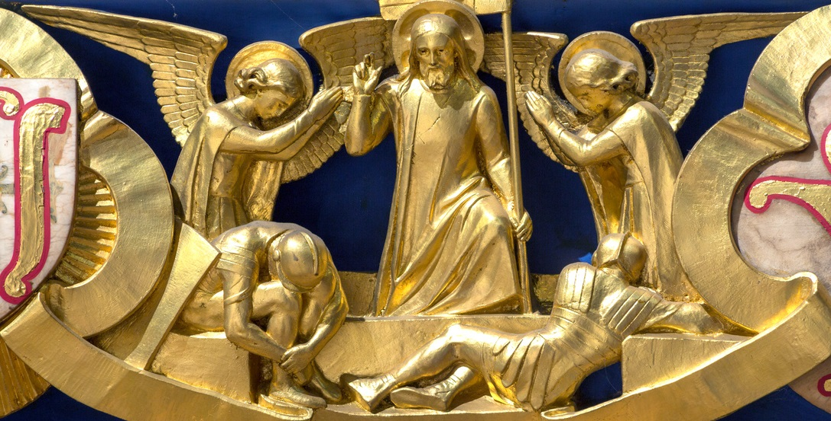
Learning
Notes:
Resurrection depicted on High Altar screen
Image:
©2021 Dean & Chapter of Westminster
Please be aware that these images are for educational use only in the classroom and should not be reproduced online.

Slide 18
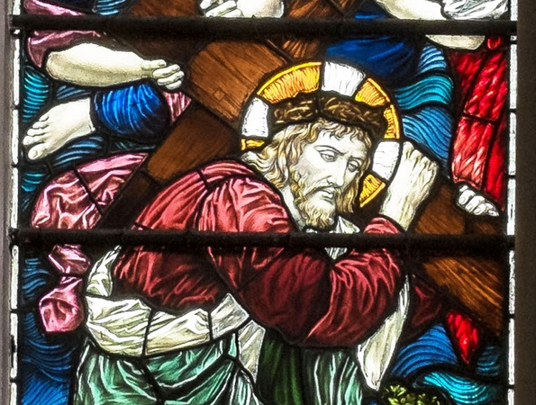
Learning
Notes:
Stained-glass window showing Christ carrying the cross
Image:
©2021 Dean & Chapter of Westminster
Please be aware that these images are for educational use only in the classroom and should not be reproduced online.

Slide 19
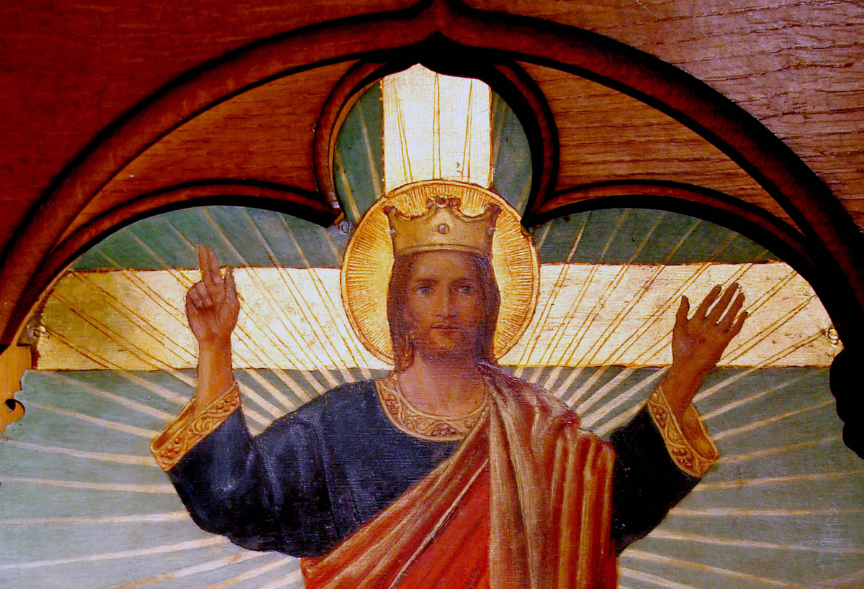
Learning
Notes:
Image of Christ in St Faith’s chapel
Image:
©2021 Dean & Chapter of Westminster
Please be aware that these images are for educational use only in the classroom and should not be reproduced online.

Slide 20
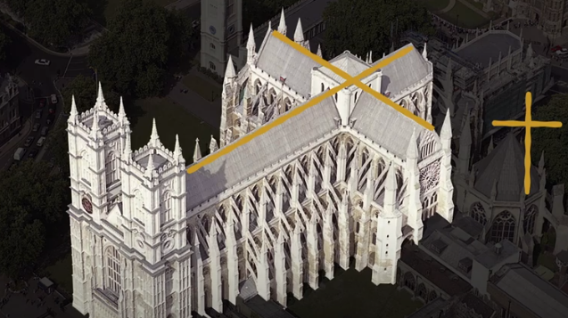
Learning
Notes:
Bird’s-eye view showing Westminster Abbey built in the shape of the cross
Image:
©2021 Dean & Chapter of Westminster
Please be aware that these images are for educational use only in the classroom and should not be reproduced online.

