Slide 1
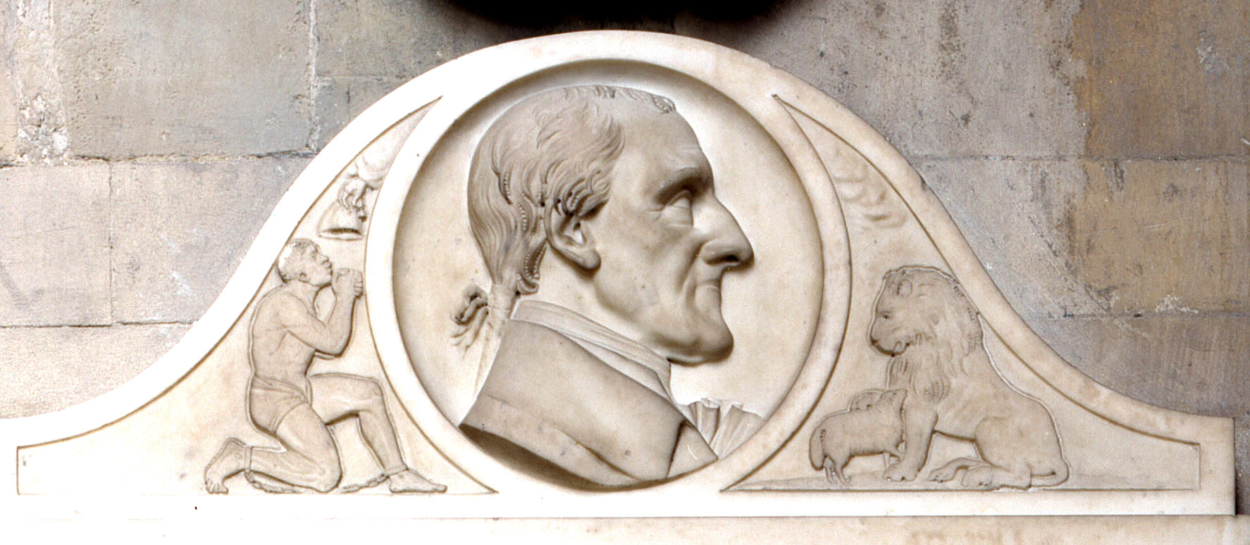
Westminster Abbey
Learning
Abolitionists image bank
©2024 Dean and Chapter of Westminster
1
Notes:
Image:
©2024 Dean & Chapter of Westminster

Slide 2
Westminster Abbey
Learning
Information for teachers
Thank you for downloading this resource. We hope that it has been a useful teaching tool in your classroom.
As we continue to grow our free catalogue of teaching resources, we’d really appreciate a few minutes of your time to let us know what you liked and what could be improved. Please complete this five-question survey
2
Notes:
Image:
©2024 Dean & Chapter of Westminster

Slide 3
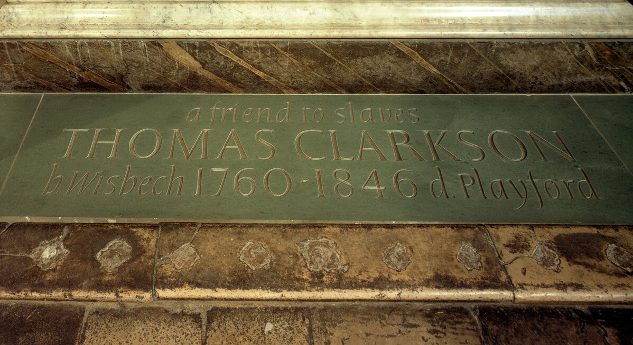
Learning
Notes:
Thomas Clarkson memorial
Image:
©2024 Dean & Chapter of Westminster

Slide 4
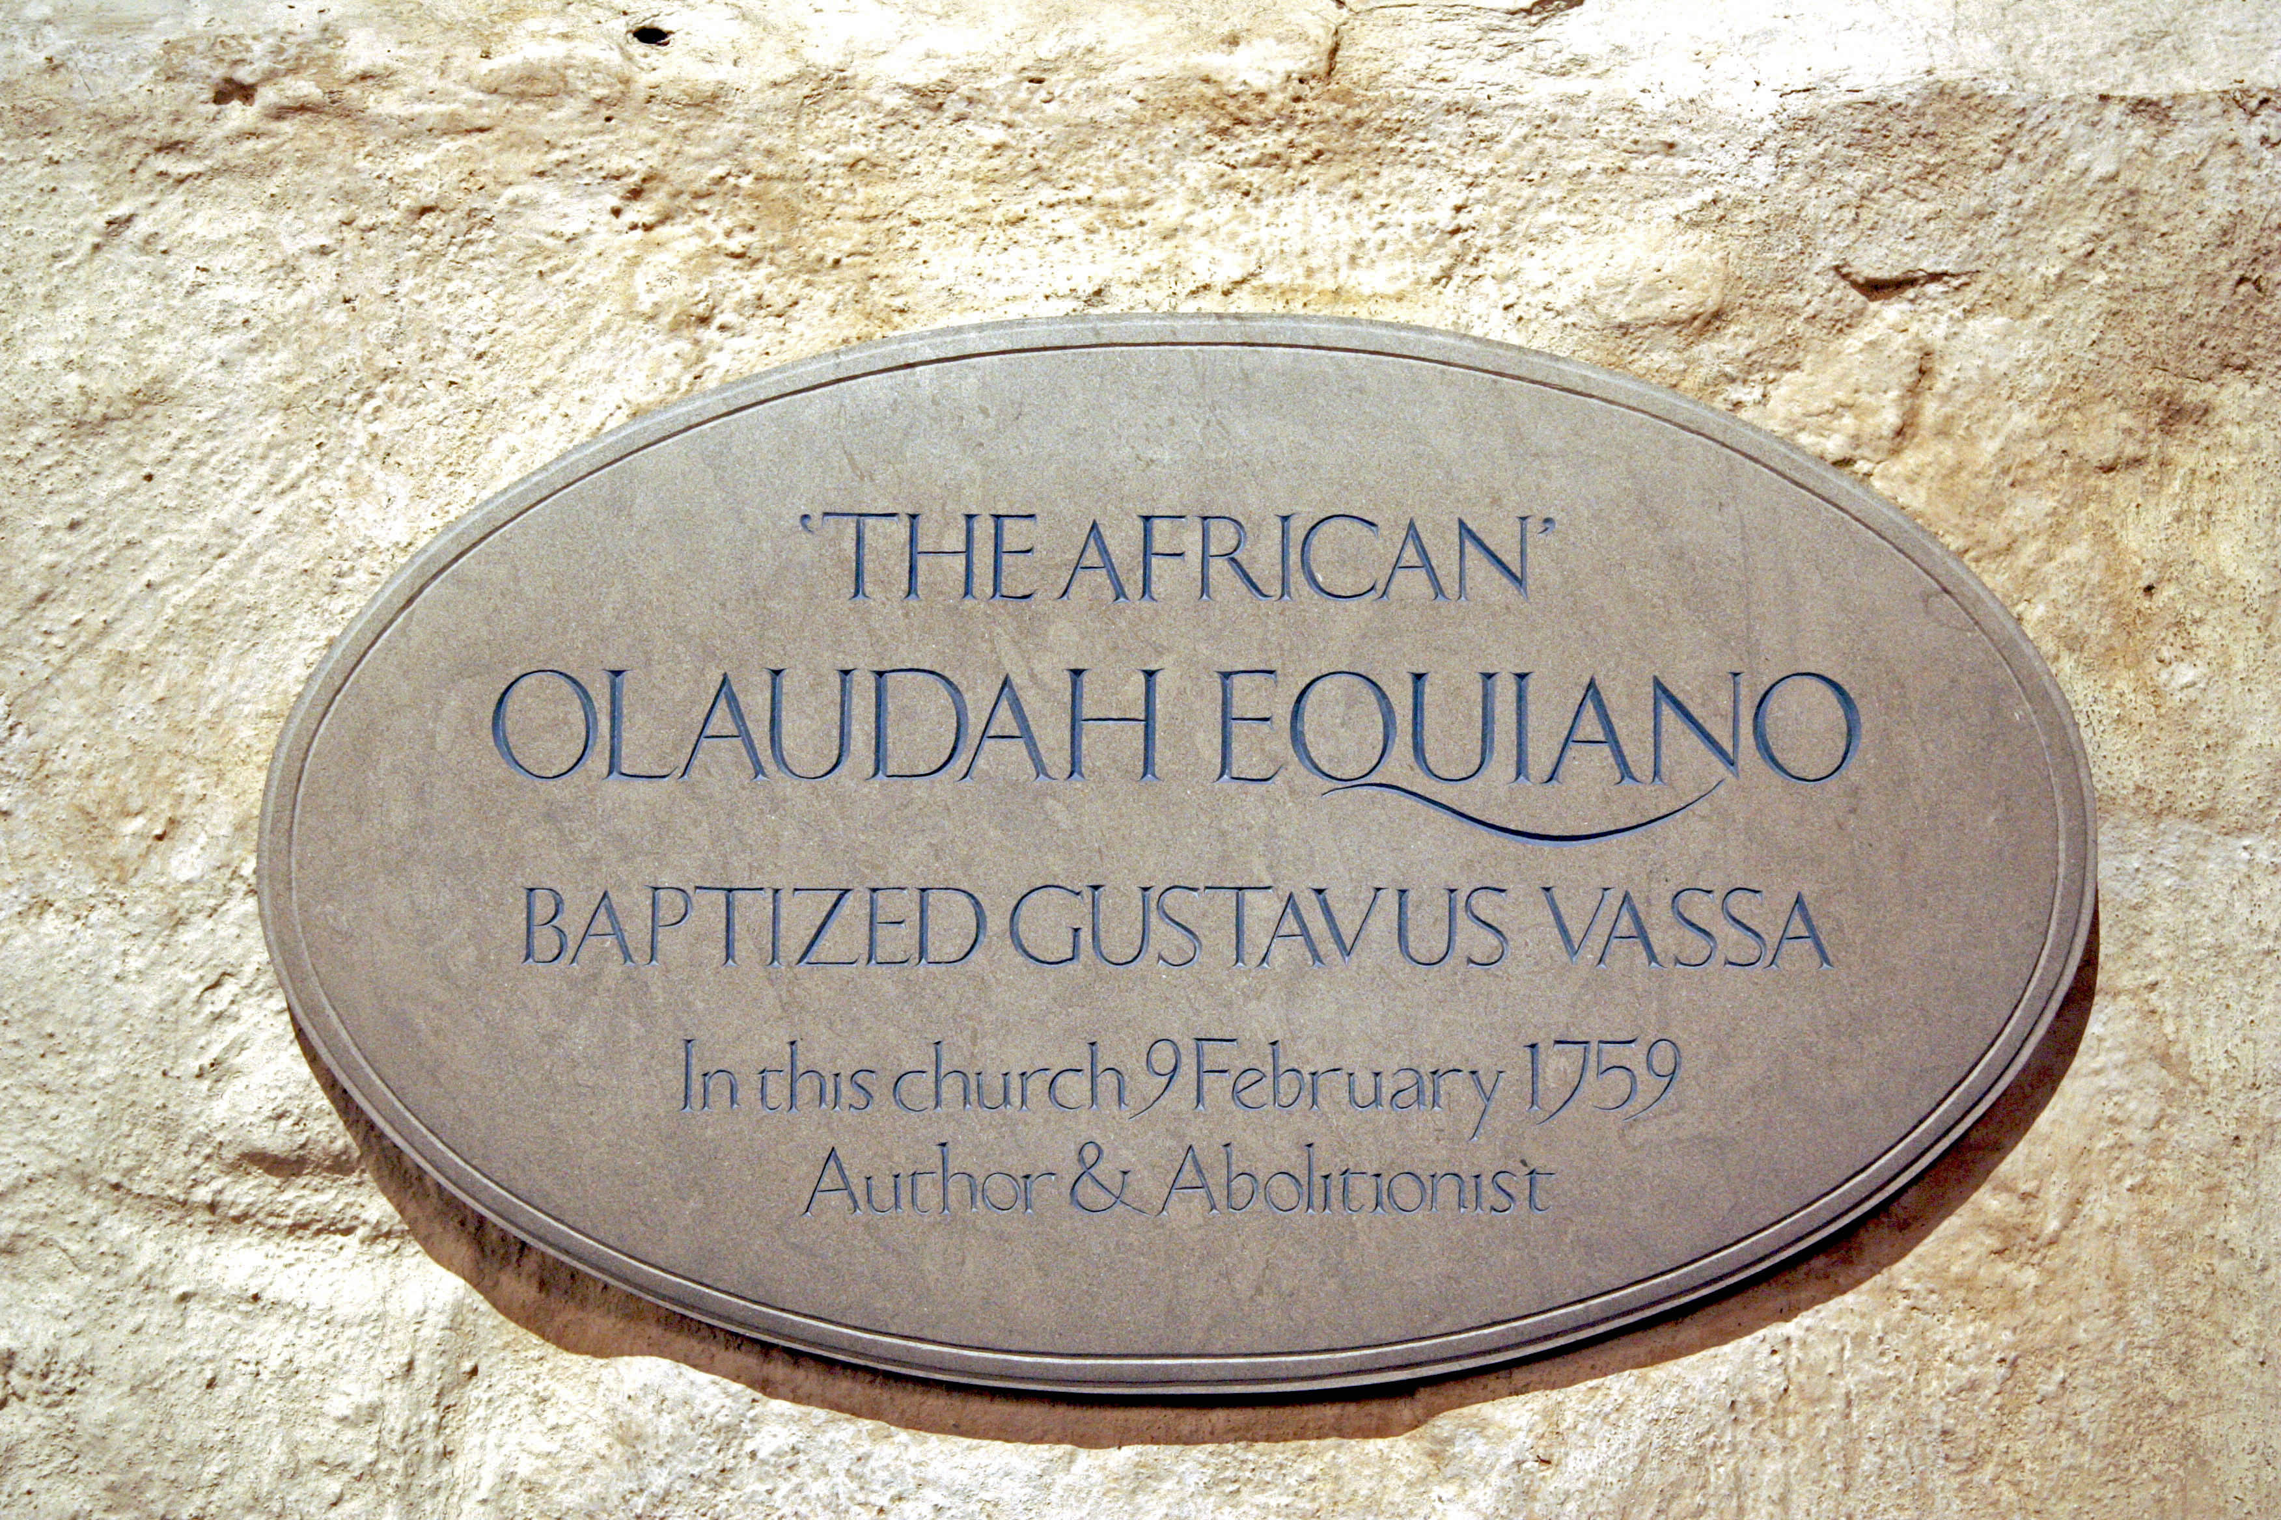
Learning
Notes:
Olaudah Equiano memorial, in St Margaret's Church
Image:
©2024 Dean & Chapter of Westminster

Slide 5
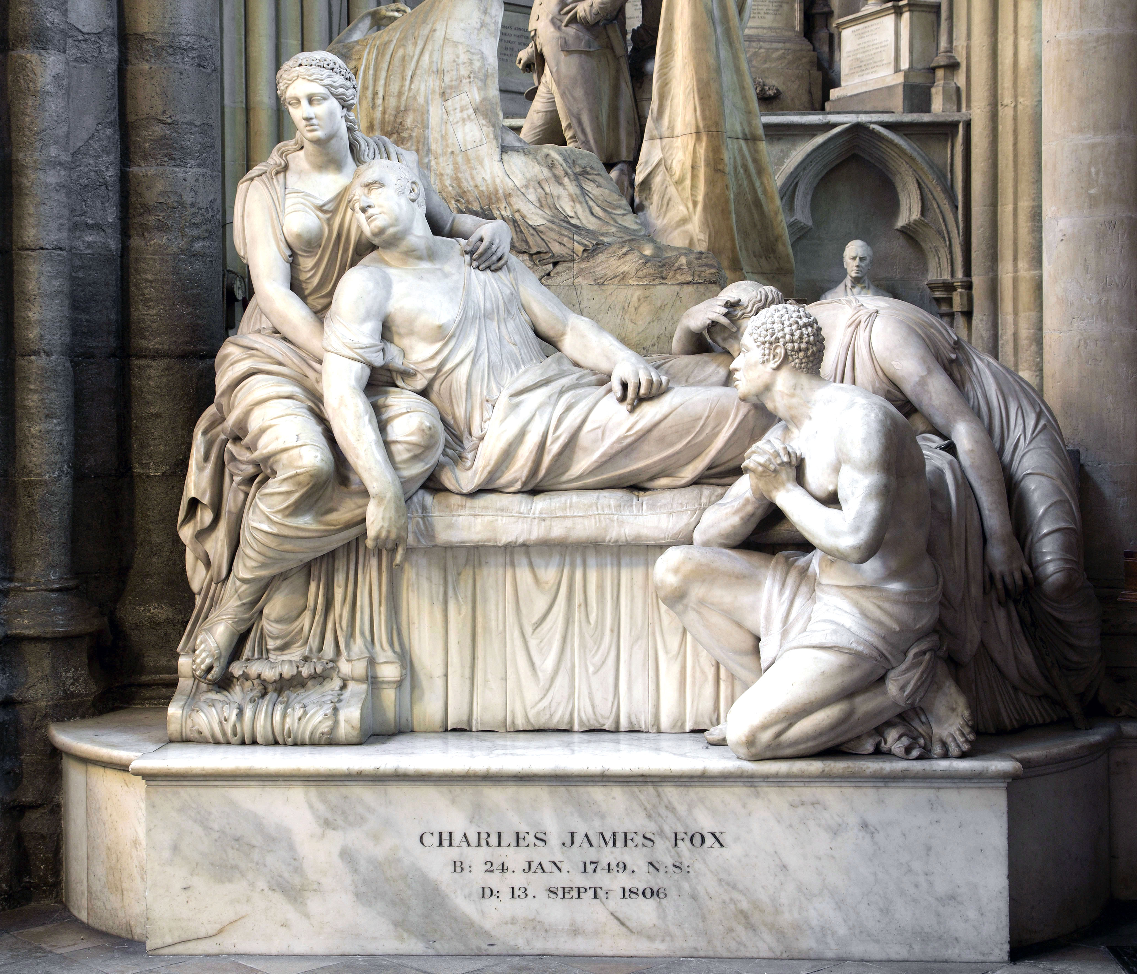
Learning
Notes:
Monument to Charles James Fox
Image:
©2024 Dean & Chapter of Westminster

Slide 6
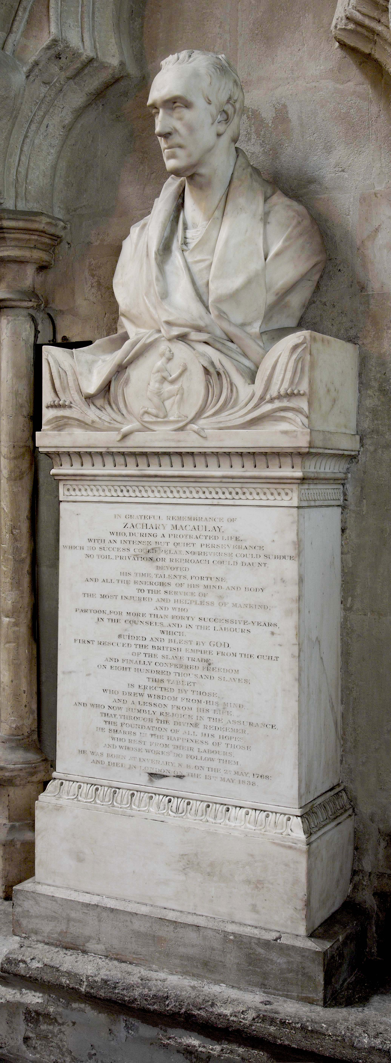
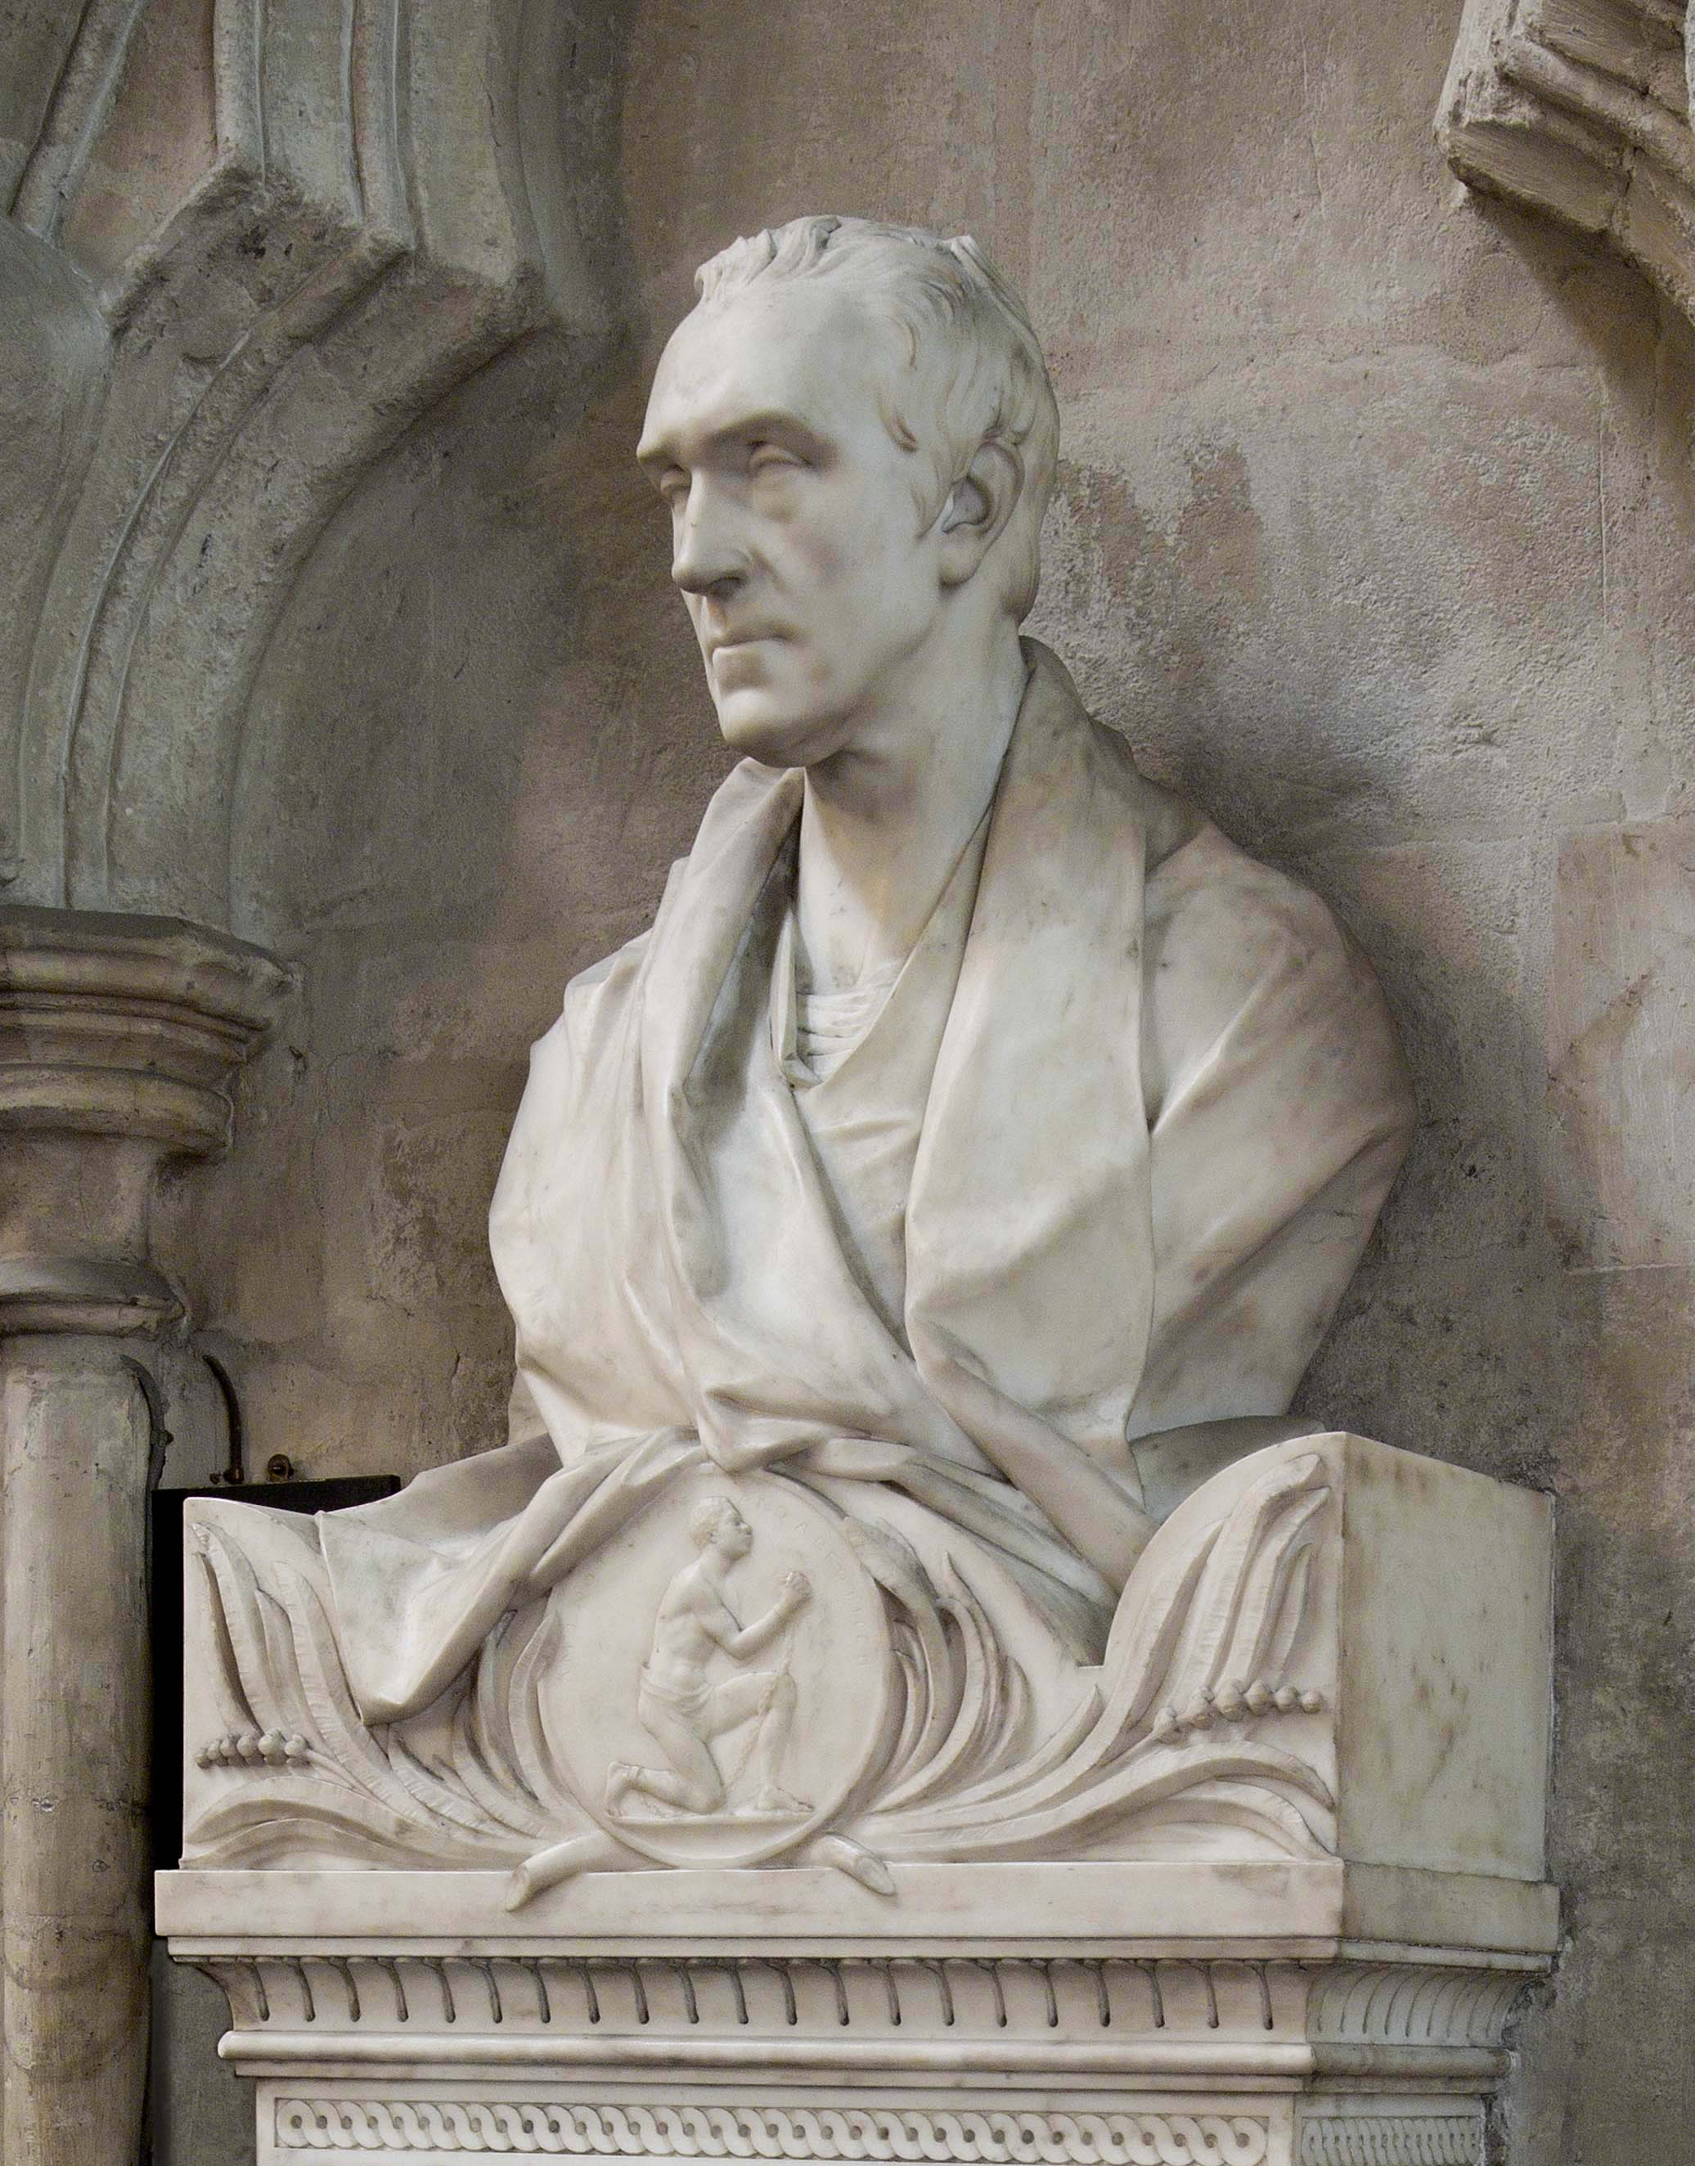
Learning
Notes:
Bust of Zachary Macaulay
Image:
©2024 Dean & Chapter of Westminster

Slide 7
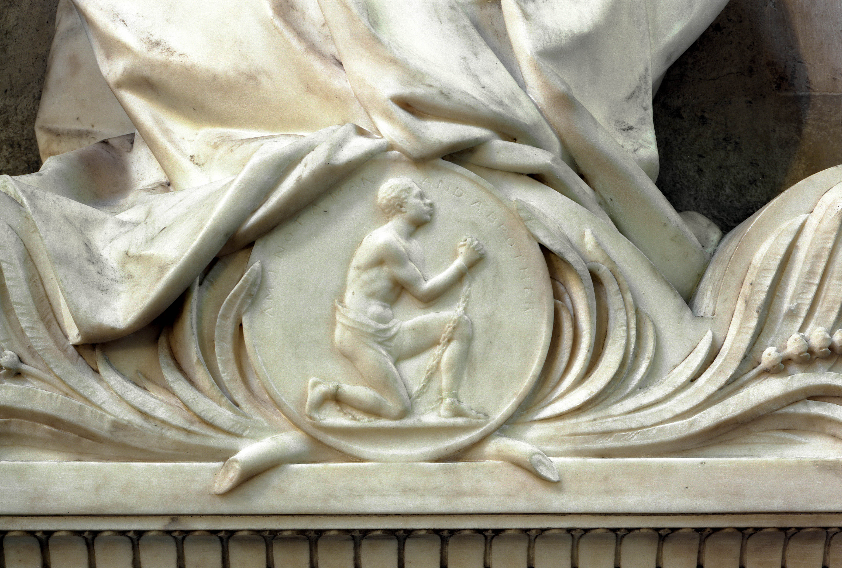
Learning
Notes:
Bust of Zachary Macaulay (detail)
Image:
©2024 Dean & Chapter of Westminster

Slide 8
Learning
Notes:
Memorial to Ignatius Sancho, in St Margaret's Church
Image:
©2024 Dean & Chapter of Westminster

Slide 9
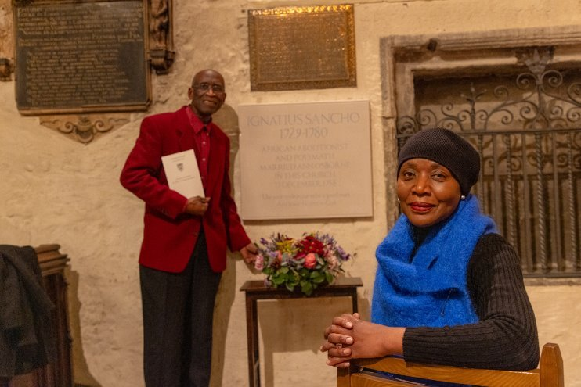
Learning
Notes:
Arthur Torrington (left) and Marcia Bennett-Male (right) with the Ignatius Sancho memorial.
Image:
©2024 Dean & Chapter of Westminster

Slide 10
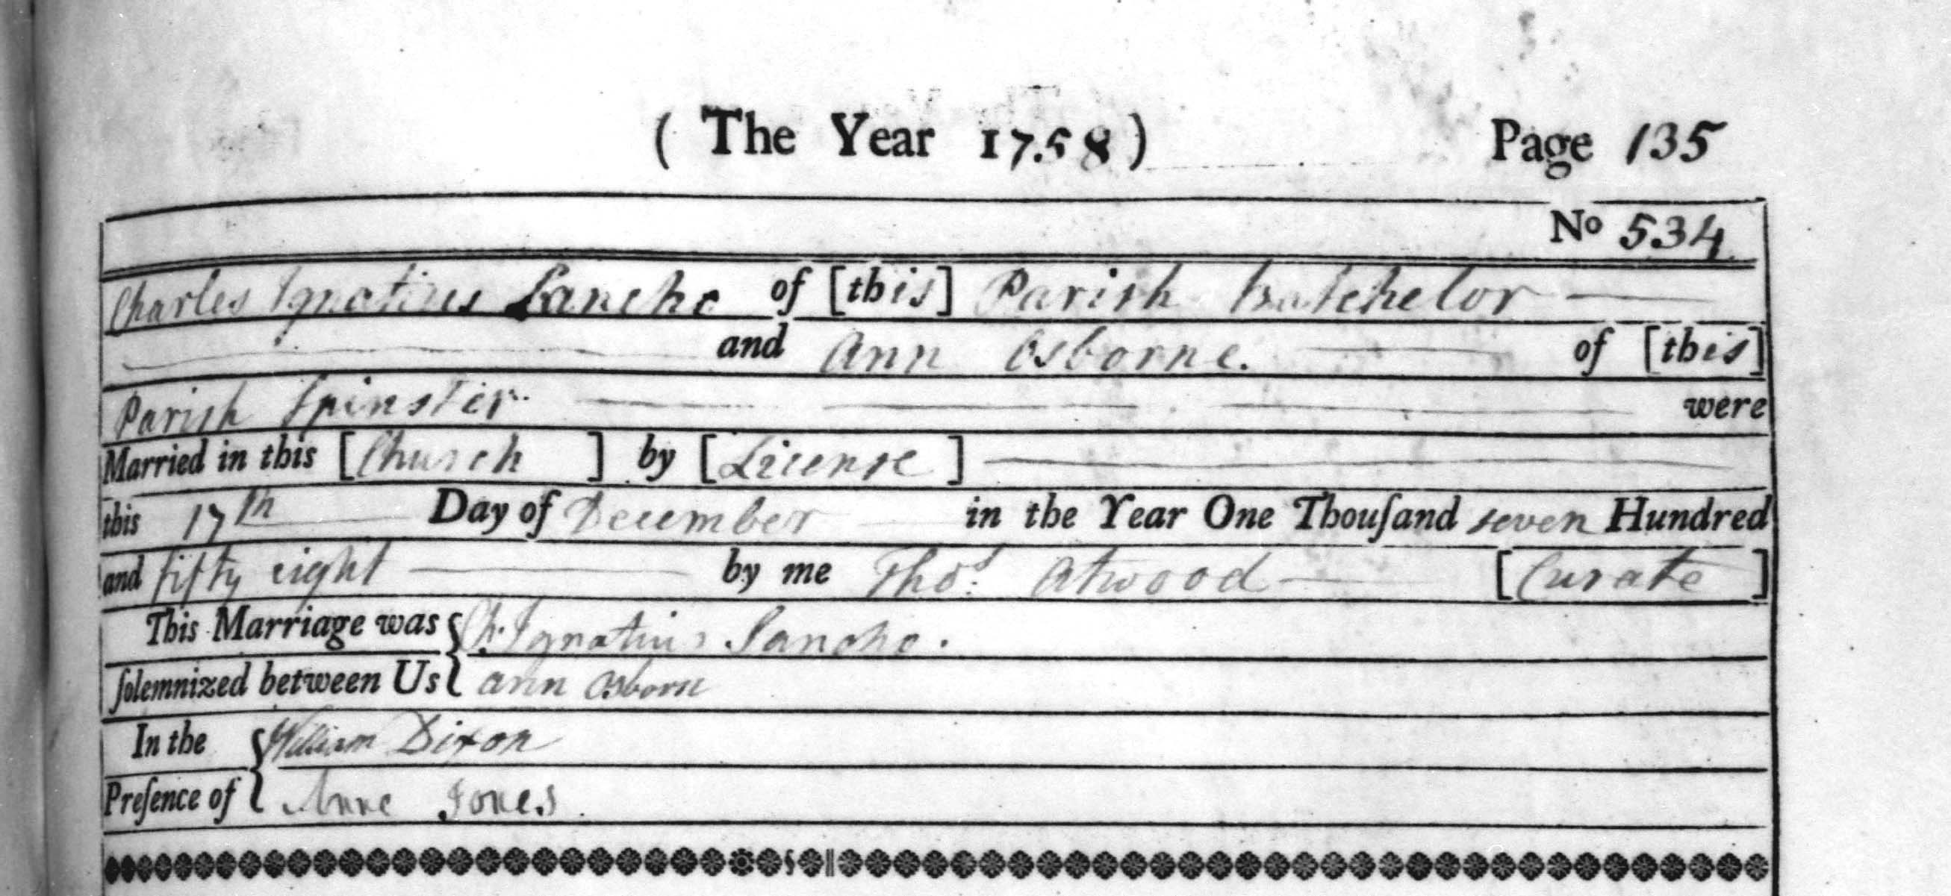
Learning
Notes:
Ignatius Sancho's marriage license
Image:
©2024 Dean & Chapter of Westminster

Slide 11
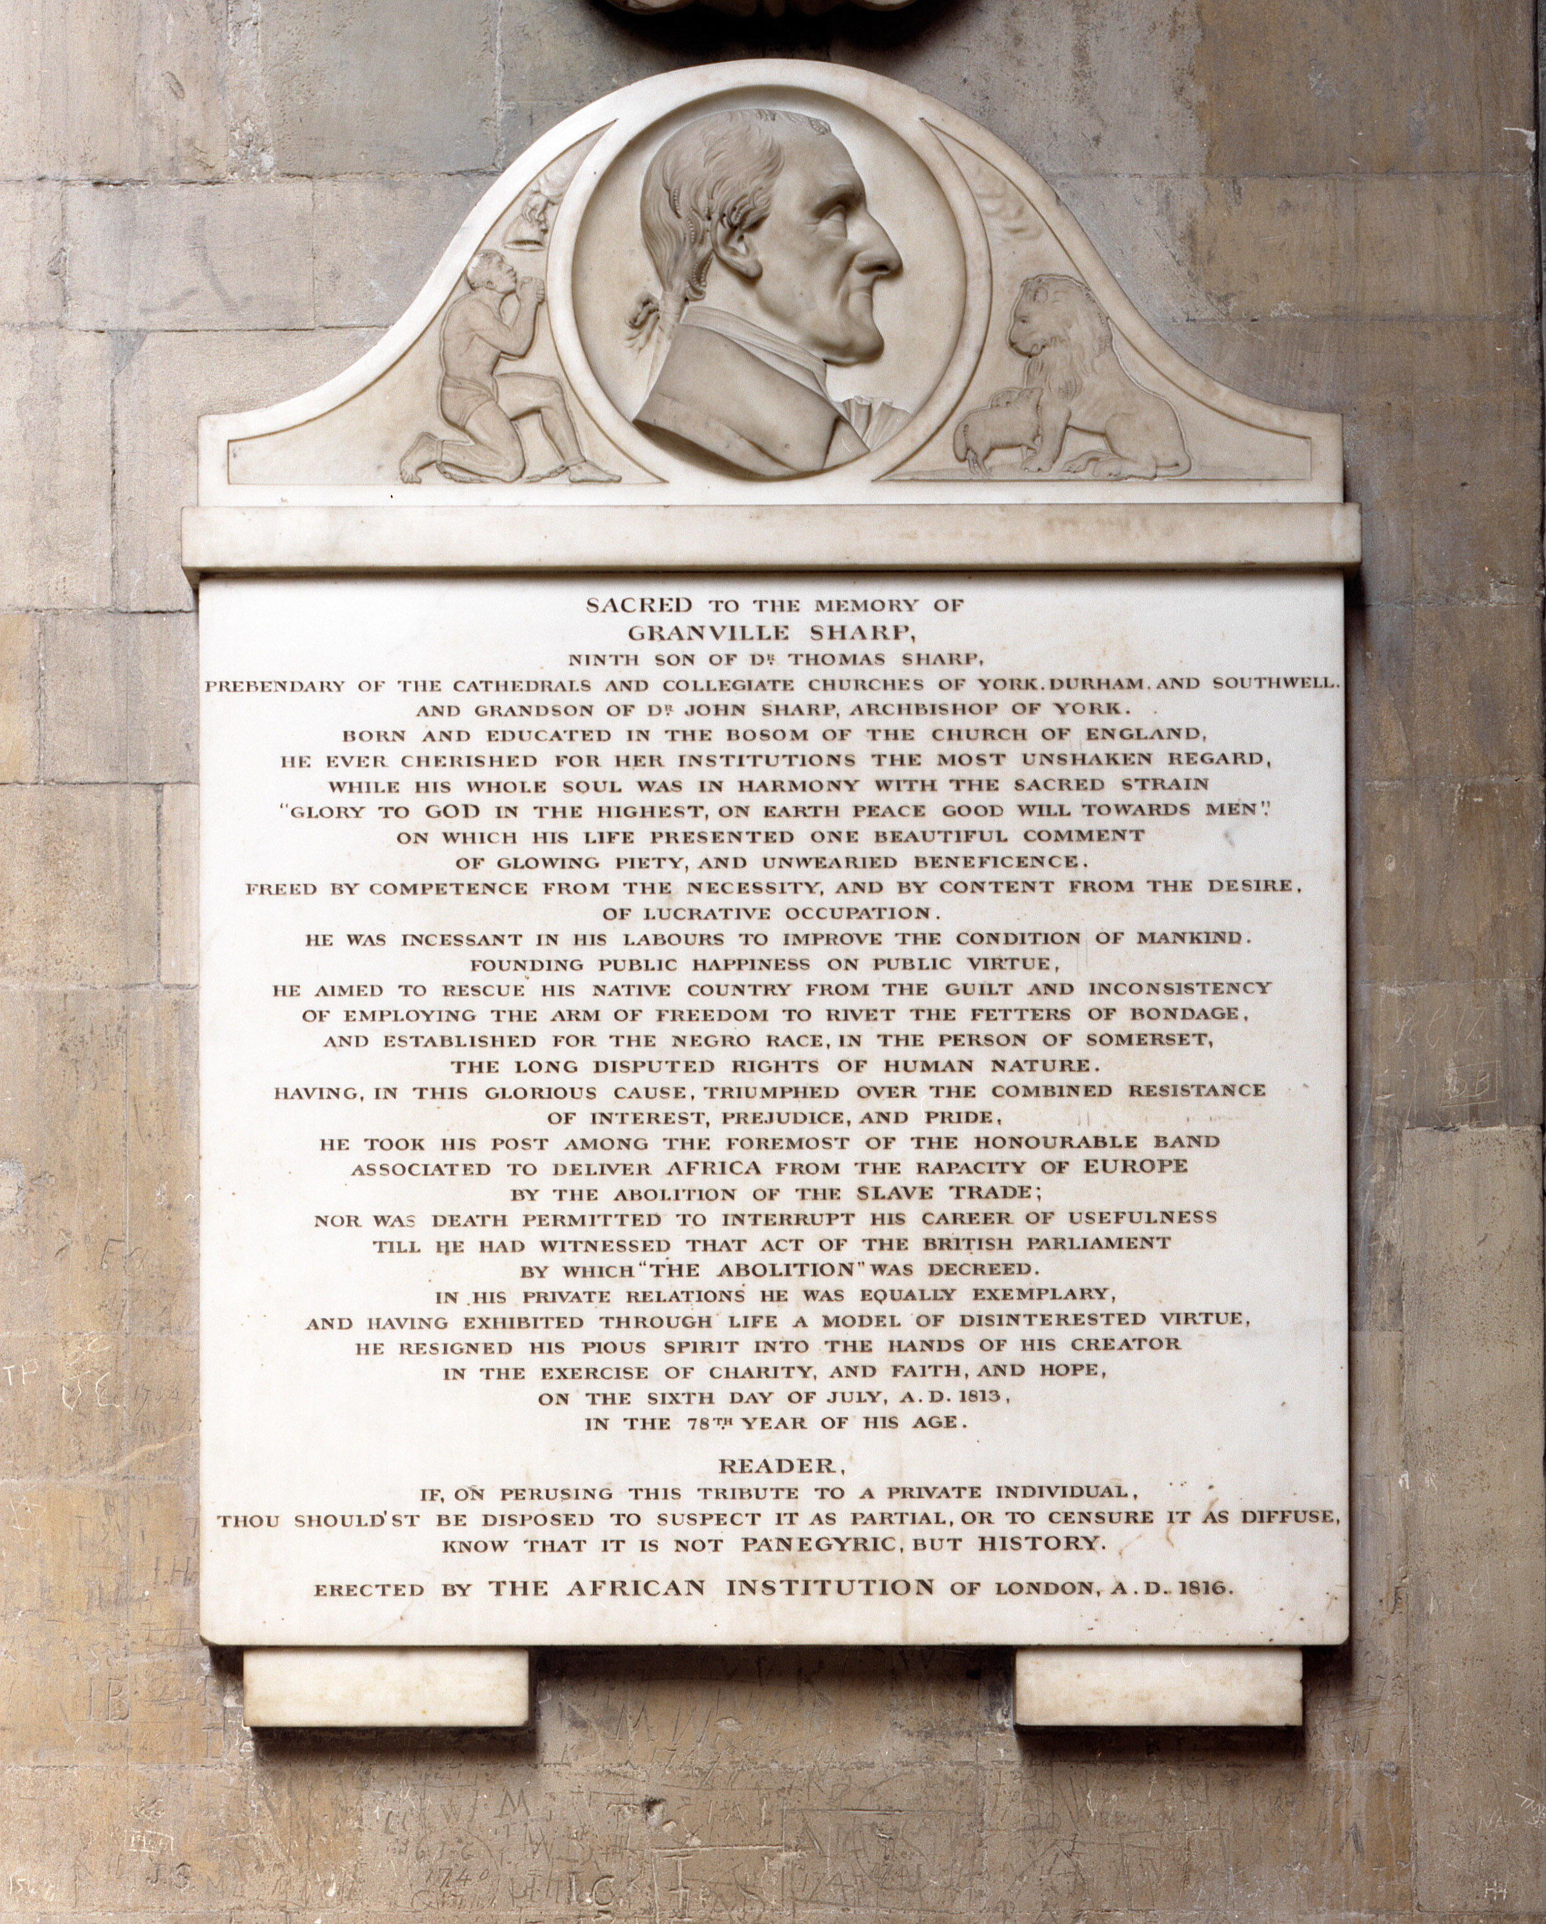
Learning
Notes:
Memorial to Granville Sharp
Image:
©2024 Dean & Chapter of Westminster

Slide 12
Learning
Notes:
Memorial to Granville Sharp (detail)
Image:
©2024 Dean & Chapter of Westminster

Slide 13
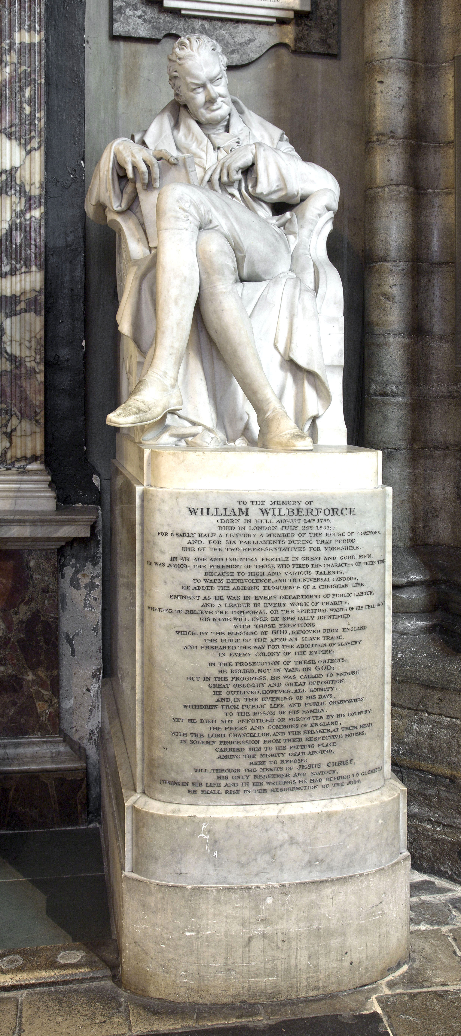
Learning
Notes:
Statue of William Wilberforce
Image:
©2024 Dean & Chapter of Westminster

Slide 14
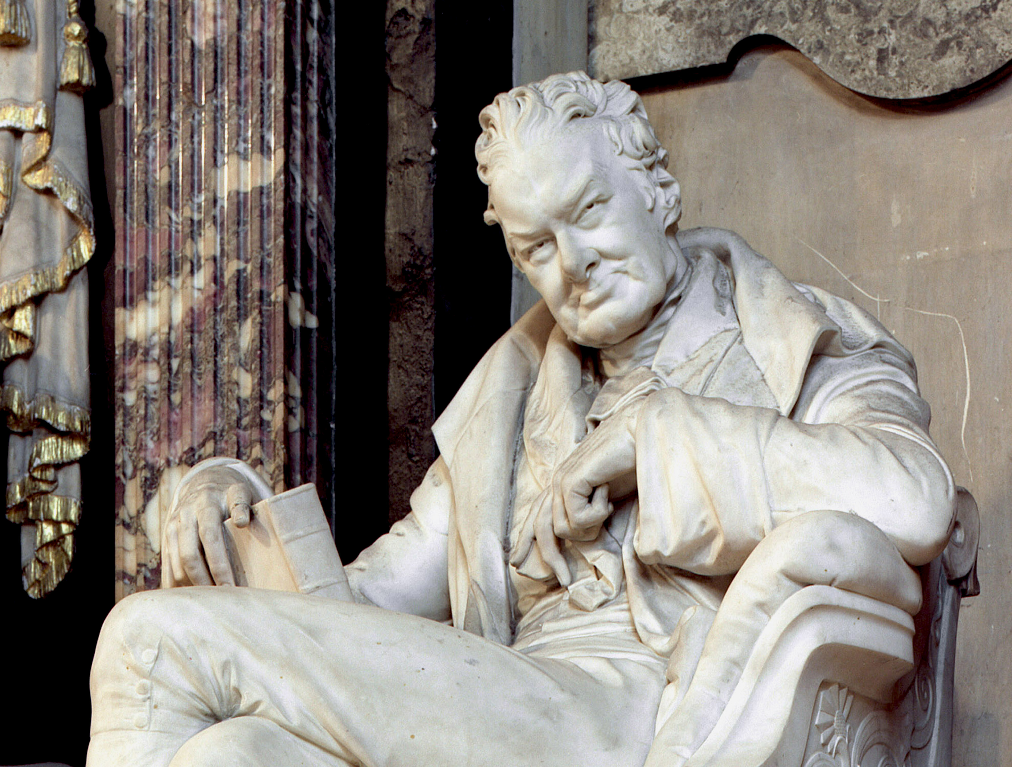
Learning
Notes:
Statue of William Wilberforce (detail)
Images:
©2024 Dean & Chapter of Westminster

Slide 15
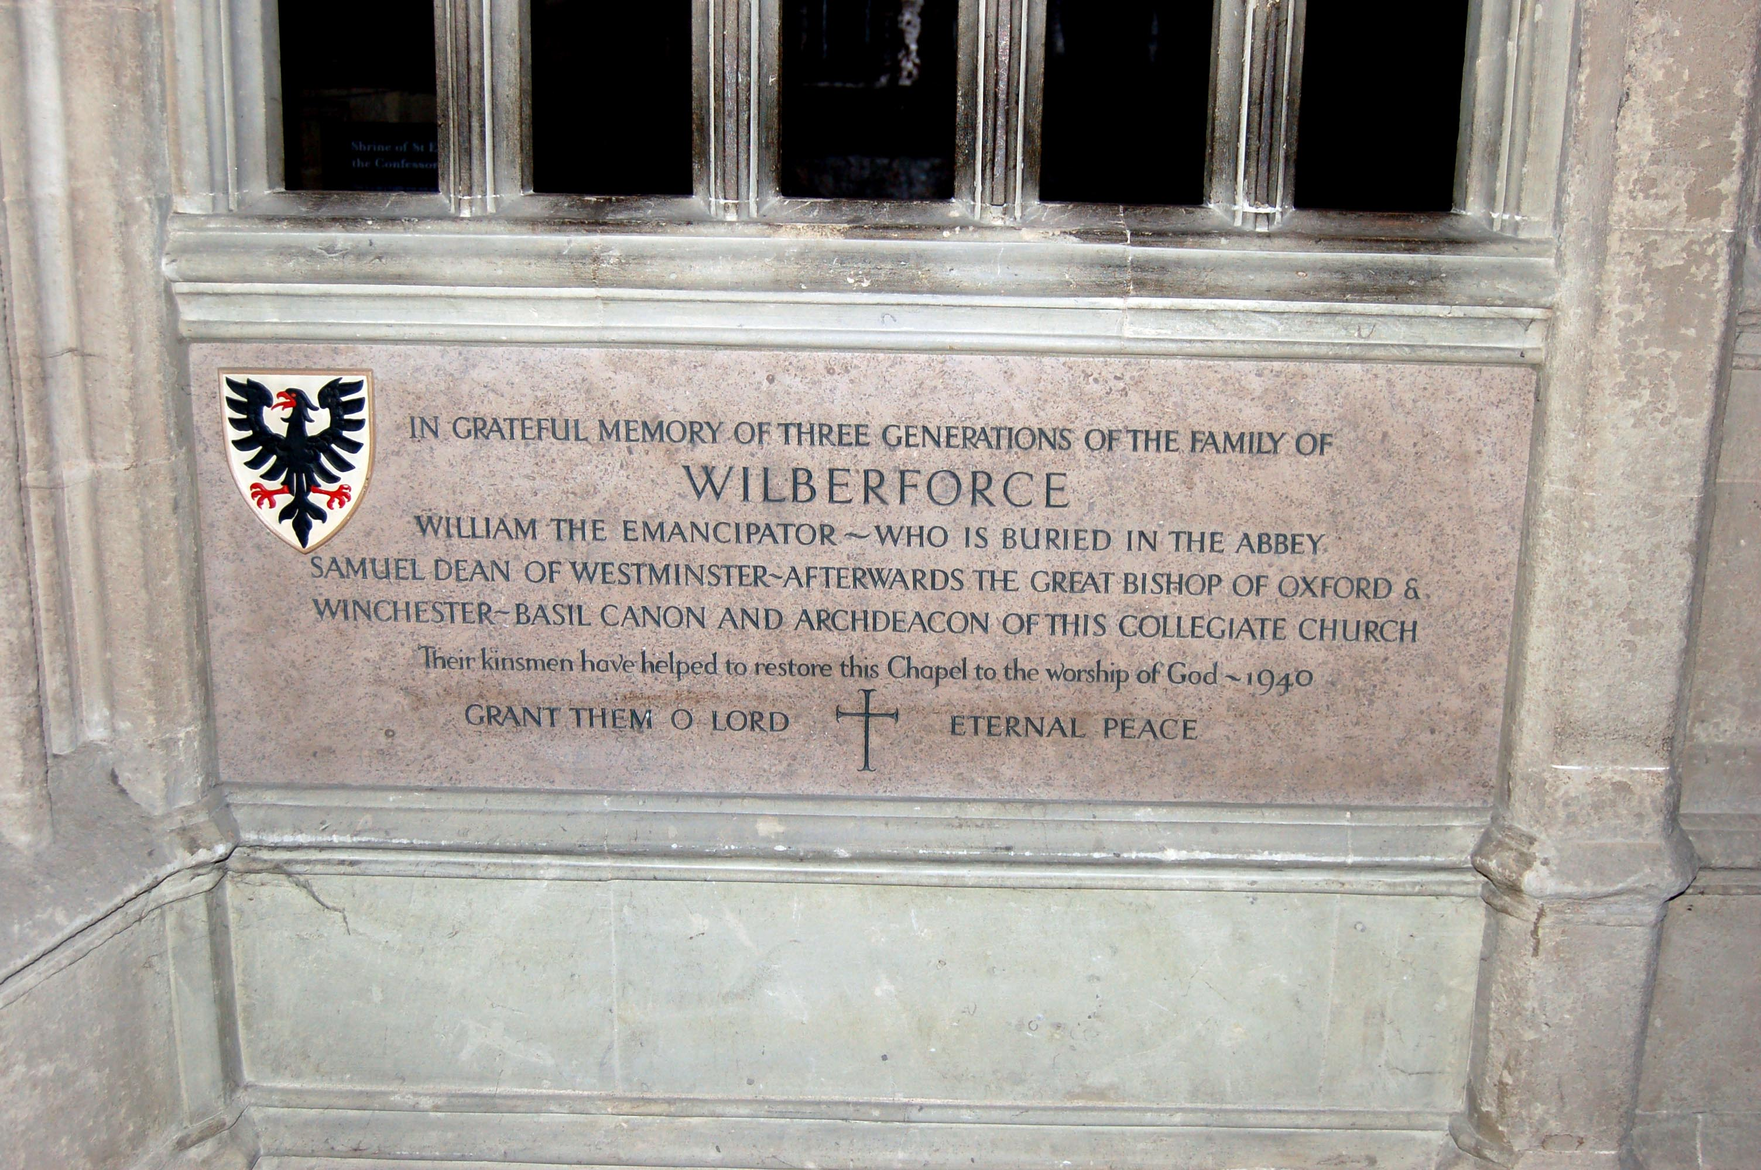
Learning
Notes:
Wilberforce family plaque
Image:
©2024 Dean & Chapter of Westminster

Slide 16
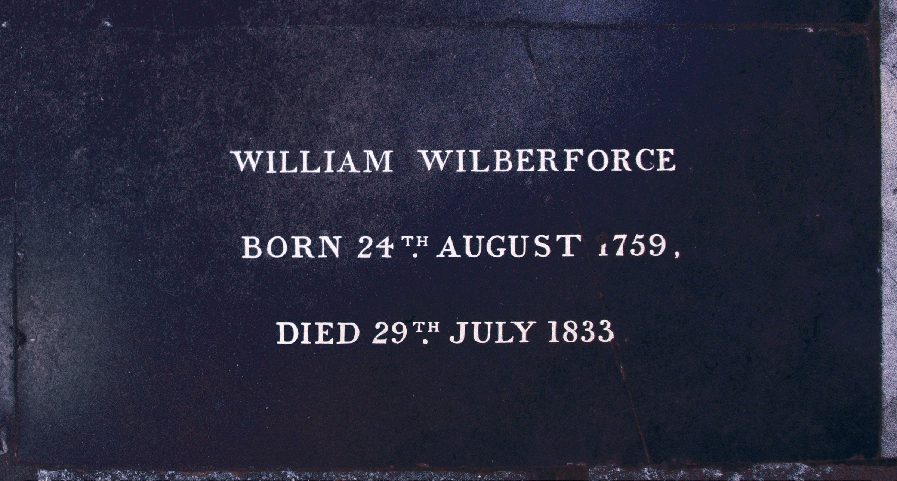
Learning
Notes:
Grave of William Wilberforce
Image:
©2024 Dean & Chapter of Westminster

