Slide 1
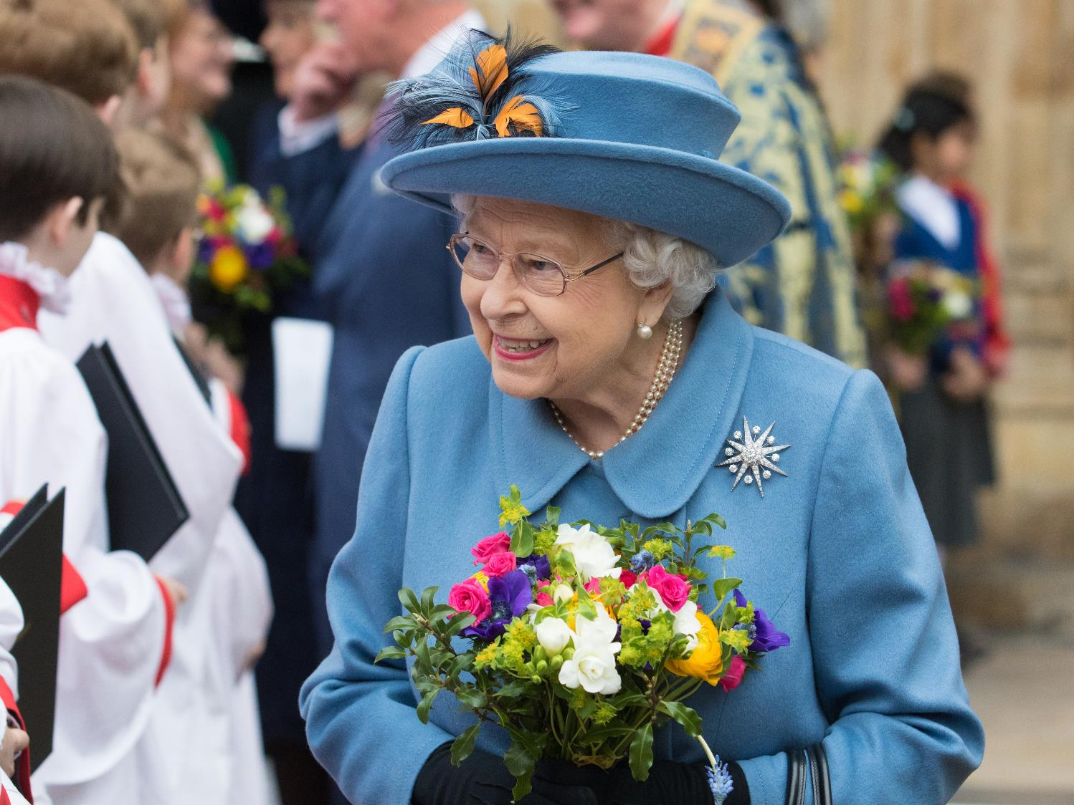

Westminster Abbey
Learning
Life of Queen Elizabeth II
Assembly for secondary
©Dean and Chapter of Westminster
1
Notes:
Image:
©Dean & Chapter of Westminster

Slide 2
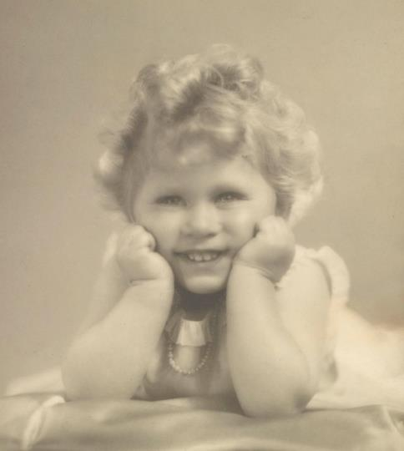
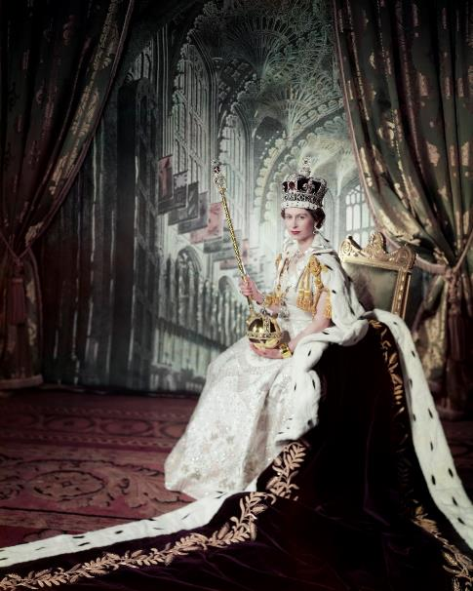
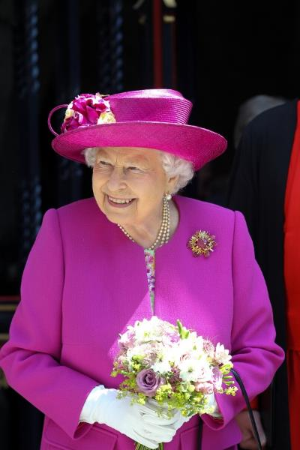
Learning
Notes:
Teacher: In assembly today we are going to think about the life of Queen Elizabeth II. It was a long life. Queen Elizabeth II was the longest reigning monarch this country has ever had, she was our queen for 70 years.
Images:
Elizabeth II as a child: Royal Collection Trust / © Her Majesty Queen Elizabeth II 2022 www.rct.uk/collection/2943653
Elizabeth II in her coronation robes - Royal Collection Trust / © Her Majesty Queen Elizabeth II 2022 www.rct.uk/collection/2153177
Elizabeth II, elderly visiting Westminster Abbey: ©Dean & Chapter of Westminster

Slide 3
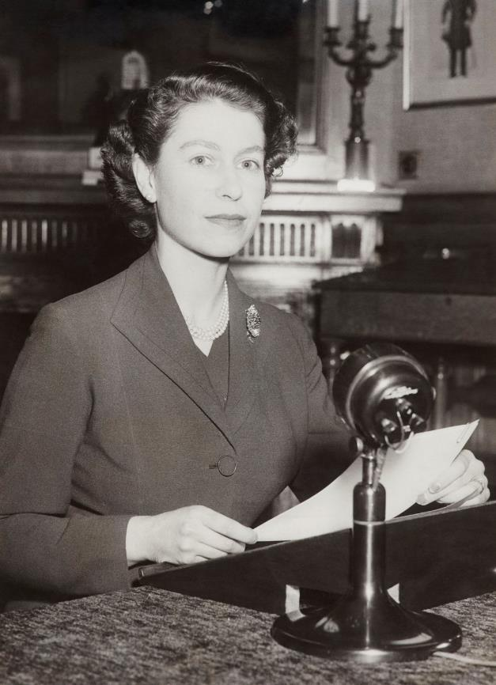
Learning
‘Pray that God may give me wisdom and strength’
Queen Elizabeth II, Christmas Broadcast 1952
Notes:
Teacher: When someone has lived a long life they have a lot of experience of life. They often have wise things to say. Every year, Queen Elizabeth II recorded a special message for her people. It was broadcast (on radio at first then television) on Christmas Day and was known as the Christmas Broadcast. The tradition of the Christmas Broadcast was started by her grandfather King George V, and was continued by her father King George VI. Queen Elizabeth II recorded a Christmas Broadcast almost every single year of her reign. The Broadcast gave her an opportunity to share wise words and to give guidance to people who might be struggling.
Teachers Notes
The following slides focus on aspects of Queen Elizabeth II’s life and values:
service and hard work
Christian faith
personal relationships
the Commonwealth
sense of humour
A relevant quote from one of the Christmas broadcasts is used for each.
Pose the question ‘What lessons can we learn from Queen Elizabeth II’s example?’ either after every slide or at the end.
Image:
Royal Collection Trust / © Her Majesty Queen Elizabeth II 2022 www.rct.uk/collection/2004814

Slide 4

Learning
‘I declare before you all that my whole life whether it be long or short shall be devoted to your service ‘
Queen Elizabeth II, radio broadcast 1947
Notes:
Teacher: This promise was made by Queen Elizabeth II five years before she became queen. She had grown up knowing that one day she would be queen and she had thought deeply about what being a queen meant. She saw the role of queen as one of serving others. This means working for the good of others. Her coronation at Westminster Abbey in 1953 was stunning, she wore the glittering crown jewels and a beautiful dress. It might sometimes look like a lot of fun to be a king or queen.
During her coronation she took an oath (a solemn promise) before God to govern her lands according to law. Governing is hard work. It has to be taken seriously. The governor of a country needs to understand and know the laws and customs. Queen Elizabeth II worked very hard all her life to be a good governor and to serve her people.
Image:
Royal Collection Trust / © Her Majesty Queen Elizabeth II 2022 www.rct.uk/collection/2153177

Slide 5
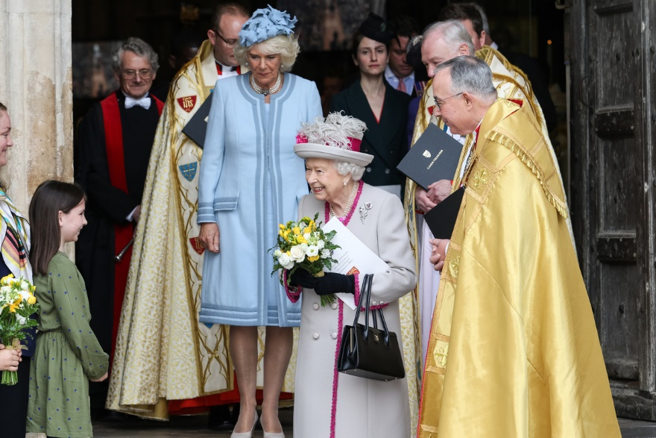
Learning
‘Forgiveness lies at the heart of the Christian faith. It can heal broken families, it can restore friendships and it can reconcile divided communities. It is in forgiveness that we feel the power of God’s love.’
Queen Elizabeth II, Christmas Broadcast, 2015
Notes:
Teacher: Queen Elizabeth II had a strong personal Christian faith. As Queen, she was the Supreme Governor of the Church of England. She felt that she must protect the rights of people to follow their own faith or to choose to have no faith. Her Christmas broadcasts were an opportunity for her to explain something of her Christian faith. She often spoke of the importance of forgiveness and of having hope.
Image:
©Dean & Chapter of Westminster

Slide 6
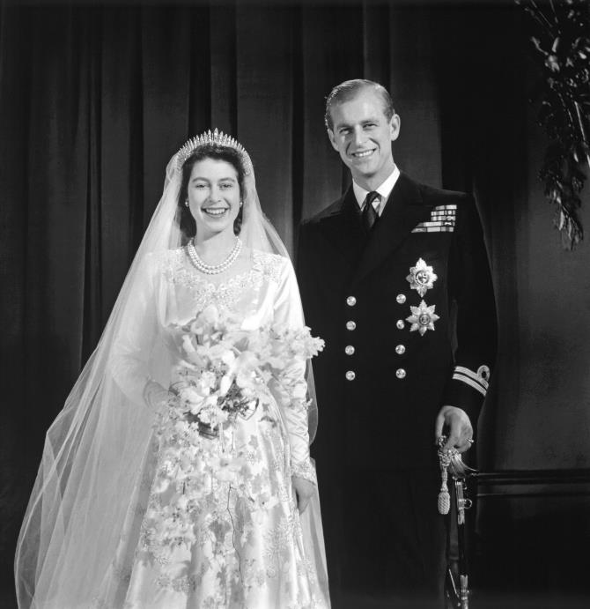
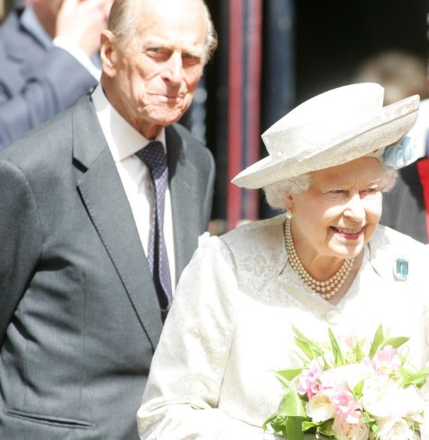
Learning
‘…people matter, and it is our relationship with one another that is most important... Kindness, sympathy, resolution, and courteous behaviour are infectious.’
Queen Elizabeth II, Christmas Broadcast 1975
Notes:
Teacher: Queen Elizabeth II married Philip, Duke of Edinburgh at Westminster Abbey in 1947. They were married for 73 years. The Duke of Edinburgh once said that the secret to a happy marriage was tolerance and that Queen Elizabeth II had plenty of tolerance. What do you think he meant by the word tolerance? Not everyone gets married, but we all benefit from having close friends.
Images:
Marriage of Elizabeth II and Philip - Royal Collection Trust / © Her Majesty Queen Elizabeth II 2022 www.rct.uk/collection/2805954
Elizabeth II and Philip at Westminster Abbey service – ©Dean & Chapter of Westminster

Slide 7
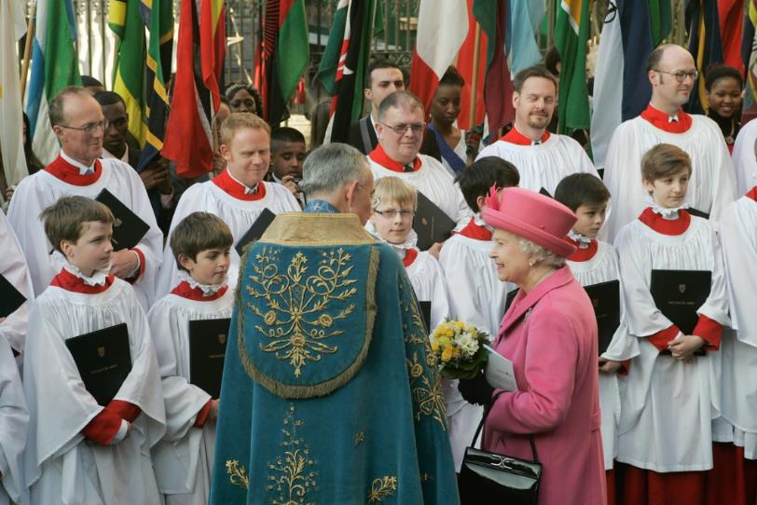
Learning
‘This great Commonwealth, of which I am so proud to be the Head… is an entirely new conception, built on the highest qualities of the spirit of man: friendship, loyalty and the desire for freedom and peace…
…To that new conception of an equal partnership of nations and races I shall give myself heart and soul every day of my life’
Queen Elizabeth II, Christmas Broadcast 1953
Notes:
Teacher: Queen Elizabeth II was the Head of the Commonwealth of Nations, which are a group of 56 countries that voluntarily joined together to support each other. Many of these countries were once ruled by Britain. Queen Elizabeth II was Queen not only of Britain but also of some of the Commonwealth countries such as Australia and Canada. The Commonwealth continues under the leadership of King Charles III.
Every year, a special service is held at Westminster Abbey to celebrate the diversity and traditions of the different Commonwealth countries. Queen Elizabeth II always tried to attend these services, the Commonwealth was very important to her.
Image:
©Dean & Chapter of Westminster

Slide 8
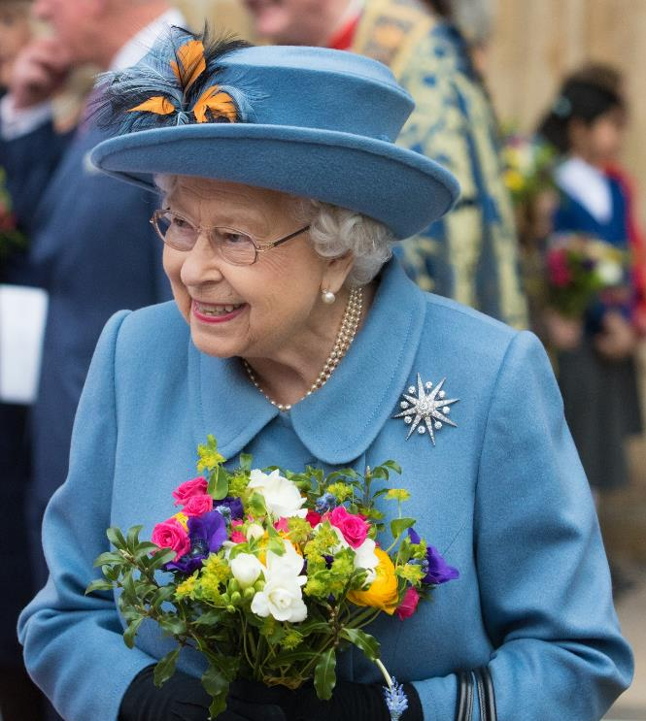
Learning
Watch this clip from the London Olympics in 2012, when Queen Elizabeth II met James Bond
‘Let us not take ourselves too seriously’
Queen Elizabeth II, Christmas Broadcast, 1991
Notes:
Set up: Clip 1.17 onwards - https://www.youtube.com/watch?v=1AS-dCdYZbo
Teacher: Queen Elizabeth II’s grandson, Prince William once described what made his grandparents laugh. He said ‘when things go wrong – they absolutely adore it because obviously everything always has to be right, but when things go wrong around them they’re the first people to laugh.” Queen Elizabeth II’s husband, Prince Philip, was known to make her laugh. Queen Elizabeth II had a healthy sense of humour herself. During the London Olympics in 2012, she made a short film with the actor Daniel Craig (James Bond)- its just one example of her sense of humour. [Watch condensed film clip] What lessons can we learn from Queen Elizabeth II’s example?
Image:
©Dean & Chapter of Westminster

Slide 9
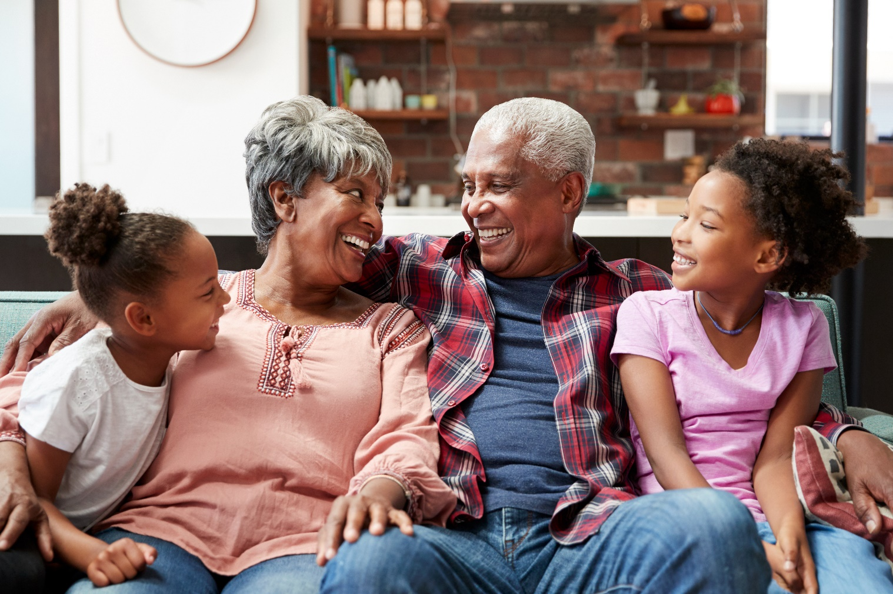
Learning
‘Now it is our turn to work for a future which our grandchildren will step into one day….
We can do this if we have the good sense to learn from the experience of those who have gone before us…’
Queen Elizabeth II, Christmas Broadcast 1978
Notes:
Teacher:
What lessons for life can we learn from Queen Elizabeth II’s example? [take a few answers]
What lessons can we learn from the wisdom of people who have lived a long life?
What might we do ourselves to remember Queen Elizabeth II at this sad time?
If you have an elderly relation or neighbour perhaps you could have a chat with them and ask them to tell you what they think is important in life. You could talk to them about this assembly and find out what their memories of Queen Elizabeth II are.
Image: Shutterstock

