Slide 1
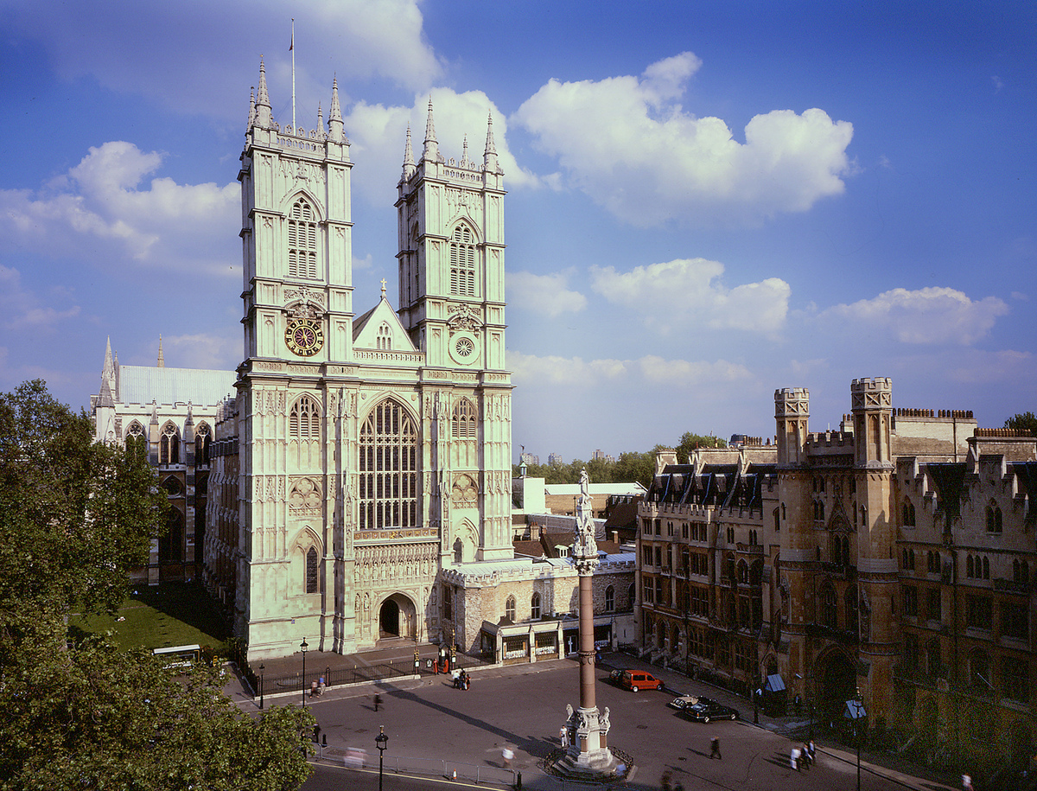

Westminster Abbey
Learning
Why is church a special place?
©2020 Dean and Chapter of Westminster
1
Notes:
Image:
©2021 Dean & Chapter of Westminster
Please be aware that these images are for educational use only in the classroom and should not be reproduced online.

Slide 2
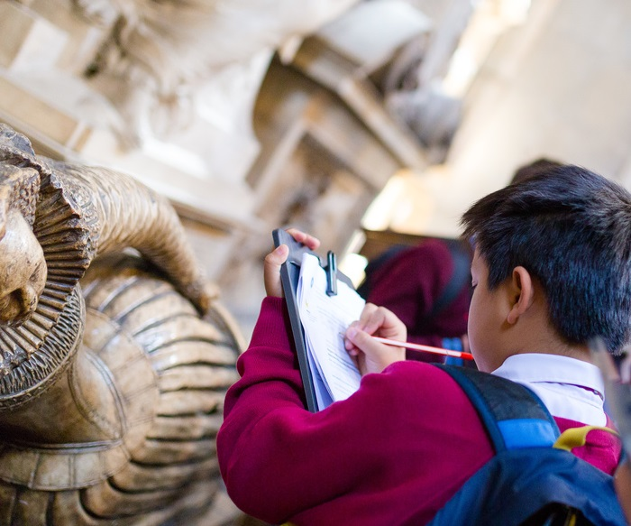
Westminster Abbey
Learning
Information for teachers
Thank you for downloading this resource. We hope that it will be a useful teaching tool in your classroom.
As we continue to grow our free catalogue of teaching resources, we’d really appreciate a few minutes of your time to let us know what you liked and what could be improved. Please complete this five-question survey.
2
Notes:
Image:
©2021 Dean & Chapter of Westminster

Slide 3
Learning
Today, we’re thinking about special places. Different places are special for different people. Do you have a special place where you like to go? Perhaps the park is a special place for you? Perhaps it’s your home or the home of someone in your family? Why is that place special for you?
For Christians, church is a special place. It’s a place that they usually go to once a week on a Sunday. Churches are built as a place for Christians to go to pray and worship God. They are often tall buildings, reaching up into the sky. Can you see how tall Westminster Abbey is? Look at those arches, all pointing upwards towards Heaven.
Church is much more than just a building. For Christians, church is a place where they can come together with other Christians, who all want to worship God. Church is a place where Christians celebrate exciting events like a baby being christened or two adults getting married. Church is also a place where we remember people who have died. Over 1,000 years, Christians have gathered together in Westminster Abbey to loudly sing hymns that praise God and quietly pray, asking for help and support. Church can be happy or sad, noisy or quiet. What happens in your special place?

Slide 4
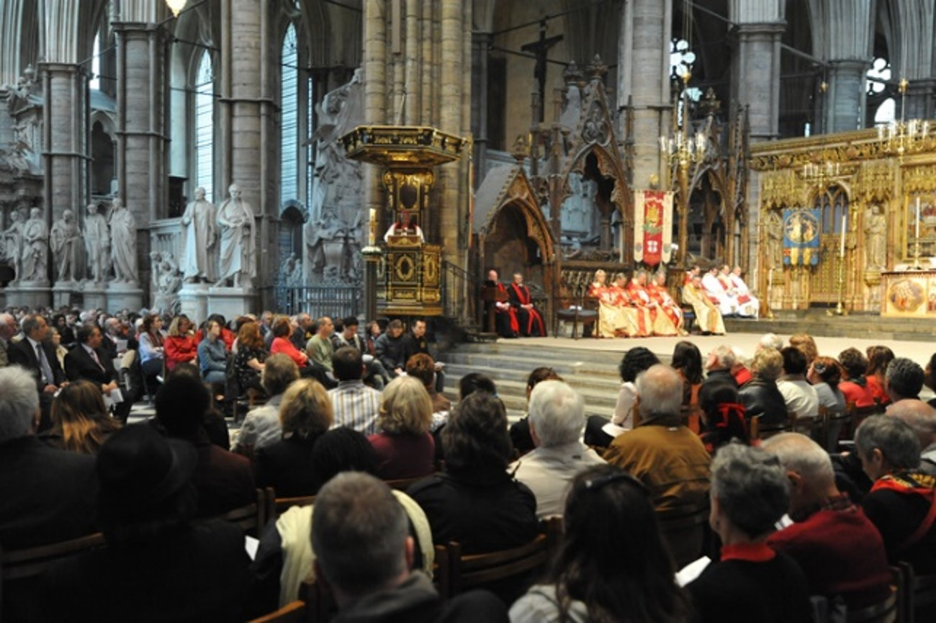
Learning
Notes:
Congregation attending a service
Image:
©2021 Dean & Chapter of Westminster
Please be aware that these images are for educational use only in the classroom and should not be reproduced online.

Slide 5
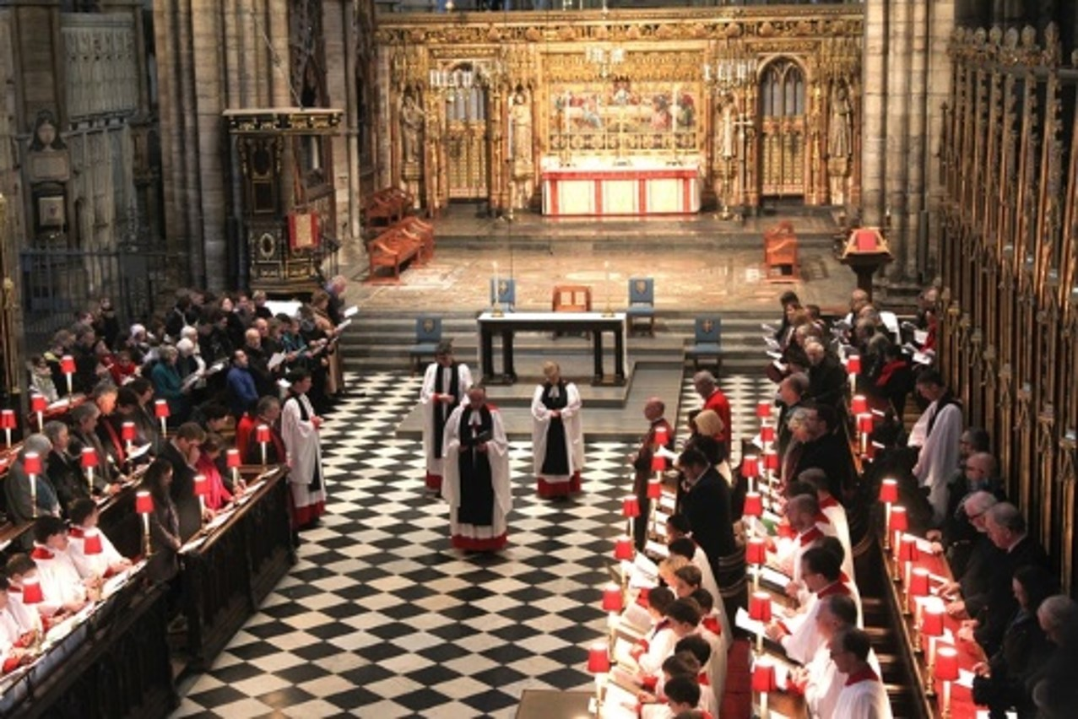
Learning
Notes:
View of a service, focusing on the Quire
Image:
©2021 Dean & Chapter of Westminster
Please be aware that these images are for educational use only in the classroom and should not be reproduced online.

Slide 6
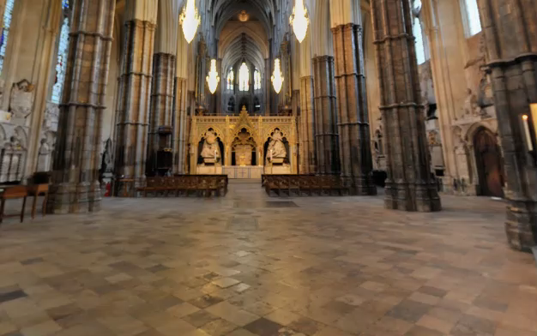
Learning
Notes:
Short clip of the Nave, showing the height of the ceiling
Image:
©2021 Dean & Chapter of Westminster
Please be aware that these images are for educational use only in the classroom and should not be reproduced online.

Slide 7
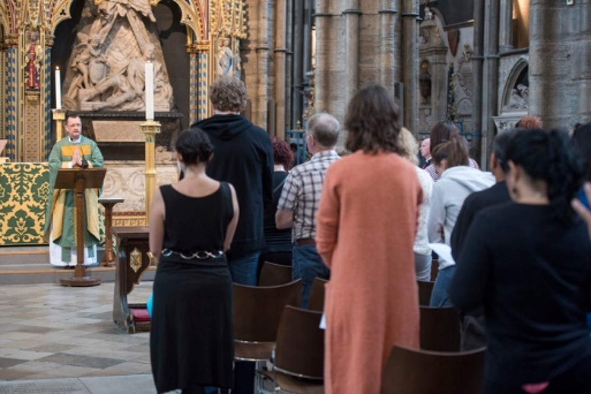
Learning
Notes:
Congregation during a service
Image:
©2021 Dean & Chapter of Westminster
Please be aware that these images are for educational use only in the classroom and should not be reproduced online.

Slide 8
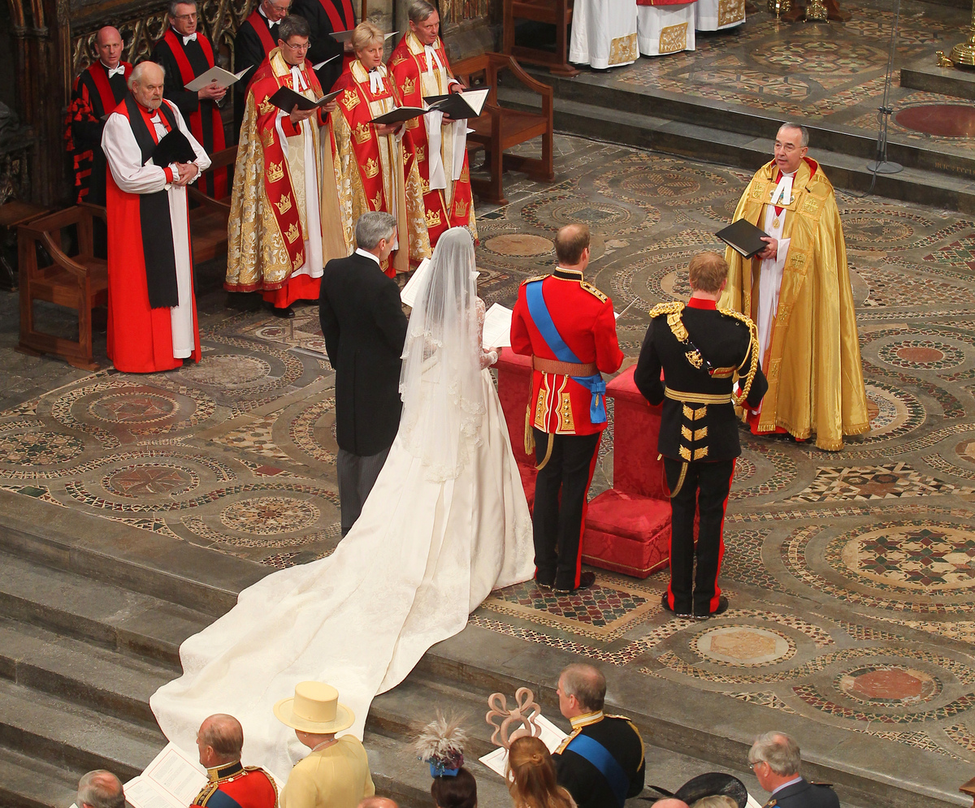
Learning
Notes:
Wedding of HRH The Duke and Duchess of Cambridge in 2011
Image:
©2021 Dean & Chapter of Westminster
Please be aware that these images are for educational use only in the classroom and should not be reproduced online.

Slide 9
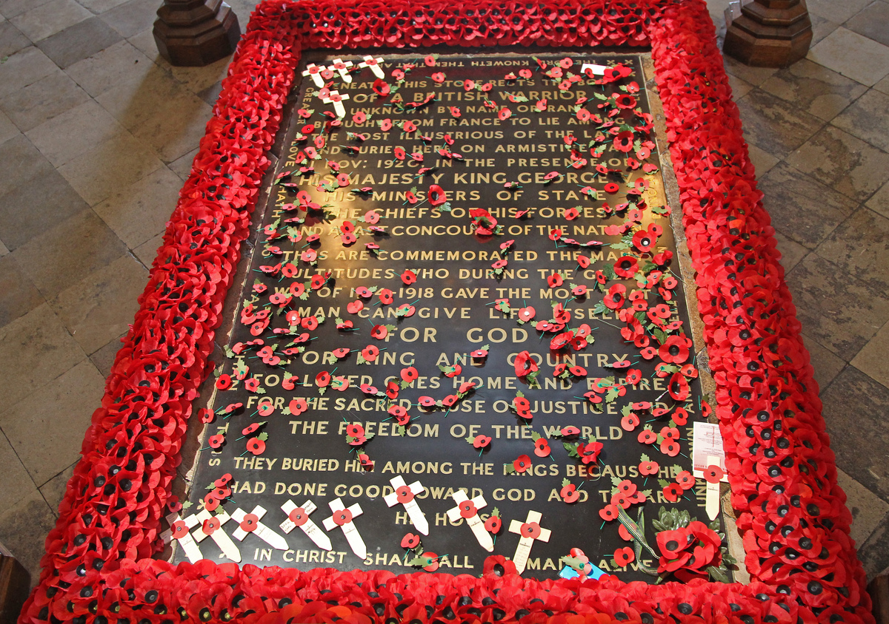
Learning
Notes:
Grave of the Unknown Warrior
Image:
©2021 Dean & Chapter of Westminster
Please be aware that these images are for educational use only in the classroom and should not be reproduced online.

Slide 10
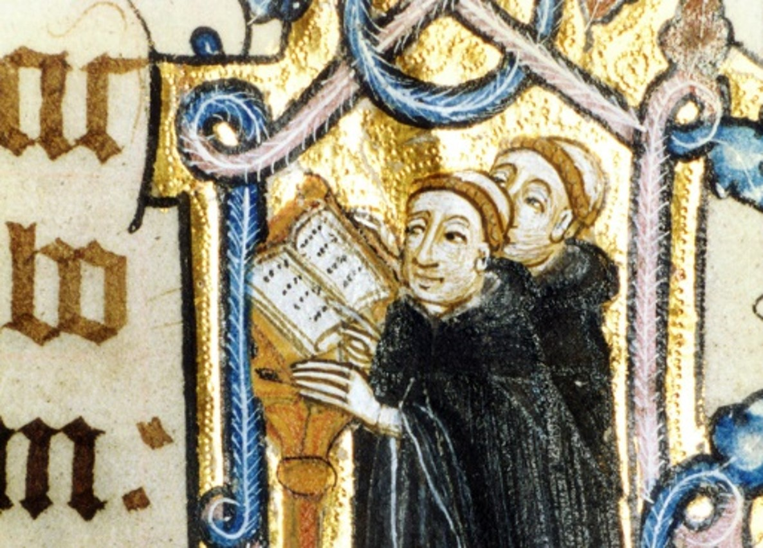
Learning
Notes:
Manuscript showing monks
Image:
©2021 Dean & Chapter of Westminster
Please be aware that these images are for educational use only in the classroom and should not be reproduced online.

Slide 11
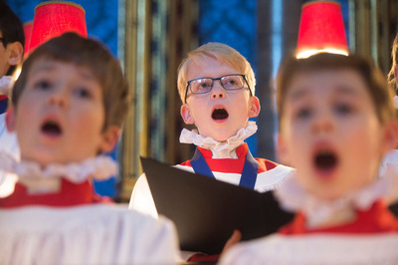
Learning
Notes:
The Choir of Westminster Abbey
Image:
©2021 Dean & Chapter of Westminster
Please be aware that these images are for educational use only in the classroom and should not be reproduced online.

Slide 12
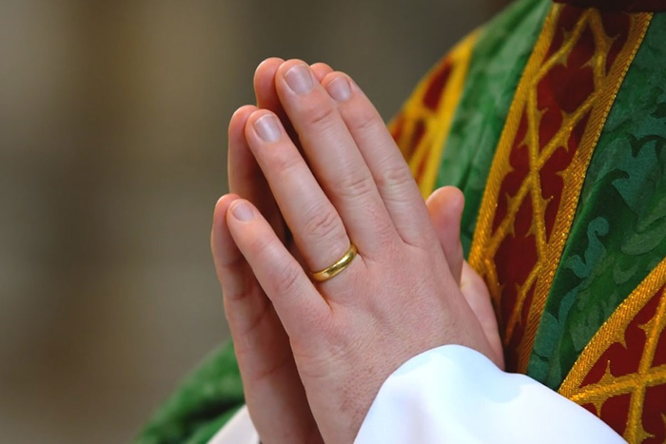
Learning
Notes:
Hands praying
Image:
©2021 Dean & Chapter of Westminster
Please be aware that these images are for educational use only in the classroom and should not be reproduced online.

