Slide 1
Westminster Abbey
Learning
What happens during a church service?
©2020 Dean and Chapter of Westminster
1
Notes:
Image:
©2021 Dean & Chapter of Westminster
Please be aware that these images are for educational use only in the classroom and should not be reproduced online.

Slide 2
Westminster Abbey
Learning
Information for teachers
Thank you for downloading this resource. We hope that it will be a useful teaching tool in your classroom.
As we continue to grow our free catalogue of teaching resources, we’d really appreciate a few minutes of your time to let us know what you liked and what could be improved. Please complete this five-question survey.
2
Notes:
Image:
©2021 Dean & Chapter of Westminster

Slide 3
Learning
Today, we’re thinking about times when people gather together to all do the same thing. Can you think of a time when you do this? Perhaps its in your classroom, when you sit together and listen to a story? Perhaps its during an assembly when you might sing songs? How do you feel when you do something in a group?
For Christians, church services are the time when they gather together to all think about God. Often on a Sunday, but every day at Westminster Abbey, Christians gather together for worship. The start of a service can be very noisy as loud bells are rung, telling everyone it’s time to start the church service. Once everyone has sat down, they listen carefully to the priest, who tells them about stories in the Bible and helps them to pray together. Sometimes the priest is the only one speaking and sometimes everyone in the church joins in. There is a prayer called the Lord’s Prayer, which everyone says out loud together. It begins, “Our Father who art in heaven, hallowed by thy name” Have you heard it before?
As well as speaking, church services also contain lots of singing. Christians sing songs called hymns about their belief in God. An organ might be played alongside the hymns and a choir may be at the church to sing along too. Speaking and singing together is a very important part of Christian worship. How do you feel when you sing together?

Slide 4
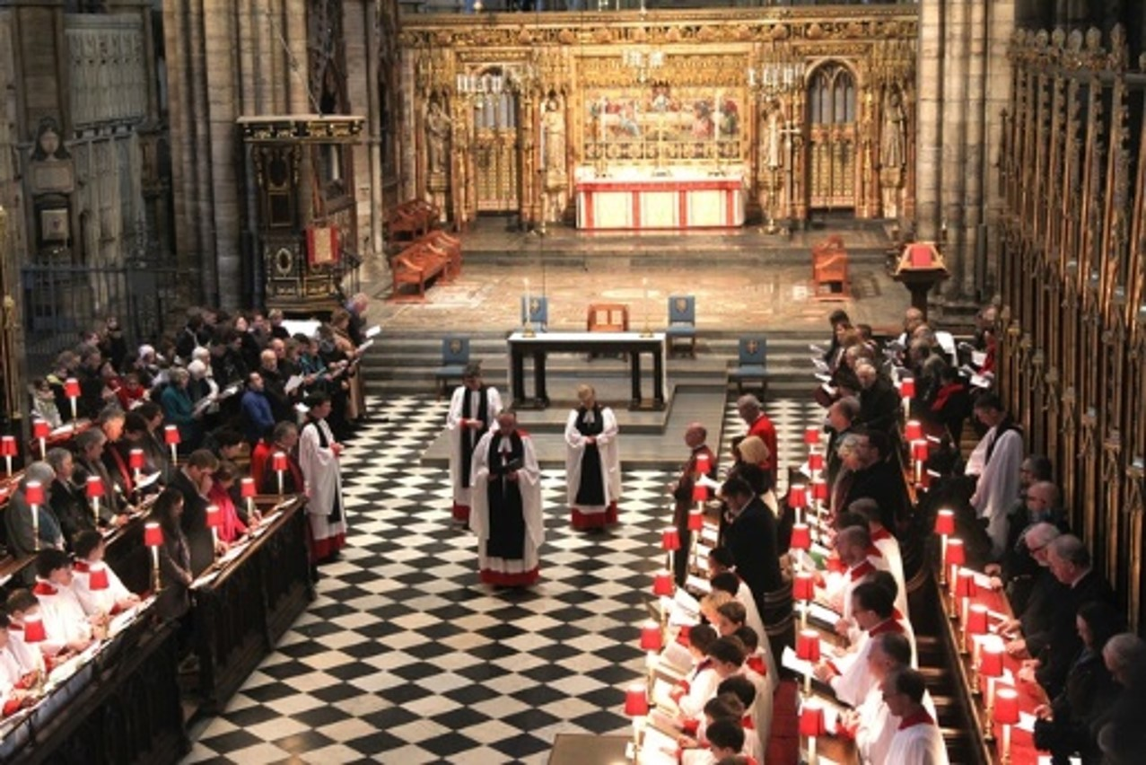
Learning
Notes:
View of a service, focusing on the Quire
Image:
©2021 Dean & Chapter of Westminster
Please be aware that these images are for educational use only in the classroom and should not be reproduced online.

Slide 5
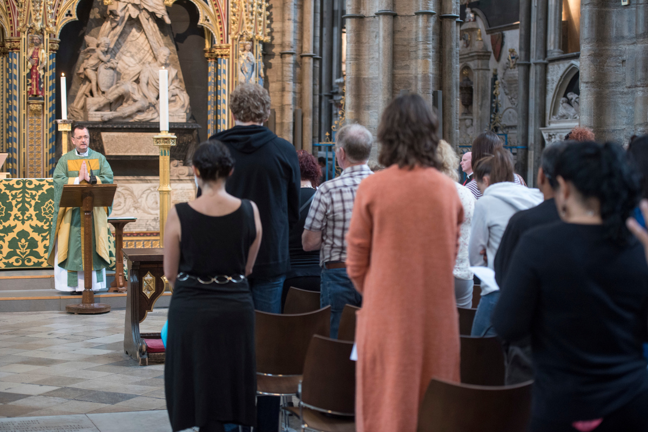
Learning
Notes:
Congregation during a service
Image:
©2021 Dean & Chapter of Westminster
Please be aware that these images are for educational use only in the classroom and should not be reproduced online.

Slide 6
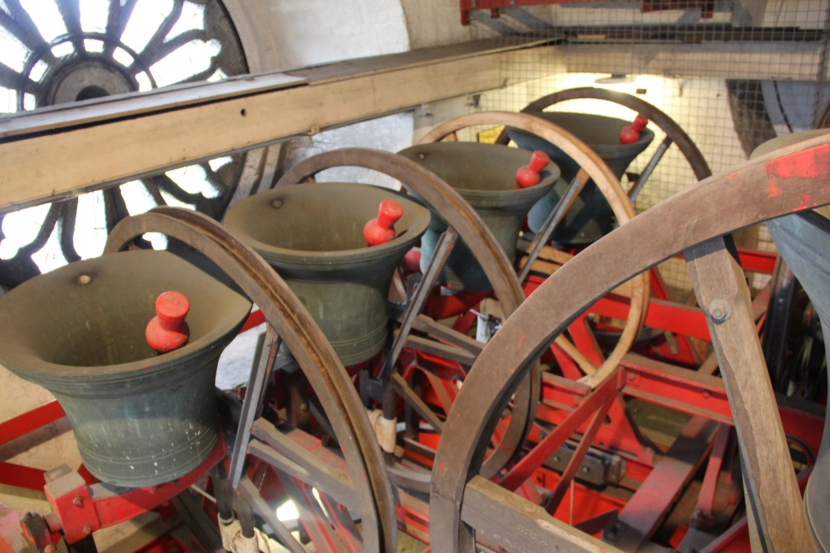
Learning
Notes:
Close-up of bells within Westminster Abbey
Image:
©2021 Dean & Chapter of Westminster
Please be aware that these images are for educational use only in the classroom and should not be reproduced online.

Slide 7
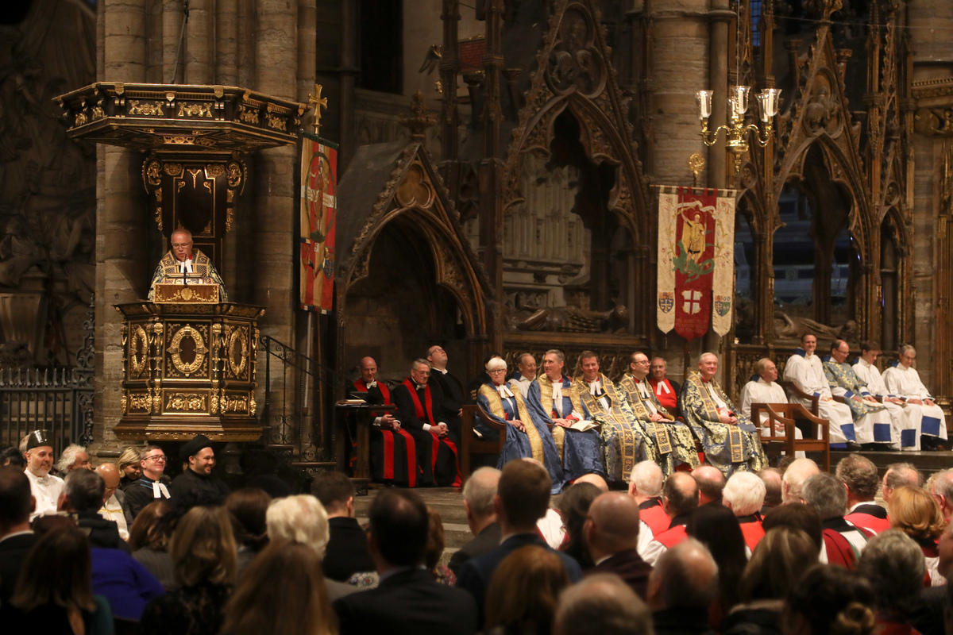
Learning
Notes:
Congregation during a service
Image:
©2021 Dean & Chapter of Westminster
Please be aware that these images are for educational use only in the classroom and should not be reproduced online.

Slide 8
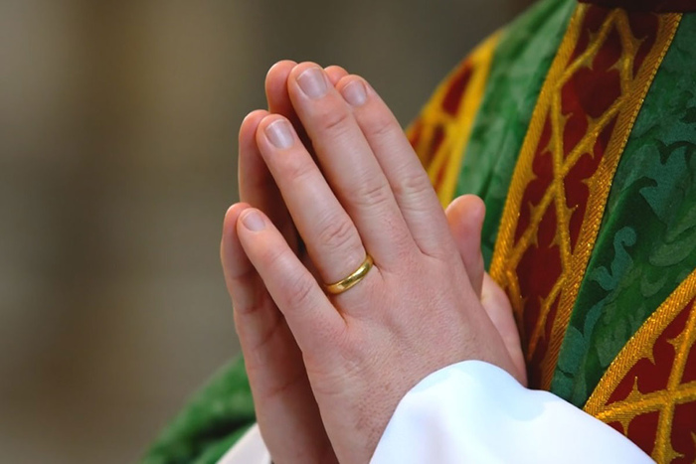
Learning
Notes:
Hands praying
Image:
©2021 Dean & Chapter of Westminster
Please be aware that these images are for educational use only in the classroom and should not be reproduced online.

Slide 9
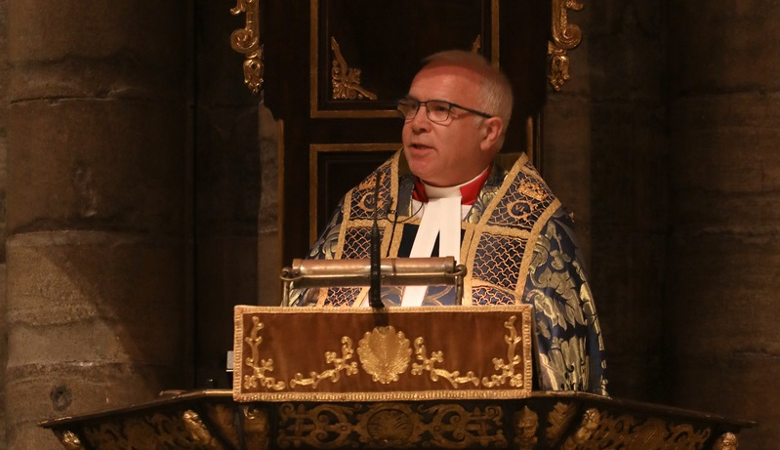
Learning
Notes:
The Very Reverend Dr David Hoyle
Image:
©2021 Dean & Chapter of Westminster
Please be aware that these images are for educational use only in the classroom and should not be reproduced online.

Slide 10
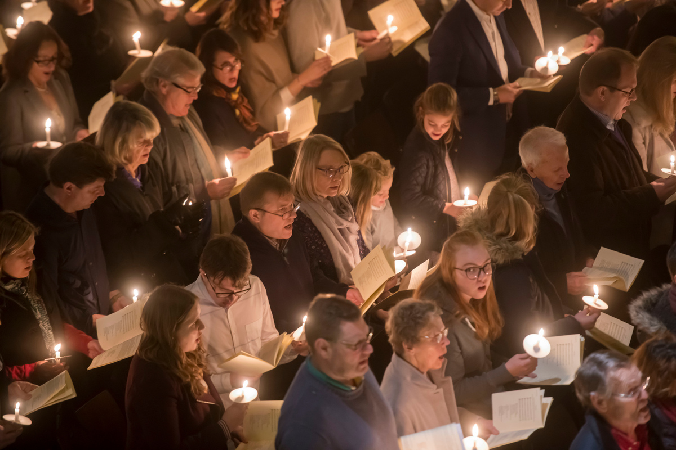
Learning
Notes:
Service using candle light
Image:
©2021 Dean & Chapter of Westminster
Please be aware that these images are for educational use only in the classroom and should not be reproduced online.

Slide 11
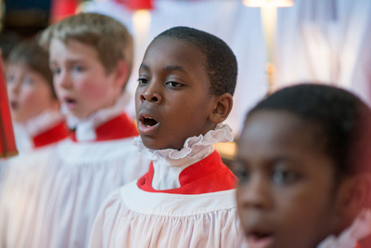
Learning
Notes:
The Choir of Westminster Abbey
Image:
©2021 Dean & Chapter of Westminster
Please be aware that these images are for educational use only in the classroom and should not be reproduced online.

Slide 12
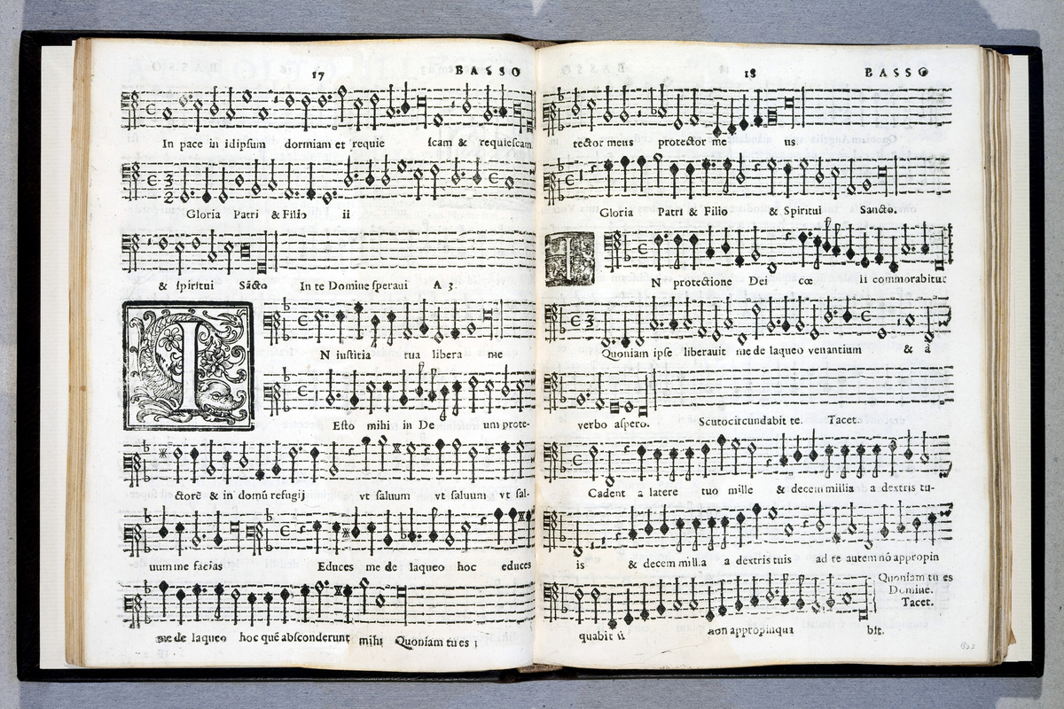
Learning
Notes:
Music manuscript
Image:
©2021 Dean & Chapter of Westminster
Please be aware that these images are for educational use only in the classroom and should not be reproduced online.

Slide 13
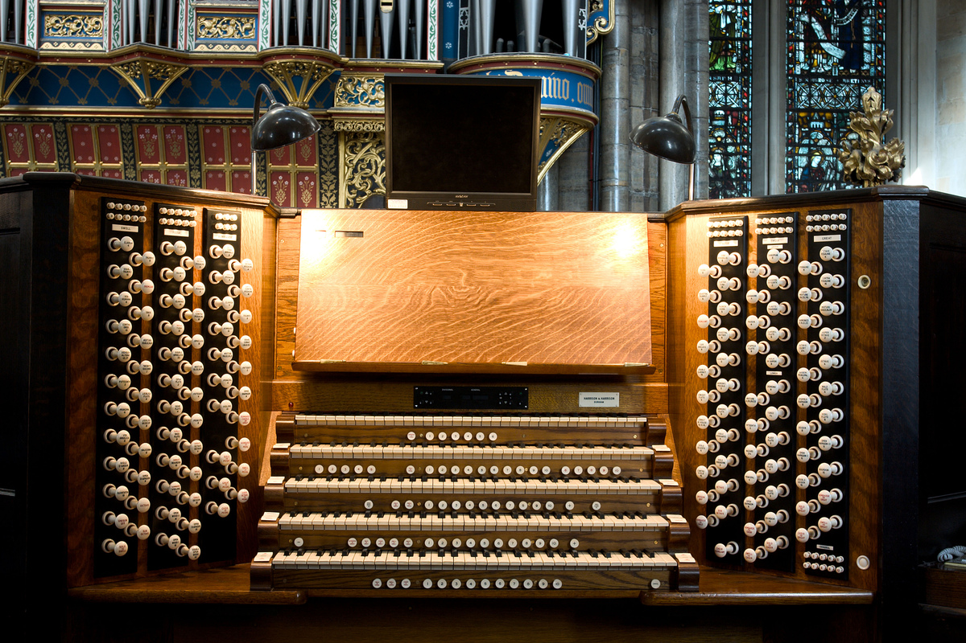
Learning
Notes:
Organ within organ loft
Image:
©2021 Dean & Chapter of Westminster
Please be aware that these images are for educational use only in the classroom and should not be reproduced online.

Slide 14
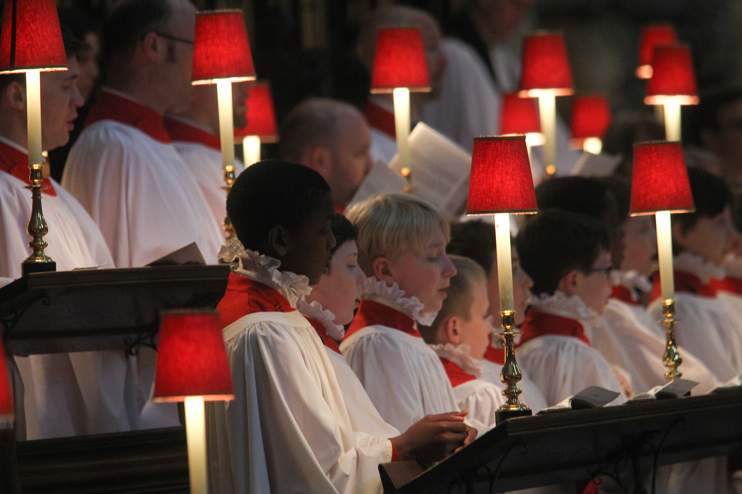
Learning
Notes:
The Choir of Westminster Abbey
Image:
©2021 Dean & Chapter of Westminster
Please be aware that these images are for educational use only in the classroom and should not be reproduced online.

Slide 15
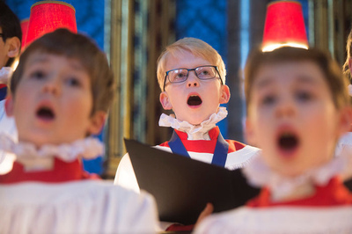
Learning
Notes:
The Choir of Westminster Abbey
Image:
©2021 Dean & Chapter of Westminster
Please be aware that these images are for educational use only in the classroom and should not be reproduced online.

