Slide 1
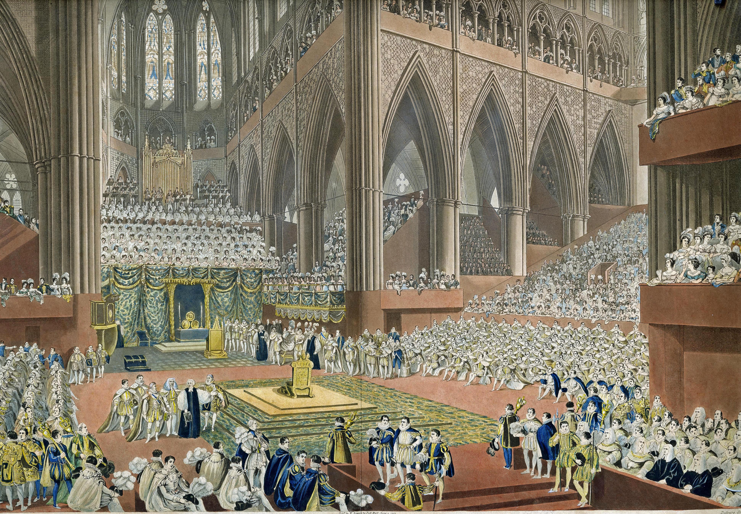

Westminster Abbey
Learning
Coronation debate topics
©2023 Dean and Chapter of Westminster
1
Notes:
Image:
©2023 Dean & Chapter of Westminster

Slide 2

Westminster Abbey
Learning
Information for teachers
Thank you for downloading this resource. We hope that it will be a useful teaching tool in your classroom.
As we continue to grow our free catalogue of teaching resources, we’d really appreciate a few minutes of your time to let us know what you liked and what could be improved. Please complete this five-question survey.
2
Notes:
Image:
©2023 Dean & Chapter of Westminster

Slide 3
Learning
Debate topics
The coronation of His Majesty King Charles in 2023 is an opportunity for people in the UK and around the world to witness history in the making. It is a significant national event, which will naturally spark questions about the British monarchy, the constitution and its impact on daily life.
This document provides three key topics and some facts to discuss about the coronation within a classroom setting. These include:
The religious significance
The national significance
The representation of society
Notes:
Image:
©2023 Dean & Chapter of Westminster

Slide 4
Learning
Topic: The religious significance
Regardless of faith within the nation, the coronation always has and always will be a Christian service. Discuss.
In the 2021 census, only 46% of the population of England and Wales identified as Christian and 37.2% described themselves as having 'no faith’.
In a 2015 radio interview, HM King Charles, then the Prince of Wales, said: “it’s always seemed to me that, while at the same time being Defender of the Faith, you can also be protector of faiths.” The Sunday Hour, BBC Radio 2
The anointing of the monarch with holy oil is the most important moment of the entire Coronation service, linking back to the Bible and the anointing of King David and King Solomon.
The monarch is Defender of the Faith (a title conferred on Henry VIII in 1521 by the Pope) and Supreme Governor of the Church of England (title adopted by Elizabeth I in 1558).

Slide 5
Learning
Topic: The national significance
To uphold a nearly 1,000-year tradition, the coronation should continue to be held in London. Discuss.
When Westminster Abbey in London was rebuilt in 1245, it included a large space or ‘theatre’ between the quire and the high altar, specifically for coronations to take place.
As the coronation is relevant to people all around the world in different Commonwealth nations, there are regional events on the day such as street parties, so that people can celebrate no matter where the coronation is held.
In 2022, HM King Charles became king while in Scotland, one of the nations he reigns over.
Among the King’s first acts as Sovereign was to visit Scotland, Northern Ireland and Wales, all autonomous parts of the United Kingdom of Great Britain and Northern Ireland.

Slide 6
Learning
Topic: The representation of society
Those invited to the Coronation should represent the people that the monarch leads. Discuss.
In the 2021 census of England and Wales 81.7% of people identified as ‘white’. Therefore, to be truly representative, at least 18% of guests should be non-white.
As the coronation is a state occasion, the Government will ultimately decide on the guest list, rather than HM King Charles or Westminster Abbey.
Historically, invited guests were known personally to the monarch. This was important so they could witness that the rightful monarch was crowned in Westminster Abbey.
In 1953, extra seating was built to allow over 8,000 guests to attend the coronation of Queen Elizabeth II. The normal seating capacity of Westminster Abbey is around 2,000 people.

