Slide 1
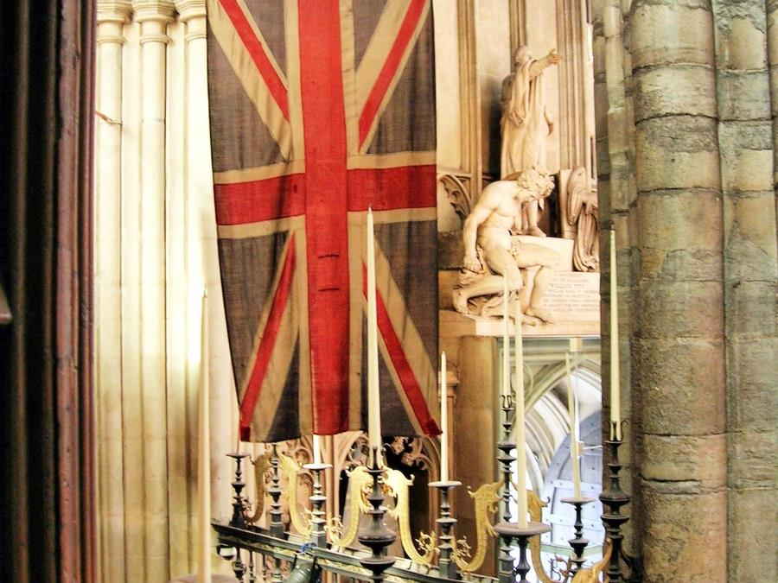

Westminster Abbey
Learning
Remembrance image bank
©2024 Dean and Chapter of Westminster
1
Notes:
Image:
©2024 Dean & Chapter of Westminster
Please be aware that these images are for educational use only in the classroom and should not be reproduced online.

Slide 2
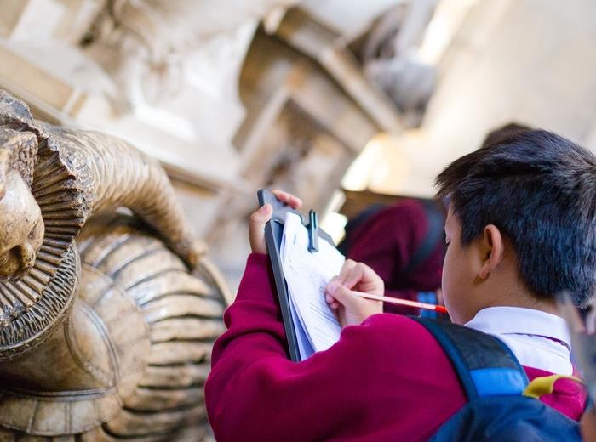
Westminster Abbey
Learning
Information for teachers
Thank you for downloading this resource. We hope that it will be a useful teaching tool in your classroom.
As we continue to grow our free catalogue of teaching resources, we’d really appreciate a few minutes of your time to let us know what you liked and what could be improved. Please complete this five-question survey.
2
Notes:
Image:
©2024 Dean & Chapter of Westminster

Slide 3
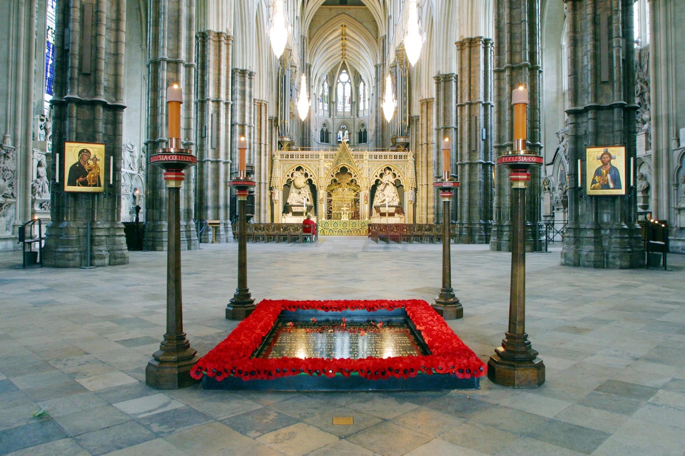
Learning
Notes:
Grave of the Unknown Warrior, surrounded by four candles.
Image:
©2024 Dean & Chapter of Westminster
Please be aware that these images are for educational use only in the classroom and should not be reproduced online.

Slide 4
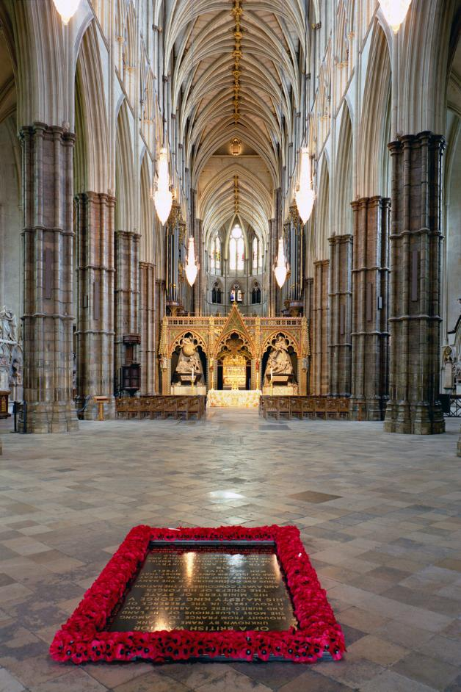
Learning
Notes:
Grave of the Unknown Warrior in the empty nave.
Image:
©2024 Dean & Chapter of Westminster
Please be aware that these images are for educational use only in the classroom and should not be reproduced online.

Slide 5
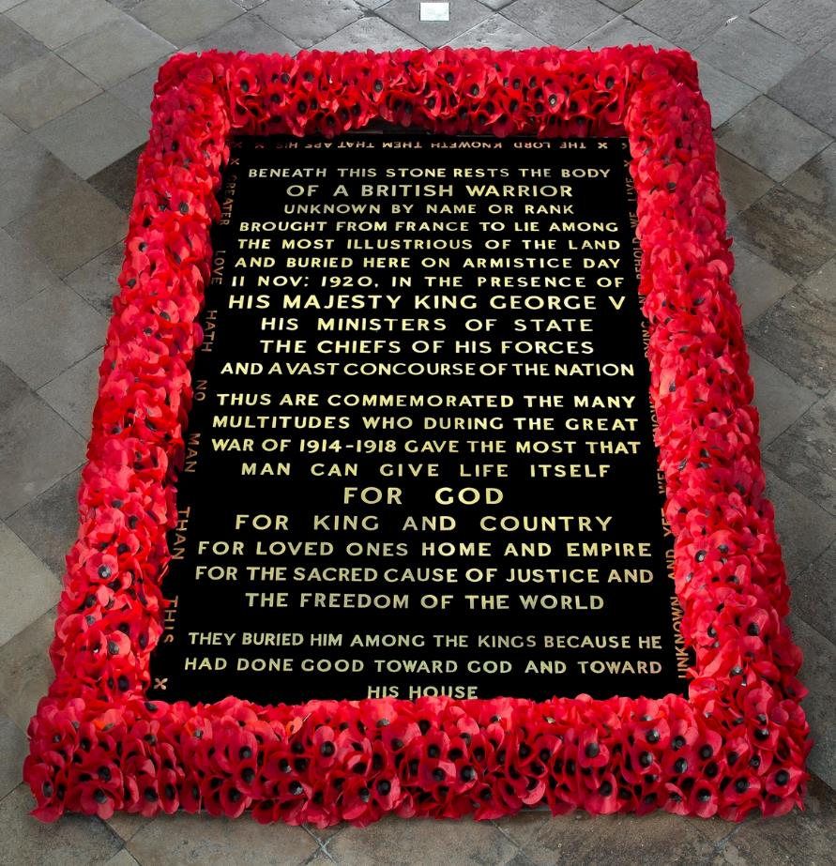
Learning
Notes:
Close up of the Grave of the Unknown Warrior.
Image:
©2024 Dean & Chapter of Westminster
Please be aware that these images are for educational use only in the classroom and should not be reproduced online.

Slide 6
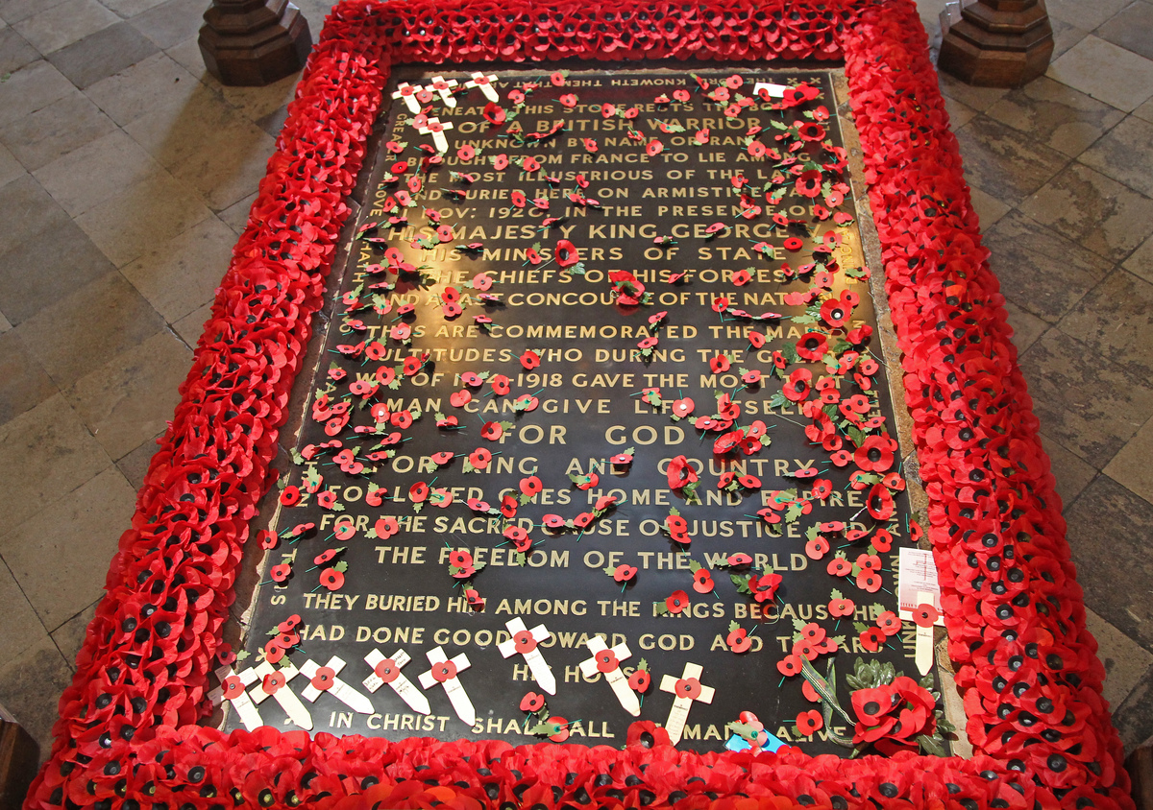
Learning
Notes:
Grave of the Unknown Warrior strewn with poppies after the Remembrance Sunday Service in 2014, one hundred years after the start of the First World War.
Image:
©2024 Dean & Chapter of Westminster
Please be aware that these images are for educational use only in the classroom and should not be reproduced online.

Slide 7
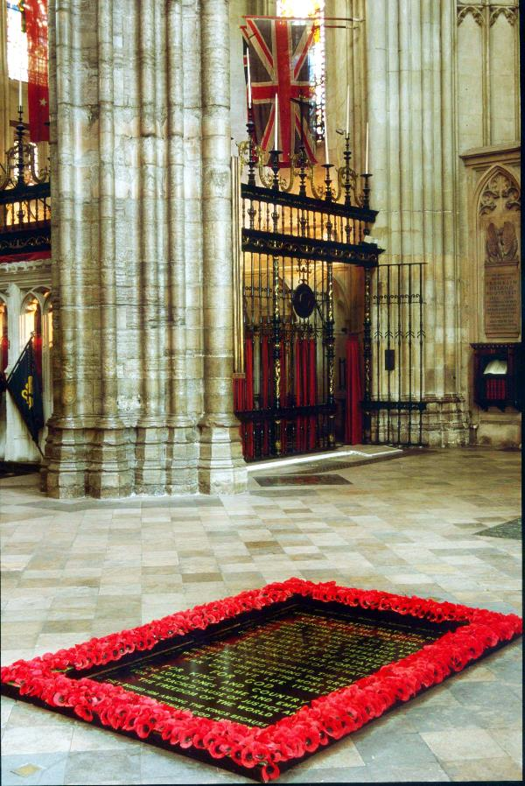
Learning
Notes:
Grave of the Unknown Warrior and the Padre’s Flag in Westminster Abbey.
Image:
©2024 Dean & Chapter of Westminster
Please be aware that these images are for educational use only in the classroom and should not be reproduced online.

Slide 8
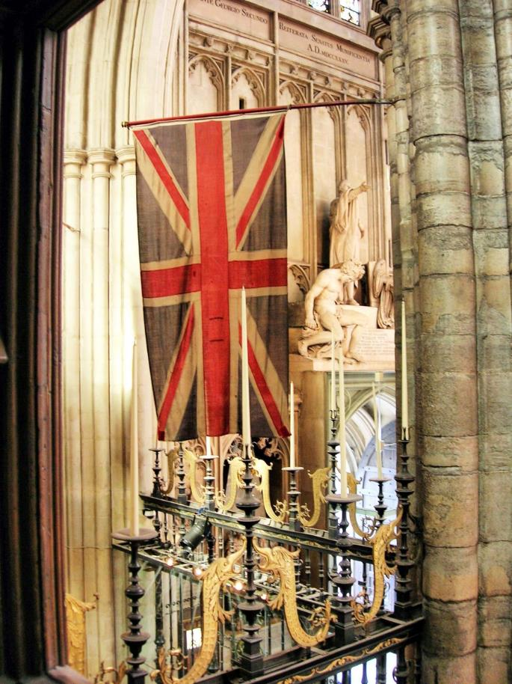
Learning
Notes:
The Padre’s Flag in Westminster Abbey.
Image:
©2024 Dean & Chapter of Westminster
Please be aware that these images are for educational use only in the classroom and should not be reproduced online.

Slide 9
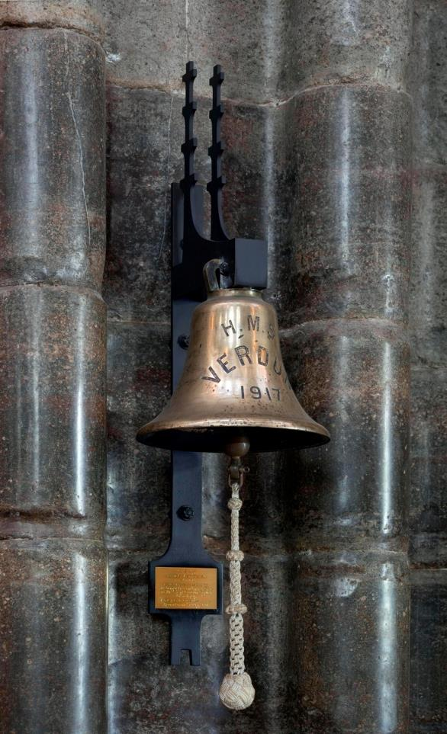
Learning
Notes:
Verdun Bell from HMS Verdun, the ship which brought over the Unknown Warrior’s body.
Image:
©2024 Dean & Chapter of Westminster
Please be aware that these images are for educational use only in the classroom and should not be reproduced online.

Slide 10
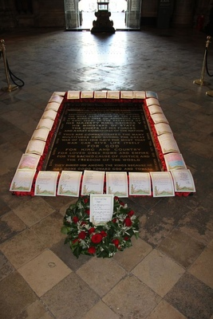
Learning
Notes:
A wreath which has been laid at the Grave of the Unknown warrior and children have written their own poems to soldiers who died in the First World War.
Image:
©2024 Dean & Chapter of Westminster
Please be aware that these images are for educational use only in the classroom and should not be reproduced online.

Slide 11
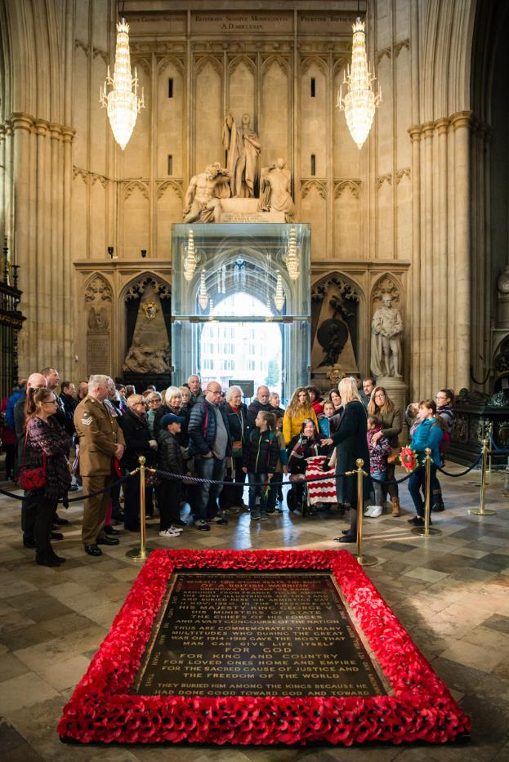
Learning
Notes:
Families remembering and bringing their own tributes one hundred years after the end of the First World War.
Image:
Amy Murrell/Westminster Abbey
Please be aware that these images are for educational use only in the classroom and should not be reproduced online.

Slide 12
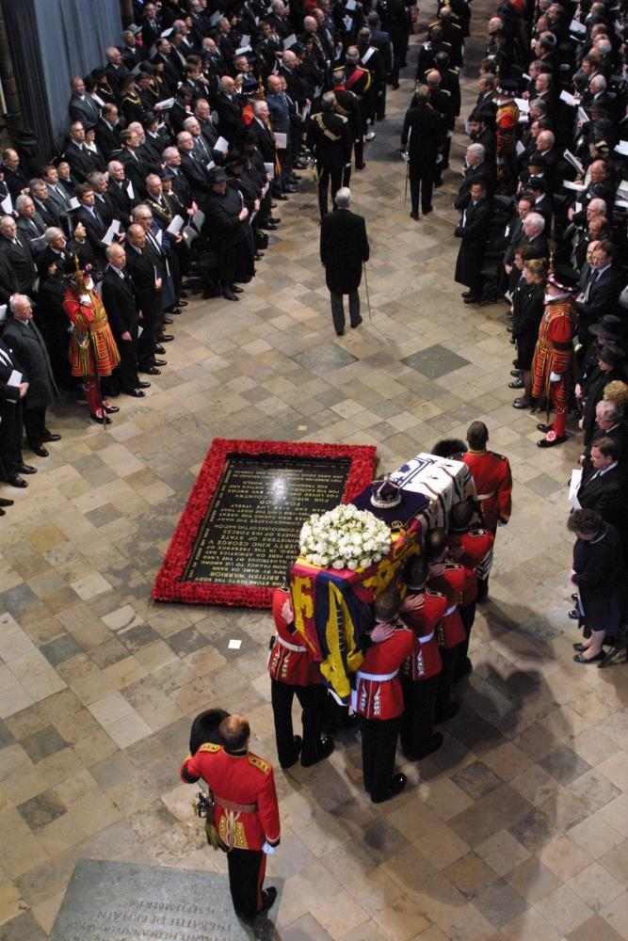
Learning
Notes:
The Queen Mother’s funeral in 2002, as pallbearers walk round the Grave of the Unknown Warrior with the coffin.
Image:
Andrew Dunsmore/Dean and Chapter of Westminster
Please be aware that these images are for educational use only in the classroom and should not be reproduced online.

Slide 13
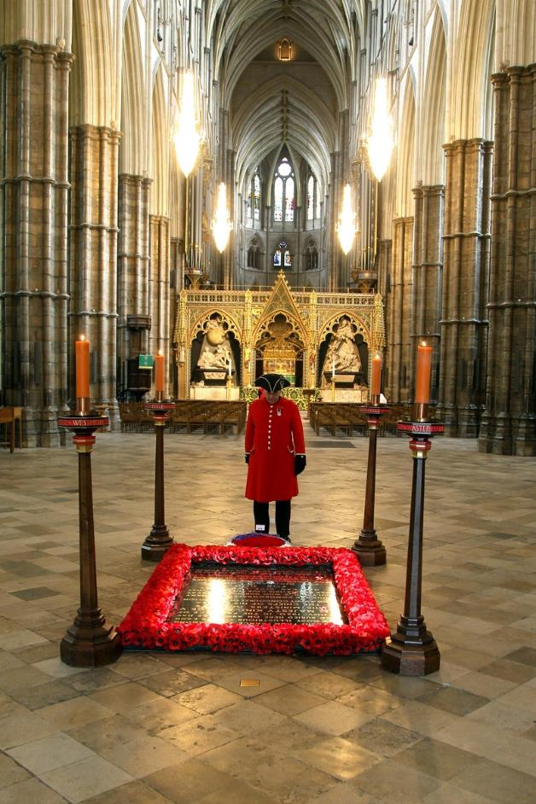
Learning
Notes:
A Chelsea Pensioner standing by the Grave of the Unknown Warrior.
Image:
©2024 Dean & Chapter of Westminster
Please be aware that these images are for educational use only in the classroom and should not be reproduced online.

Slide 14
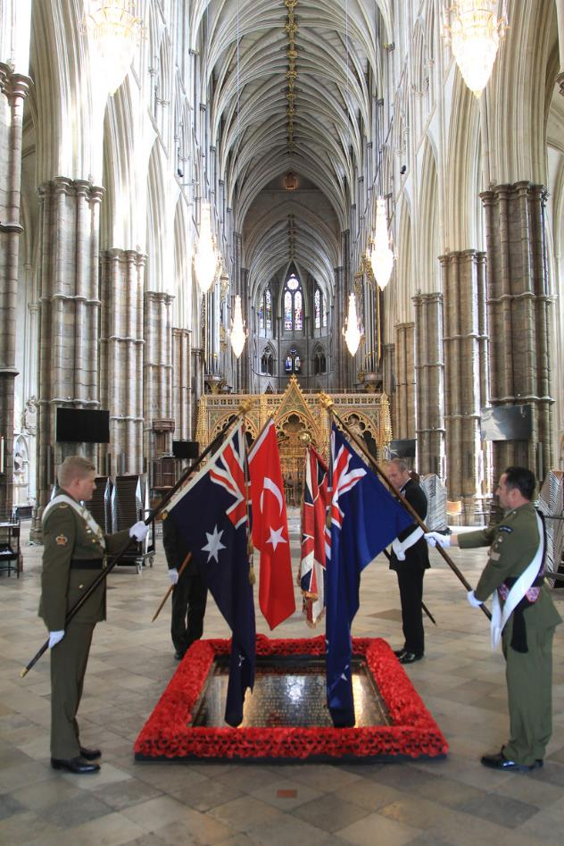
Learning
Notes:
An ANZAC service around the Grave of the Unknown Warrior.
Image:
Picture Partnership/Westminster Abbey
Please be aware that these images are for educational use only in the classroom and should not be reproduced online.

Slide 15
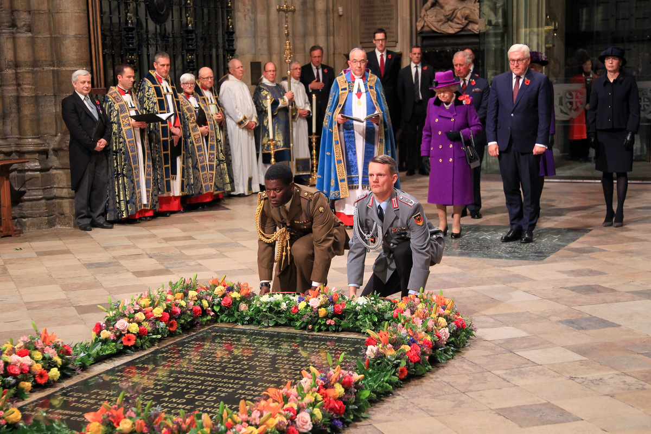
Learning
Notes:
Centenary of the Armistice, November 11th 2018. Wreaths were laid to fill the gaps in the fresh flowers surrounding the Grave of the Unknown Warrior on behalf of Queen Elizabeth II and the President of Germany.
Image:
©2024 Dean and Chapter of Westminster
Please be aware that these images are for educational use only in the classroom and should not be reproduced online.

Slide 16
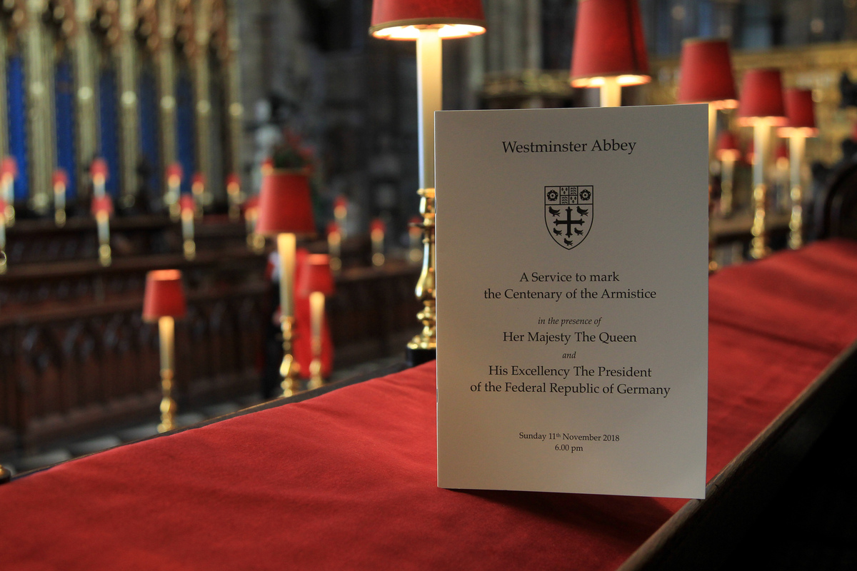
Learning
Notes:
A service booklet from A Service of Thanksgiving to mark the Centenary of Blind Veterans UK held at Westminster Abbey in 2015.
Image:
Andrew Dunsmore/Dean and Chapter of Westminster
Please be aware that these images are for educational use only in the classroom and should not be reproduced online.

Slide 17
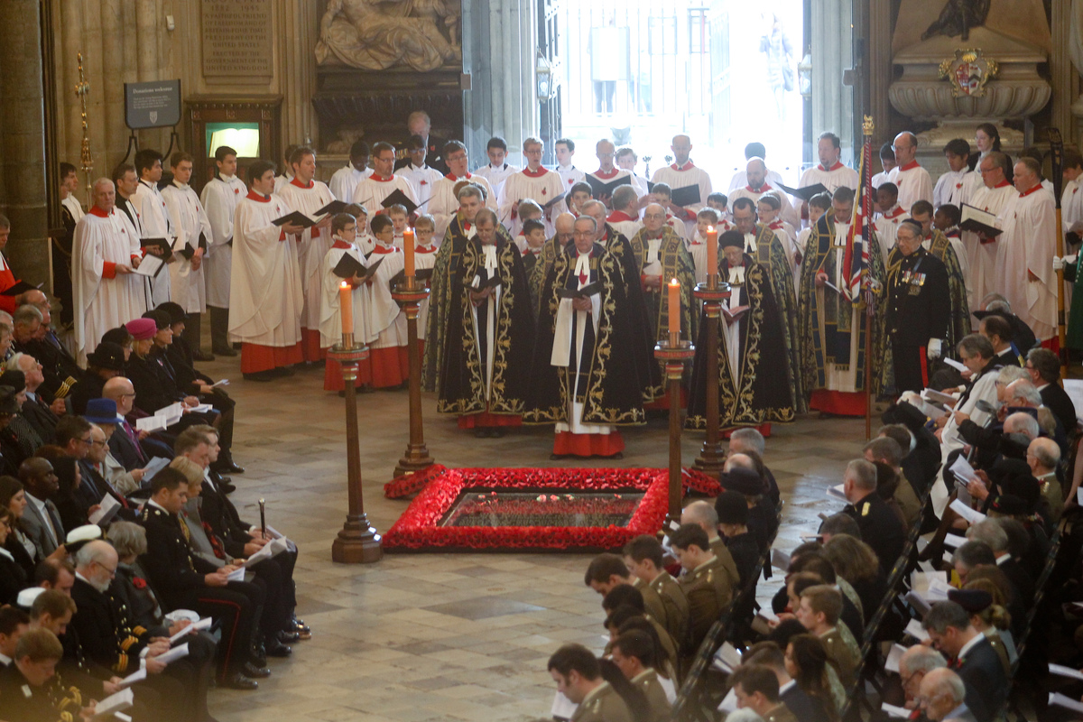
Learning
Notes:
Remembrance Sunday, 2015.
Image:
Picture Partnership/Westminster Abbey
Please be aware that these images are for educational use only in the classroom and should not be reproduced online.

Slide 18
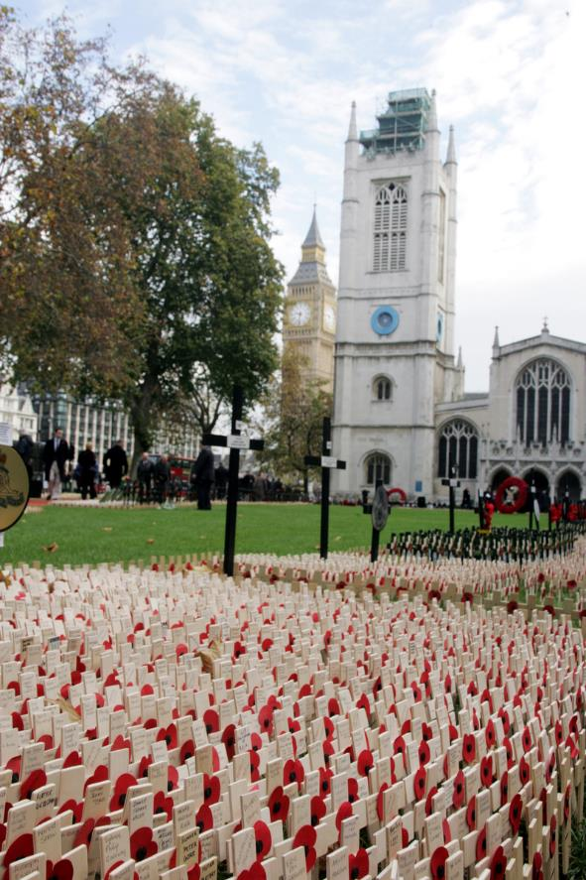
Learning
Notes:
St Margaret’s Church and the Field of Remembrance.
Image:
©2024 Dean and Chapter of Westminster
Please be aware that these images are for educational use only in the classroom and should not be reproduced online.

Slide 19
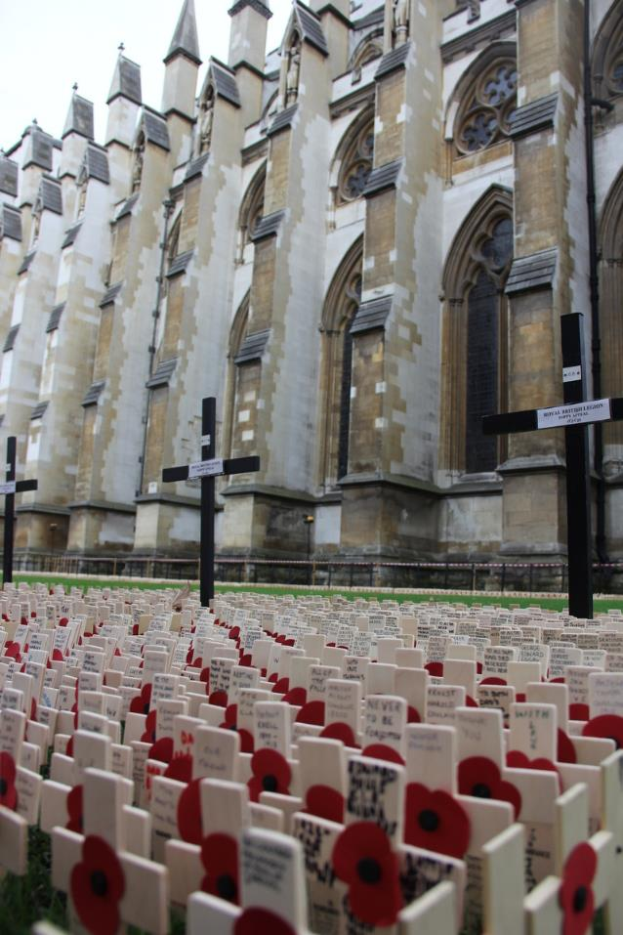
Learning
Notes:
The Field of Remembrance.
Image:
©2024 Dean and Chapter of Westminster
Please be aware that these images are for educational use only in the classroom and should not be reproduced online.

Slide 20
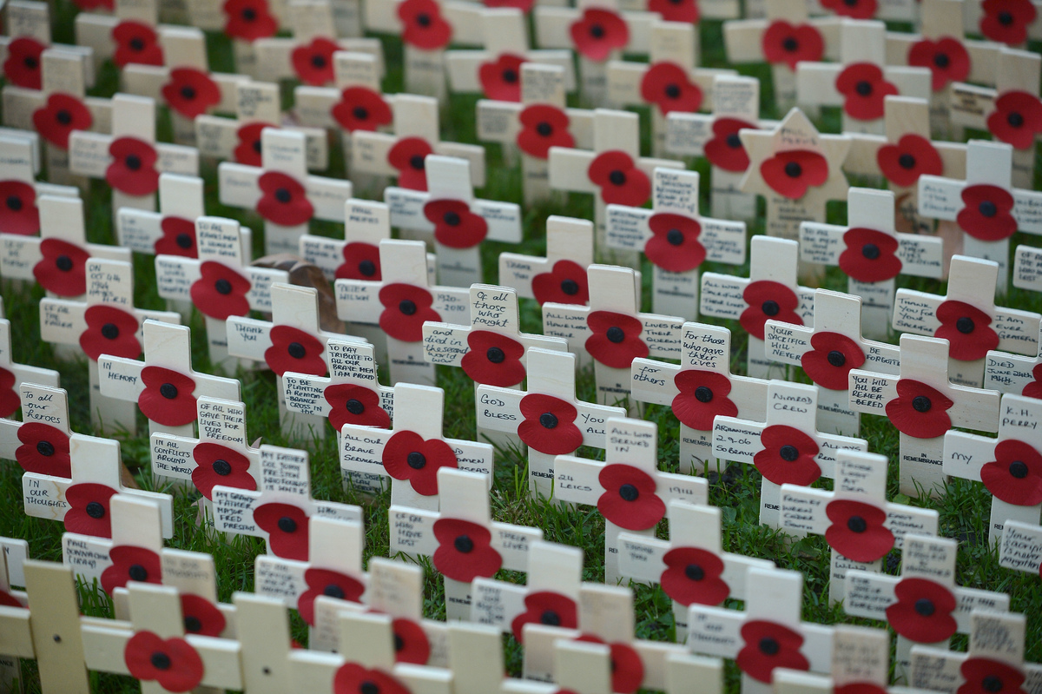
Learning
Notes:
Close up of the Field of Remembrance.
Image:
Jim Dyson/Westminster Abbey
Please be aware that these images are for educational use only in the classroom and should not be reproduced online.

Slide 21
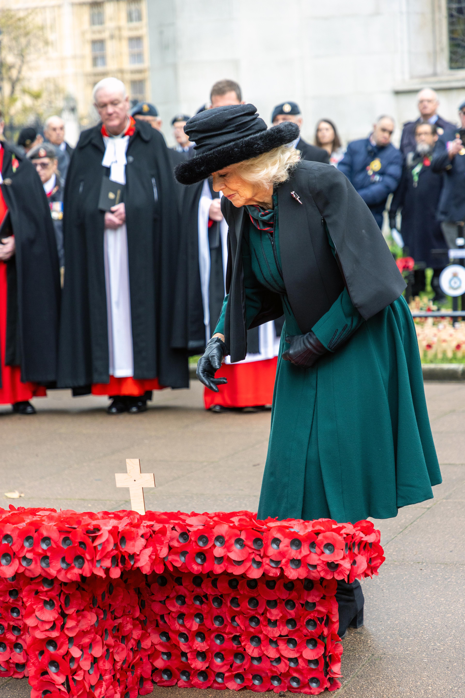
Learning
Notes:
HM The Queen laying a Cross of Remembrance, 2023.
Image:
Picture Partnership/Westminster Abbey
Please be aware that these images are for educational use only in the classroom and should not be reproduced online.

Slide 22
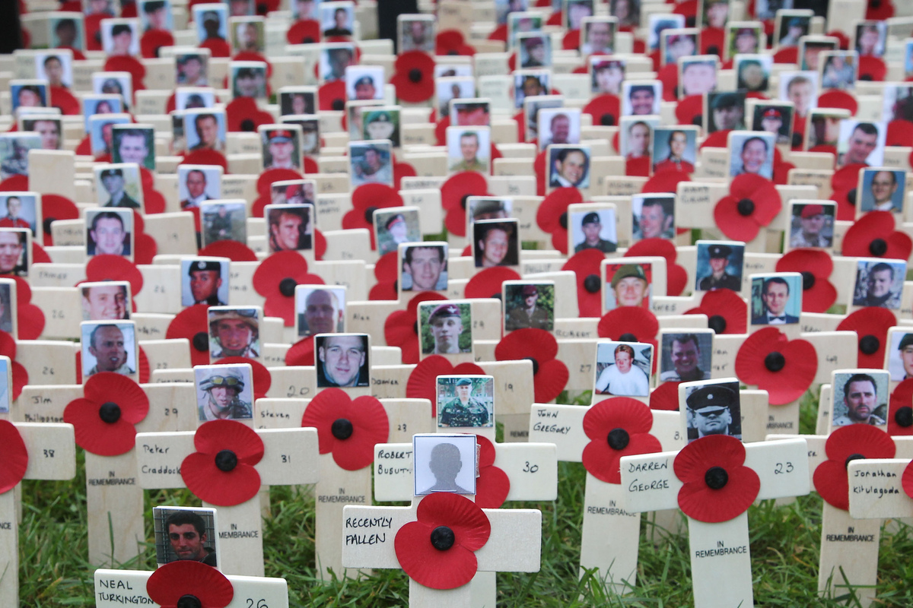
Learning
Notes:
Field of Remembrance showing poppies with photographs.
Image:
©2024 Dean and Chapter of Westminster
Please be aware that these images are for educational use only in the classroom and should not be reproduced online.

Slide 23
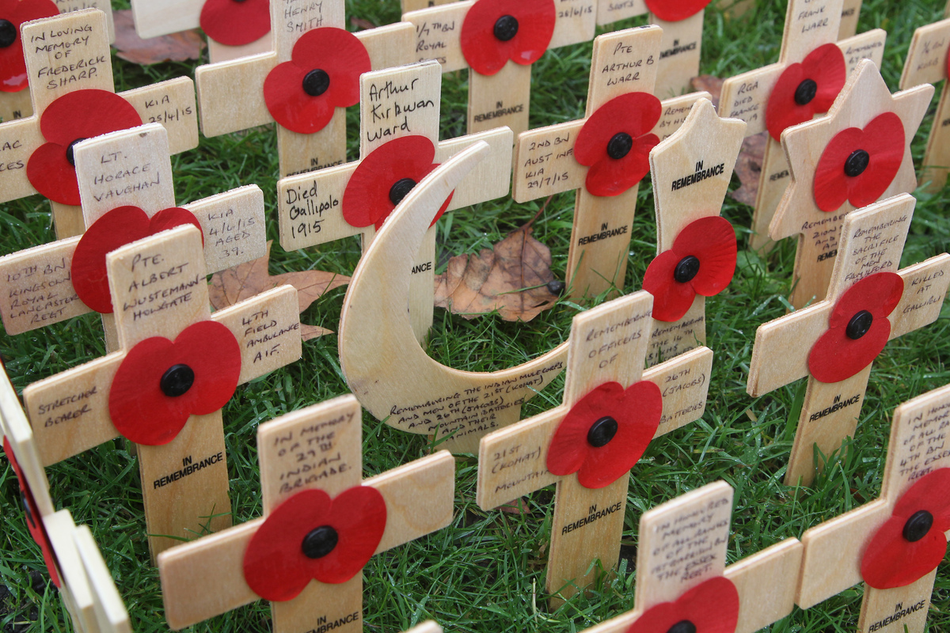
Learning
Notes:
Crescent Moon in Field of Remembrance.
Image:
Picture Partnership/Westminster Abbey
Please be aware that these images are for educational use only in the classroom and should not be reproduced online.

Slide 24
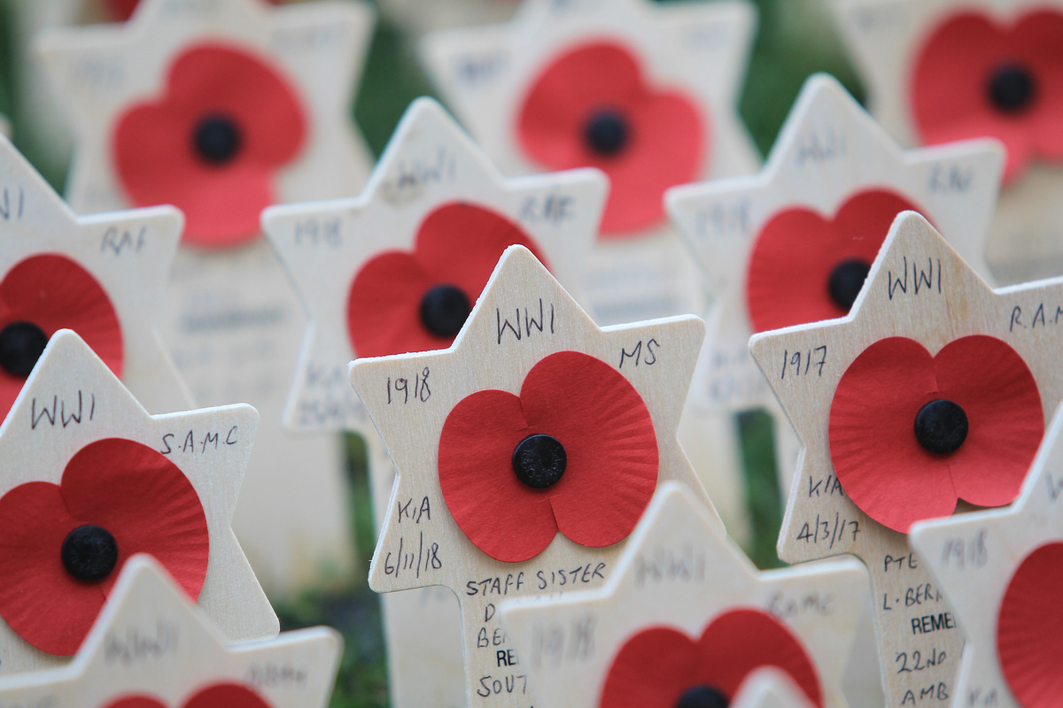
Learning
Notes:
Star of David in Field of Remembrance.
Image:
Picture Partnership/Westminster Abbey
Please be aware that these images are for educational use only in the classroom and should not be reproduced online.

Slide 25
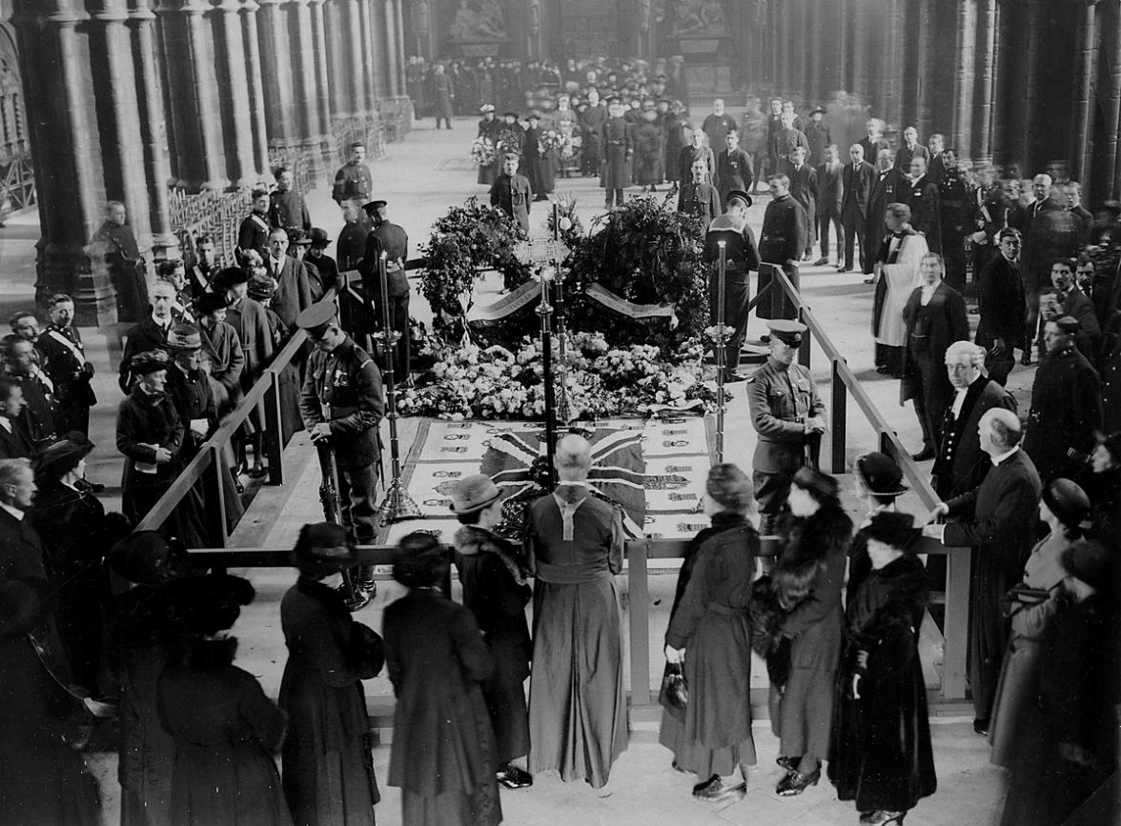
Learning
Notes:
Crowds filing past the Unknown Warrior’s Grave after the funeral on November 11th 1920.
Image:
©2024 Dean and Chapter of Westminster
Please be aware that these images are for educational use only in the classroom and should not be reproduced online.

Slide 26
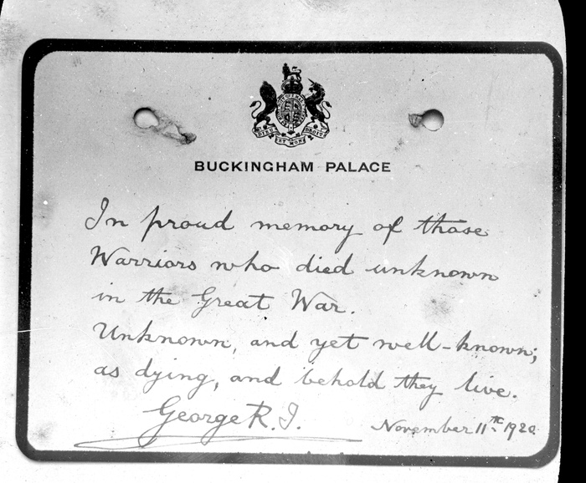
Learning
Notes:
Handwritten note by King George V.
Image:
©2024 Dean and Chapter of Westminster
Please be aware that these images are for educational use only in the classroom and should not be reproduced online.

Slide 27
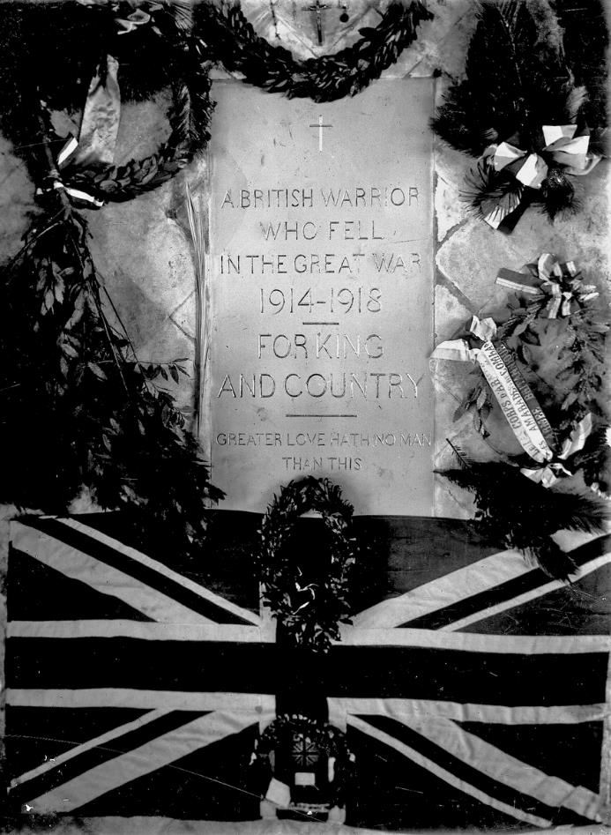
Learning
Notes:
Original stone of the Grave of the Unknown Warrior.
Image:
©2024 Dean and Chapter of Westminster
Please be aware that these images are for educational use only in the classroom and should not be reproduced online.

Slide 28
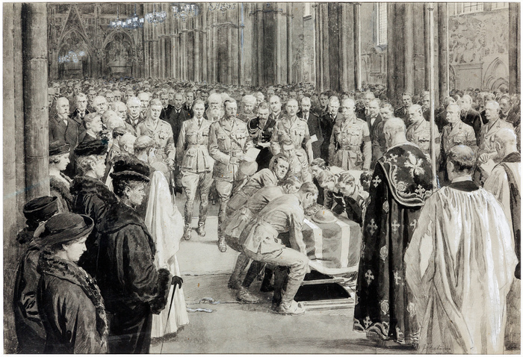
Learning
Notes:
Burial of the Unknown Warrior by Fortunino Matania.
Image:
©2024 Dean and Chapter of Westminster
Please be aware that these images are for educational use only in the classroom and should not be reproduced online.

Slide 29
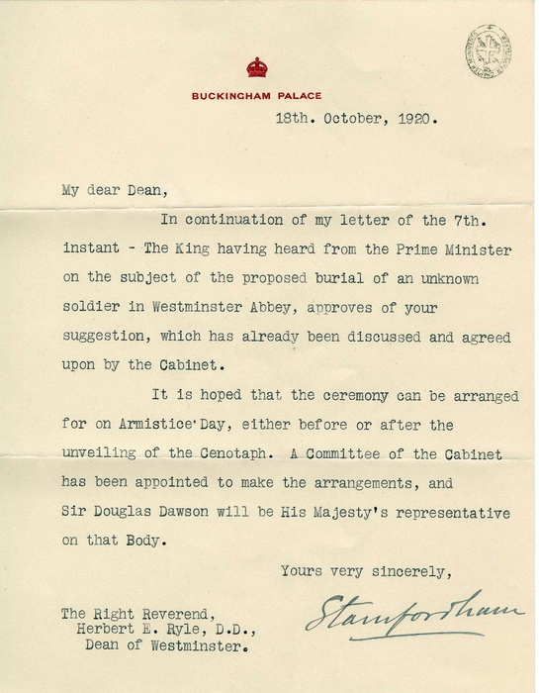
Learning
Notes:
Letter from King George V’s private secretary.
Image:
©2024 Dean and Chapter of Westminster
Please be aware that these images are for educational use only in the classroom and should not be reproduced online.

Slide 30
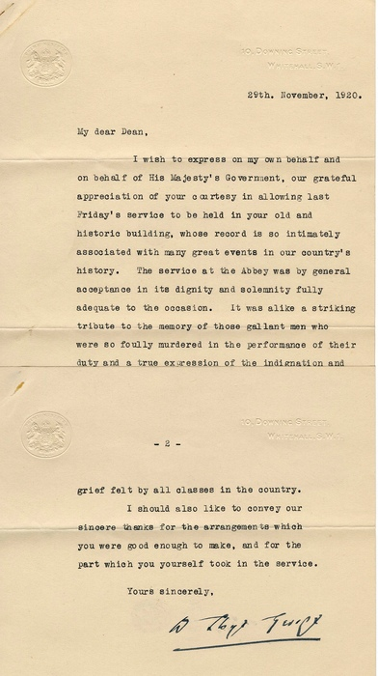
Learning
Notes:
Letter from Prime Minister David Lloyd George.
Image:
©2024 Dean and Chapter of Westminster
Please be aware that these images are for educational use only in the classroom and should not be reproduced online.

Slide 31
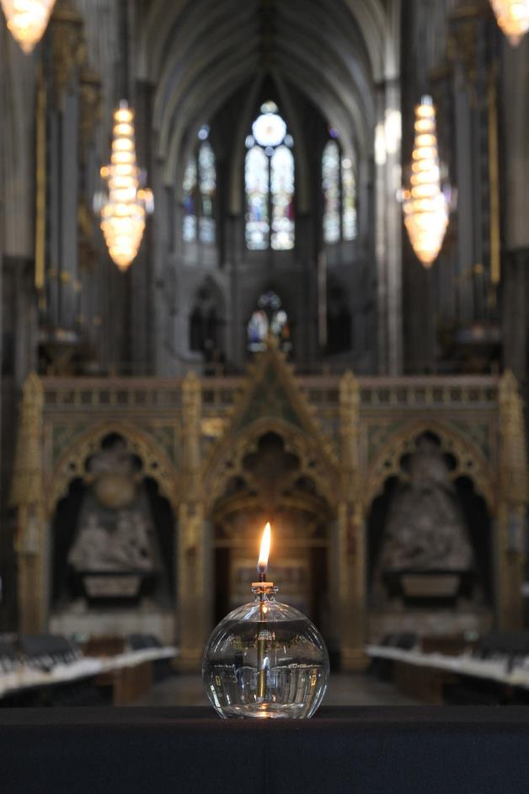
Learning
Notes:
Single vigil candle.
Image:
Picture Partnership/Westminster Abbey
Please be aware that these images are for educational use only in the classroom and should not be reproduced online.

Slide 32
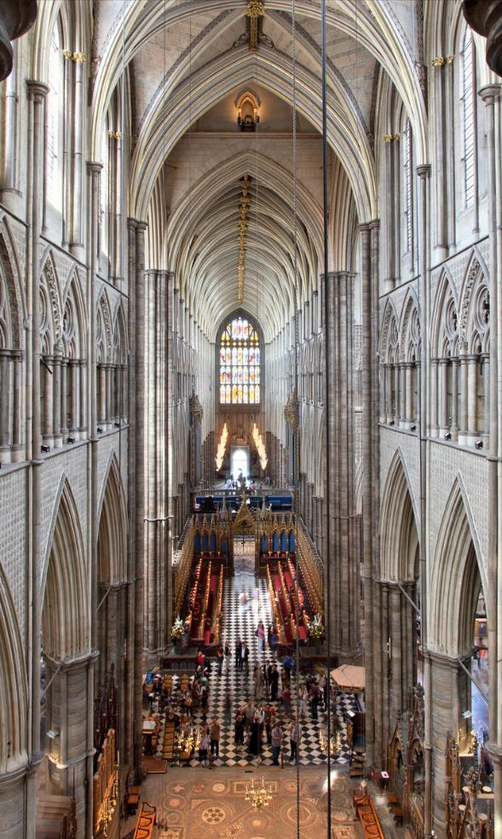
Learning
Notes:
View of Abbey looking West from the Triforium.
Image:
©2024 Dean and Chapter of Westminster
Please be aware that these images are for educational use only in the classroom and should not be reproduced online.

Slide 33
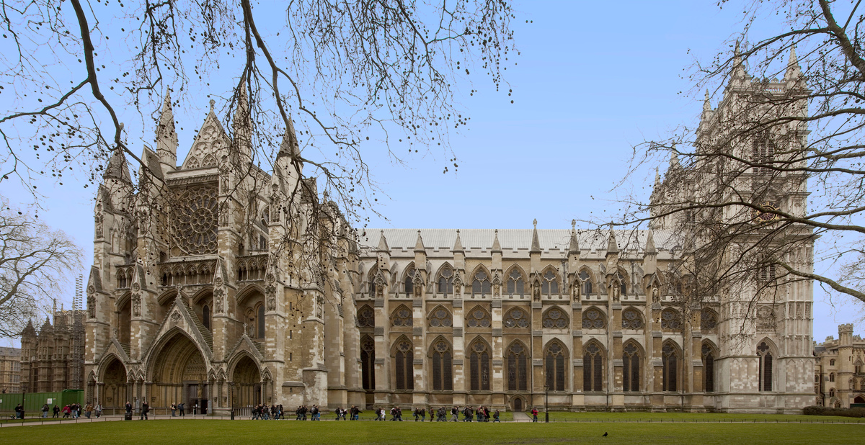
Learning
Notes:
North Front of Westminster Abbey.
Image:
©2024 Dean and Chapter of Westminster
Please be aware that these images are for educational use only in the classroom and should not be reproduced online.

Slide 34
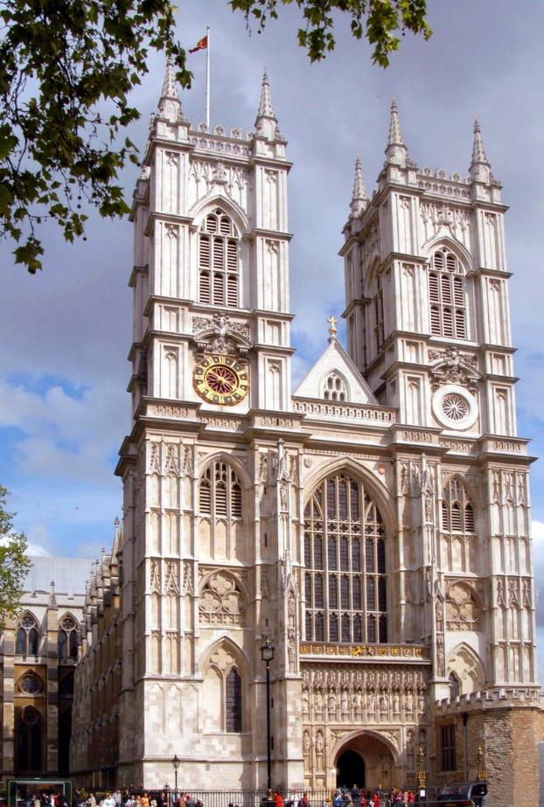
Learning
Notes:
West Front of Westminster Abbey.
Image:
©2024 Dean and Chapter of Westminster
Please be aware that these images are for educational use only in the classroom and should not be reproduced online.

